Slide 1
Computer Electronics
Lecture 16: History of Computer Memory, Mask ROMs

Slide 2
Outline
Introduction
Punched cards
Delay line memory
Williams tube
Drum memory
Ferrite core memory
Mask ROM
PROM
EPROM, EEPROM and FLASH
SRAM
DRAM

Slide 3
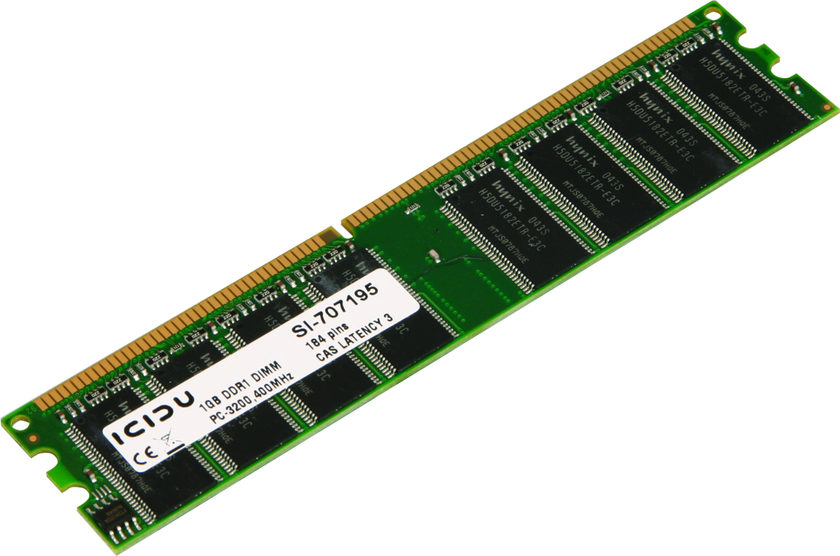
Intro (1): Oh memory, my memory…

Slide 4
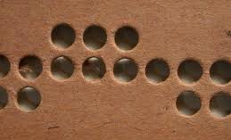
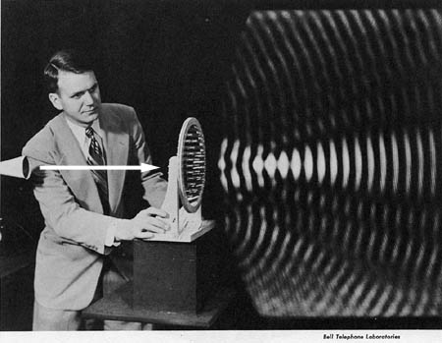
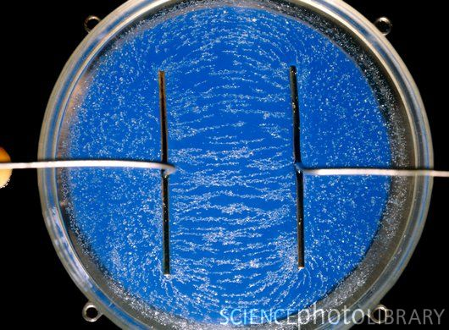
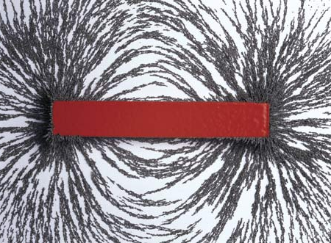
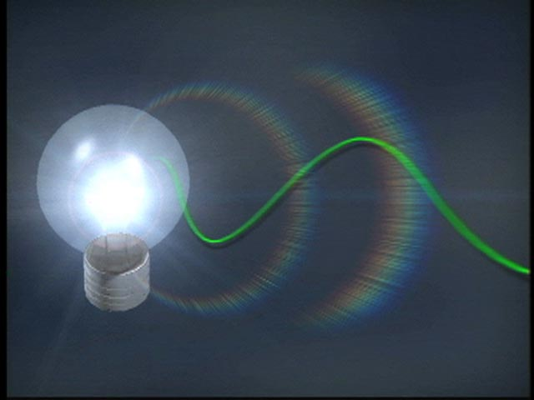
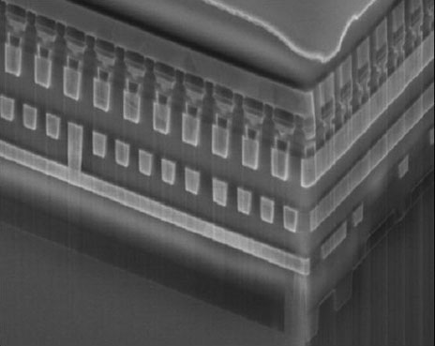
Intro (2): leverage physics
Notes:
--material morphology
– mechanical pressure
– propagation delay
– magnetism
– semiconductors

Slide 5

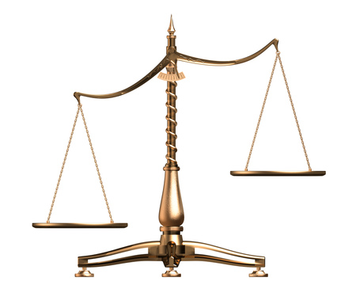
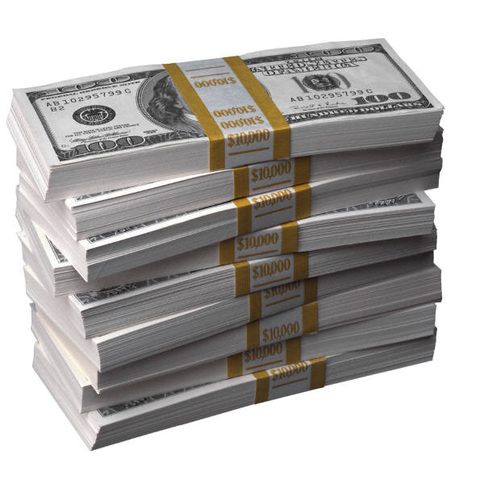
Intro (3): the usual motivation

Slide 6
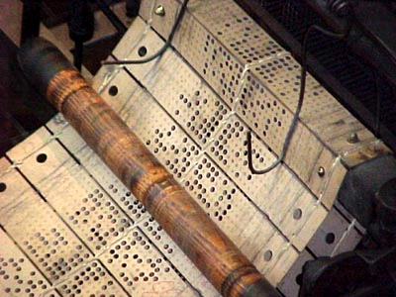
Punched cards

Slide 7
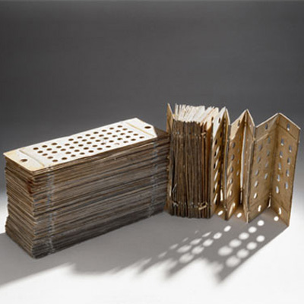
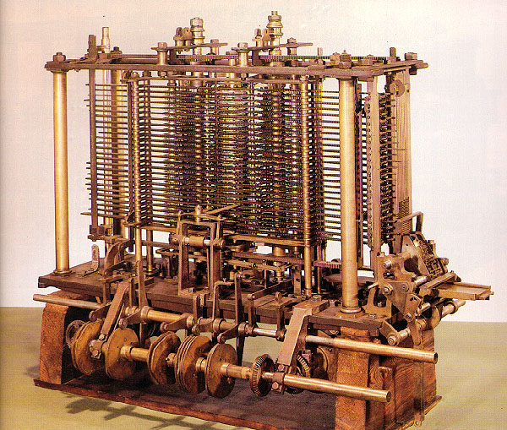
The first computer: Analytical Engine, Charles Babbage, 1837
Designed for 20 kB memory!! Mechanical access time: fraction of seconds

Slide 8



Hollerith census machine, 1890

Slide 9
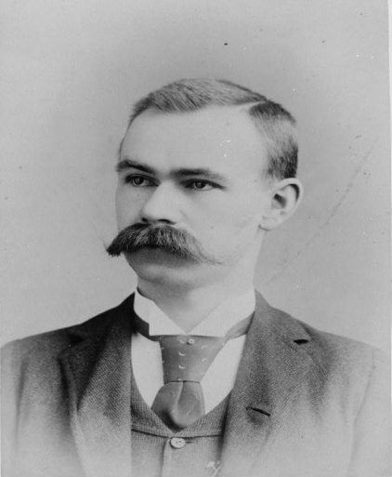
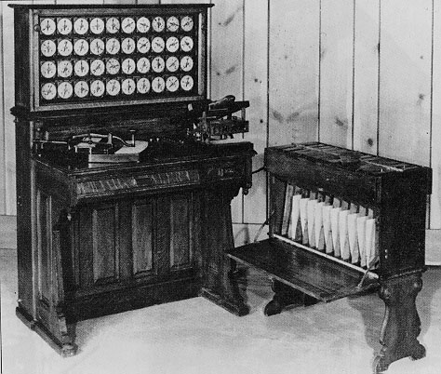
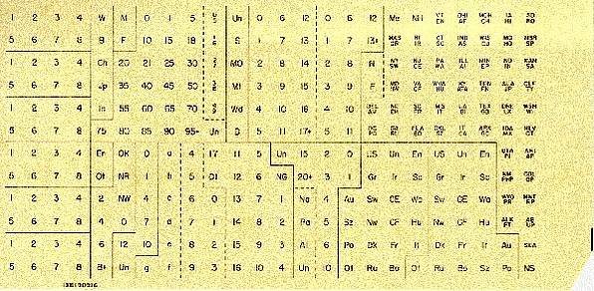
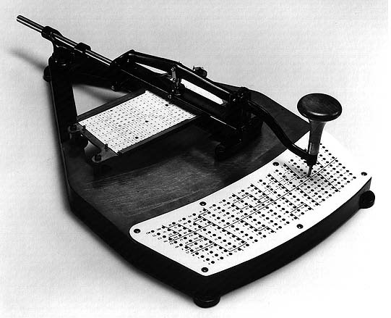
Hollerith mechanical computer using punched cards for memory

Slide 10
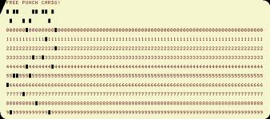
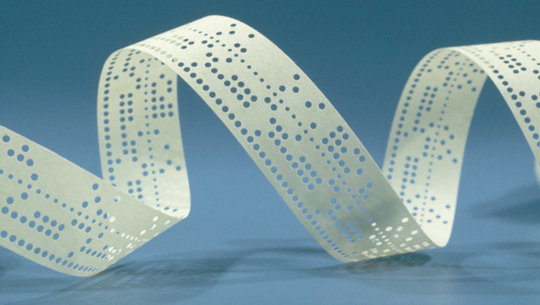
From punched card to punched tape

Slide 11
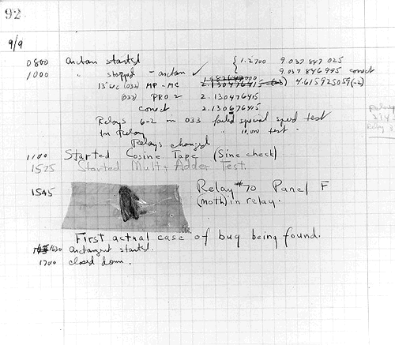
Debugging...

Slide 12
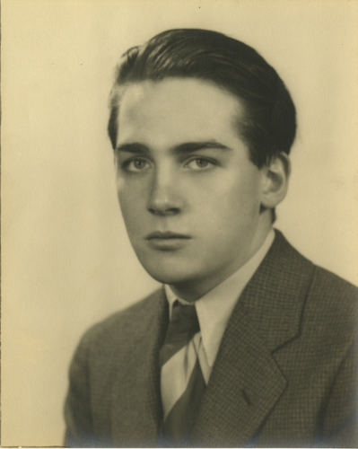
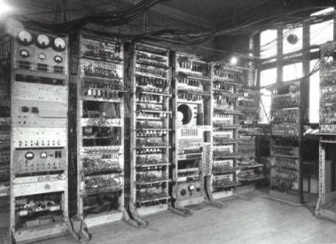
Acoustic delay line memory
Created by J. Presper Eckert, 1943
For the EDVAC computer (electronic)

Slide 13
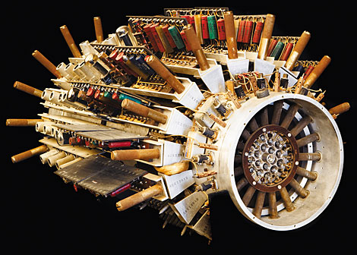
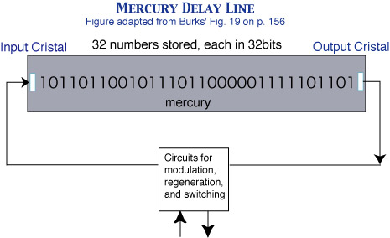
Acoustic delay line memory working
Few thousand bits capacity, few hundred microseconds access
Serial access. Volatile.

Slide 14
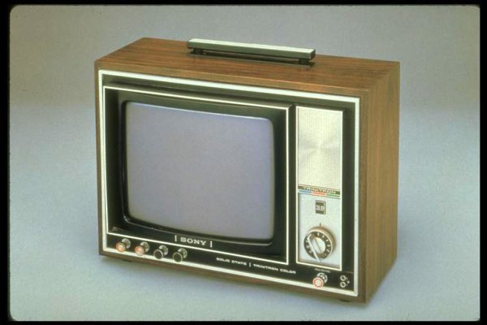
Williams tube
Freddie Williams started it in 1946
Tom Kilburn finished it in 1947
Stores 2048 bits for a few hours
Bit access time: 10 microseconds
Use of existing technology for a different end

Slide 15
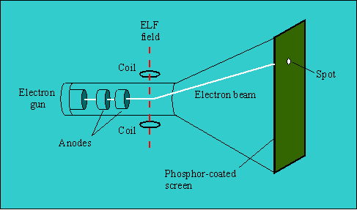
How a TV set works

Slide 16
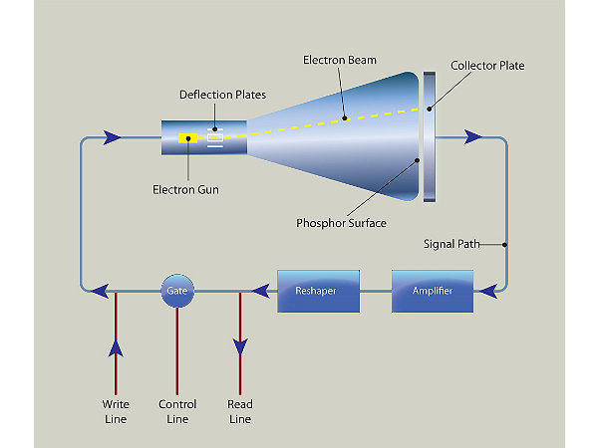
Williams tube block diagram

Slide 17
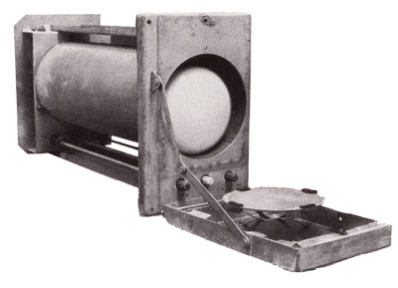
Williams tube photograph
Features:
Random access
Volatile (needs refreshing)

Slide 18
Williams tube: differences compared to Delay Line
More common and cheaper components
Simpler and integrated mechanism:
  No separate control for temperature and supply voltage
Trend continues today …

Slide 19
Drum memory
Von Neumann computer
  Program and data stored in memory
Consequence:
  More memory capacity
  Faster access time
Drum memory invented
First used in the Manchester Mark I computer, 1949

Slide 20
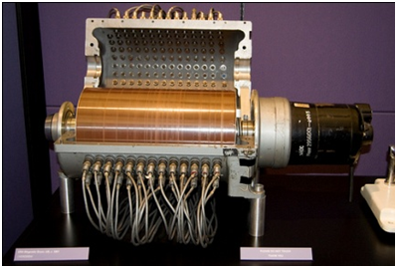
Drum memory: how it works
Drum coated with ferromagnetic tracks
Information stored in magnetic field
One read/write head per track

Slide 21
Drum memory capacity and access time
Capacity is much higher than Williams tube
Used in 1st mass produced computer: the IBM 650, 8.5kB
Access time is slower (milliseconds initially)
  Depends solely on rotation speed
  On modern hard disk drives (HDD) it also depends on the (single) head repositioning time

Slide 22
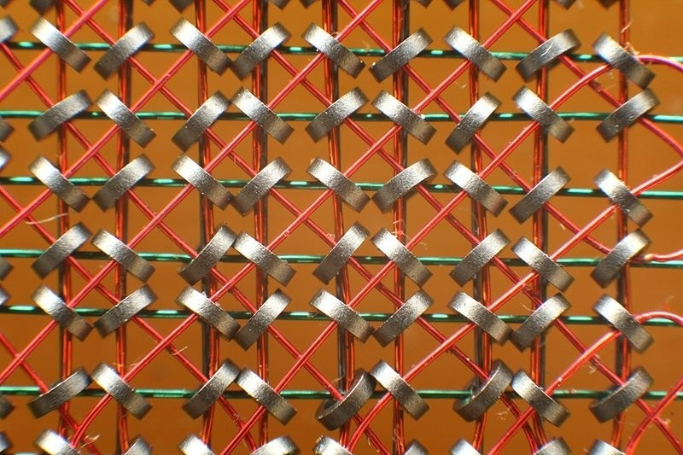
Ferrite core memory
Another magnetic storage device
Small ferrite rings are polarized in either senses to store 0 or 1
Polarization is effected by a wire mesh

Slide 23
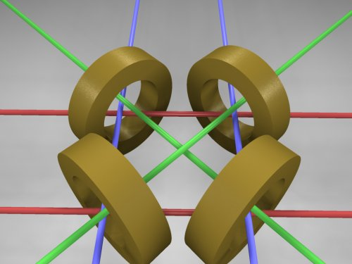
Ferrite core memory organization
Sense lines green)
Row select lines (red)
Column select lines (blue)
Row/column , Word read/write

Slide 24
Ferrite core memory writing
To write a 0 or a 1 one needs to apply a magnetic field stronger than a limit
Horizontal and vertical wires drive half of the necessary current
Addressing by row and column: 2n wires instead of n² wires

Slide 25
Ferrite core memory reading
To read a core ring one needs to write a 0 to it and measure the sense line
If it already contained a 0 than nothing is sensed
If the contained a 1 then a current is induced in the sense line
Reading is destructive, so it needs to be followed by rewriting the sensed bit

Slide 26
Ferrite core memory access time
Capacity of more than 1 megabyte!
Started with 12 microseconds, a very fast memory for that time!
During the 70s got reduced to 1.2 microseconds!
Non-volatile: magnetic polarization does not go away if power is switched off!

Slide 27
Mask ROM
Punched cards are Read Only Memories (ROMs)
Could not keep up with capacity and speed requirements
Mechanical became Electronic in the form of Mask ROMs
In both information is stored in its own material or lack of it
All other memories use a physical property: pressure (delay line), charge (Williams tube), magnetic bias (drum and ferrite core memories)

Slide 28
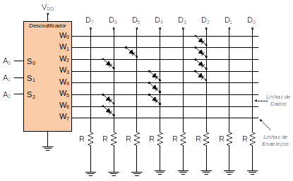
Mask ROM circuit
If Diode present then 1
Else 0

Slide 29
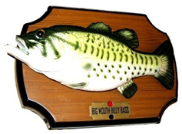
Mask ROM applications
Not field programmable. Only justifiable at large volumes.
Boot ROM
Initially IBM computers used it for the Basic Input/Output System (BIOS)
Big Mouth Billy Bass ($100M in 1 year)
Function look up tables (trigonometric, etc)
Character fonts (not used anymore)
Etc

Slide 30
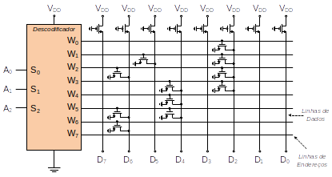
Mask ROM evolution with transistors

Slide 31
Programmable Read Only Memory (PROM)
Can be programmed once after fabrication
What is the advantage?
R: create different products or versions while mass fabricating one device
Uses fuses: initially all bits are 1; applying high voltage turns bit into 0

Slide 32

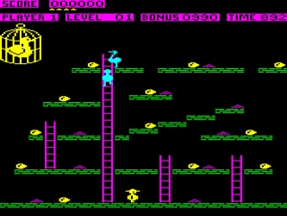
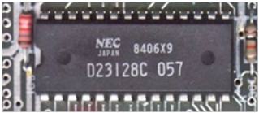
Used in (Sir) Sinclair 48k ZX Spectrum

Slide 33
PROM origin
Invented by Wen Tsing Chow in 1956
Requested by US air force
  Simple way to store constants
  Atlas E/F ICBM computer
  Ballistic missiles

Slide 34
EPROM, EEPROM, FLASH
Non volatile memories
EPROM = Erasable PROM
EEPROM = Electrically Erasable PROM
FLASH = EEPROMS that can be written in a flash
Based on Floating Gate MOS transistors (FGMOS)

Slide 35
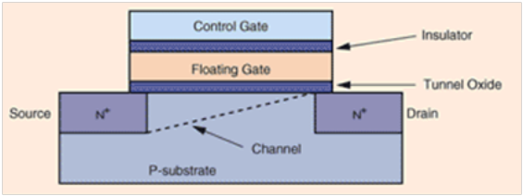
Floating gate MOS transistor

Slide 36
Information storage in FGMOS
Information is stored by the presence of electrons in the floating gate
If the FG is negatively charged then FGMOS stores a 0 (electron surplus)
If the FG is positively charged then FGMOS stores a 1 (electron shortage)

Slide 37
Programming and erasing methods
 | Programming | Erasing
EPROM | Hot carrier injection | Ultra violet light (non-electric)
EEPROM | Tunnel effect | Tunnel effect
FLASH | Hot carrier injection | Tunnel effect

Slide 38
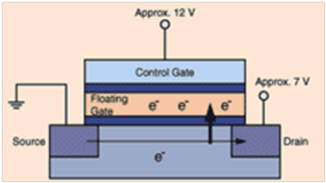
Hot carrier injection programming

Slide 39
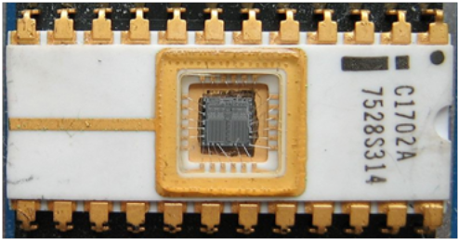
Ultraviolet light erasing
Ultraviolet light is directed to die
Causes dielectric ionization
Ions remove charge excess in FG

Slide 40
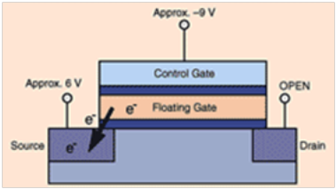
Programming/erasing by tunneling

Slide 41
Worksheet #15
Create a table for memory size and access time for the following types of memories (also show approximate dates)
  Delay line
  Williams tube
  Drum
  Ferrite core
Design the address decoder and the diode crossbar for pull-up resistors instead of pull-down; compute Vol and Voh
Show the direction of the electric fields (Drain-Source and Gate-Bulk) for storing a logic ‘1’ in an FGMOS transistor

