Slide 1
Computer Electronics
Lecture 2: Introduction to Iob-SoC, Git, Make

Slide 2

Recap of last lesson
John von Neumann
CPU
Processor Bus
MASTER
SLAVES
Output bus
BUS SPLIT
Input bus
Output
Devices
Output
Devices
Output
Devices
Output
Devices
Output
Devices
Output
Devices
Output
Devices
Input
Devices
Output
Devices
Memory
Accelerators’ bus
Output
Devices
Output
Devices
Output
Devices
Output
Devices
Output
Devices
Compute
Devices
Memory bus
Notes:
Let’s simplify the vNA.

Slide 3
The Processor Bus
Processor buses can be complex, for example ARM’s AXI
In this course a minimalistic yet effective 6-signal bus called the Native Bus will be used:
Signal Name | Direction wrt CPU | Width in bits (wires) | Description
Valid | Output | 1 | CPU wants to access data or instructions
Address | Output | 32 | Address of the data
Wdata | Output | 32 | Data to write
Wstrb | Output | 4 | Byte write
Rdata | Input | 32 | Data read
Ready | Input | 1 | Slave is ready
REQUEST
RESPONSE
Notes:
Let’s simplify the vNA.

Slide 4
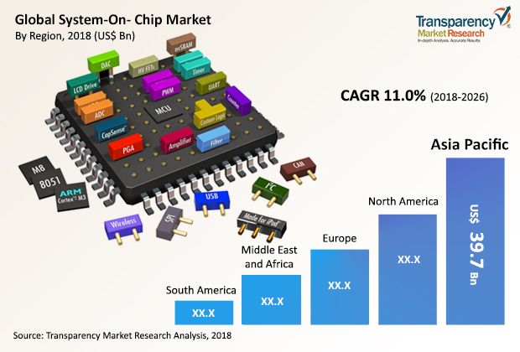
System on Chip & IP Cores
IP Core providers design IP cores: ADC, MCU, PWM, etc
Fabless Integrated Circuit providers integrate IP cores and make the SoC (AMD, Xilinx, etc)
Foundries fabricate SoCs and other chips
Notes:
Let’s simplify the vNA.

Slide 5
System on Chip
The SoC is an IP core assembly
The whole system sits on a single chip
Less components on Printed Circuit Boards
Less weight and volume
More performance
Lower power consumption

Slide 6
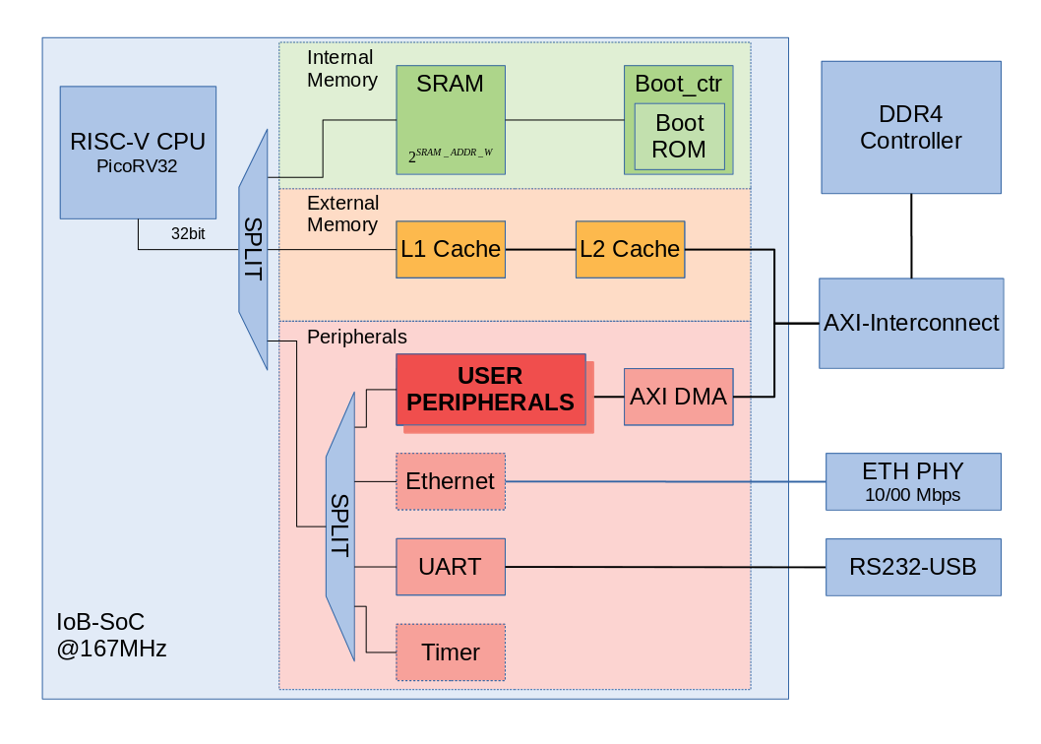
IOb-SoC block diagram
Developed by IP core provider IObundle Lda with the help of master students students (Roque,Silva,Ratinho,Mário, …, Internships/Dissertations)
Simple SoC comprising
  The PicoRV32 RISC-V CPU (open-source)
  Boot ROM (has small program to load user programs)
  SRAM (on-chip memory for running small programs or storing fast access data)
  Instruction and Data L1 Caches + shared L2 cache
  UART interface for communication
  Other optional modules: Ethernet, UART, DMA
  Ready to attach user modules

Slide 7
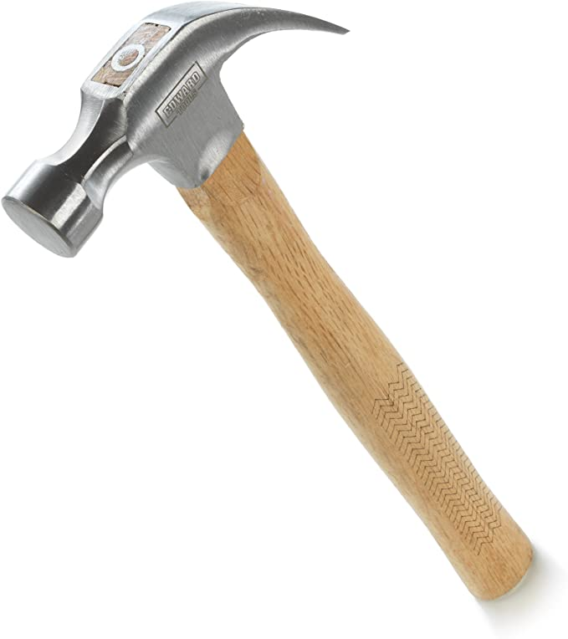

Getting hands dirty on IOb-SoC
Computer systems are inherently complex: use suitable tools!

Slide 8
Simple IOb-SoC assignment
Hosted by Github
Read the README file
Clone the repository
Move into its directory
Simulate the design and visualize simulation waveforms
Make the document

Slide 9
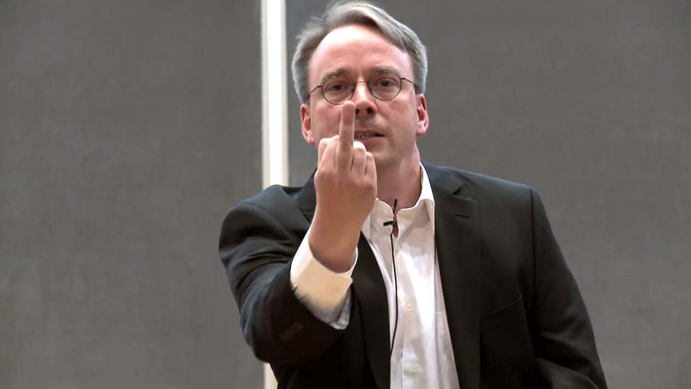
Git in a few slides
Developed by Linus Torvalds (also Linux creator)
Managing your project files efficiently
Reduce storage and backup needs
Manage different versions and development branches in large teams
Access the project files anywhere
Successor of CVS, SVN but better

Slide 10


The cloud
The edge
remote
server
remote
server
remote
server
Push
Pull
edge
device
edge
device
edge
device

Slide 11
Meanwhile and the Edge
The index
The tree
repository
(directory)
user
file
.git
(directory)
Checkout
user
directory
user
directory
user
directory
user
directory
user
directory
(or Plato’s Cave!)
(or Real Thing)

Slide 12
Common git commands
git config –global user.name “your name”
git config –global user.email “your@fantastic.email”
git init: turns directory into git repository
git status: shows differences to index
git add: stages the files to be commited in index
git commit: creates a new development node (commit or hash)
git push: sends your commits to a remote
git branch: creates a development branch

Slide 13

Development branches
Develop each feature in a branch
Test / Fix
Merge with master branch
Retest / Fix
Release!

Slide 14
Common git commands
git log: shows commit history
git fetch: downloads branches from a remote
git pull: same as git fetch + git merge
git show: shows contents in any commit
git remote: shows remote servers in use
After you get up: eat breakfast then do git pull (update your repo)
Before you go to bed: do git push (save your work) and brush your teeth

Slide 15

The Make utility program
Make is a program that automates the process of building programs (compiling)
Created by Steward Feldman in 1976
  Also wrote the first Fortran 77 compiler
  Part of the Bell Labs team who created the Unix operating system, the precursor of Linux for masses
Make is still one of the best build automation tools to date!

Slide 16
The Make utility program
Make programs are called Makefiles
Makefile is based on rules. Example rule:
  dead: beef.c lib.c
    gcc -o $@ $<
    cat $^
Target
List of dependencies
Recipes
Short for “beef.c”
Short for “beef.c lib.c”
Short for “dead”

