Slide 1
Computer Electronics
Lecture 5: Computer History & Economics

Slide 2
Computer vs. Embedded Systems
Computers
  A Personal Computer (PC): desktop or laptop
  A server: cloud computing
Embedded system
  An Anti-lock Brake System (ABS) for a vehicle
  A washing machine
  A smart phone?
Both computers and embedded systems contain processors

Slide 3

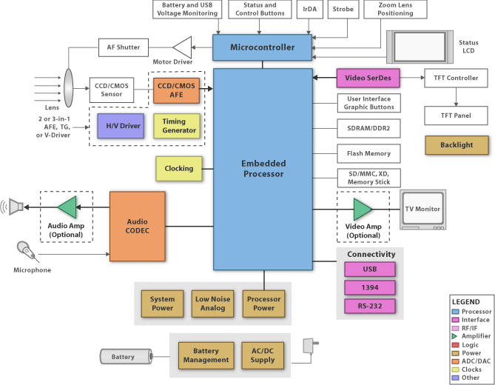
Example: a digital camera

Slide 4
Design concerns
Size and weight
Cost
Safety
Performance
Energy consumption
User friendly interface
Environmental impact

Slide 5
Computer evolution
The word “computer” is used since the XVII century to designate a human worker in charge of performing calculation series
  Navigation tables, astronomy, tides (sea levels), etc
From the XIX century the word began to be used to designate a machine that performs programmed actions and calculations
  A simple calculator is not a computer
  A computer must execute “programs”
Advantages of using a machine vs. human
  Speed, no errors, repeatability, no weekends, vacation or labor laws to obey

Slide 6
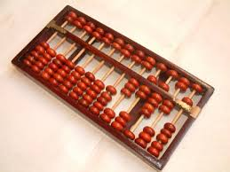
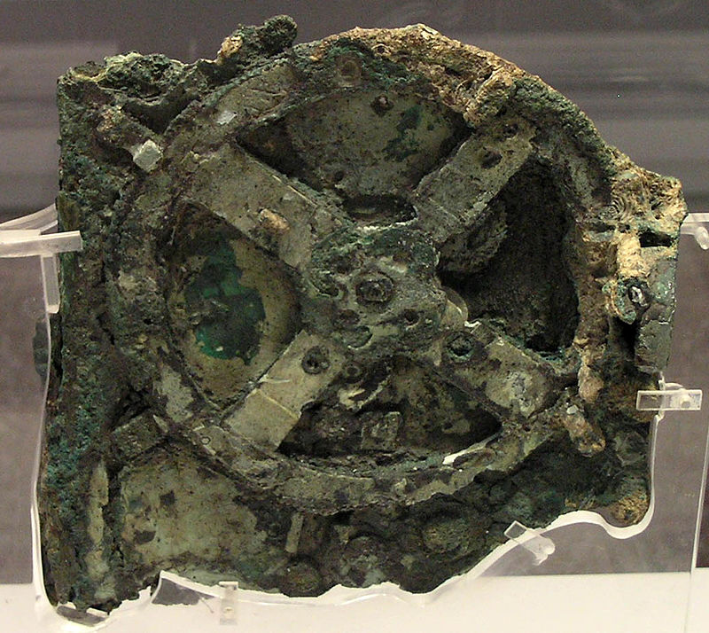
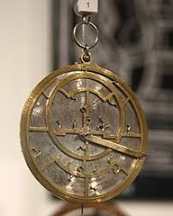
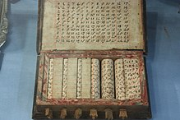
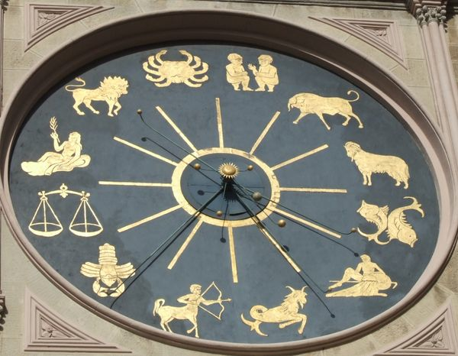
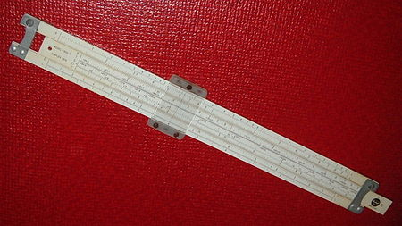
Before the first machine computer
Several calculator apparatuses
Abacus (2400 AC)
Antikythera’s mechanism and astrolabe (150-100 AC)
Al Jazari’s clock (1206, programmable)
Napier bones (1617, John Napier)
Slide rule (1620, William Oughtred et al.)

Slide 7
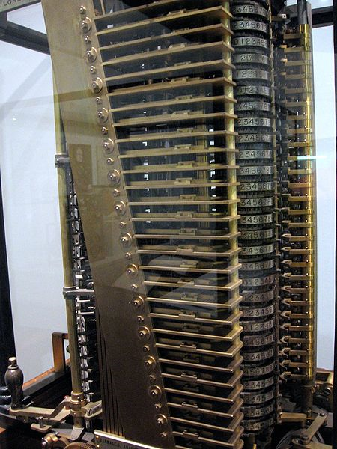
The first computer
The Analytical Computer (1833, Charles Babbage)
Only finished in 1991 for London’s Science Museum
Mechanical, powered by steam engine
Uses punched cards for program and data Input/Output

Slide 8
Capabilities of the Analytic Computer
Addition, subtraction, multiplication, division
Conditionals (if statements)
Program loops (jumps)
Processing part separated from data storage part
Sounds familiar?

Slide 9
Evolution aspects from 1833
From mechanics to electronics
Electronic component evolution: relays, vaccum tubes, transistors, integrated circuits
Transistor evolution; bipolar to MOSFET
Number representation: analog, digital base 10, digital base 2
What is stored in memory: program, data, program and data
Users: researchers, companies, everybody
Applications: specific to general purpose

Slide 10
War as main driver...
Z3 (1941, Konrad Zuse): electromechanical using relays
ABC - Atanasoff‑Berry Computer (1939): vacuum tubes, the 1st electronic computer, digital, binary numbers
Colossus (1943,Tommy Flowers): electronic binary digital computer, vacuum tubes

Slide 11
Analog versus digital
Analog: continuous range, susceptible to electromagnetic noise
Digital: discrete range, noise immune
Digital resolution: number of bits (32 or 64 bits)

Slide 12
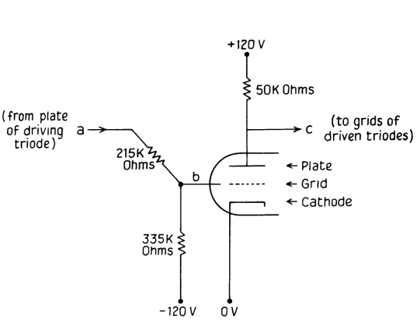
Logic gates in the ABC computer
Negative logic
  0: High Voltage
  1: Low voltage
Implemented using vacuum tubes
30 operations per second!
Vacuum tubes big, unreliable, power hungry

Slide 13
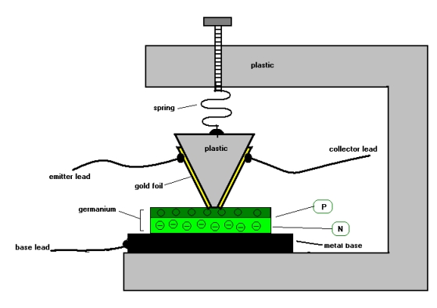
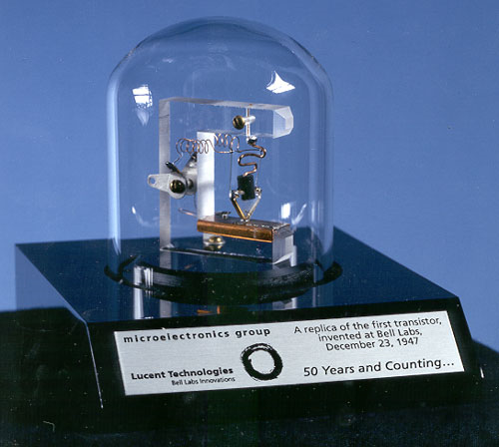
The transistor
John Bardeen and Walter Brattain,
  Bell Labs, 1947, using germanium
  A 3-pin controlled switch

Slide 14
Transistors, integrated circuits (IC), systems on chip (SoC)
Logic gates made of a few transistors
  Initially diodes and resistors also used
Integrated circuits (John Kilby, 1958)
  made of many integrated logic gates
  Kilby received the Nobel prize in 2000
From Bipolar devices to MOS devices
Current feature size: 7nm
Current density: billions (10⁹) of transistors per SoC

Slide 15
Computer Economics
Project management
Team building
Product
  Purchasing 3rd party components
  User interface
  Packaging
  Documentation

Slide 16
Project management
Really crucial and complex task as computers are complex products
Managers are competent, experienced and well paid
It is a very broad activity: engineering, design, team management, marketing, sales, etc

Slide 17
Project management tasks
Building a team
Planning development
Process: implement work flows
Choosing the target technology and 3rd party components
Validation, verification and production testing

Slide 18
Team building
Take into account the experience of each individual (to avoid common mistakes)
Take into account the expertise of each individual (to match the tasks)
Take into account the inter-personal capabilities of each individual (to ensure efficient communication)

Slide 19
Team work
One well defined task
One well defined deadline
One coordinator and spokesperson
Each team member should have a clearly defined responsibility
Each team member should be assessed continuously to detect
  Difficulties, problems, inefficiencies

Slide 20
Planning development
Divide development in parts, as independent as possible to enable parallel fast development
Divide each part in hierarchical fashion, from top to bottom tasks
At the bottom there will be development modules with a single purpose that can be given to different teams/people
Reuse existent software and hardware modules as much as possible

Slide 21
Process: implement work flows
start
design
prototype
no
Ok?
Test
yes
finish

Slide 22
Project decision making
There is no single solution
There are many factors to take into account
There are no free lunches
  There are always pros and cons

Slide 23
Non recurrent engineering (NRE) cost
NRE is the development cost
NRE is independent from the number of units produced
When production starts NRE activities stop
NRE grows with product complexity
  Product complexity grows exponentially with features.
Lower is better (bad news for engineers!)

Slide 24
How to decrease NRE
Hire an experienced team
  This is why big companies buy startups
Optimize team size
  Bigger or smaller will cause delay
Use suitable machinery and tools
Use Commercial Off the Shelf Components (COTS)

Slide 25
Unitary cost (UC)
Cost for producing a single product unit
NRE is excluded
Lower is better
  Increases profit margin
  Allows more competitive pricing

Slide 26
How to reduce the unitary cost
Buy cheaper components (watch quality)
Balance make versus buy decisions
  Apple dumped Imagination Technologies
Increase scale
  Produce more units with same resources
Automate processes
Optimize labor costs (salaries, legal obligations, relationship to labor laws)

Slide 27
Example
To create a product, it is estimated that
  NRE = 2000 and UC = 100
  Selling price = 300
Compute the profit for
  10 units
  1000 units

Slide 28
Size matters: small is better!
# transistors
# code lines
# memory bytes
Specially important in portable products

Slide 29
Performance matters
Performance metrics:
  Execution time (latency?)
  Throughput (data processed per second)
    Eg. Samples per Second
Better performance generally leads to more competitiveness but
  Requires more expensive components
  Increases power consumption (no-no for battery operated gadgets)
A right balance must be found

Slide 30
High energy consumption causes:
Shorter battery life
Higher energy dissipation
  Temperature rise
  Need for cooling
  Larger product size
  Higher unitary cost

Slide 31
Flexibility means competitiveness
Ease of adding / removing features
Reactivity to market changes
Software enabled flexibility
Programmable hardware enabled flexibility

Slide 32
Time-to-prototype
Time to build first prototype
Validates the project choices
Shows that performance is adequate
Shorter is better
  More time to make changes if needed
  Faster market entry: investors happy

Slide 33
Time-to-market
Time from project beginning to product launch in market
Shorter is better: arrive before competitors
Delays have significant impact in profit margins
Typically several months to few years, depending on complexity

Slide 34
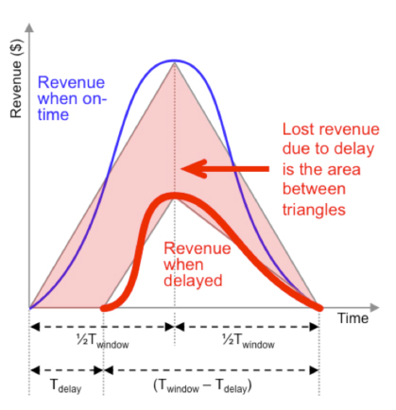
Time-to-market delay effect

Slide 35
Safety concerns
Probability that faulty behavior will cause harm to users
Liability costs
Damaged reputation costs for existing and potential customers

Slide 36
Environmental concerns
Marketing value of environmentally friendly devices on the rise
Efficient use of energy
Avoidance of hazardous materials

Slide 37
The ideal computer product
Small
Safe
Environmentally friendly
Optimal performance
Low energy consumption
Low unitary cost
Low NRE
Fast time-to-market

Slide 38
Worksheet
What was the name of the first modern computer, date of invention and inventor name?
What is the difference between a computer and an embedded system.
What is the most common transistors technology today, state of the art feature size and how many can fit in a large chip?
For a given product a 30% profit margin is desired. For a selling price of $1k, and a UC=$500, determine the NRE budget for a production volume of one million units
Assuming triangular revenue windows, compute the relative revenue loss for a delay of ¼ of the window width

