Slide 1
Computer Electronics
Lecture 16: Dynamic Random Access Memory (DRAM)

Slide 2
Outline
DRAM cell
DRAM matrix
DRAM read
DRAM write
DRAM high-level operation
DRAM module organization
DRAM refresh
Real DRAM chips

Slide 3
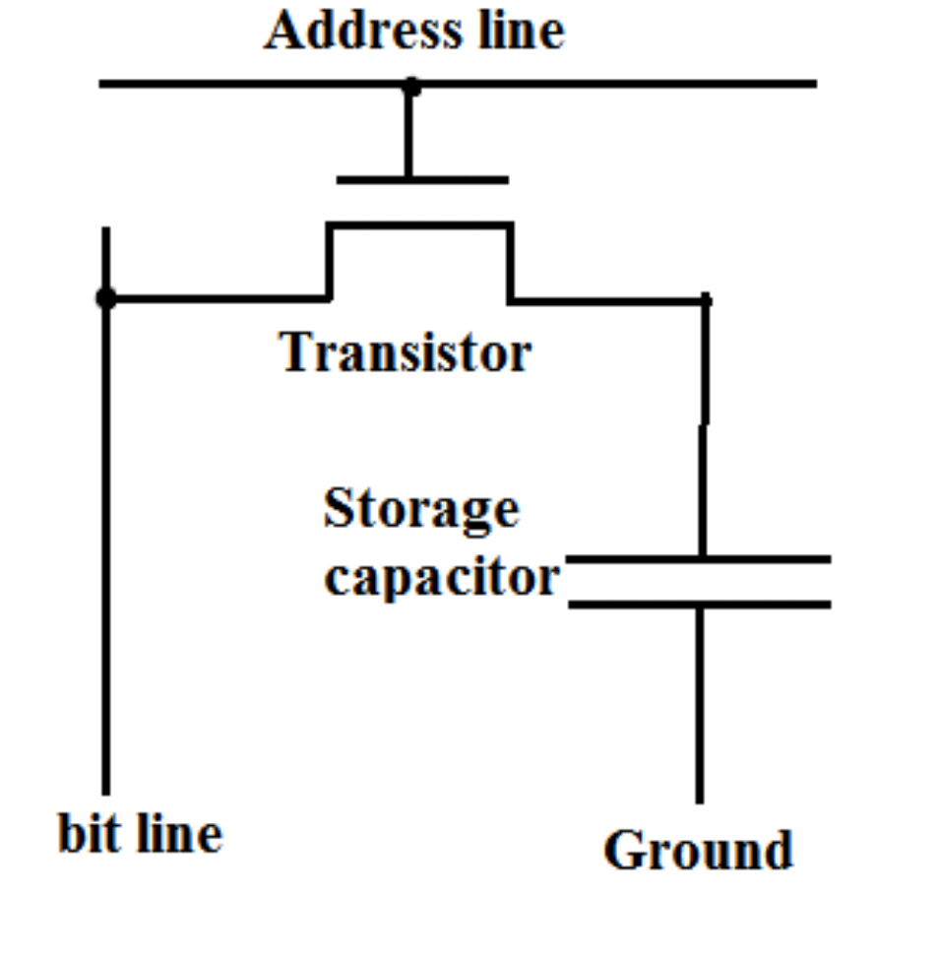
DRAM Cell

Slide 4
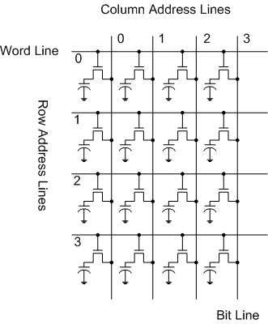
DRAM cell matrix

Slide 5
DRAM Reading problem
Select Row using address
Cell charge has little effect on line voltage Vd because Cc << Cd
Final voltage Vf=(Cd*Vd+Cc*Vc)/(Cd+Cc)
Vf = Vd+Cc/Cd Vc
For Cc=40fF, Cd=1pF, Vc=5V then the variation is only 200mV
Since the transistors leak current then variation is even smaller
Difficult to detect this small variation!
Cc
Cd

Slide 6
Solving the read problem
Use complementary bit lines to store d and ~d (doubles circuit area, not necessary but eases explanation)
Pre-charge the bit lines at Vdd/2
Select Row:
Vd=Vdd/2+ΔV/2 and V~d=Vdd/2-ΔV/2
Amplify ΔV using sense amp
Select Column to read data

Slide 7
Pre-charge complementary bit lines
d
~d
Vdd/2
Voltage equalization circuit
Pre-charge enable
(disable after complete)

Slide 8
Select row, sense and read
d
~d
Select Row:
Vd=Vdd/2+ΔV/2 and V~d=Vdd/2-ΔV/2
Amplify ΔV using sense amp – This also restores the cells!
Select Column to read data
Select Row
Power Up
Sense Amp
Select Column

Slide 9
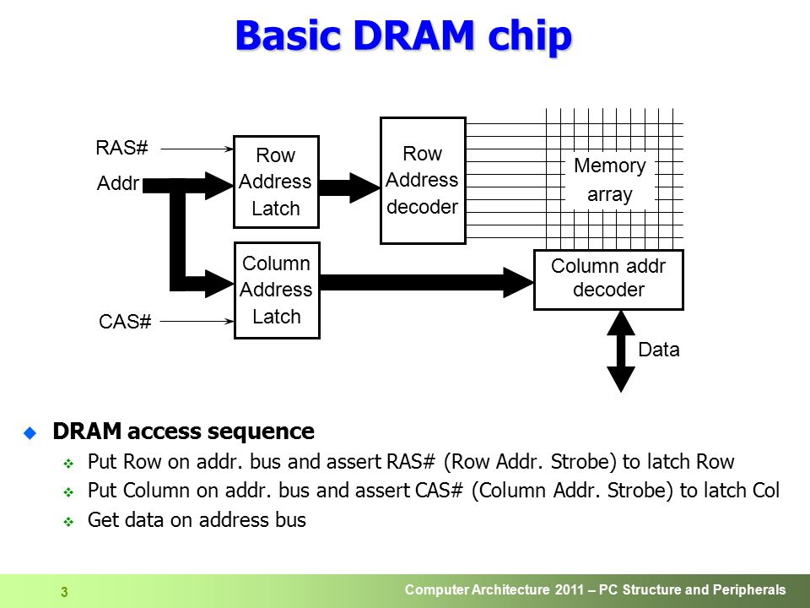
DRAM high-level view

Slide 10
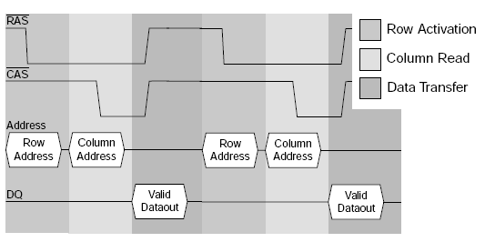
DRAM timing diagram

Slide 11
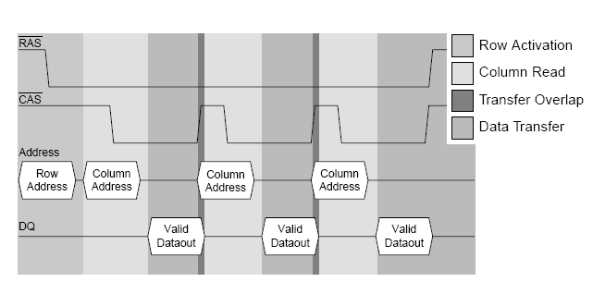
DRAM fast page mode

Slide 12
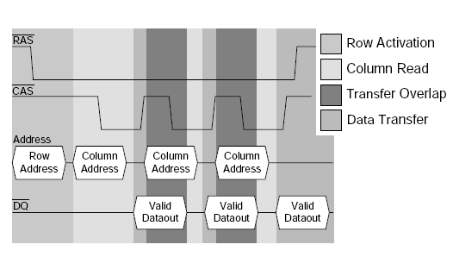
DRAM Extended Data Output (EDO)
Uses register to hold previously read data while new data is read
Pipelined access!

Slide 13
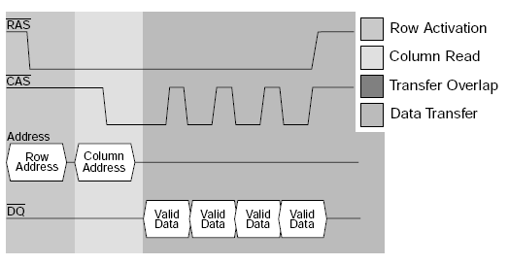
Burst Extended Data Output (BEDO)
Column address is incremented internally for greater speed!

Slide 14
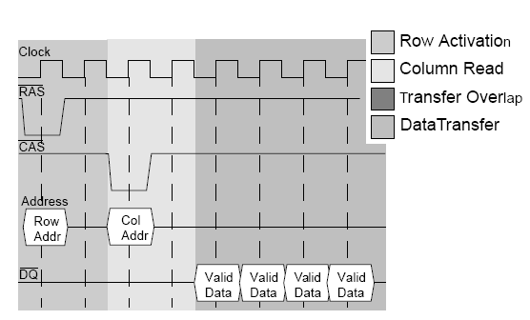
Synchronous (SDRAM)
Synchronous operation facilitates external generation of signals
Column address still incremented internally like BEDO

Slide 15
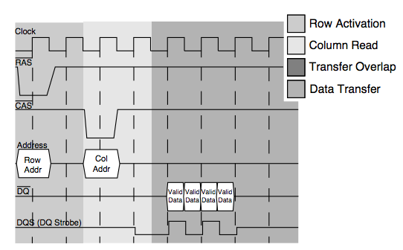
Double Data Rate (DDR)
Like SDRAM but data made available at both clock edges
Bandwidth is doubled!

Slide 16
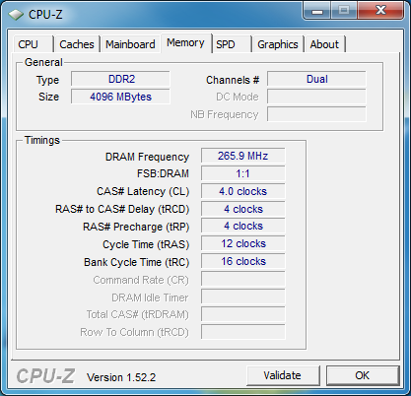
Configuring CPU to use some DRAM
Note that cycle time is given by
tRAS=tRP+tRCD+tCL

Slide 17
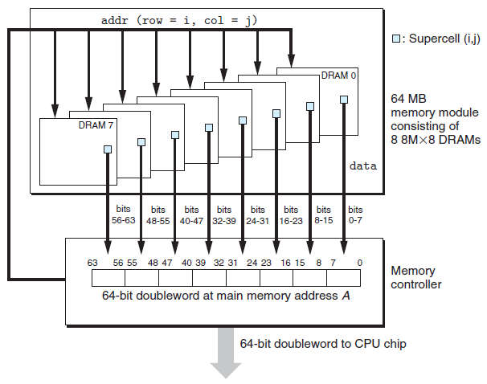
Memory module organization

Slide 18
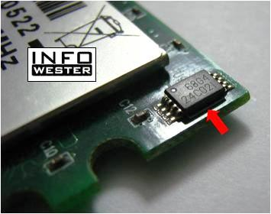
Serial presence detect
Modules have a small chip to inform whether they are present
Useful in Power On Self Test (POST)

Slide 19
DRAM refreshing
Cell transistors leak and there’s nothing we can do about it
Cell needs refreshing before stored info is gone
When a cell is read it is restored (refreshed)

Slide 20
DRAM refresh modes
RAS only
CAS before RAS
Hidden

Slide 21
RAS only refresh
address
data
Provide Row address and activate RAS
No need to activate CAS

Slide 22
CAS before RAS refresh
No need to provide Row address (incremented internally)
This is signaled by activating CAS before RAS

Slide 23
Hidden refresh
Performs refresh while data is output
Reduces refresh overhead

Slide 24
Refresh overhead
Refresh interval: every row must be refreshed within this interval
Refresh time: time to refresh all rows
Overhead = refresh time/refresh interval

Slide 25
A real example

Slide 26
Datasheet values

Slide 27
Watch this Youtube video
https://www.youtube.com/watch?v=8zhr72a6tqQ
By Prof. Amitava Dasgupta, Department of Electrical Engineering, Indian Institute of Technology, Madras.

