Slide 1
Computer Electronics
Lecture 15: Adder Circuits – Part 1

Slide 2
Typical ALU operations
Arithmetic: Addition, subtraction
Logical: NOT, AND, OR, XOR, …
Less common (normally performed by dedicated FUs):
  Bit shifting: left, right (logical or arithmetic)
  Multiplication
  Division

Slide 3
Why only simple operations?
Complex operations require more hardware whose cost must be justified
Complex functions can be decomposed as a time sequence of simple operations
Certain complex functions can be added as needed:
  Dedicated IP cores integrated in the same chip
  Dedicated chips integrated in the same board

Slide 4
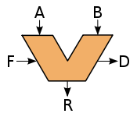
The origin of the ALU
John von Neumann proposed it
EDVAC computer, 1945

Slide 5
Integer number representation
Binary: easy to implement and robust to noise
Resolution: number of bits, N
Unsigned numbers: 0, 1, 2, …., 2^{N}-1
Signed numbers: -2^{N-1}, -2^{N-1}+1, …, -1, 0, +1, …, 2^{N-1}-1
Signed numbers: 2’s complement representation normally used

Slide 6
How to compute the 2’s complement
Method 0: (software)
  complement2two(x) = 2^{N}-x
Method 1: (hardware)
  Invert all bits
  Add 1
Method 2: (hand, hardware?)
  Scan number from right to left
  Up to the first 1 inclusively: leave unchanged
  Invert all remaining bits
0000
1111
0001
1110
13+6=3!
0010
1101
0011
1100
0100
1011
0101
1+5=6
1010
0110
1010
0111
1000

Slide 7
Adder circuits
Addition is the most basic arithmetic operation
Basis for more complex operations, like multiplication, division, etc
Different possible implementations
  Simple implementation: small and cool (low power), high combinational delay
  Elaborate implementation: big and hot (high power), low combinational delay
Technology used influences architecture choice
  FPGA use the simplest, for example

Slide 8
Unsigned addition
1010+0011=10₁₀+3₁₀
1010 → 10
+0011 → 3
1101 → 13
0010 -> Carry
Overflow happens if
result < some operand
1010 -> 10
+1010 -> 10
0100 -> 4 (!)
1010 -> Carry

Slide 9
Visualizing and computing unsigned addition and overflow
0000
10 + 12 = 6!
1010
+1100
--------
0110
1000 → carry on MSB is overflow
0001
1111
1110
13+6=3!
0010
1101
0011
1100
0100
1011
0101
1+5=6
1010
0110
1010
0111
1000

Slide 10
Signed addition
Overflow happens if addition of 2 positives (negatives) is a negative (positive)
1010 → -6, negative
+1011 → -5, negative
--------
0111 → 7!, positive!
1010 → carry
-3 - 2 = -5
1101
+1110
--------
1011
1100 → carry

Slide 11
Visualizing and computing signed addition and overflow
How to flag signed addition overflow in hardware?
Overflow = (result_sign XOR a_sign)
AND (a_sign XNOR b_sign)
Equivalent to
Overflow = C(n-1) XOR C(n-2)
Can you prove this?
0000
1111
0001
1110
-1+2=1
0010
1101
0011
1100
4+7=-5!
0100
1011
0101
1010
-4-6=6!
0110
1010
0111
1000

Slide 12
Unsigned vs. signed addition
Same adder hardware is used!!
  Greatest advantage of 2s complement!
  Unsigned and signed interpreted differently but addition operation is the same
Overflow detection
  Unsigned: Carry(n-1)
  Signed: Carry(n-1) XOR Carry(n-2)

Slide 13
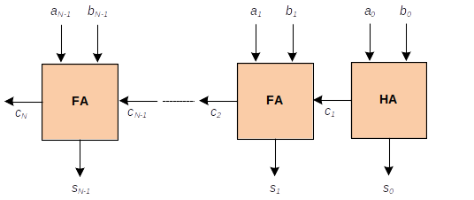
Ripple carry adder

Slide 14

Half Adder (HA) truth table
No input carry
Inputs
Outputs

Slide 15
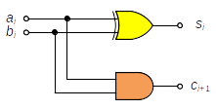
Half adder logic circuit
Area: 2 gates
Delay: 1 gate

Slide 16
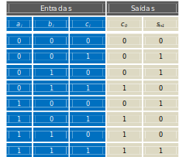
Full Adder truth table
Inputs
Outputs
Input carry
Generate
Propagate

Slide 17
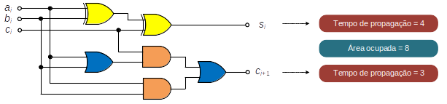
Full Adder logic circuit
Area: 6 (2-input) gates
Propagation delay: 3 gate delays
Carry delays will add up when blocks chained!

Slide 18
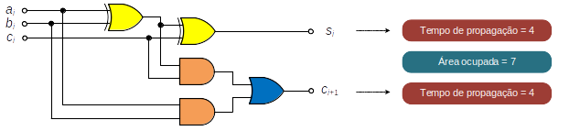
Full Adder simplification
Area: 5 gates (1 less!)
Delay: 3 gates (same)
Carry delays will add up!

Slide 19
Ripple carry adder
Compute area and delay

Slide 20
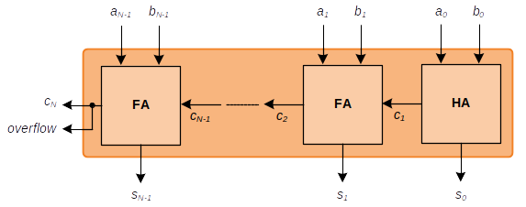
RCA: compute unsigned overflow

Slide 21
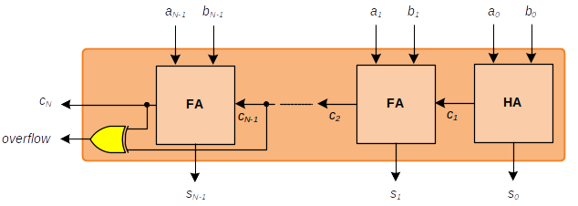
RCA: compute signed overflow

Slide 22
RCA: advantage and disadvantage
Advantage: simplest adder circuit, lowest area and power dissipation
Disadvantage: it is slow
  Delay is O(N), where N is number of bits
  Because carry computation is sequential:
    Wait for C(i-1) to compute C(i)

Slide 23
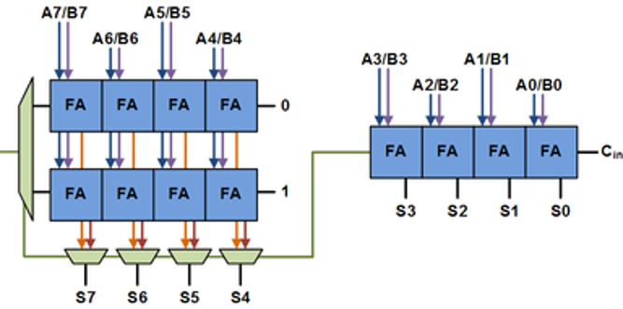
Carry-select adder

Slide 24
CSA algorithm summary
Split N-bit addition into N/2-bit additions
Use 1 RCA for lower part (A)
Use 2 RCAs for higher part (B and C)
  B assumes carry from lower part is 0
  C assumes carry from lower part is 1
Carry A selects the output from either B or C, which had been computed in parallel with A
CSA delay is half RCA delay + mux delay
CSA is 100% faster than RCA but 50% larger

Slide 25
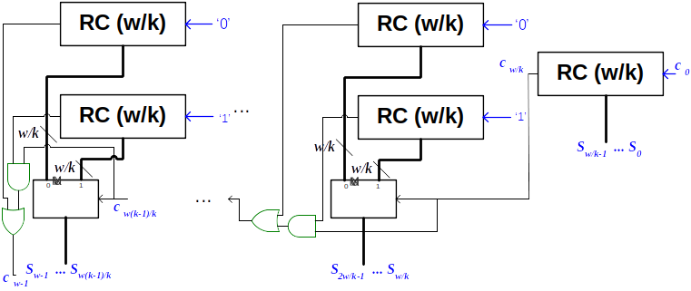
K-stage CSA
Example 32-bit/4-stage:
A(CSA)/A(RCA)= (32+24)FA/32FA = 7/4
Delay(RCA) / Delay(CSA) = 32FA/8FA= 4

