Slide 1


ComponentOne DataEngine Deep-Dive
John Juback | Product Architect

Slide 2

ComponentOne DataEngine
Cross-platform .NET Standard library for data analytics
Low-footprint, high-performance for large datasets
Column-oriented storage model using memory-mapped files
Import data from SQL Server or from a collection of strongly-typed objects
Programmatically create queries to group, join, filter, and aggregate the underlying data
Access query results as an in-memory list or persistent memory-mapped file
Convenient APIs for file export or creating a strongly-typed collection for data binding
Also includes a visual tool and a command line interface
Part of the following products:
Studio Enterprise
WinForms Data Services Edition
Data Services Edition

Slide 3
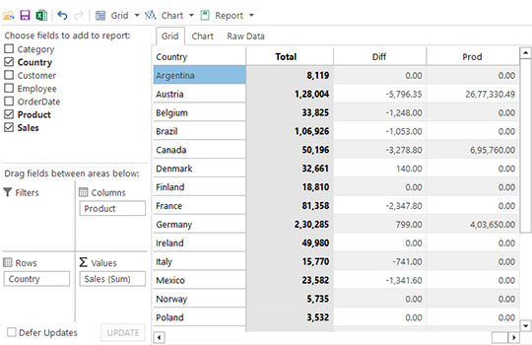
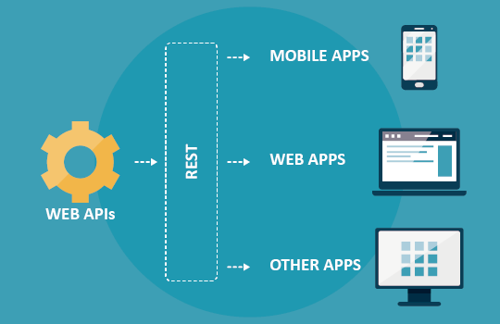
Background
DataEngine’s core technology was originally developed to support other products in Studio Enterprise:
FlexPivot (WinForms and WPF)
WebApi (Data Services)

Slide 4

Use Cases
Cross-Platform
Windows, MacOS, Linux
Large Amounts of Unstructured Data
Multiple, Disparate Data Sources
SQL Server (System.Data.SqlClient)
Oracle (Oracle.ManagedDataAccess.Core)
Text (CSV, JSON, log files)
Convert to IEnumerable
ComponentOne DataConnector
OData, Kintone, Salesforce, Dynamics 365, etc.
Self-contained Analytics
Avoid external tools, licenses, metered usage

Slide 5
DataEngine Workbench

Slide 6
Fundamentals
Base Table
Data imported from an external source
Uniquely named collection of columns
Connector
DbConnector, for importing from a database
ObjectConnector, for importing from an IEnumerable collection
Workspace
Folder containing base tables and query results
Uses memory-mapped files to read/write tables and queries
Query
Operation that retrieves data from one or more base tables
Performs grouping and aggregation
Supports range and filter operations

Slide 7
NuGet Packages (DataEngine)
C1.DataEngine
Initialize new or existing workspace
Import base tables
Execute queries and joins
Retrieve base table data and query results (IDataList)
C1.DataEngine.Api
Create bindable collections from IDataList
Sort table/query data
Output table/query data to a TextWriter
Serialize queries from JSON input (for ASP.NET Core applications)
C1.DataEngine.Tool
.NET command line tool for performing workspace tasks
Import base tables
List table/query data
Remove unwanted tables or query results

Slide 8
NuGet Packages (PivotEngine)
C1.PivotEngine
APIs for constructing pivot table views from a data source
IEnumerable
DataEngine workspace table
SQL Server Analysis Services cube
Field collections define pivot table structure:
RowFields
ColumnFields
ValueFields
FilterFields

Slide 9
Importing Data from Code
SQL Server
DataConnector
DbConnector
IEnumerable
ObjectConnector
Workspace
Base Table
Base Table
Base Table
CSV
JSON

Slide 10
Walkthroughs
Console App
Import from SQL Server
Execute queries (aggregate, range, date part, join)
Output results in CSV format
WinForms App
Same data and queries as console app
Display results in a DataGrid
DataEngine Workbench
Same results as other apps, without coding
Data visualization options
Blazor Server App
Import from CSV (~0.7 GB, ~450,000 rows)
Ad-hoc queries using RuntimeQuery API

Slide 11
Demo Projects
https://github.com/jjuback/DataEngineWebinar

