Slide 1
Web Based Motor and Camera Controller
Jacob Juca
MTSU Quantum Optics Lab
09/02/26
System Overview

Slide 2
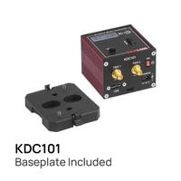
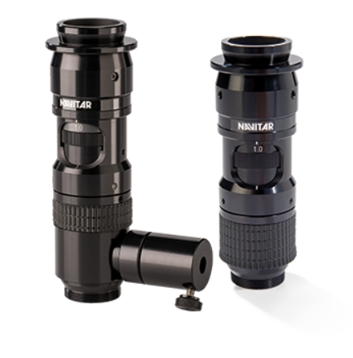
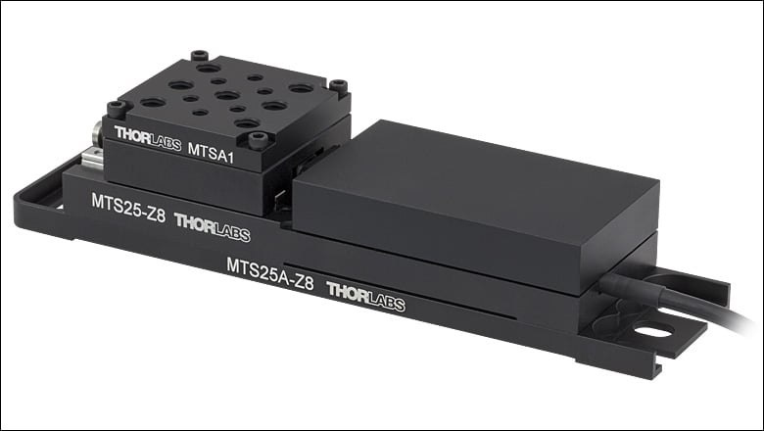
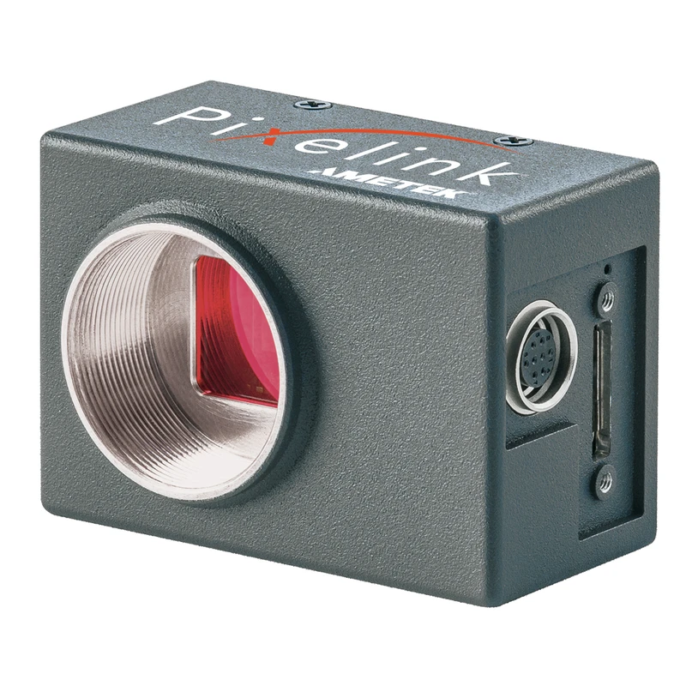


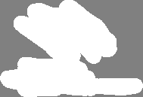
Hardware and Goals
Goals:
Hardware:
Simplify motor controls.
Control both motors and camera through one interface.
Have preset camera controls and values.
Two Thorslabs motor controllers
Two Thorslabs translation stages
Pixelink camera
Microscope
x2
x2

Slide 3


Hardware Overview
Dedicated Laptop
Motor #1
Motor #2
Stage #1
Stage #2
Camera
Microscope

Slide 4
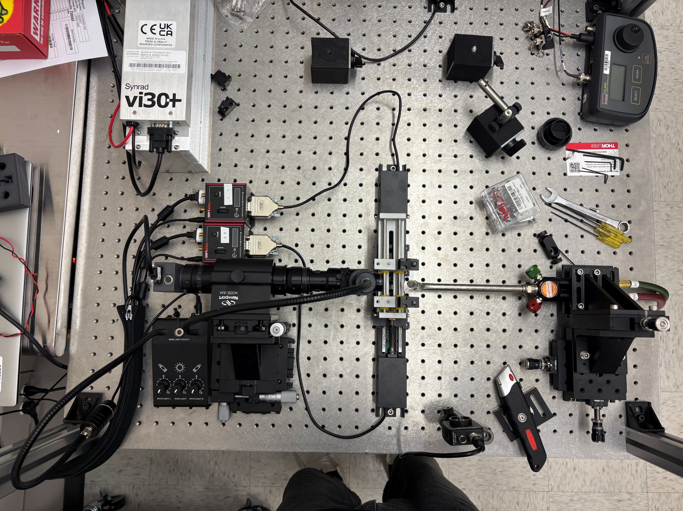
Hardware Overview (Lab View)
Stage #1
Motor #1
Motor #2
Camera
Microscope
Stage #1
Dedicated Laptop

Slide 5
User Interface Logic Map
Front End
Back End
Includes:
Camera.hmtl
Index.html
Motors.html
Style.css
Includes:
Main.py
Motor_controller.py
Camera_controller.py
Communication
Fetch()
Src
GET
POST
HTTP Requests

Slide 6
Front End
Front End
User Inputs: (buttons, text boxes, etc.)
Network Communication: Uses requests to package user actions and send to the backend
Visual Feedback: Receives JSON responses and live video frames
Index.html
Style.css
Motors.html
Camera.html

Slide 7
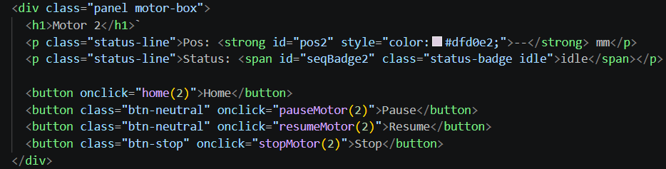
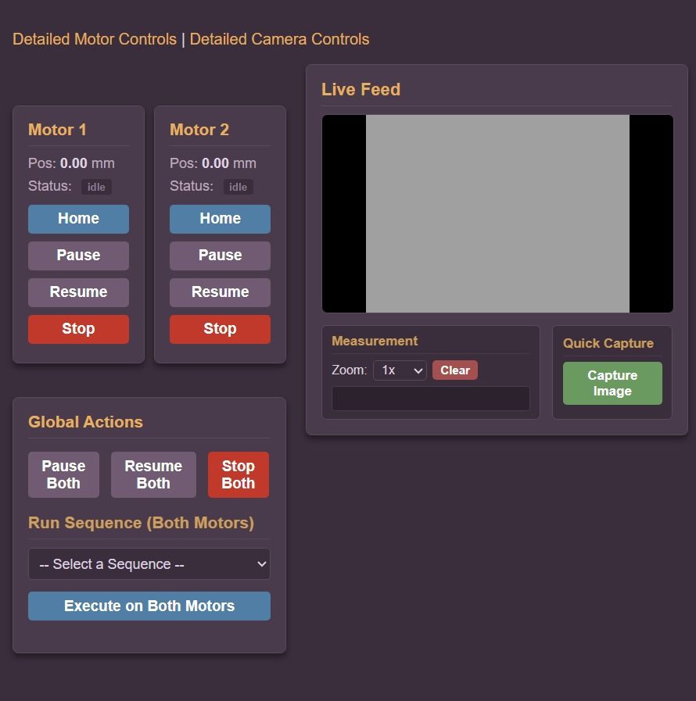

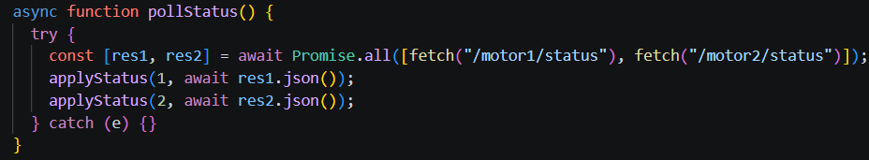
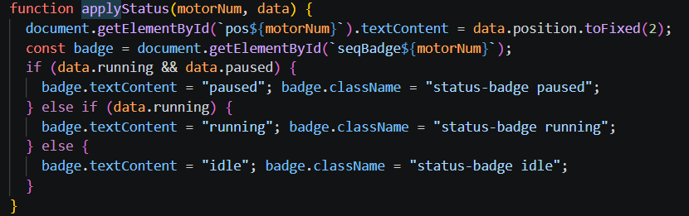
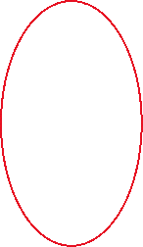

Front End
(index.html)

Slide 8
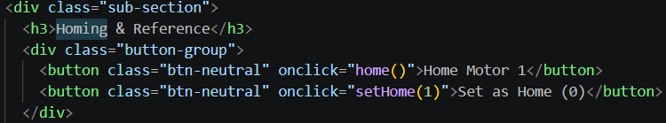
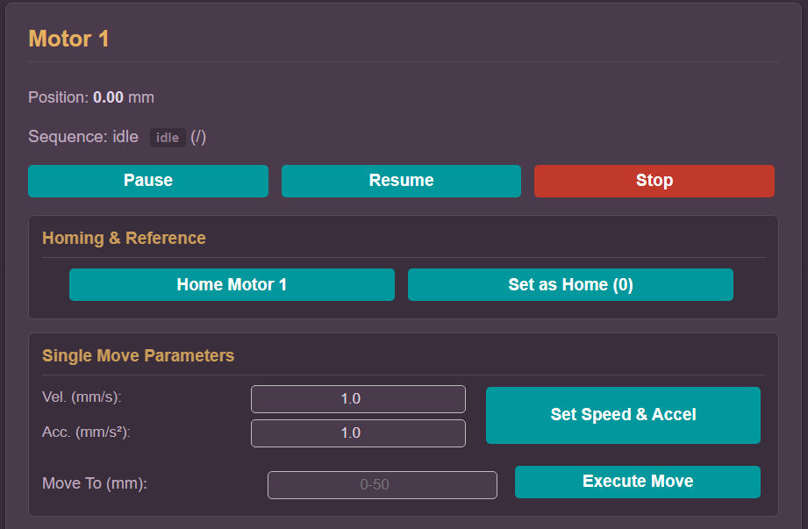
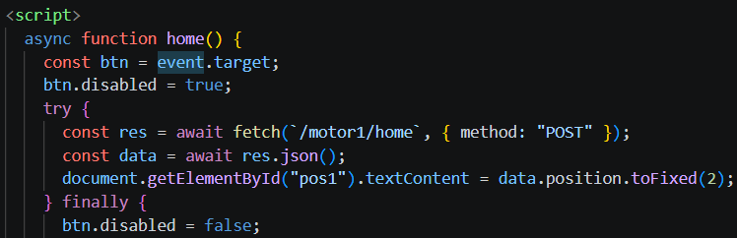

Detailed Motor Control Page (motors.html)

Slide 9
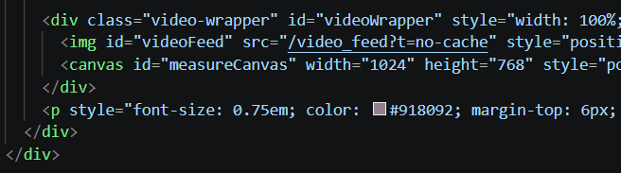
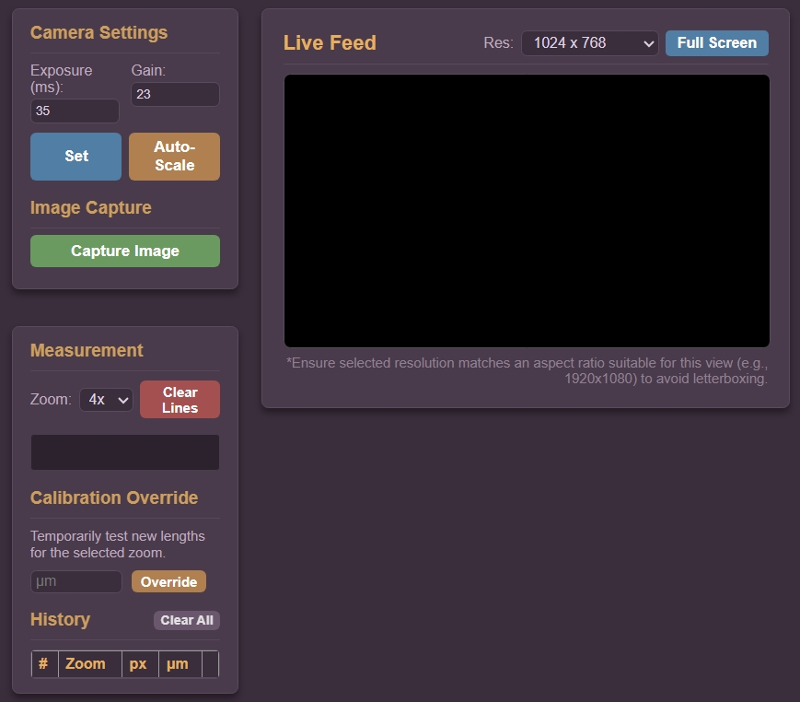
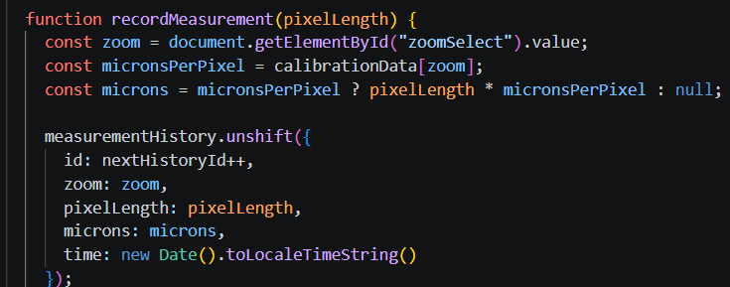



Detailed Camera Control Page (camera.html)

Slide 10


Back End
Back End
Initializes server: Launches the web program and holds functions.
Hardware Control: Translates API commands into routines and configurations.
Manages Endpoints: Hosts API routes(GET,POST…) that act destinations for front end commands.
Main.py
Motor_controller.py
Camera_controller.py

Slide 11
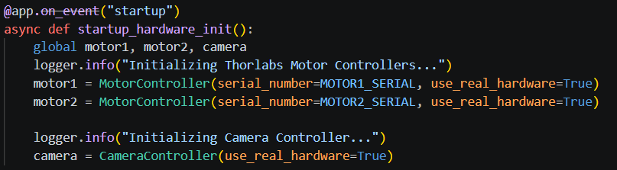
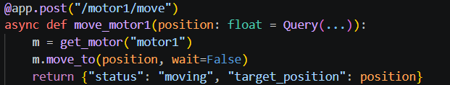
Back End (main.py)
Initializes Server:
Declares Functions:

Slide 12
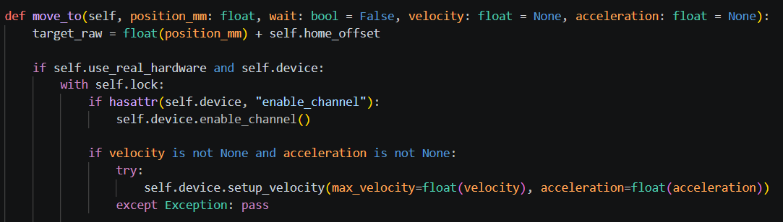
Back End (motor_controller.py)
Import driver:
(library to interface with motors)
Communicate to hardware:

Slide 13
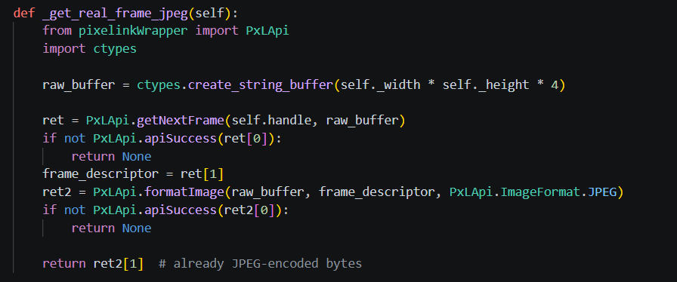
Back End (camera_controller.py)
SDK:
Retrieve image from camera

Slide 14
Front End to Back End
Front End
Back End
Fetch()
POST
Button
Function
GET
Request Video Feed
Video Feed
SRC

