Slide 1
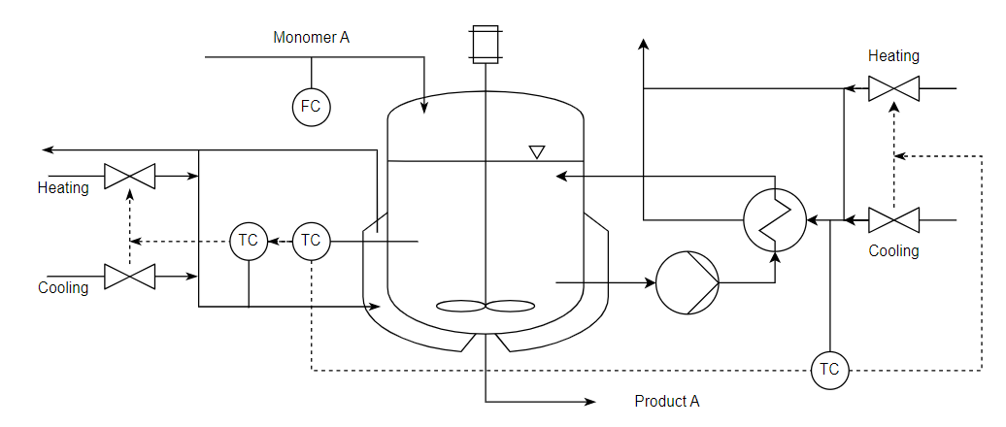
Process: Industrial polymerisation reactor
Input
Ref: https://www.do-mpc.com/en/latest/example_gallery/industrial_poly.html

Slide 2
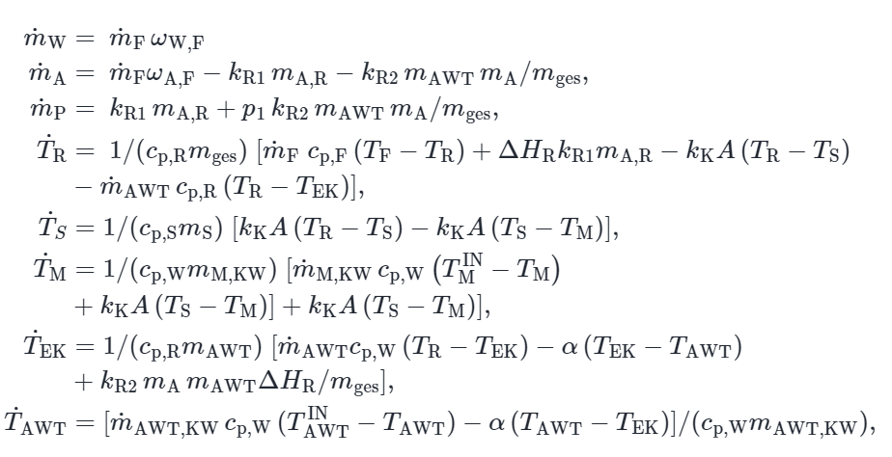
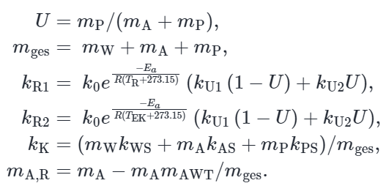
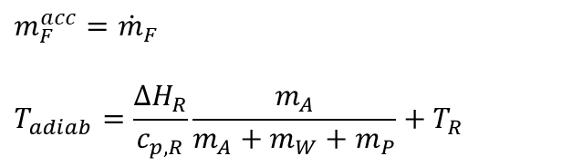
Model through conservation
Parameter uncertainty
$$m_{F}^{acc}={\dot{m}}_{F}$$
$$T_{adiab}=\frac{ΔH_{R}}{c_{p,R}}\frac{m_{A}}{m_{A}+m_{W}+m_{P}}+T_{R}$$

Slide 3
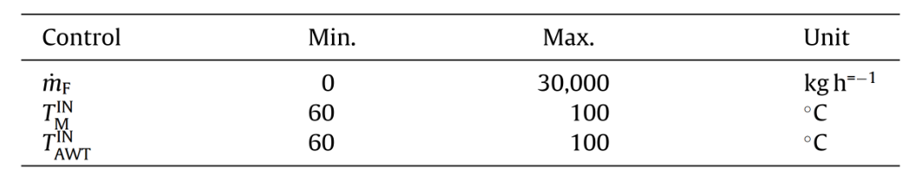
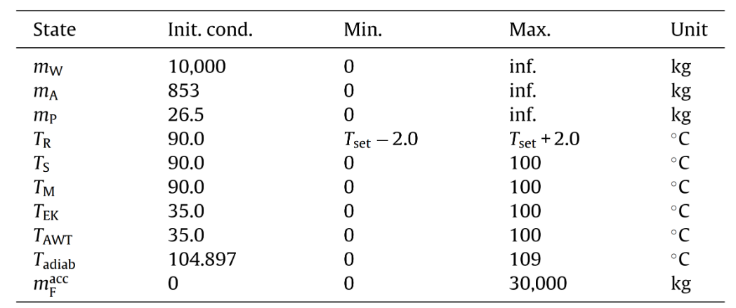
Constraints

Slide 4
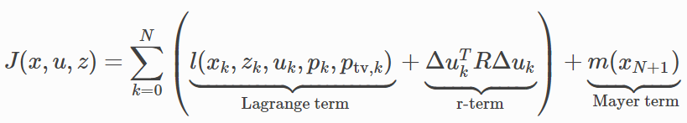
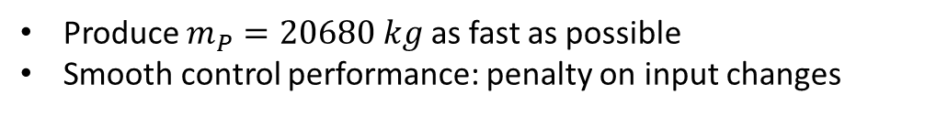
Objective
Produce $m_{P}=20680 kg$ as fast as possible
Smooth control performance: penalty on input changes

