Slide 1


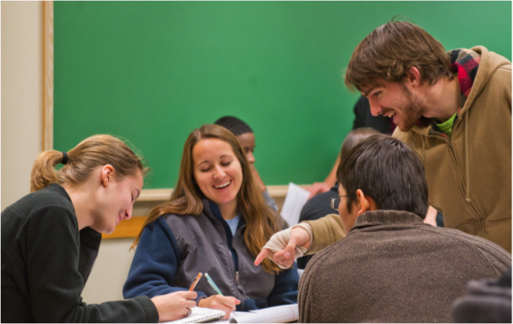
We are now recruiting Learning Assistants for Spring 2020!
Biology 212-Principles of Biology II
Section 1—MWF 3:10-4:00
Dr. Howell and Dr. Srivastava
Section 2,3 —TR 12:40-2:00
Dr. Manz and Dr. Sakaguchi
Section 4 – TR 2:10-3:30
Dr. Kukday
Do you enjoy helping others learn?
Are you good at explaining new ideas to others?
Do you need to review fundamental concepts in biology before taking entrance exams?
LAs receive 2 credits of BIOL 491 or GEN 492.
These can count as 400-level courses towards your degree.
To express interest or ask questions, please fill out this form by Nov 24: https://forms.gle/CkKgmAva2EsKtfjw8

Slide 2
Computational Activity 6
November 21, 2019

Slide 3
Building Phylogenies: Exercise
Review what you remember about phylogenies to answer the worksheet questions and build trees with:
Character/trait data
Sequence data

Slide 4
Working with mega

Slide 5
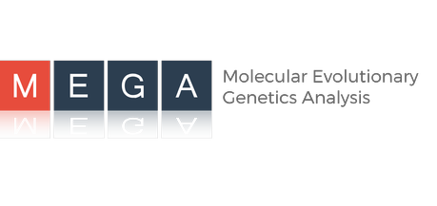
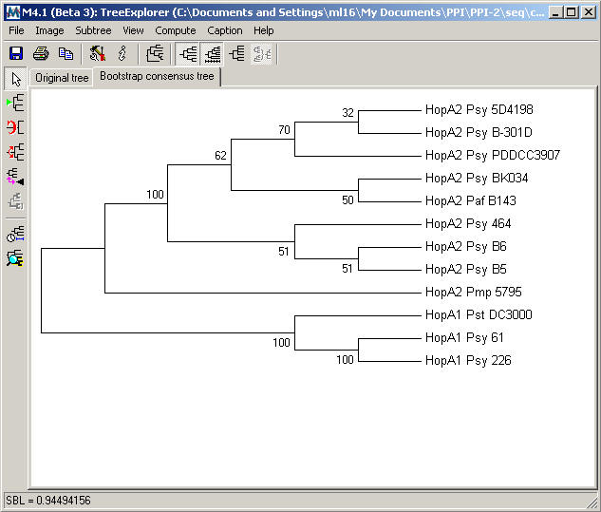
MEGA 7
Phylogenetic software
Distance and character based methods
No Bayesian methods
Data on GitHub
Take a look at the sequences
Notes:
Open the example sequence dataset from your GitHub folder. To do this, find it in your folder, select “Open With…” and choose MEGA.
You should see two tabs appear in the main space of MEGA. If you click the one that says T A, it should show you the data for the sequences you downloaded.

Slide 6
What organism are you working with?
What does “Conserved Sites” mean?
What does “Variable Sites” mean?
What about “Parsim-Informative”?
What sequence information will be helpful for building a tree?
The statistics tab can tell you about the sequences. Look at the Nucleotide Composition. What is this telling you?

Slide 7
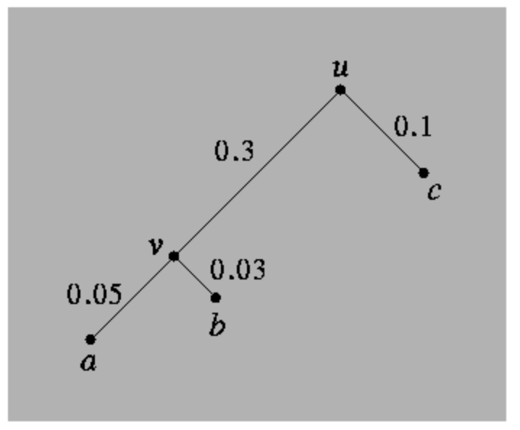
Pairwise Distances
What sequences appear to be closer?
Which appear to be different?
Notes:
You have multiple options available to you using the data you loaded on MEGA. One is calculating the pairwise distance between sequences. This is essentially a measure of how different two sequences are from each other. This information is ultimately informative for building a phylogenetic tree.

Slide 8
Building a Tree in MEGA
Run a Maximum Likelihood Tree in the Phylogeny tab of MEGA.
Which species are being called sister species?
Now let’s run a neighbor-joining tree. What is different between the two trees?
Try out the other methods available on MEGA. What can you conclude?
Notes:
Not all methods are made equal.

Slide 9
Methods of building PHylogenies

Slide 10
Classified into two categories: Distance methods: use some measure of evolutionary distance between pairs of OTUs and construct a tree based on those distances (do not use sequence data directly)  UPGMA  Neighbor-Joining Character state methods: use the actual sequence data, where each site is considered a character with one of 4 possible states for DNA (A, C, G, T)  Parsimony  Maximum likelihood  Bayesian

Slide 11
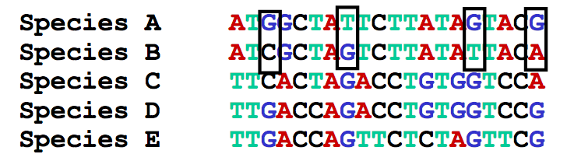

Distance-Based: Calculating Distances
Uncorrected Distance: Count the changes between sequences and divide by the sequence length. Ex: Dist(A,B) = ?
Tends to underestimate genetic distance
Jukes-Cantor Distance: Allows the setting of the substitution rate. Assumes that any nucleotide change is equally likely and that all nucleotides occur at equal frequency.
Notes:
20 base pairs.
What is the problem with Jukes-Cantor?

Slide 12
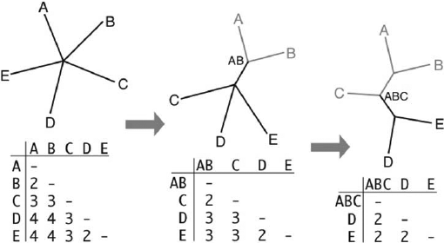
Neighbor-Joining Method
Find the smallest distance using your chosen distance estimator.
Those two species will be pulled away from the star, as they are considered closely related.
Recalculate distances to the new group AB
Find the smallest distance again.
Pull out the species that now have the lowest distance.
Repeat
Does not assume molecular clock
Notes:
Works through star decomposition.

Slide 13
Molecular Clock
Relationship between mutations and time; can be used to estimate divergence times
# Mutations
0
1,000,000
# Years Since Divergence

Slide 14
UPGMA: Unweighted Pair Group Method with Arithmetic mean
Assumptions
Constant substitution rate
Over time
Over lineages
Similar to Neighbor-Joining, but always produces a rooted tree
Not a robust method, why?

Slide 15
Molecular Clock: Problematic?
Gene 2
Gene 1
Relationship between mutations and time can be dependent on the genes used and the species included!
# Mutations
Gene 3
0
1,000,000
# Years Since Divergence

Slide 16
Which should we prefer?
NJ
UPGMA
Notes:
Neighbor Joining, because has no assumptions about molecular clock.

Slide 17
Character-Based
Parsimony Methods
Maximum Parsimony: (reviewed in class) Try to minimize branch lengths by minimizing the number of mutations between closely related sequences.
Minimum Evolution: Tries to fit the assumption that the tree with the smallest sum of branch length estimates is the true tree.
Assumptions
No reversals
No convergence/parallel evolution
No homoplasy
Notes:
Character based: now we are actually using the sequences.

Slide 18
Max Parsimony
Min Evolution

Slide 19
Maximum Likelihood
Choose the tree which makes the data the most “probable”; in other words, choose the tree which is best able to predict the data that you have
Can use different evolutionary models
Robust
Computationally intensive
Notes:
It evaluates a hypothesis about evolutionary history in terms of the probability that the proposed model and the hypothesized history would give rise to the observed data set. The supposition is that a history with a higher probability of reaching the observed state is preferred to a history with a lower probability. The method searches for the tree with the highest probability or likelihood.

Slide 20
Hypothesis Testing Using Trees
Form hypothesis of evolutionary relationships between species
Trait data
Fossils
Biogeography
Collect genetic or trait data
Choose an appropriate tree-building method
Bootstrapping

Slide 21
Bootstrapping
How much confidence should we have in a certain tree?
100% ➔ high support for that portion of the tree
Which trees are similar? Which are different?

Slide 22
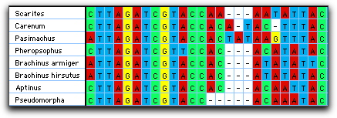
Using Mega with GenBank: Alignment
Alignment
Notes:
When working with sequences from different species and with unequal lengths, must align sequences to determine where the differences lie between sequences

Slide 23
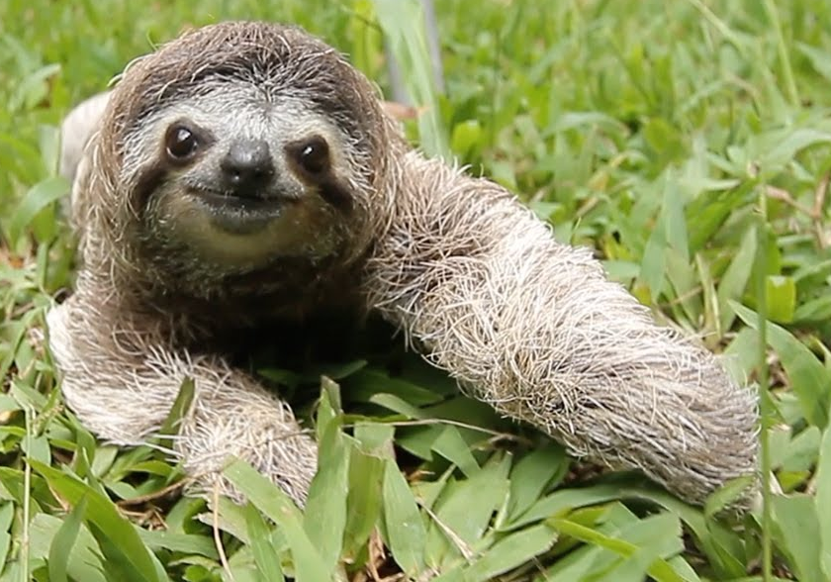
Steps
Create new DNA alignment
Use the Web: GenBank option
Do a nucleotide search for “sloth cytochrome b”.
Click an entry and select Add to Alignment in the top right.
Add names and click OK.
Go back and now click the entry for Bradypus tridactylus
Select sequences and align
Export alignment in MEGA format
Notes:
Try to give the sequences unique names

