Slide 1
Computational Exercise #1
September 5, 2019
Evolutionary Genetics 462

Slide 2

https://github.com/jjudson28/GEN_462_2019
On your computer:
Move into the GEN_462_2019 Folder
cd GEN_462_2019
Type ls to list the folder’s contents
To update your repository to be consistent with what is online, type git pull and then press enter
If you are on a cart computer:
Go to the website for the github repository on your browser
Click the files you want to download

Slide 3
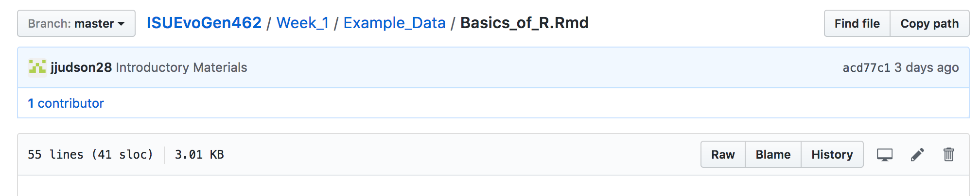
Go to File, Save as in your web browser
Choose location to save that you can find easily
Don’t append the “.txt” file ending

Slide 4
Objectives for Today
Review different marker types and their pros/cons
Brief HWE reminder
Use R Studio and the packages ”adegenet” and “pegas” to generate basic statistics and HWE estimates
Interpret these values in a biological context

Slide 5
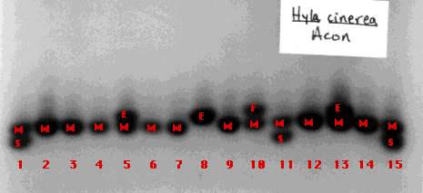
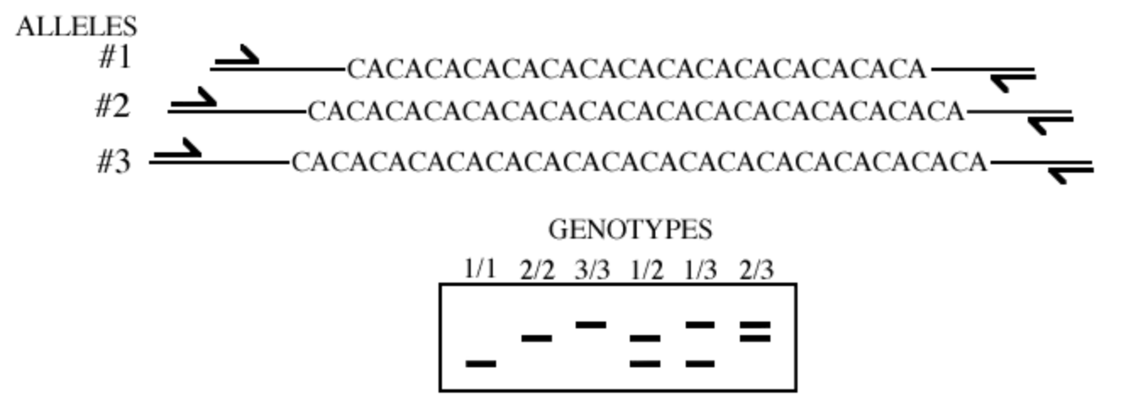
Common Marker Types
Allozymes
Different forms of an enzyme coded by different alleles at the same locus
Not very variable, not good for recent divergence
Potentially under selection
In class exercise from last week is example
Microsatellites
Tandem repeats in DNA sequence
Rapidly evolving, good for recent divergence
Neutral (?)
Data is depicted as lengths or as number of repeats (numbers instead of letter bases)

Slide 6
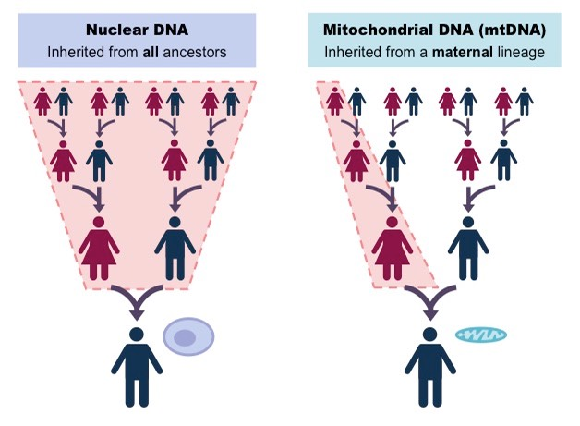
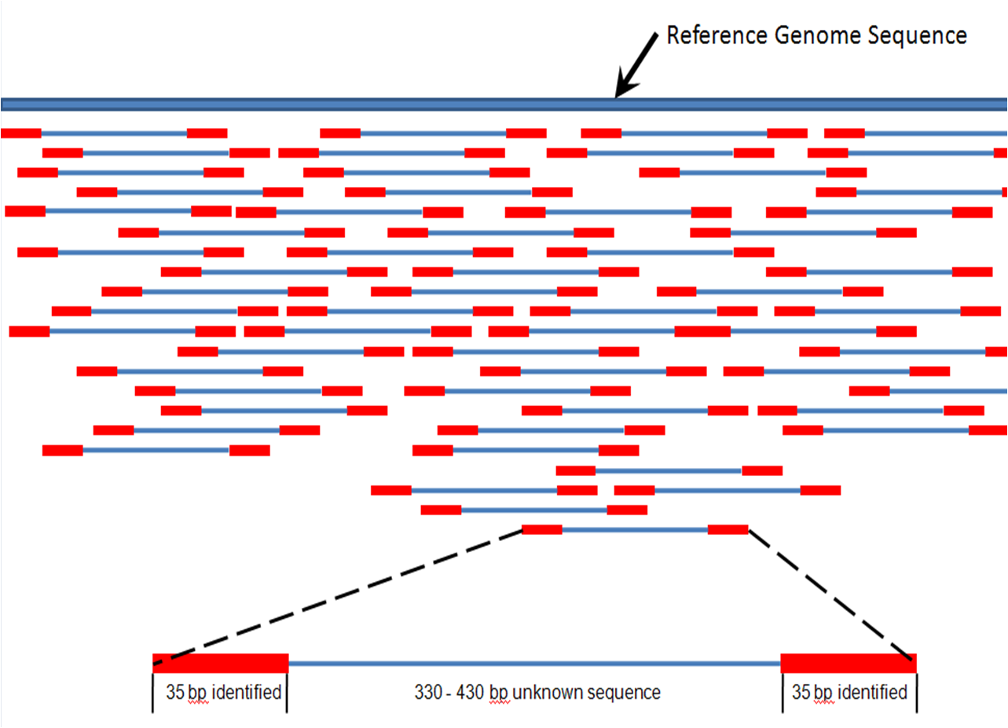
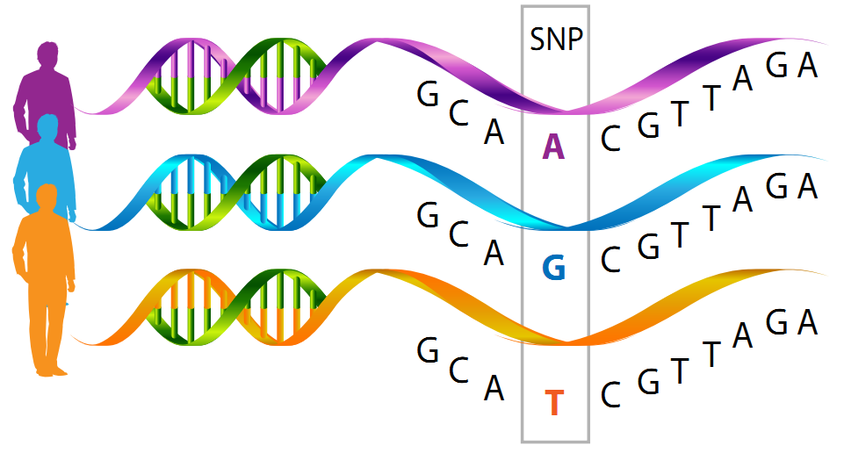
Sequence data (shorter or genomic sequence data)
Mitochondrial or Chloroplast
Full genome sequence data
Single Nucleotide Polymorphisms (SNPs)
An example of use of sequence data
Data depicted as letters representing DNA base

Slide 7
SNPs
Can have lots of data for fine-scale population structure / recent divergence
Not as rapidly evolving as microsatellites
Can be in coding regions (genes) or in neutral regions
Common way of assessing variation today

Slide 8
Hardy-Weinberg Equilibrium
What does it mean for a population to be in HWE?
Assumptions are being met:
No natural selection
No mutation
No drift
No migration
Random mating
What does it mean when a population is not in HWE?
Assumptions are NOT being met
Evolution is occurring

Slide 9
Interpreting Values of HWE
When analyzing HWE, we use p-values to assess whether the population allele frequencies deviate from HWE:
P < 0.05 → Population is not in HWE
P ≥ 0.05 → Population is in HWE

Slide 10
References
Sayres, M. A. W. et al. Bioinformatics Core Competencies for Undergraduate Life Sciences Education. bioRxiv 170993 (2017).
http://www.biology-pages.info/P/Polymorphisms.html
http://www.informatics.jax.org/silver/figures/figure8-10.shtml
https://neuroendoimmune.wordpress.com/2014/03/27/dna-rna-snp-alphabet-soup-or-an-introduction-to-genetics/

