Slide 1
Computational Labs
ISU GEN 462
August 27, 2019

Slide 2
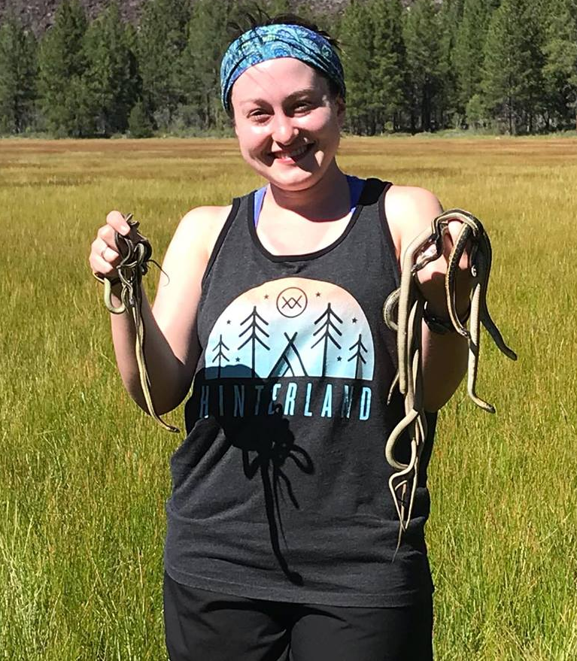
TA: Jessica Judson
From Fort Worth, TX
Master’s Degree: Mississippi State University
Population genetics of the Lesser Antillean Iguana
PhD Candidate
Dr. Fredric Janzen
Population genomics, local adaptation, mating strategies of the painted turtle and the western terrestrial garter snake
I will be available by appointment or via Slack direct message
Send me an email: jjudson@iastate.edu
353C Bessey Hall

Slide 3
Tools for the Course
Laptop (Your own or a provided laptop)
Communication: Slack (questions and announcements about the labs); Canvas (all grades, lecture material posted on Canvas)
File Sharing for Computational Exercises: GitHub
Programming Language: R and R Studio
Other misc. programs for special topics (TBA)

Slide 4
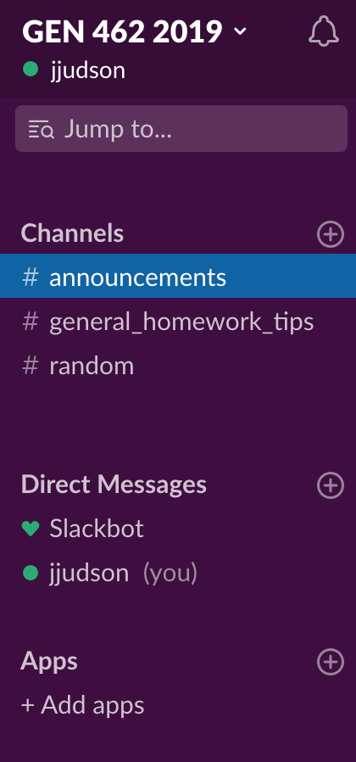

https://2019isugen462.slack.com/
Messaging, chat, and file sharing device
Can set up notifications to your desktop
Where you will turn in your assignments
Can ask questions about homework, ect.
Create your account with your ISU email; use this link to access the Slack page:
https://join.slack.com/t/2019isugen462/shared_invite/enQtNzMyMzQ2MzE2MTk3LTNmNmZkZTA3Y2E2Nzg1ZmVjMWU2ZDI0YjFhMTRmYjA2MWJiNTQ2NzI5YTM0MGMwMWJkMzc0ZmNkYWMxN2FkZGI

Slide 5
Slack Guides
Getting Started with Slack
Slack How-To Video
General comments:
#announcements is for me to communicate with everyone about issues I have found with code, general reminders, and for you to ask general troubleshooting questions
#general_homework_tips is for me to share tips on how to complete assignments, or point out common errors in code
#random can be for whatever you would like! If you come across some cool way of analyzing genetic and genomic data you want to share, this is the place!
Direct messaging is for submitting your homework assignments to me, and for other questions you want to ask me directly (setting up meetings, help, discussing grades, ect.)
There is an app for iPhone and Android, and the messaging functions much like texting

Slide 6

Great tool for sharing files
Has neat features for collaborative work
Avoids merge conflicts
Split up large projects
While GitHub has a GUI (graphical user interface), we will not be using it. Instead, you will learn to use the text-based interface.
Must learn some coding!

Slide 7
GitHub Resources
We will be doing the preparation of GitHub on your computer in two parts:
Installing Git on your computer
Cloning a GitHub repository
Here are some resources to help you with GitHub:
GitHub Guides
Terminal-based GitHub How-To

Slide 8
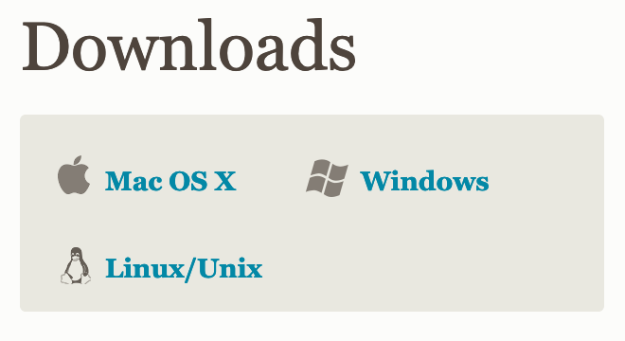
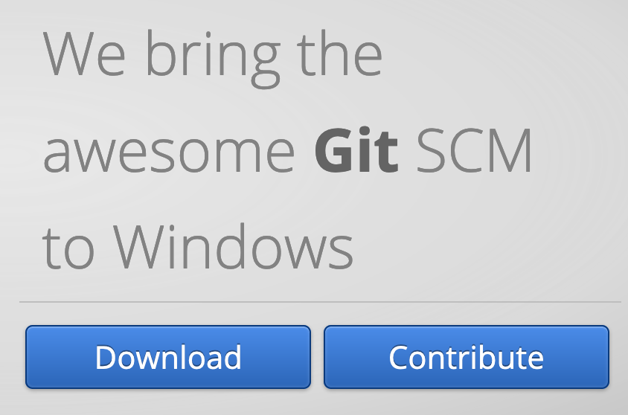
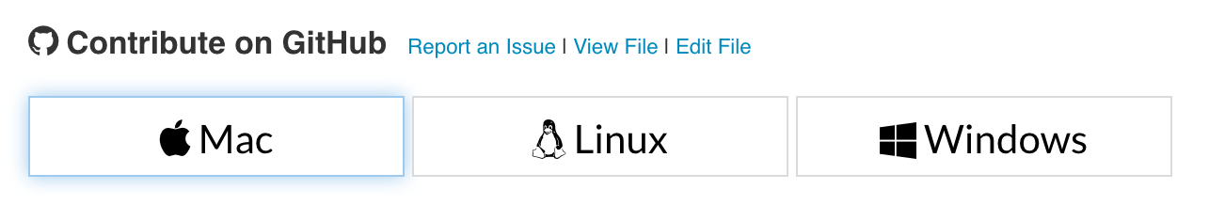
Step #1: Installing Git on your computer
GitHub: You can make an account if you’d like here; you don’t have to if you just want to clone a repository
Mac Git Download
Windows Git Download
How to Install Git: Guide

Slide 9
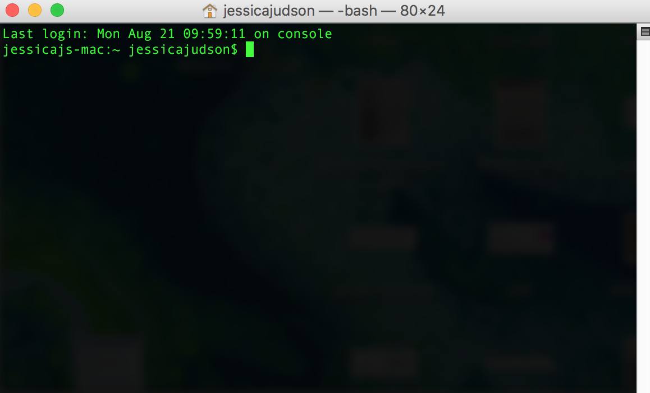
Terminal
An interface in which you can type and execute text based commands
Offers flexibility, streamlines repetitive tasks and file sorting, and is repeatable for other researchers

Slide 10
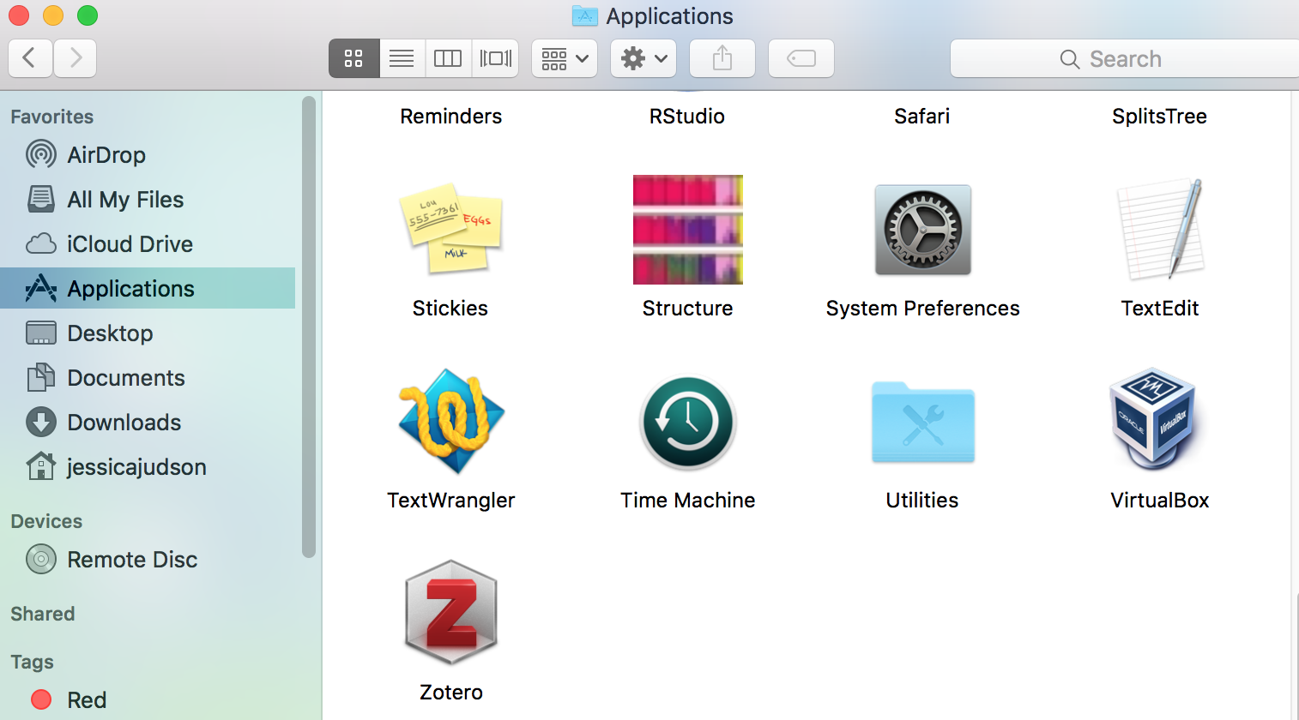
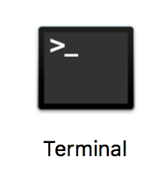
Navigating the Terminal
Mac users:

Slide 11

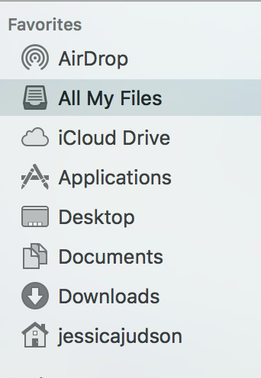
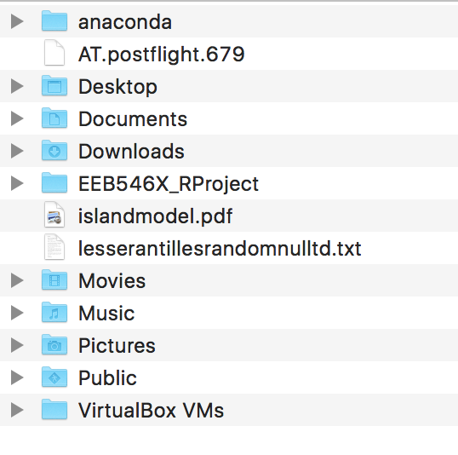
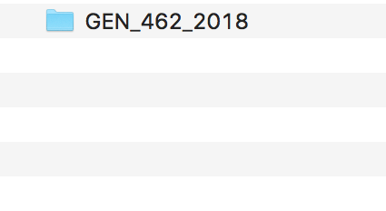
Navigating the Terminal
Windows Users:
Open the terminal in Git Bash (if you checked the box for desktop icon during set-up, should show up on your desktop)

Slide 12
What Are Directories?
Home Directory
Desktop
GEN_462_2019
Documents
Research
Where your computer begins when you open a terminal
Folders contained within the home directory
Items contained within those folders
Downloads
Applications
Teaching

Slide 13


Navigating the Directories in Terminal
Moving around your computer in Unix Bash: The Basics
Change directories: cd DirectoryName/
Go back a directory: cd ..
Go back to the home directory: cd
Helpful tip: when entering directories, can use tab to automatically fill in the directory name once you have entered a few letters

Slide 14

More Terminal Commands
Up arrow: scrolls through previous commands you have used
pwd: “Print working directory” tells you your location in your computer’s files
ls: See contents of your working (current) directory

Slide 15
https://github.com/jjudson28/GEN_462_2019
Always read the README documents
Explains what is in each folder, and with programs, tells you how to use the program, ect.
Guide to Cloning a Repository

Slide 16
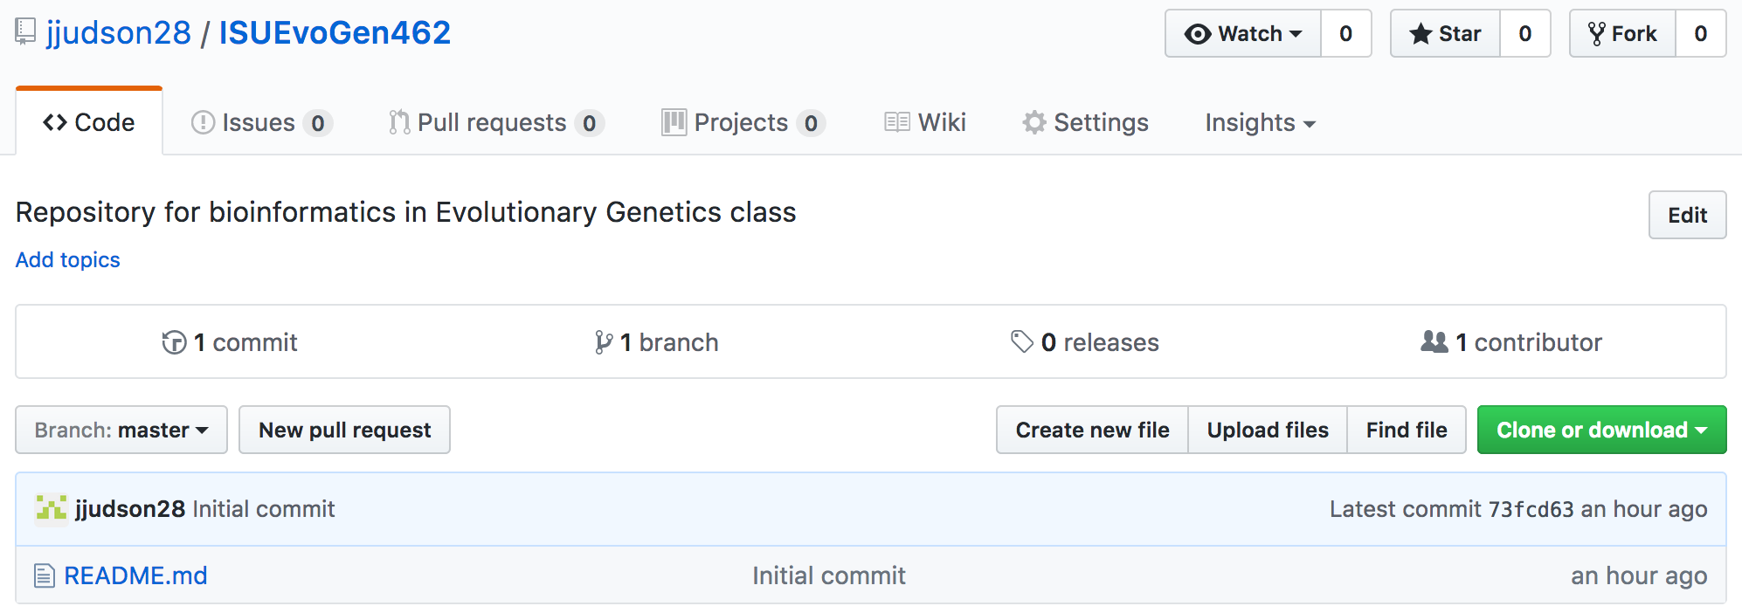
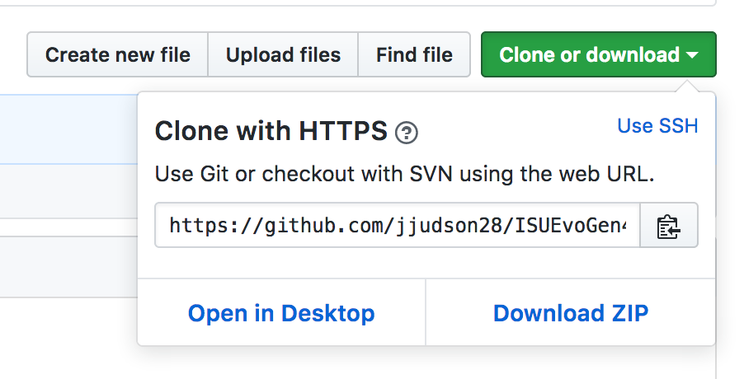
Cloning the GitHub Repository on your Computer

Slide 17
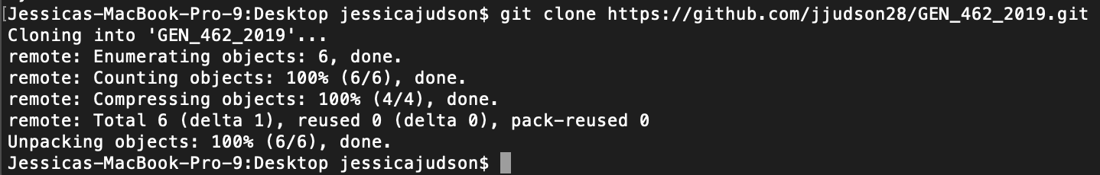
Cloning the GitHub Repository on your Computer
Open either Terminal (Mac) or Git Bash (Windows)
Navigate to where you want to put the folder containing the repository; ex:
Type git clone; ex:
Then paste the url you copied earlier and press enter
Notes:
for mac, just command v. for PC, to paste, use the right click and paste option.

Slide 18
Possible Error Mac
Mac error: invalid active developer path
xcode-select --install

Slide 19
Getting Materials from GitHub
Move into the GEN_462_2019 Folder
cd GEN_462_2019/
Type ls to list the folder’s contents
To update your repository to be consistent with what is online, type git pull and then press enter
You must be in your GEN_462_2019 folder to update your repository
DO THIS BEFORE EVERY COMPUTATIONAL CLASS

Slide 20

R and R Studio
Download R
https://www.r-project.org/
CRAN mirror is Iowa State University
Download R Studio
https://www.rstudio.com/products/rstudio/download/#download

Slide 21
Possible Error PC: R Studio Download
If you can download Rstudio, but can't open it:
1) Open the Rstudio file in your program files.
2) In the Rstudio file, double click INSTALL. It will then prompt you by asking what application you would like to use to open it with.
3) Select Rstudio.
4) Now that you have Rstudio open, pin it to your taskbar so you don't lose it.

