Slide 1
Quantitative Genetics
Computational activity 11/07/19

Slide 2
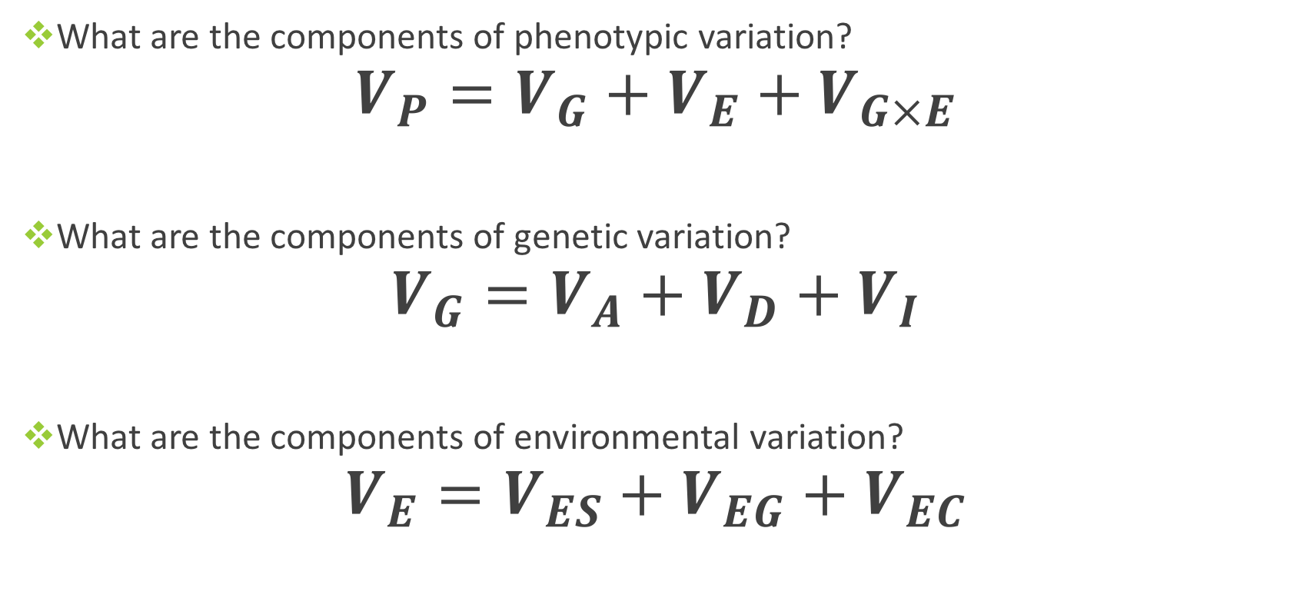
Review: Phenotypic Variation
What are the components of phenotypic variation?
$$V_{P}=V_{G}+V_{E}+V_{G×E}$$
What are the components of genetic variation?
$$V_{G}=V_{A}+V_{D}+V_{I}$$
What are the components of environmental variation?
$$V_{E}=V_{ES}+V_{EG}+V_{EC}$$
Notes:
Va: additive, the resemblance between offspring and parents, most Evol. change of quantitative genetic traits due to Va, of interest with heritability
Vd: dominance, variance due to dominance effects among alleles, an important contributor to resemblance among full-sibs but not parent/offspring
Vi: epistatic, typically is not passed on to offspring due to recombination
Ves: special environmental variance: usually treated as measurement error
Veg: general environmental variance: microenvironmental variation among individuals
Vec: common family environmental variance: common family environment, maternal effects

Slide 3
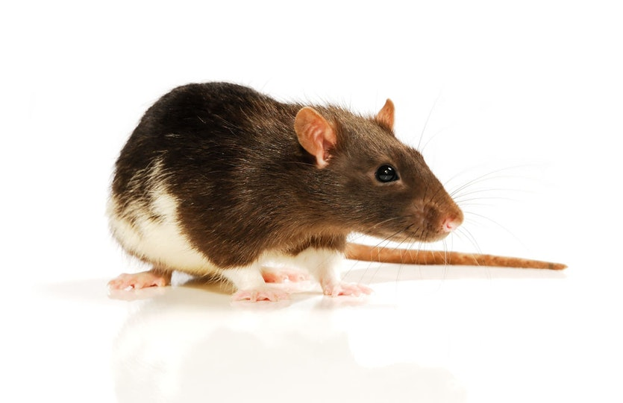
Important!
These separate parts of the phenotypic variance can be seen as proportions of the total variance. An increase or decrease in one part of the variance will influence the other parts.
Example: A lab experiment of mice (where the environment is the same) finds the heritability of coat color to be 0.42. Will a wild population express the same heritability?

Slide 4
Lab mice: Wild mice:
Notes:
Heritability is not the same!
Heritability is context dependent!

Slide 5
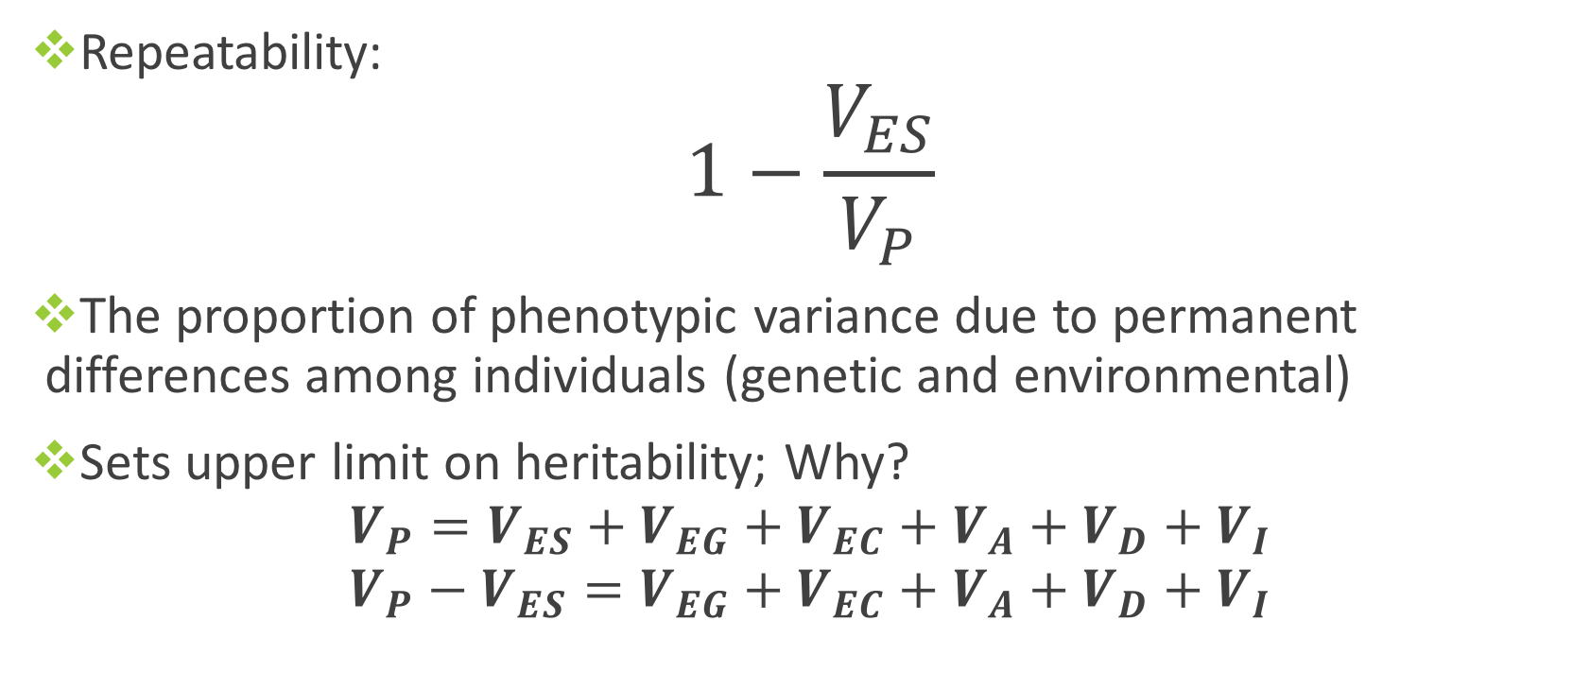
Accounting for Within-Ind. Variation, V_{ES}
Repeatability:
$$1−\frac{V_{ES}}{V_{P}}$$
The proportion of phenotypic variance due to permanent differences among individuals (genetic and environmental)
Sets upper limit on heritability; Why?
$$V_{P}=V_{ES}+V_{EG}+V_{EC}+V_{A}+V_{D}+V_{I}$$
$$V_{P}−V_{ES}=V_{EG}+V_{EC}+V_{A}+V_{D}+V_{I}$$

Slide 6
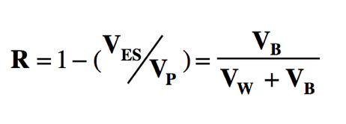
Analysis of Variance
Used to calculate repeatability, heritability
Partitions variance into the variance among individuals and the variance within individuals
Set your working directory and load the turkey dataset into your environment
Where does the variation “within” individuals come from?
Notes:
Among and within variance
We need Vb and Vw. Lets use anova to get those numbers from our dataset.

Slide 7
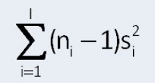
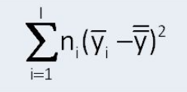
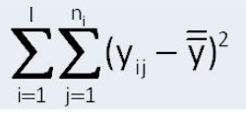
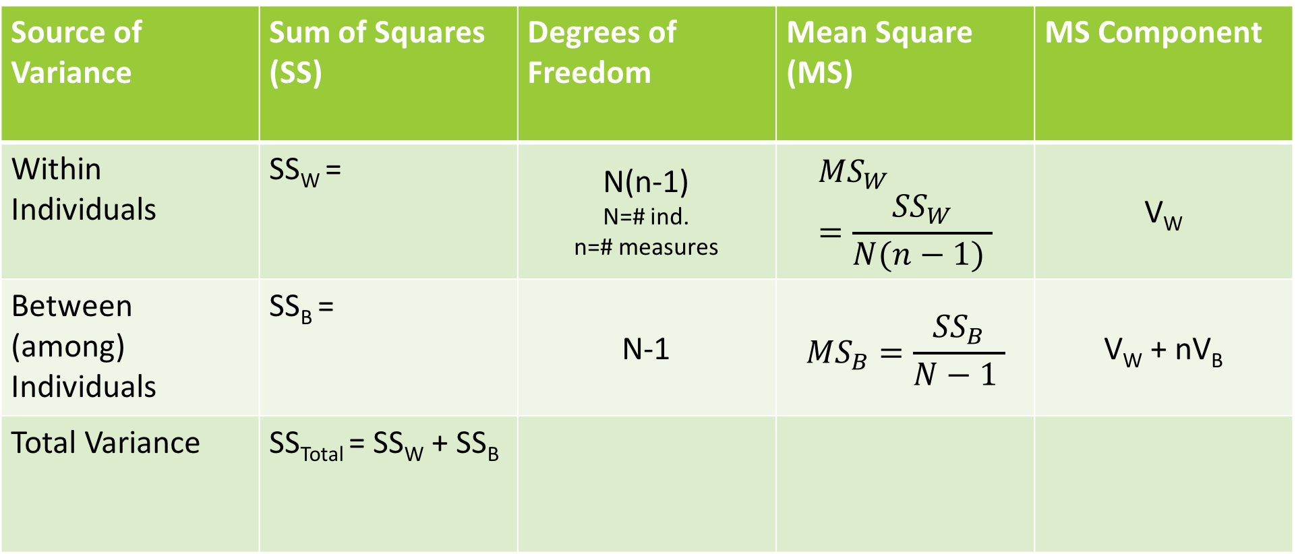
ANOVA Table
Source of Variance | Sum of Squares (SS) | Degrees of Freedom | Mean Square (MS) | MS Component
Within Individuals | SS_{W} = | N(n-1) N=# ind. n=# measures | $${MS}_{W}=\frac{{SS}_{W}}{N(n−1) }$$ | V_{W}
Between (among) Individuals | SS_{B} = | N-1 | $${MS}_{B}=\frac{{SS}_{B}}{N−1 }$$ | V_{W} + nV_{B}
Total Variance | SS_{Total} = SS_{W} + SS_{B}

Slide 8
Heritability Estimates
Not all are equal!
Mid-parent/Offspring comparisons are commonly used
They account for the additive genetic variance passed from parents to offspring in a straightforward manner (calculated as the slope of the relationship).
Full-sibling correlations are the least reliable
You must now account for variance due to dominance and common environment (for example, maternal effects)
Offspring are usually grouped in a common environment at birth.

Slide 9
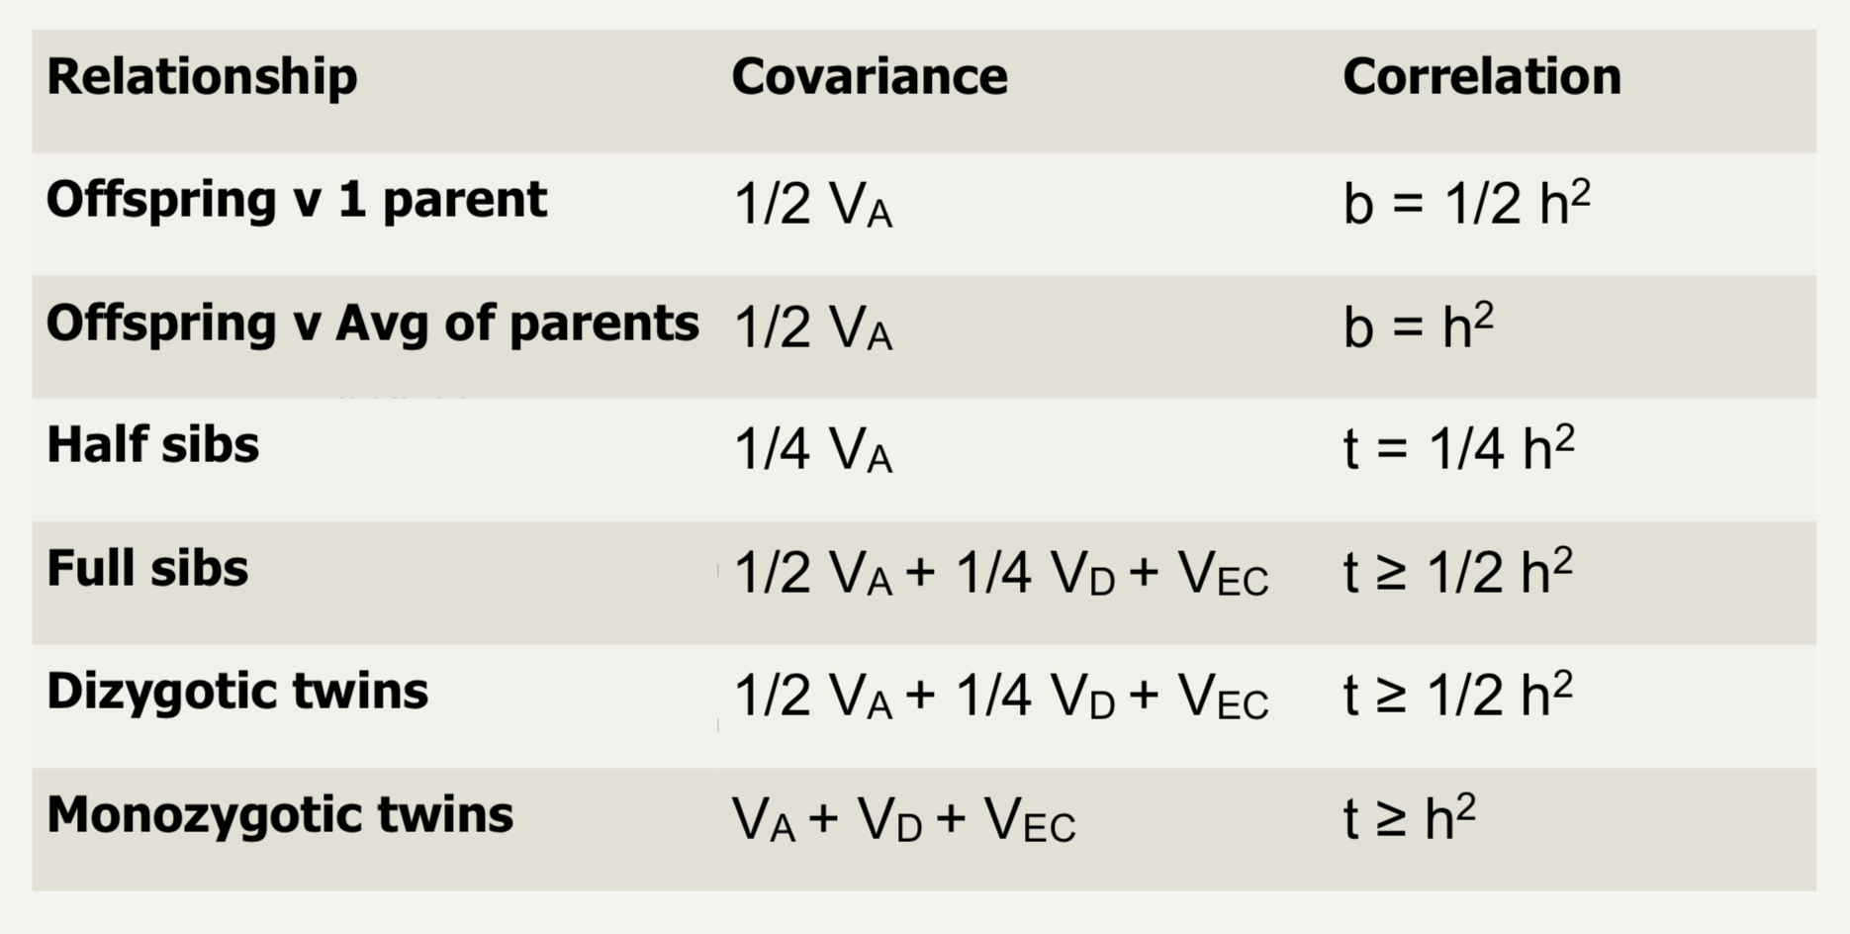
Calculations of heritability

Slide 10
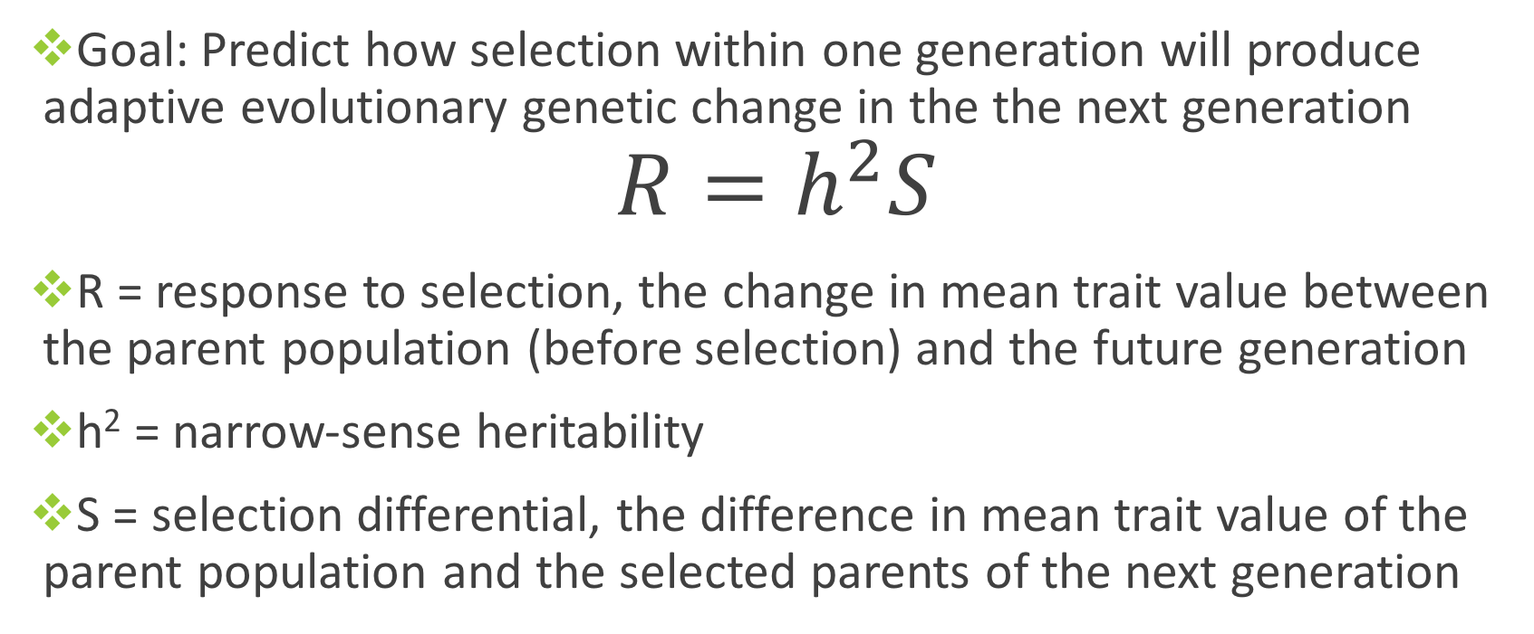
Response to Selection
Goal: Predict how selection within one generation will produce adaptive evolutionary genetic change in the the next generation
$$R=h^{2}S$$
R = response to selection, the change in mean trait value between the parent population (before selection) and the future generation
h² = narrow-sense heritability
S = selection differential, the difference in mean trait value of the parent population and the selected parents of the next generation

Slide 11
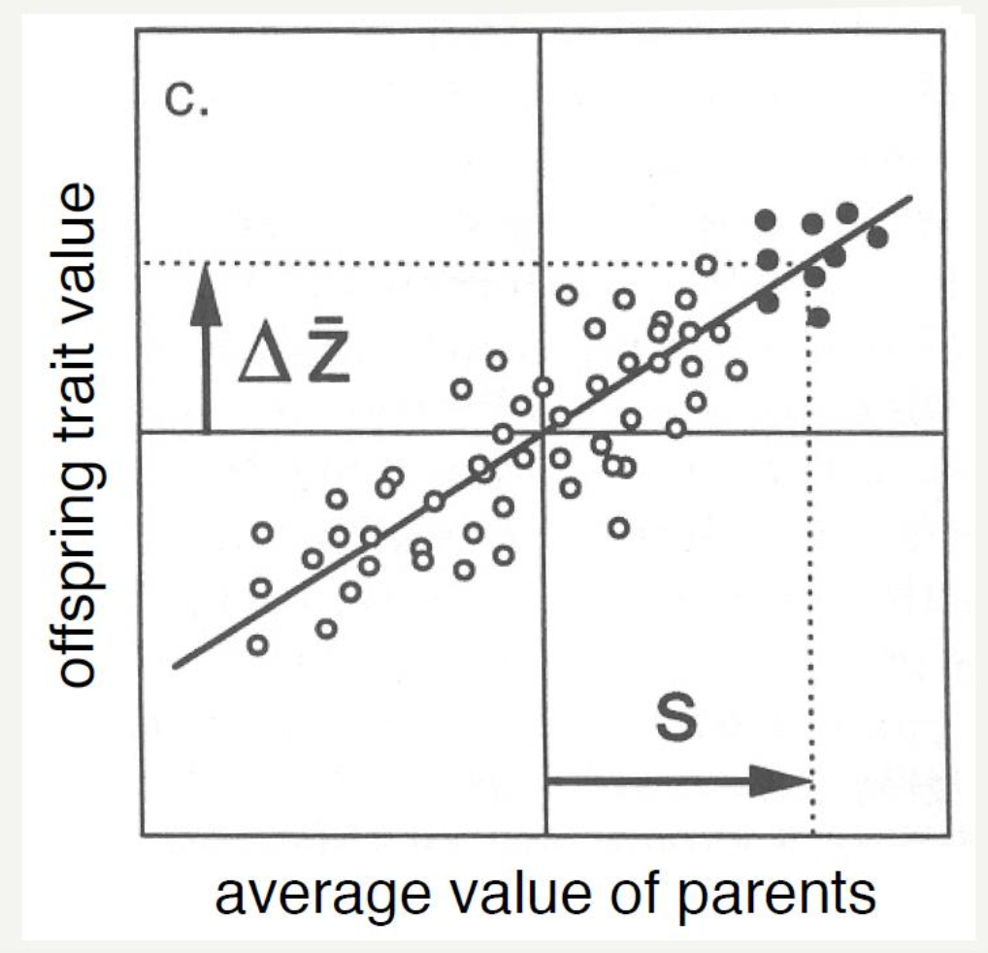
R

