Slide 1
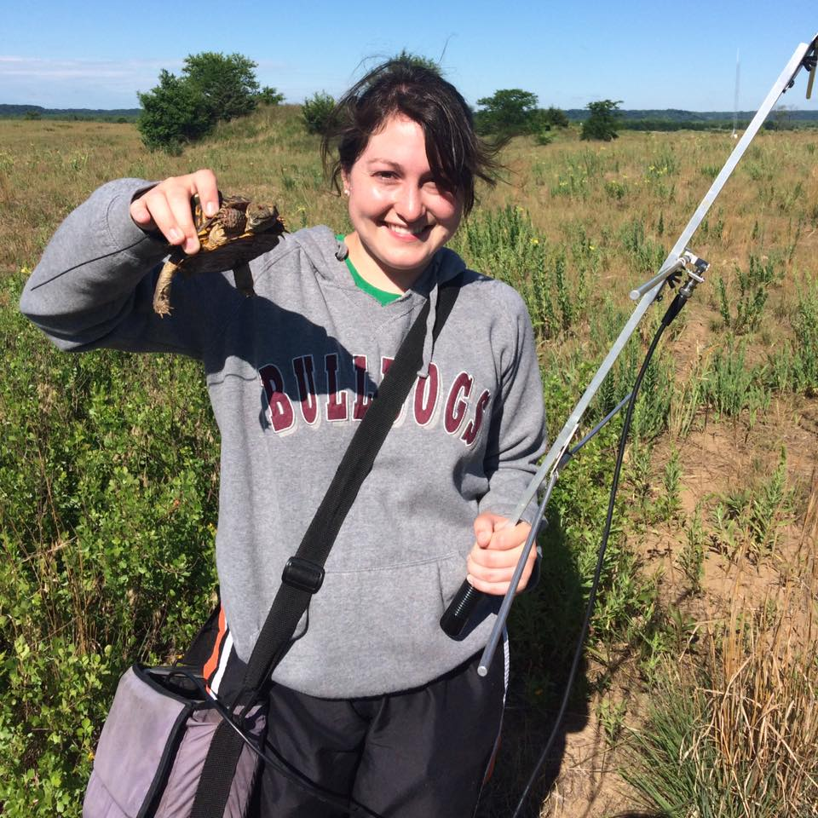
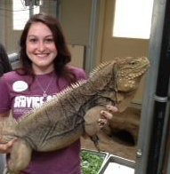
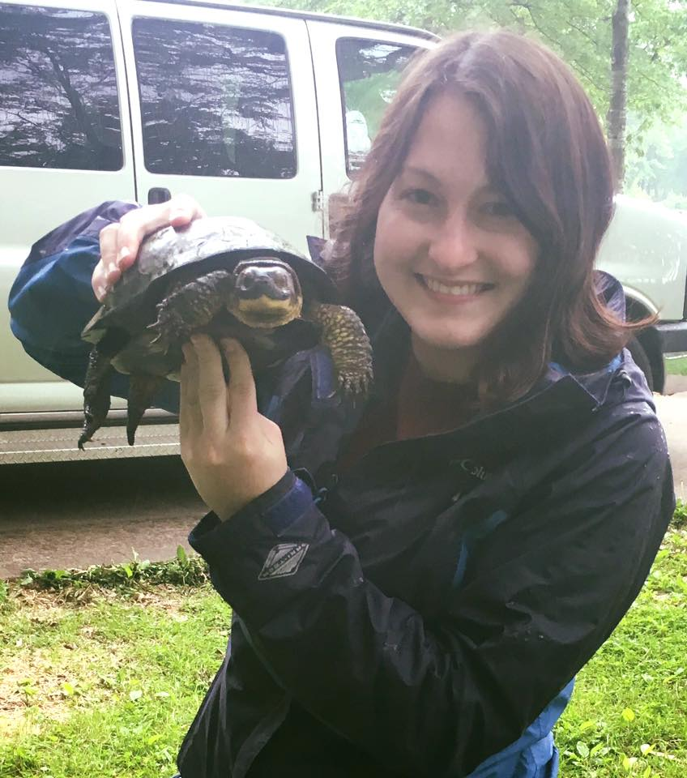
Introduction: Jessica Judson
From Fort Worth, TX
Master’s Degree: Mississippi State University
Population genetics of the Lesser Antillean Iguana
PhD Candidate
Dr. Fredric Janzen
Population genomics, local adaptation, mating strategies of the Painted Turtle and the Chicken Turtle
I will be available by appointment
Send me an email: jjudson@iastate.edu
353C Bessey Hall

Slide 2
Tools for the Course
Laptop (Your own or a provided laptop)
Communication: Slack
File Sharing: GitHub
Programming Language: R and R Studio

Slide 3

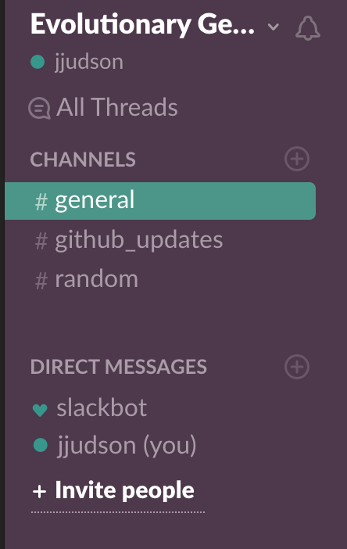
https://isuevogen462.slack.com
Messaging, chat, and file sharing device
Can set up notifications to your desktop
Create your account with your ISU email; use this link to access the Slack page: https://join.slack.com/t/isuevogen462/shared_invite/MjI5NTgyNjIyNDY2LTE1MDMzNDA0NDUtMjhkODcyNDdkNg

Slide 4

Great tool for sharing files
Has neat features for collaborative work
Avoids merge conflicts
Split up large projects
Does not have a GUI (graphical interface)
Must learn some coding!

Slide 5
Download Git
GitHub: can make an account if you’d like; you don’t have to if you just want to clone a repository
Mac: https://git-scm.com/downloads
PC: https://git-for-windows.github.io/
https://www.linode.com/docs/development/version-control/how-to-install-git-on-mac-and-windows/#installing-git

Slide 6
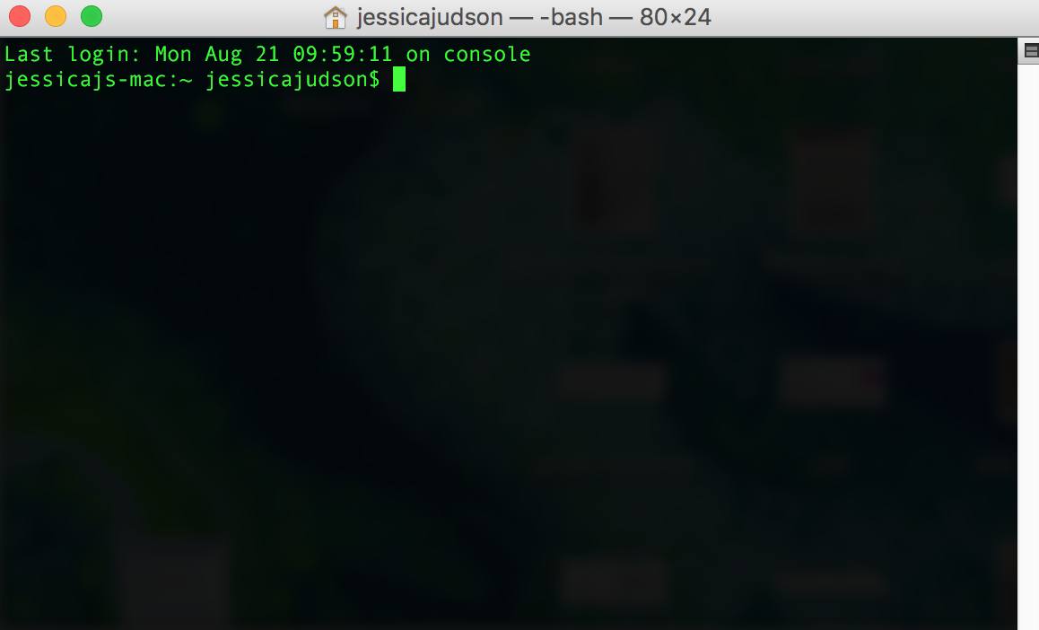
Terminal
An interface in which you can type and execute text based commands
Why use it?

Slide 7
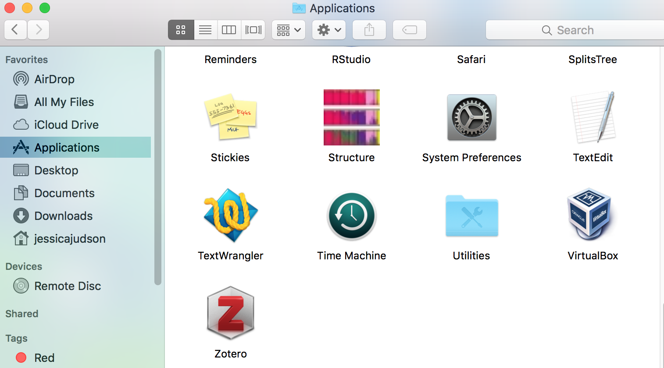
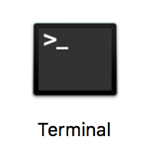
Navigating the Terminal
Mac users:

Slide 8

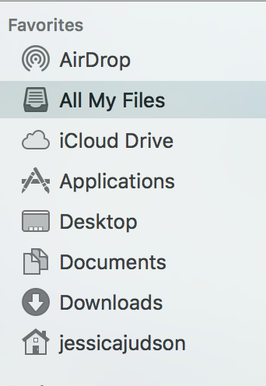
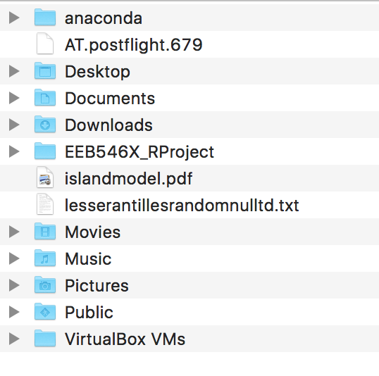
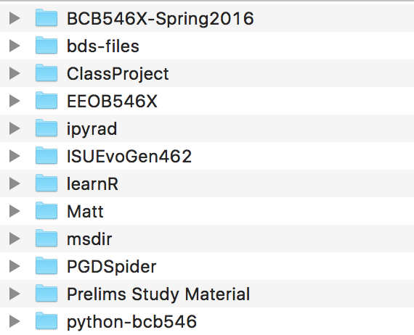
Navigating the Terminal
Windows Users:
Open the terminal in Git Bash (if you checked the box for desktop icon during set-up, should show up on your desktop)

Slide 9


Navigating the Terminal
Moving around your computer in Unix; the Basics
Change directories: cd DirectoryName/
Go back a directory: cd ..
Go back to the home directory: cd
Helpful tip: when entering directories, can use tab to automatically fill in the directory name once you have entered a few letters

Slide 10

More Terminal Fun!
Up arrow: scrolls through previous commands you have used
Printing current directory: tells you where you are at in your computer
See contents of directory

Slide 11
https://github.com/jjudson28/ISUEvoGen462
Always read the README documents
Explains what is in each folder
https://help.github.com/articles/cloning-a-repository/

Slide 12
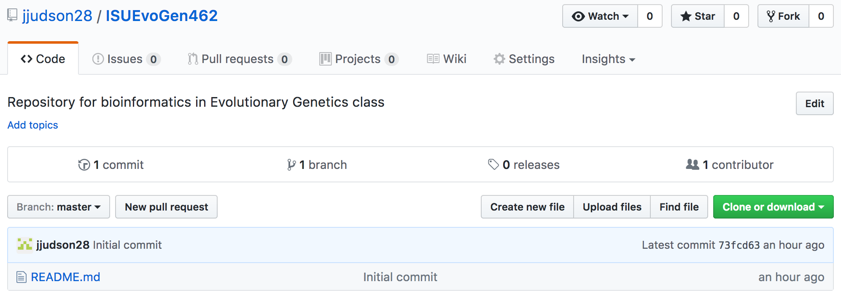
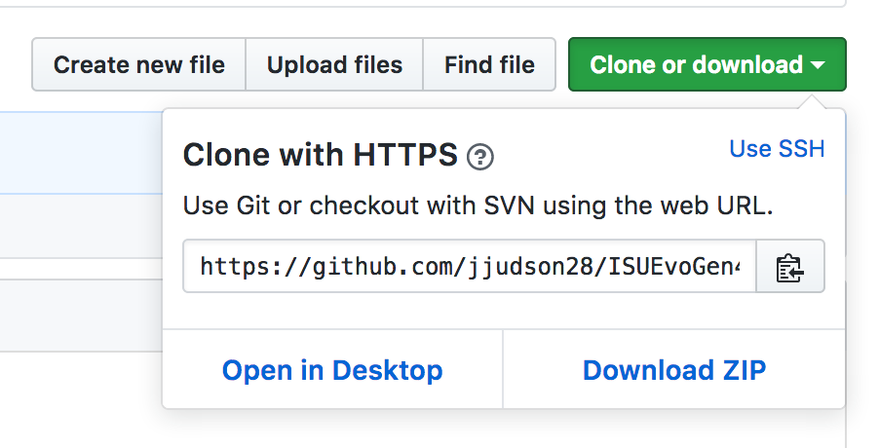
Cloning the GitHub Repository on your Computer

Slide 13
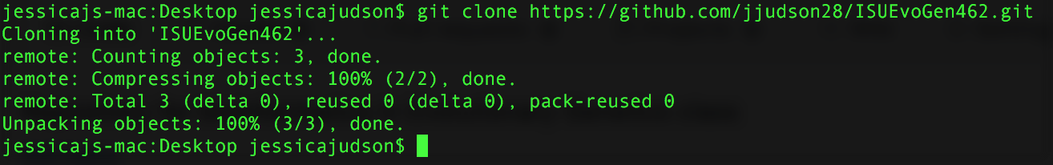
Cloning the GitHub Repository on your Computer
Open either Terminal (Mac) or Git Bash (Windows)
Navigate to where you want to put the folder containing the repository; ex:
Type git clone; ex:
Then paste the url you copied earlier and press enter

Slide 14
Possible Error Mac
Mac error: invalid active developer path
xcode-select --install

Slide 15
Getting Materials from GitHub
Move into the ISUEvoGen462 Folder
cd ISUEvoGen462/
Type ls to list the folder’s contents
To update your repository to be consistent with what is online, type git pull and then press enter
DO THIS BEFORE EVERY CLASS

Slide 16

R and R Studio
Download R
https://www.r-project.org/
CRAN mirror is Iowa State University
Download R Studio
https://www.rstudio.com/products/rstudio/download/#download
Discuss basics of R Studio: Open R Studio
Open file in Example Data called Basics_of_R.Rmd

