Slide 1
Post-Verkko!
Juhyun Kim
Postdoc, Phillippy group, NHGRI, NIH
Dec, 12, 2024

Slide 2
Introduction

Slide 3
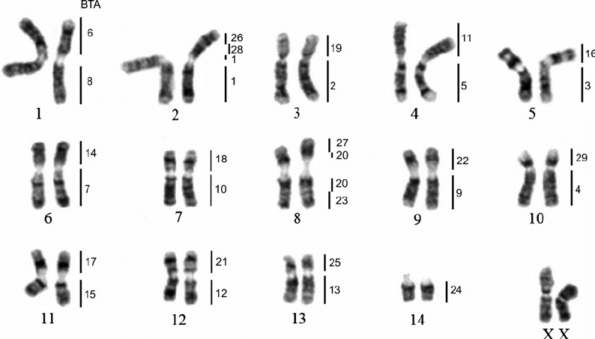
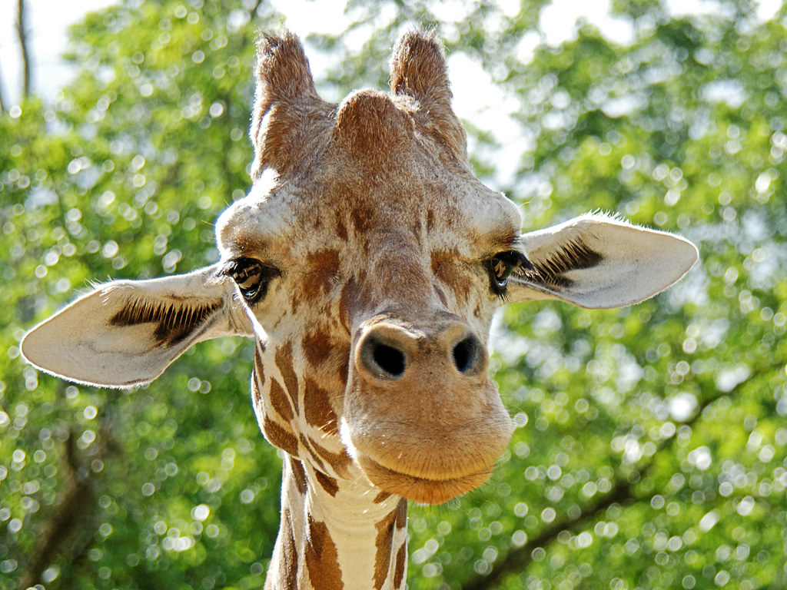
Giraffe genome

Slide 4
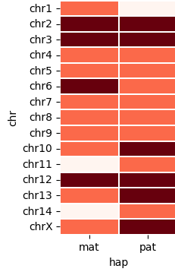
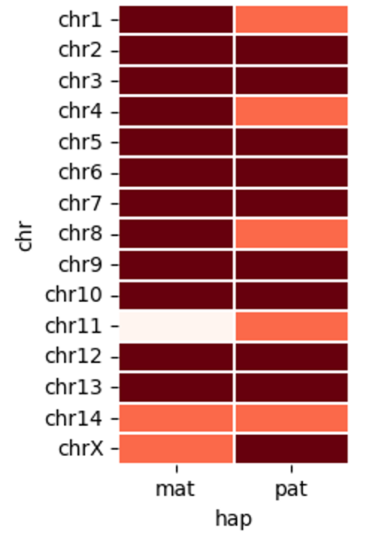
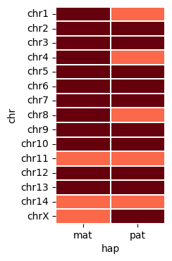
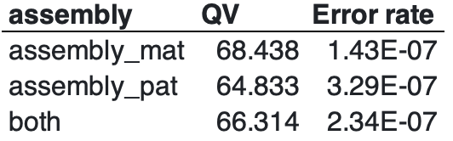
Improvement of Giraffe genome
Trio-hic mode
verkko-thic
gapfilling
trimming
Contig (T2T no gap)
Scaffold (T2T with gap)
Not T2T

Slide 5
Workflow

Slide 6
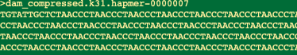

Verkko output directory
.
├── 1-buildGraph/
├── 2-processGraph/
├── 3-align/
└── split/ont*.fasta.gz
├── 3-alignTips/
├── 4-processONT/
├── 5-untip/
├── 6-layoutContigs/
├── 7-consensus/
├── 8-hicPipeline/
├── assembly.fasta
├── assembly.scfmap
├── assembly.paths.tsv
├── assembly.colors.csv
├── assembly.homopolymer-compressed.noseq.gfa
└── assembly.homopolymer-compressed.gfa
ONT reads used in verkko
Fasta file
Name converter
Gap Extraction
Reference for ONT aligning

Slide 7
Workflow
Let Verkko-CNS determine which complete paths should be used during consensus building to achieve a gap-free T2T assembly.
Verkko run
Cleaning
Polishing
v0.1.0
Chromosome assignment
Running Verkko-cns with filled paths
Quality check
v0.2.0
Gap/bubble/tangle check from paths
Trimming
Aligning ONT reads on the asm graph
Gap filling using the ONT alignment -> filled paths
v0.2.1

Slide 8
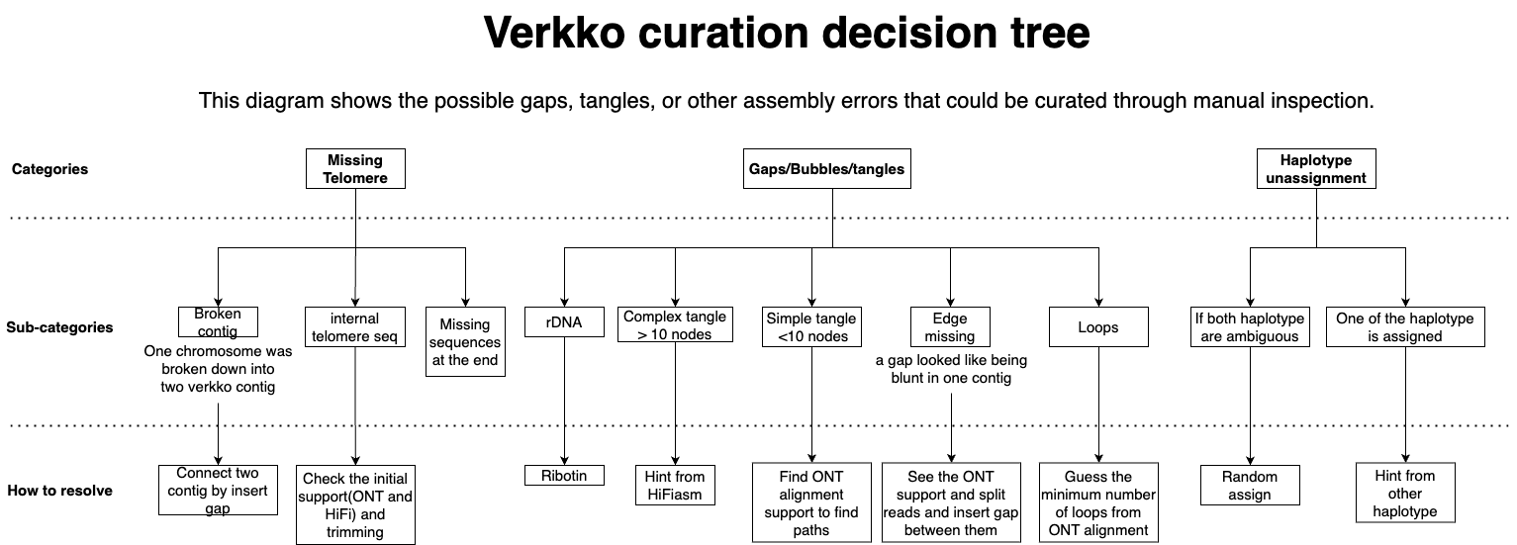
Categories of gaps, bubbles and tangles.

Slide 9
Missing telomeres
chr1
Ref
Chr1 pat
T
Contig1(chr1)
T
Contig2(chr1)
Verkko contig
T
Contig1(chr1)
T
(no chr)
Additional sequences(seq bias)
Verkko contig
T
T

Slide 10
Missing telomeres
Assigned to the same chr
chr1
Ref
Chr1 pat
T
T
Contig1(chr1)
New gap
Contig2(chr1)
Small frag aligned to another haplotype.
chr1
New gap
mat
T
T
chr1
pat
T
T
Additional sequences(seq bias)
Verkko contig
T
T
Trimming
This small nodes aligned on the same chromosome from another haplotype

Slide 11
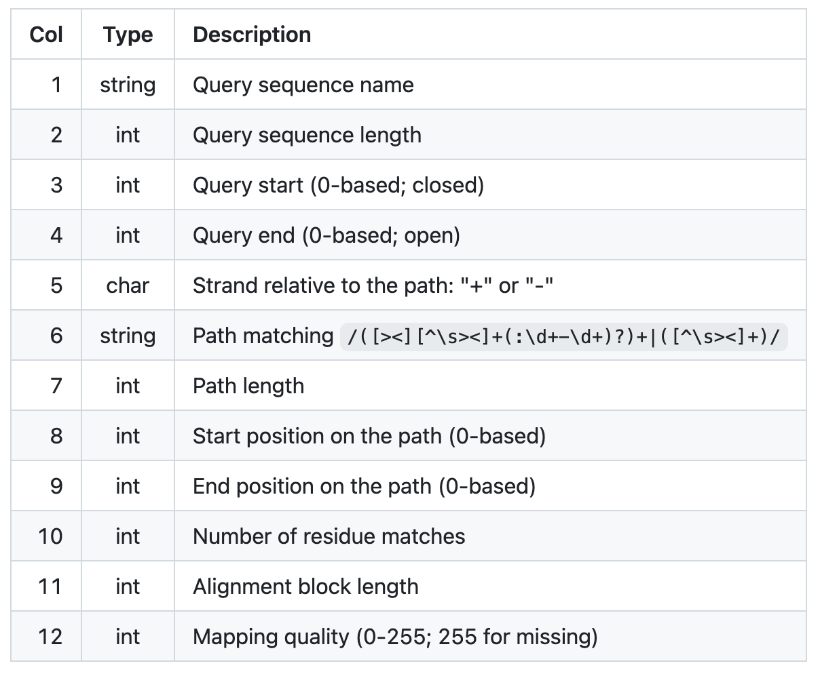
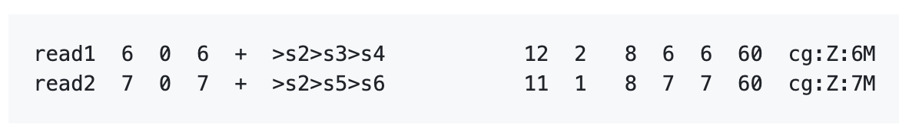
ONT alignment on verkko graph
Align ONT reads under split dir to the assembly.homopolymer-compressed.gfa -> GAF
This step will be included in Verkko in near future

Slide 12
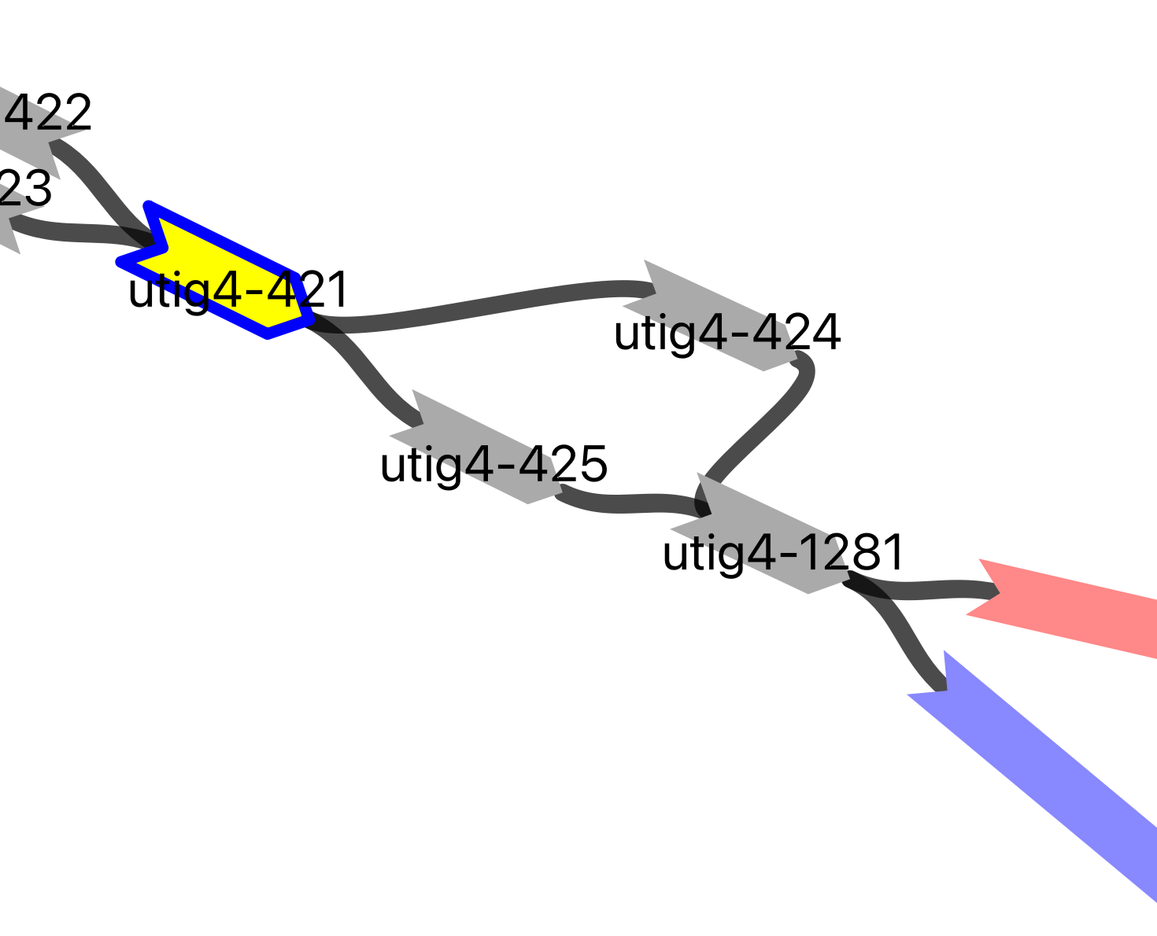

Gap filling
Gap (in path file) :
[utig4-424+, [N5000N:ambig_path], utig4-1283+]
ONT support (in ONT alignment GAF file) :
Utig4-1282
Utig4-1283
Gap filled :
[utig4-424+, utig4-1281+, utig4-1283+]
* You could align HiFiasm assembly to guess paths as well.

Slide 13
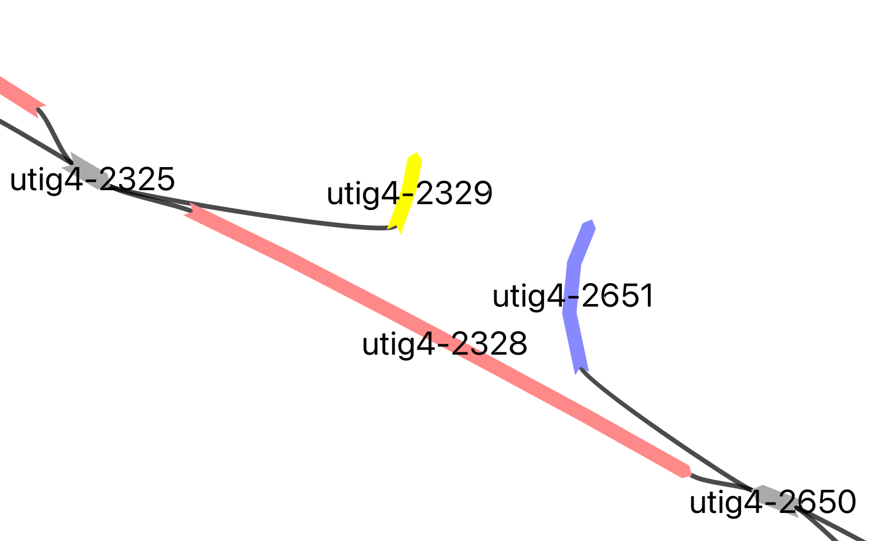
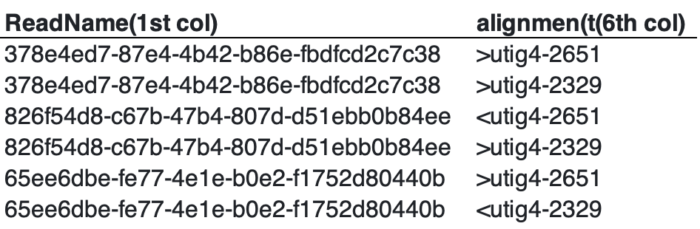
Missing edges
ONT read
Split alignment
> 50kbp
> 50kbp
New node and edges
Gap (in path file) :
[utig4-2329+, [N495830N:alt-utig4-2328], utig4-2651-]
Gap filled :
[utig4-2329+,gapmanual-1-len--4492-cov-2+,utig4-2651-]

Slide 14
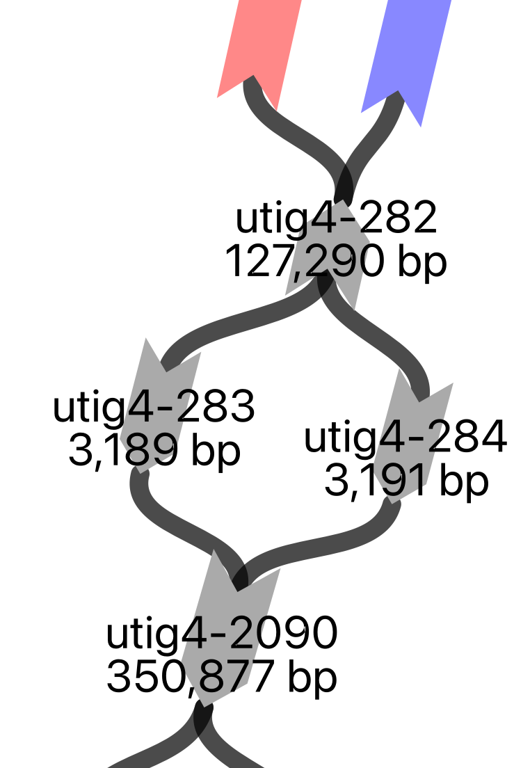
Haplotype unassignment
large homologous nodes flank the heterozygous nodes but lack trio markers.
Hint from other haplotype path.
Mat : utig4-282-,utig4-283+,utig4-2090+
pat : utig4-282-, [N5000N:ambig_path], utig4-2090+
Gap (in path file) :
[utig4-282-, [N5000N:ambig_path], utig4-2090+]
Gap filled :
["utig4-282-, utig4-284+, utig4-2090+"]

Slide 15
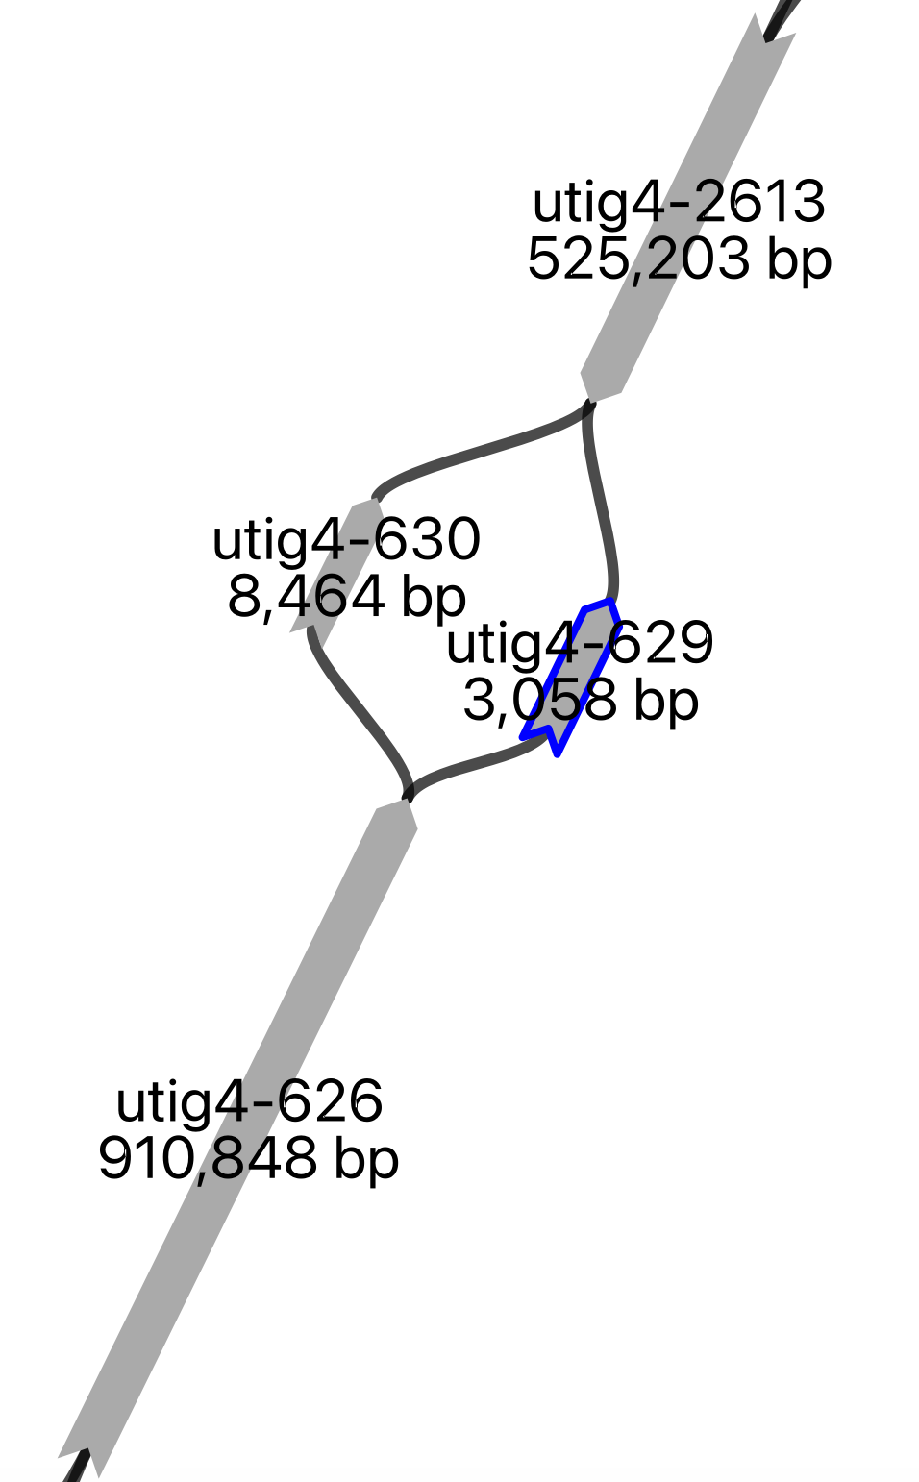
Haplotype unassignment
large homologous nodes flank the heterozygous nodes but lack trio markers.
NO Hint from other haplotype path.
Mat : utig4-2613+,[N1000N:ambig_bubble],utig4-626-
pat : utig4-2613+,[N1000N:ambig_bubble],utig4-626-
Randomly assigning haplotype to each node.
Gap filled for mat:
[utig4-2613+, utig4-630-, utig4-626-]
Gap filled for pat:
[utig4-2613+, utig4-629-, utig4-626-]

Slide 16
Run Verkko consensus
Filled path file(GAF)
Gap filled :
[utig4-100+, [N5000N:loop_uncertain_copy],utig4-2421+,utig4-2421+,utig4-2421+,[N5000N:loop_uncertain_copy]]
<utig4-1913<utig4-1911<utig4-1693>utig4-1692>utig4-1695<utig4-2162>utig4-2164<utig4-2562<utig4-2435
Ready for polishing
Assembly.fasta
Assembly.fasta
Verkko cns
CTCGCTGTGAGTGCGTTTAGGGGAGTCAGTCAGCATGCGCTGTGCACGTGTATGCTAGCGG
TTAGGGGAGTCAGTCAGCATGCGCTGTGCACGTGTATGCTAGCTCACACGCTAGCTCACAC
trimming

Slide 17
Verkko-fillet

Slide 18
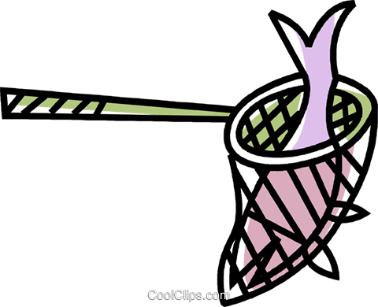
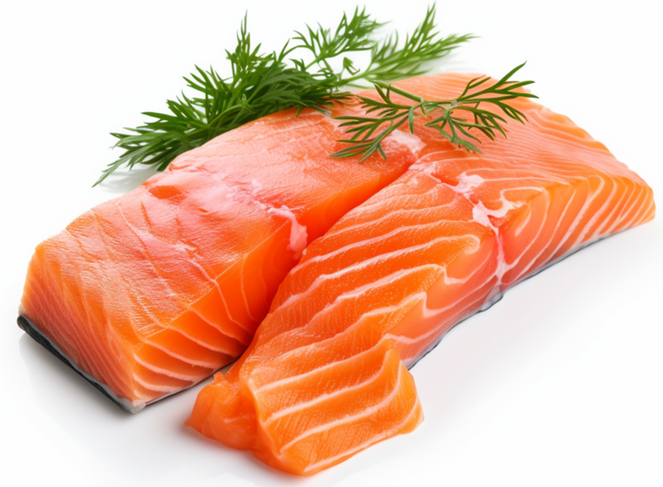
Verkko-fillet
Under development!
Verkko(Finnish)
mesh, net, web, network
fishnet, a net used to catch fish
Verkko-Fillet!
remove the bones from a fish.
➔ cleaning verkko assembly

Slide 19
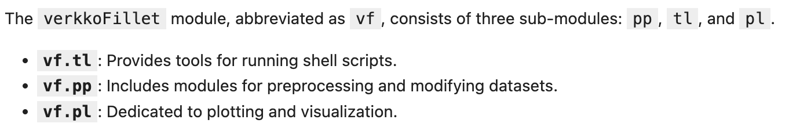
Verkko-fillet pkg
Easy-to-use toolkit for cleaning Verkko.
Python pkg
Includes generating verkko obj, QC, identifying gaps, assigning chromosomes, searching ONT reads to help resolve gaps, filling gaps, and generating the final rukki paths.

Slide 20
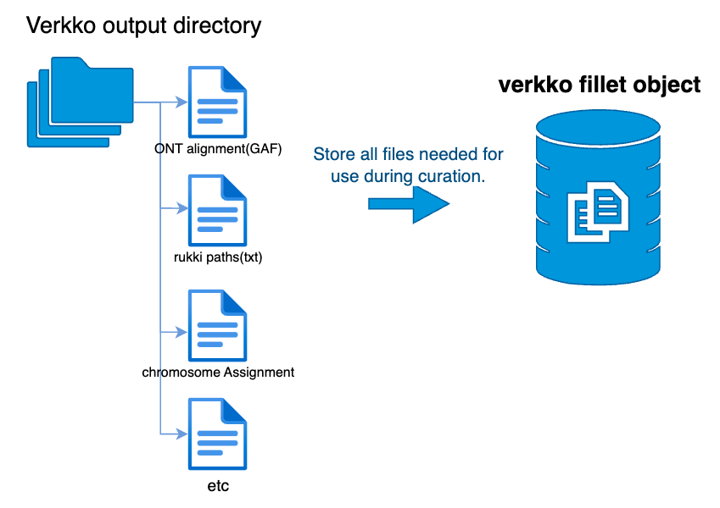
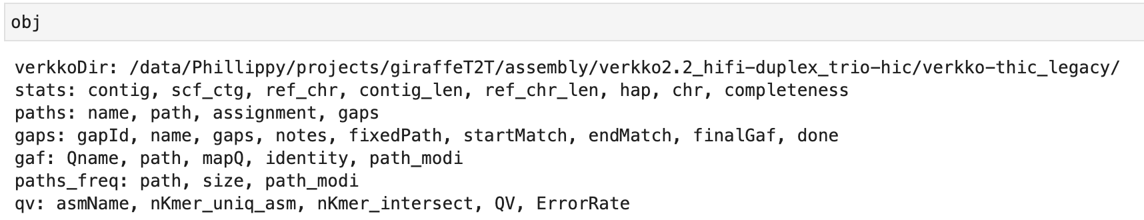
Verkko-fillet object

Slide 21
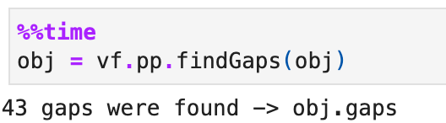
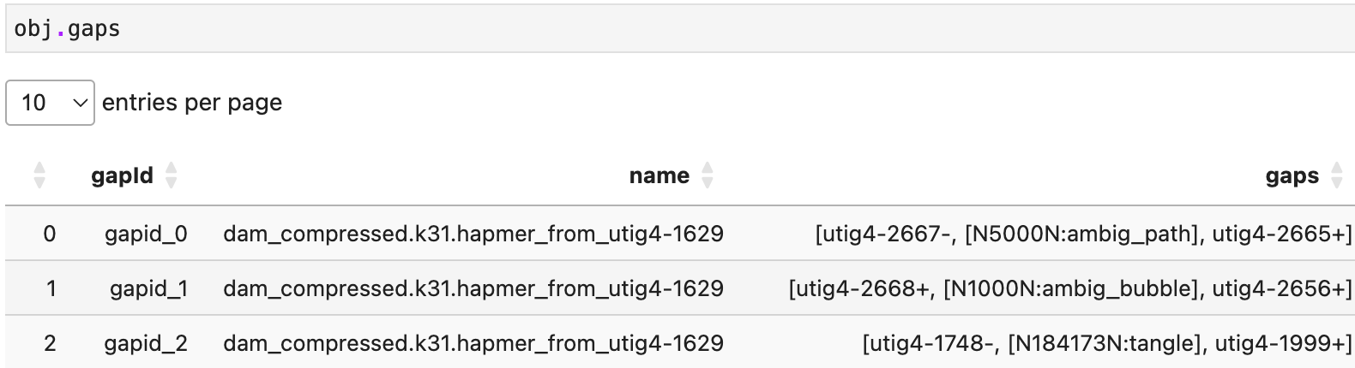
Main Functions

Slide 22
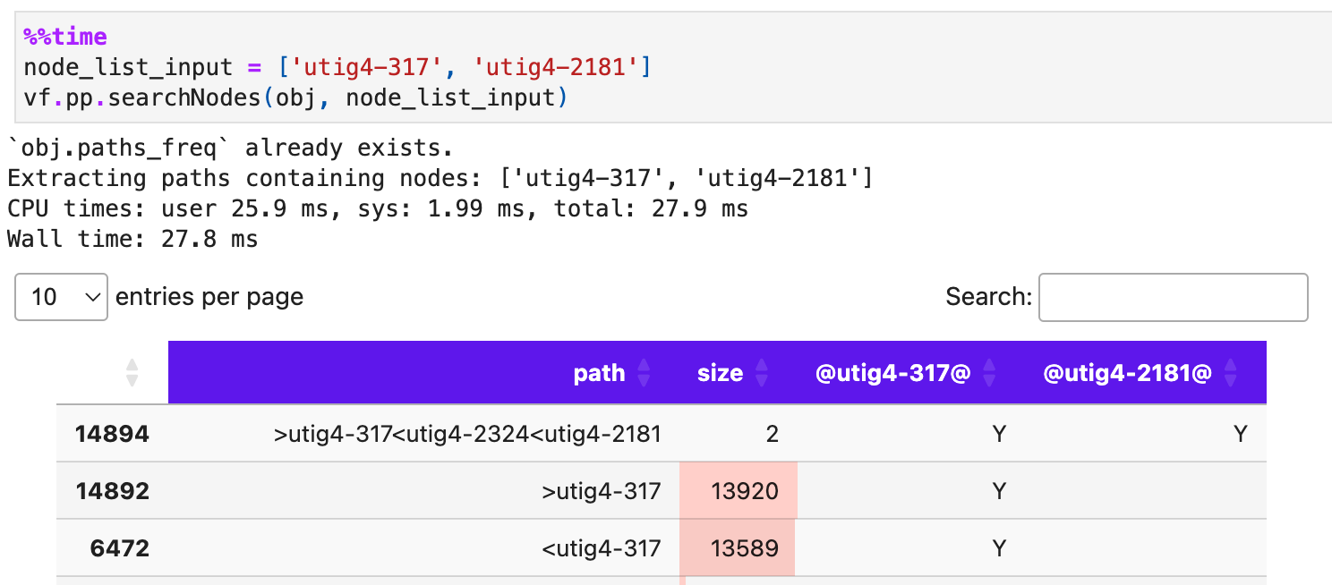
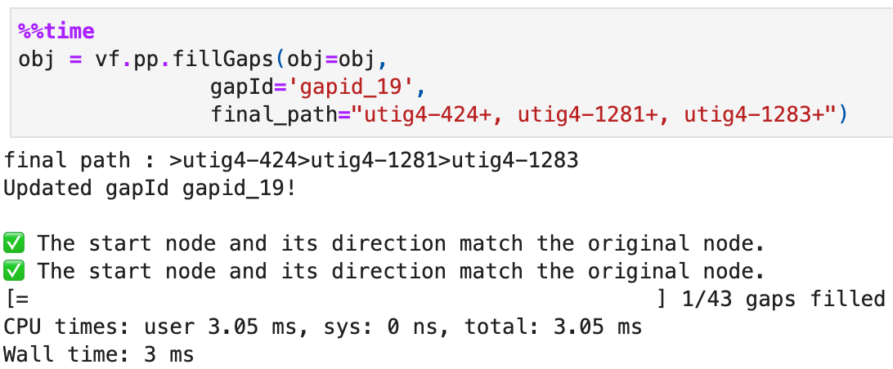
Main Functions

Slide 23
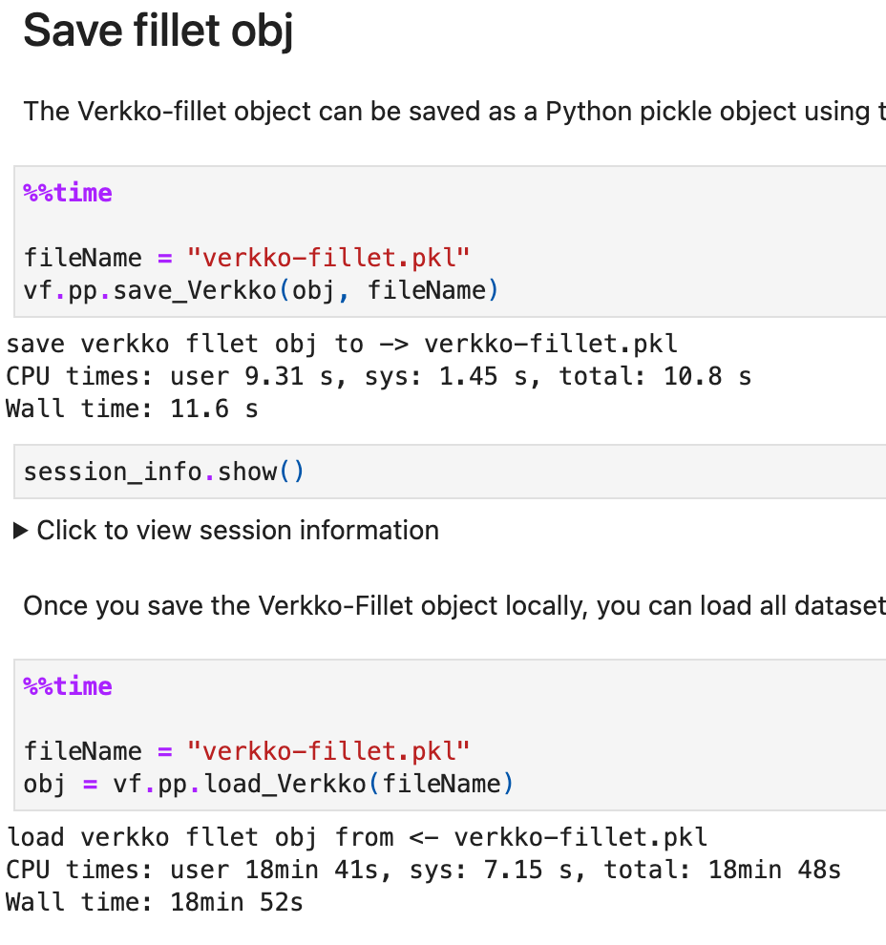
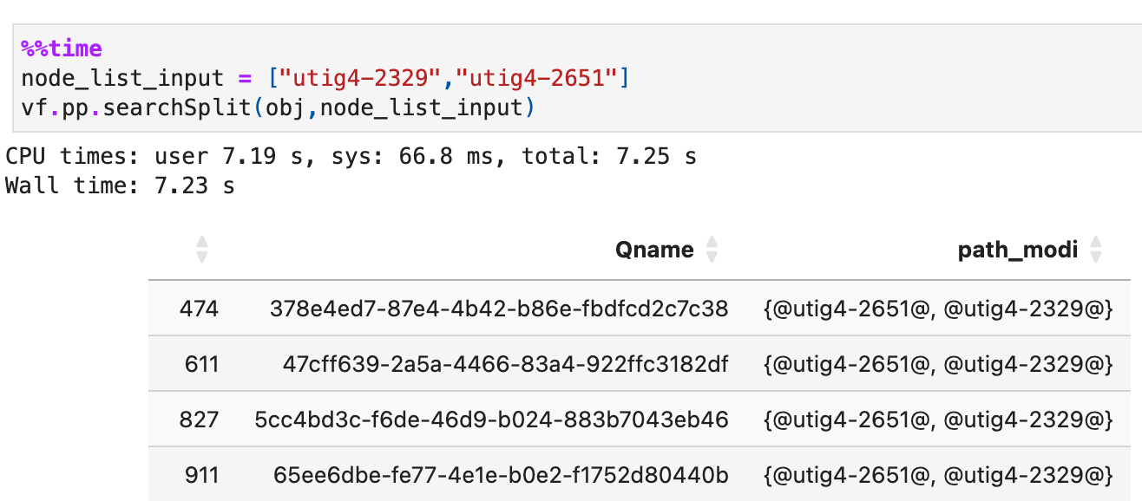
Main Functions
Find Split reads

