Slide 1


Verkko-fillet
post-verkko process toolkit
Easy-to-use toolkit for cleaning Verkko assemblies.
Assign chromosomes, trim, flip, rename, and sort with ease.
Validate with QV checks and quality control metrics.
Visualize stats and progress.
Resolve gaps and tangles.
Under development
Juhyun Kim
Arang Rhie
Sergey Koren
Adam Phillippy
Will be released soon!
“Make your own fillet”
Notes:
Slide for advertising

Slide 2
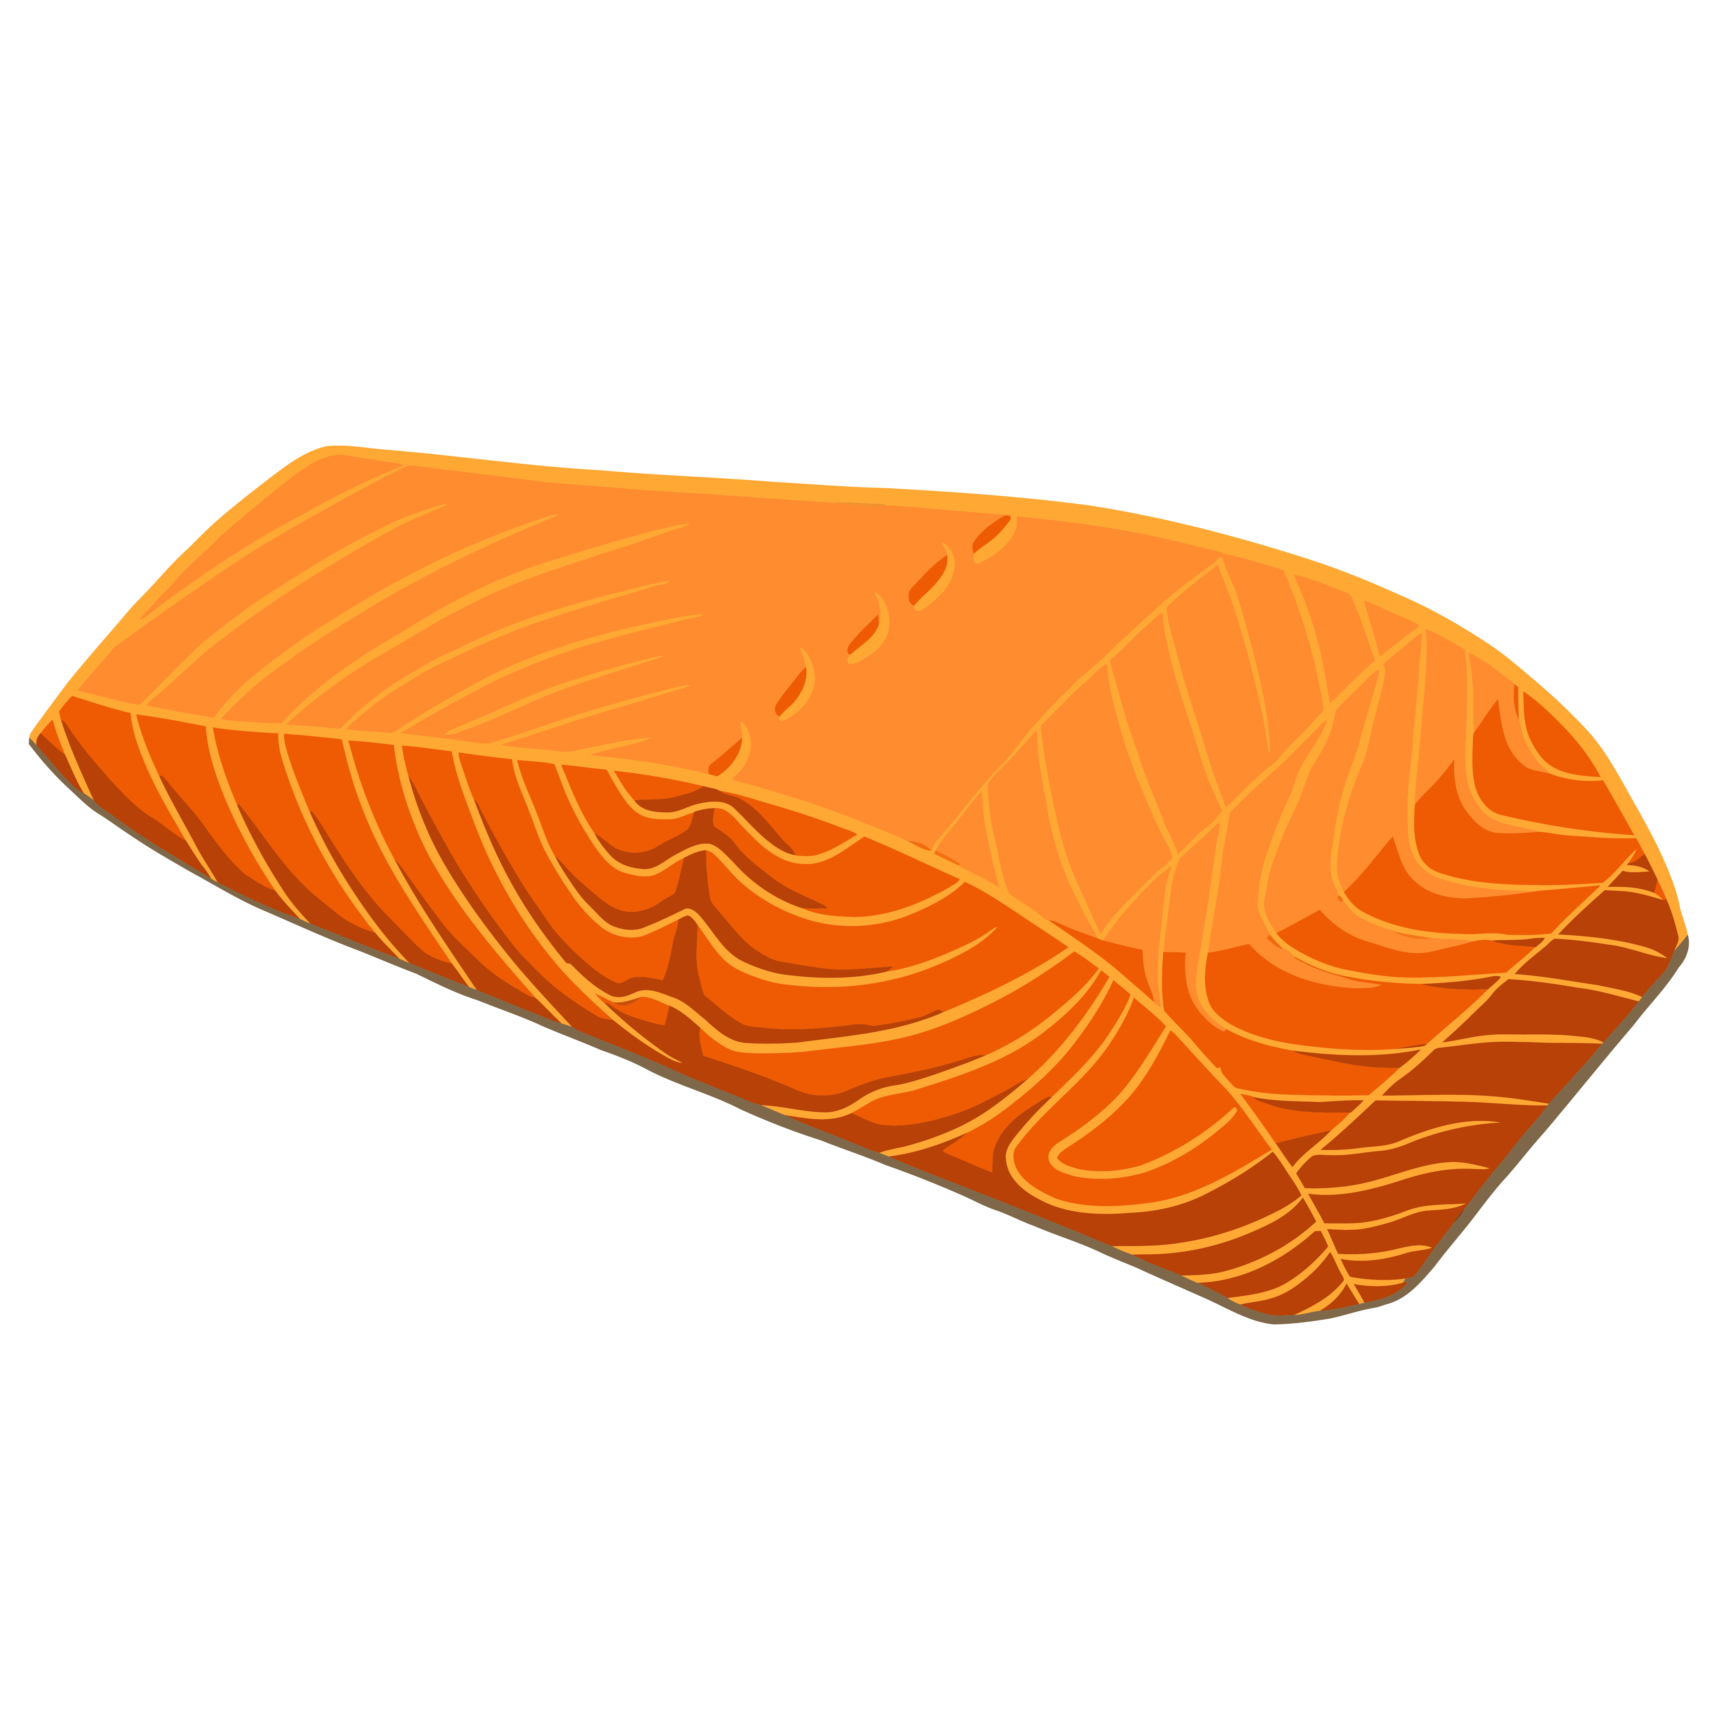
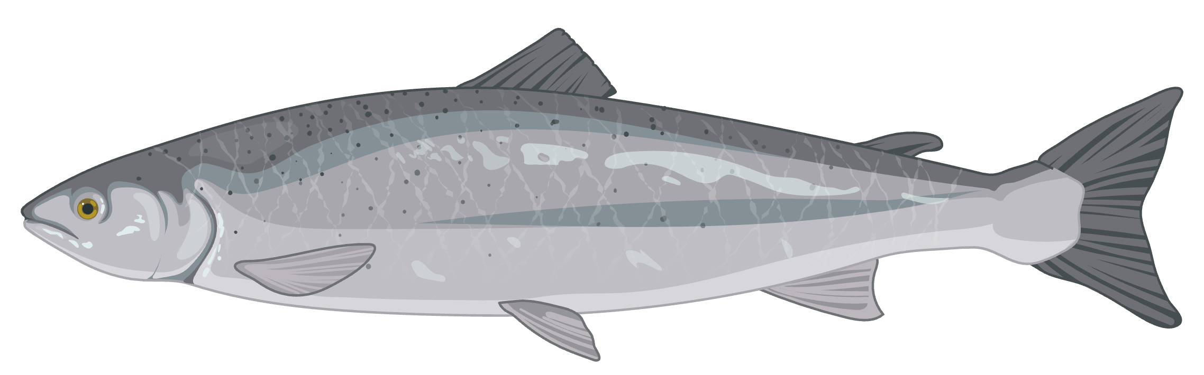
Verkko-fillet

