Slide 1
Data Visualization and Communication
Julia El Masri

Slide 2
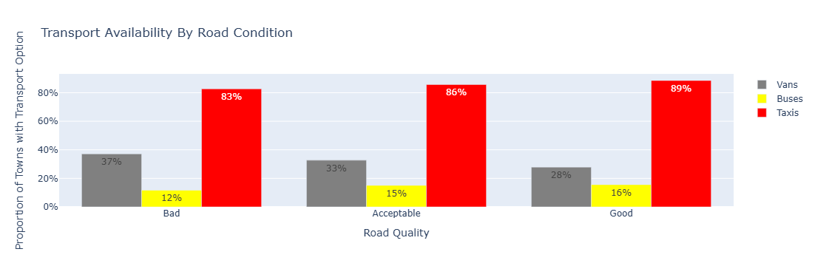
Main insight- transport by vans increase in bad road quality as opposed to buses and taxis.
Chart type usage- Bar chart was used to group and compare the availability of transport, making it easier understand grouped data.

Slide 3

Main insight- there are very few good quality roads in all three types of roads.
Chart type usage- spider plot allows us to compare the roads in a fluid way as they are more complex, since all types of roads contain 3 main qualities.

Slide 4
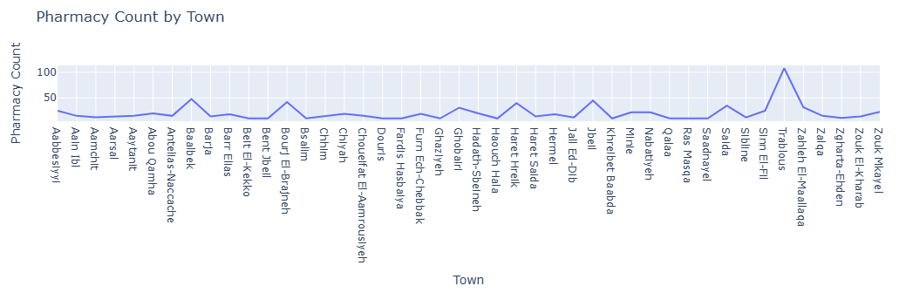
Main insight- pharmacy count increases with size of towns
Chart type usage- line plot allows us to visualize the distribution of huge amounts of unsorted data with ease, without being too overwhelming.

Slide 5
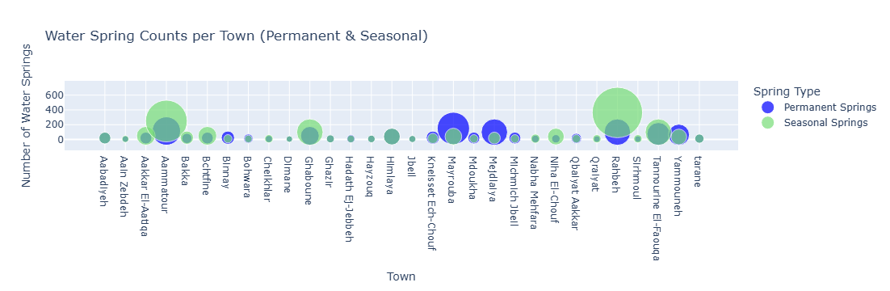
Main insight- there are few towns without reliable freshwater sources (permanent springs), making townsfolk depend on purchasing water.
Chart type usage- scatter plot showing the distribution of spring types across towns, where circle size represents number of springs available, showing a better relationship with freshwater availability

Slide 6
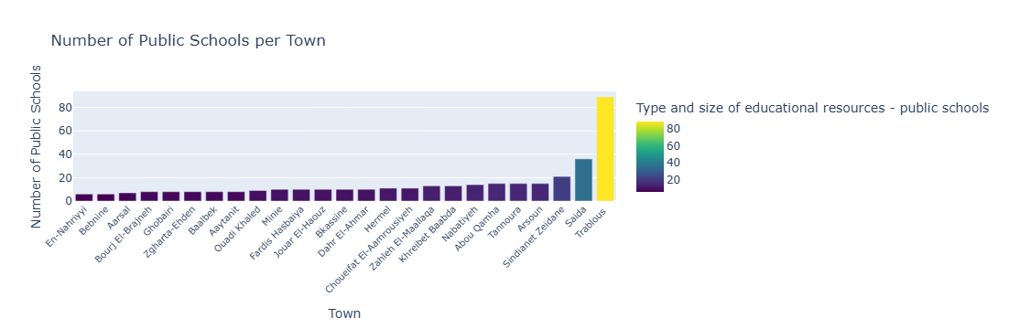
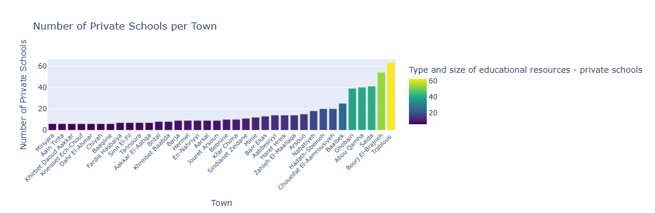
Main insight- There are more private schools than public.
Chart type usage- sorted bar graph allows comparison of the same variable in a sorted manner.

