Slide 1
Quicksort vs Mergesort
Csc 510 Dr. Rahul Singh Spring 2019
Created by: Jonathan Julian

Slide 2
The Problem
Assist in the accurate and timely sorting of Credit Card Transactions.
Simplify the sorting process for transactions.

Slide 3
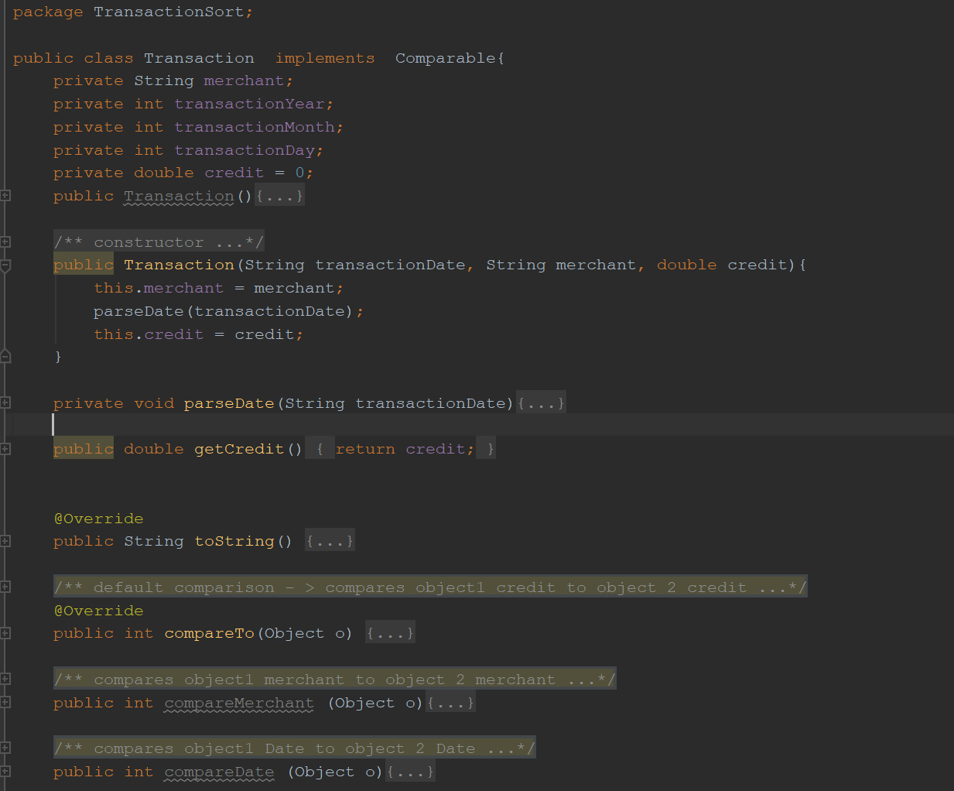
TransactionSorter & Separator classes
TransactionSorter
Main method
TA(String) -> separator
Run() ->
TAManager = Separator.load()
UI
Separator
Sep(String)
TAManager <- Load()

Slide 4
TransactionManager
Manages ArrayList of Transaction Objects & calls sorts
CallQuickSort()
CallMergeSort()
Starts timer
Checks for pivot type
Enters QuickSort()
Ends timer
Prints result
Starts timer
Enters QuickSort()
Ends timer
Prints result

Slide 5
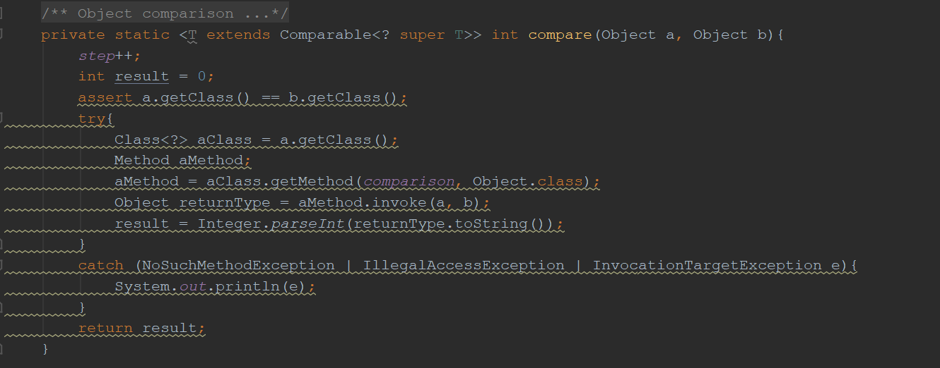
MergeSort()
MergeSort(T[], Comparison)
MergeSort(T[], first, last)
MergeSort(T[], T[], first, last)
Merge(T[],T[], first, mid, last)
Mid = half 1 end
Mid + 1= half 2 begin
Compare(Obj, Obj)
Done by reflection

Slide 6
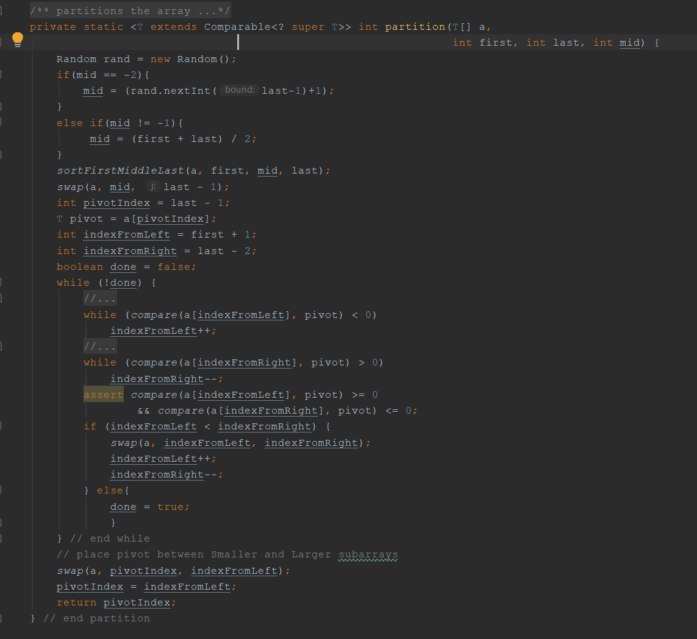
QuickSort()
QuickSort(T[], comparison)
QuickSort(T[], comparison, pivot)
QuickSort(T[] first, last)
QuickSort(T[], first, last, pivot)
Partition(T[], first, last, mid)
SortFirstMidLast()
Used to order to minimize movements
Order(T[], first, mid, last)
Swap()
Compare(obj, obj)

Slide 7
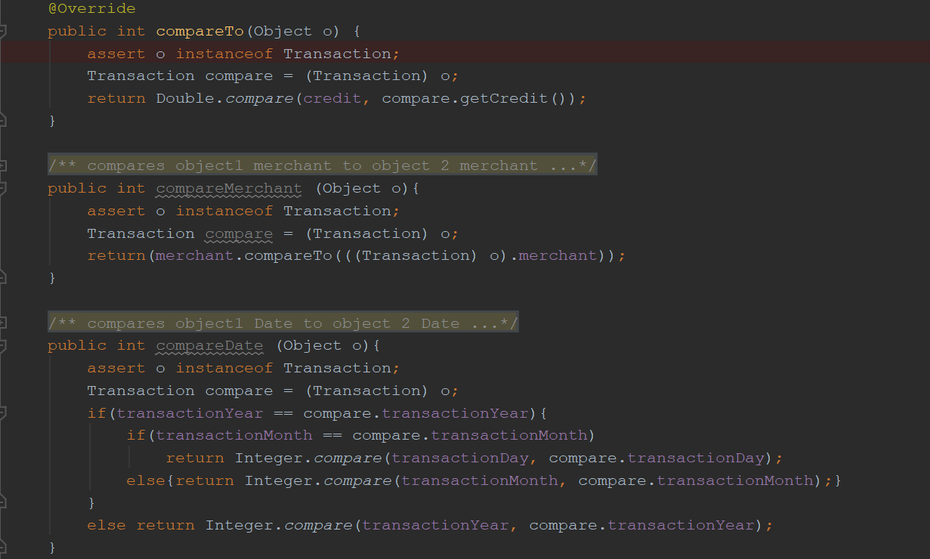
Transaction
Contains data and comparisons
Merchant: String
TransactionYear: int
TransactionMonth: int
TransactionDay: int
Credit
ParseDate
Separates date into 3 items for sorting
Comparisons
Merchant
Date
Purchase

