Slide 1
Purpose of Architecture Governance
For reference
To provide strategic architectural direction by approving relevant frameworks, standards, and principles that will inform and guide investments.
Ensure digital investments / projects are in alignment with HC/PHAC and the GC digital and architectural direction.
Inform Solution Architecture at the beginning of the initiative to re-use / leverage existing architectures when possible.
Review / inform / endorse initiatives from an enterprise architecture perspective and facilitate presentations at the three architecture governance tables that oversee HC/PHAC architecture
DTB Architecture Review Board - Terms of Reference
Digital Architecture and Strategy for Health (DASH) – Terms of Reference
GoC Enterprise Architecture Review Board – Terms of Reference

Slide 2

Architecture Governance Process
For reference
EARLY ENGAGEMENT
Budget Proposal & M.C.
SOLUTION ALIGNMENT
Solution Architecture
PROJECT AUTHORITY
TB Sub (TB)
ASSURANCE
Project Execution
The Solution Architecture Document is a living document. Any architecture modifications must be continually reflected.
Guidance Document.pdf
Concept Case
Identifies and defines strategic needs by the business
TB Submission
Project Oversight
HC/PHAC ARB GC EARB
Mandatory Procedure
Directive
OPMCA Requirements
Ongoing Project Monitoring
Ready for architecture governance?
BRM Engagement
Greater than $5M, non-standard tech, innovative tech, or OCIO requested. NOTE: Projects connected to a TB submission must visit this table at least 2 weeks prior to TB Sub being presented to cabinet.
4-5 weeks
If required
Initial visit (Gate 0) inputs
- Approved Concept Case
- Conceptual Business Model (CBM)
Digital Architecture
Strategy of Health
Do I need to go to GC EARB?
Architecture visit (GATE 2) inputs
-Option Analysis/Tech Assessment
-Solution Architect resourced
-Solution Architecture Document
2-3 weeks
If required
DG level and CIO endorsement of their architecture on the way to GC EARB table. Not all items that go to ARB will need to go to DASH, especially if they are fully aligned to existing approved architectures and patterns.
ARB Preparation with EA
1st Draft Review
2nd Draft Review
Final review with other teams(as needed)
HC/PHAC
Architecture Review Board
4 weeks
Do I need to go to DASH?
Notes:
Initial Draft Review with lead architect
Second Draft Review with EA team
Final review with EA and other teams as needed.
----
Why Gate 0?
Gate 0 architecture governance is required for projects to be aligned to the HC/PHAC architecture and the GC Enterprise Architecture Framework with the focus being on Business and Information Architecture. The GC Enterprise Architecture Framework is the criteria used by the Government of Canada and enterprise/departmental architecture review boards when reviewing digital initiatives to ensure their alignment with enterprise architectures across business, information, application, technology and security domains to support strategic outcomes. The Enterprise Architecture Framework provides details on the requirements set out in the Policy and Directive on Service and Digital where the Chief Information Officer (CIO) is responsible for prescribing expectations with regard to enterprise architecture.

Slide 3
GC Enterprise Architecture Framework Government of Canada Enterprise Architecture Framework - Canada.ca
For reference
The Enterprise Architecture Framework is the criteria used by the Government of Canada enterprise architecture review board and departmental architecture review boards when reviewing digital initiatives to ensure their alignment with enterprise architectures across business, information, application, technology and security domains to support strategic outcomes.
1
Business Architecture
Design services digitally from end‑to‑end to meet Government of Canada users and other stakeholders’ needs
Architect to be outcome‑driven and strategically aligned to the department and to the Government of Canada
Promote horizontal enablement of the enterprise
2
Collect data to address the needs of users and other stakeholders
Manage and reuse data strategically and responsibly
Use and share data openly in an ethical and secure manner
Design with privacy in mind for the collection, use and management of personal Information
Information Architecture
3
Application Architecture
Use open-source solutions hosted in public cloud
Use software as a service (SaaS) hosted in public cloud
Design for Interoperability
Important : This framework is guidance for departments. Above this, departments need to ensure that they maximize value and minimize risk by reusing architecture whenever possible. This allows us to ensure that we have the skills and capacity to procure, secure, and support a manageable set of modern architectures to meet program’s needs. Meeting these criteria is only part of the story.
4
Technology Architecture
Use cloud first
Design for performance, availability and scalability
Follow DevSecOps principles
5
Security Architecture
Build security into the system life cycle across all layers
Ensure secure access to systems and services
Maintain secure operations
Notes:
Published on Canada.ca
This is the target that initiatives are reviewed against
Key part of the GC EARB presentation template and EA summary slide.
Departments must demonstrated how they are achieving targets across all five layers.

Slide 4
Why Gate 0? Early Influence!
For reference
Refine the Business Problem
Policy on Service and Digital
Early conversations are important to ensure alignment on direction before solutions are determined
Ensures proactive consideration at the design stage of key requirements.
Establishes an enterprise-wide, integrated approach to governance, planning and management.
The Chief Information Officer (CIO) of Canada is responsible for chairing an enterprise architecture review board that is mandated to review departmental proposals for alignment.
Early Architectural Insights
The digital and architecture standards have been built into our governance and oversight processes
Directive on Service and Digital
The departmental Chief Information Officer (CIO) is responsible for:
Chairing a departmental architecture review board that is mandated to review and approve the architecture of all departmental digital initiatives and ensure their alignment with enterprise architectures.
Submitting to the GC EARB criteria-based proposals concerned with the design, development, installation and implementation of digital initiatives.
Broader Collaboration
Leverage knowledge, experience and existing information to uncover synergies that drive Enterprise level solutions
Policy on the Planning and Management of Investments
4.1.1.4 Ensuring that proposals to the GC Enterprise Architecture Review Board are submitted after review of concept cases for digital projects according to the “Mandatory Procedures for Concept Cases for Digital Projects” and before the development of a Treasury Board submission or departmental business case.
The business owner is responsible for:
Ensuring that the concept case is reviewed by the appropriate departmental investment oversight body.
Approving and submitting the concept case to the Treasury Board of Canada Secretariat for review.
_______________________________________________________________
Policy on Service and Digital- Canada.ca (tbs-sct.gc.ca)
Directive on Service and Digital- Canada.ca (tbs-sct.gc.ca)
Policy on the Planning and Management of Investments- Canada.ca (tbs-sct.gc.ca)

Slide 5
Template Guide
For reference
Slides | Gate 0 | Gate 0 | Gate 0 | Gate 2 | Gate 2 | Gate 2 | Completed by
 | ARB | DASH | GC EARB | ARB | DASH | GC EARB
Purpose of ARB/DASH/GC EARB Session | Y | Y | Y | Y | Y | Y | Program Lead / Project Manager
Request Background & Overview | Y | Y | Y | Y | Y | Y | Program Lead / Project Manager
Background & Overview - Organizational impact | Y | Y | Tbd | Y | Tbd | Tbd | Project Team
Background & Overview - Analysis Completed | Y |  | Tbd | Y | Tbd | Tbd | Project Team with TPO support
Conceptual Business Model | Y | Y |  | Y | Y |  | Enterprise Architect
Business Process/Information/Data Flow | Y | Y | Y | Y | Y | Y | Project Architect / Program Lead
Current State Architecture Problem Summary | Y | Y | Y | Y | Y | Y | Project Architect / Program Lead
Current State Architecture Diagram | Y | Y | Y | Y | Y | Y | Project Architect / Program Lead
Target State Architecture Diagram | Y** | Y** | Y** | Y | Y | Y | Project Architect / Program Lead
Target State Architecture Solution Summary | Y* | Y* | Y* | Y | Y | Y | Project Architect / Program Lead
Consultations | Y |  |  | Y |  |  | Project Team
Summary of architecture/solution options and evaluation results |  |  |  | Y | Y | Y | Project Architect / Program Lead
TCO, Funding, Procurement and FinOps Summary | Y |  | Y | Y |  | Y | Project Team
Information Architecture slides in Appendix | Y | Y | Y | Y | Y | Y | Project team with IM Advisor
Notes:
* Business and Information only
** Conceptual only
Y – Slide must be included in presentation

Slide 6
HC/PHAC Architecture Review Board (ARB) / Digital Architecture & Strategy for Health (DASH) / Government of Canada Enterprise Architecture Review Board (GC EARB)
Presenter Template
ARB, DASH, GC EARB
Gate 0, Gate 2
(Department / Branch / Program) – (Initiative Name)
(Date)
Presenter(s):
Business Lead: Email:
Program Sponsor Name: Email:
Architect Name: Email:
Based on GC EARB Template Version Date: 2024-03-07
Notes:
This slide should be included for ARB, DASH, and GC EARB.
This slide should be completed by the program lead / project manager.
Slide Instructions:
On this slide and the others, template instructions are provided in the Notes pane. These can be deleted once the template is completed by the department or replaced by notes specific to the initiative as needed.
Title should list only the architecture governance table (ARB, DASH, or GC EARB) you are currently visiting.
In the title, replace the word “Department” with the name of the presenting department or agency.
Replace the text “Initiative Name” with the official name of the digital initiative/project whose architecture is the subject of the presentation. The corresponding acronym may also be included.
Replace “Date” with the date of the architecture governance session at which this item is scheduled to be presented, as provided by the GC Enterprise Architecture team.
In the “Presenter” box at the bottom, provide the name of the Program Sponsor, followed by their Email address, and name and Email of the architect on the following line. Add extra lines and identifying information for any other presenters.

Slide 7
Purpose of ARB/DASH/GC EARB Session
ARB, DASH, GC EARB
Gate 0, Gate 2
The purpose of this presentation is to seek (initial/follow-up/final) endorsement of the (conceptual/interim/target) architecture for the (department/branch/program name) – (digital initiative name) solution.
(Please indicate if this is “in support of an upcoming TB Submission.”)
(Please indicate the specific project name and number as well as it’s gating status)
If for follow-up:
Past ARB/GC EARB date:
Condition(s):
Notes:
This slide should be included for ARB, DASH, and GC EARB.
This slide should be completed by the Program Lead / Project Manager.
Slide Instructions:
This is a boilerplate slide intended to be tweaked to fit the table you are currently visiting, and the type of endorsement you are requesting.
The title of this slide should be adjusted to reflect that table you are currently visiting ARB, DASH, or GC EARB.
This slide contains two text boxes, one above the other.
The text box at the top of this slide contains a generic boilerplate purpose statement that includes several parts in parenthesis that are intended to be adjusted by the department to fit the circumstances of their presentation.
The first parentheses contain three options – “initial” or “follow-up” or “final.” Keep the term that fits and delete the others and the parentheses.
Similarly, the second parentheses also contain three options – “conceptual” or “interim” or “target.” Keep the term that fits and delete the others and the parentheses.
The other sets of parentheses are for the department name and digital initiative name, usually the same what appears on the title slide.
The presenting department has the discretion to adjust the wording of this purpose statement. However, note that it is intended to anticipate the decision statement that will appear in the Record of Discussions for the meeting, and as such it should represent the scope of the initiative as accurately as possible.
There is another optional line at the bottom of the top text box with which the department may indicate if the proposal is in support of an upcoming TB submission, and the date if known, as this may be a dependency on the scheduling.
The text box at the bottom is optional to be used for items flagged as “follow-up.” There is a line for the date of previous architecture governance presentations, and another to spell out the conditions that were applied in the Record of Discussions for that past session. If it is not a follow-up item, this text box should be deleted.

Slide 8
Request – Background & Overview
ARB, DASH, GC EARB
Gate 0, Gate 2
Describe which departmental policies, programs and business services the presentation is addressing.
Include a summary of the business problem or opportunity statement as described in the Concept Case.
Summary of environmental scan findings related to the problem/opportunity.
Notes:
This slide should be included for ARB, DASH, and GC EARB.
This slide should be completed by the Program Lead / Project Manager.
Slide Instructions:
The content for this slide may be quite broad, the presentation should focus on information most directly related to the proposed initiative and target architecture.
If necessary extra slides may be used, but brevity is preferable due to the limited time available for each presentation during the architecture governance meetings.
More detailed background information can also be added in the annexes where relevant.
If a concept case has not been completed, refer to Appendix B: Mandatory Procedures for Concept Cases for Digitally Enabled Projects (Policy on the Planning and Management of Investments) for the related procedures and template at the following website:
https://www.tbs-sct.canada.ca/pol/doc-eng.aspx?id=32593
Questions to consider for the environmental scan may include:
Which crown institutions have you been discussing your problem with to identify potential reusable solution / component?
What other solution(s) available in the GC have you taken into consideration?

Slide 9
Background & Overview – Organization Impact
ARB & DASH
Gate 0 & Gate 2
Identify impact to the organization
Costs
Personnel
Infrastructure
Support and Operations
Information Management
Security
Governance
Ownership
Procurement
Service Delivery
What will be decommissioned, or technical debt incurred / addressed?
Where does this fit in the HC/PHAC Digital Strategy?
Provide enterprise lens - is this architecture reusable by others?
How will this be supported from an operational perspective?
Is there a Business / Product owner for application capabilities supported (if applicable)?
Notes:
This slide should be included for ARB and DASH.
To be completed by the project team.
Technical debt:
Technical debt is the business impact and costs related to past cost avoidance around IT systems and services. Tech debt is a metaphor and a storytelling device that can help explain the long-term consequences, costs, and risk introduced by prioritizing short-term cost avoidance over functionality, reliability, availability, and serviceability.
Link to Digital Strategy: Digital Strategy version 11.5 DTPO all staff.pptx

Slide 10
Background and Overview continued – Analysis Completed
ARB
Gate 0 & Gate 2
Briefly describe any analysis completed to date and sources of reference.
Identify HC/PHAC environment / perspective for context. What is being used and how prevalent to understand scope and impact. Include APM data.
Briefly describe any environmental scan completed, other Government Departments, Industry, Gartner, InfoTech, Market Scan…
Details if this is an exemption from a standard
Notes:
This slide should be included for ARB and DASH.
This slide could be completed by the Project Team with TPO support.

Slide 11
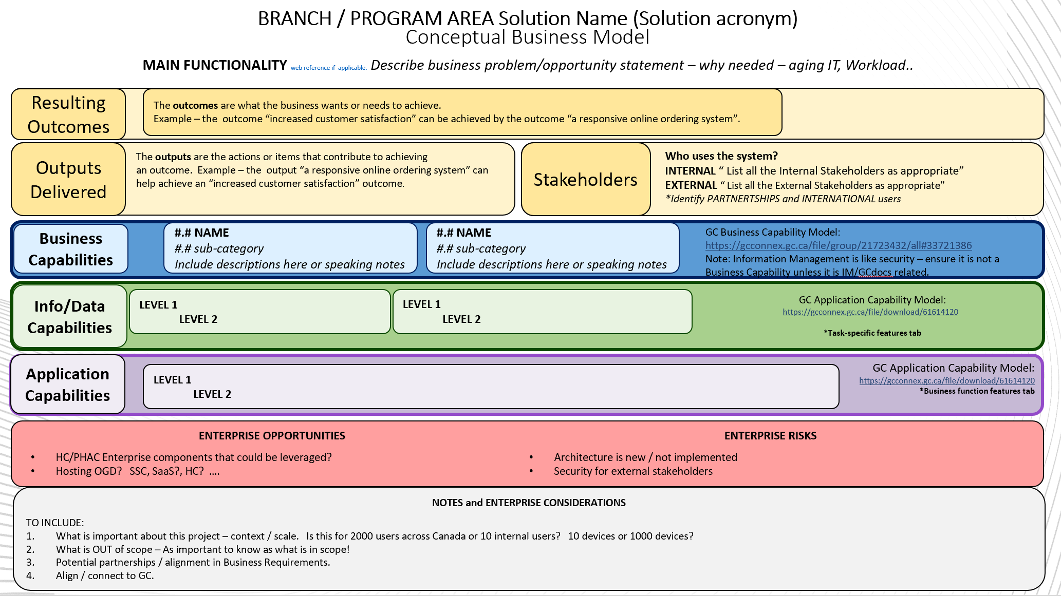
Conceptual Business Model
ARB, DASH
Gate 0, Gate 2
To be completed by HC/PHAC EA
Notes:
This slide should be included for ARB and DASH only.
To be completed by the DTB Enterprise Architecture team in consultation with the project team.

Slide 12
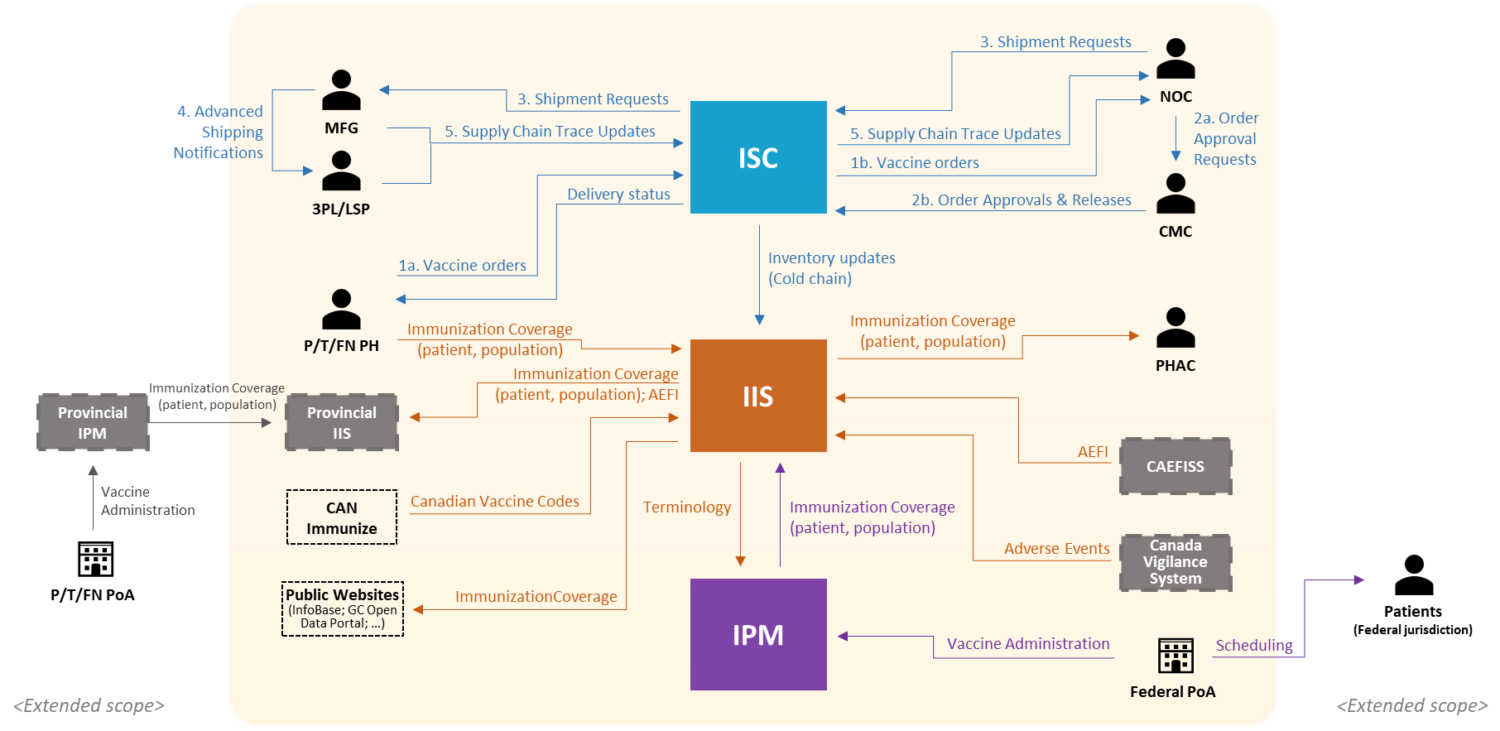
Business Process / Information / Data Flow Diagram
ARB, DASH, GC EARB
Gate 0, Gate 2
Example
Notes:
This slide should be included for ARB, DASH, and GC EARB.
This slide could be completed by the Project Architect or Program Lead.
Slide Instructions:
This slide contains a diagram of the business process, or the information/data flow, or some combination.
There is no definitive standard approach for presenting this information. The diagram on this slide is an example from a prior presentation and is provided for illustration purposes.
Indicate all other departments/ agencies / organizations involved in the fulfilment of the service(s) in scope.
Indicate data repositories and high-level data flow.
Alternate text should be provided that describes the visual content of the diagram.
The diagonal text field with the watermark “Example” should also be deleted.

Slide 13
Current State Architecture Problem Summary
ARB, DASH, GC EARB
Gate 0, Gate 2
Architecture Layer | Key elements and issues for each layer
Business | Reduced business efficiency and poor user experience from integrating and maintaining multiple solutions. Need to enable off network, off VPN management of information to support staff who work in the field - at borders, at industry sites for inspections, etc.
Information | Information and data duplication and transit across the multiple solutions – with associated compliance and productivity risks.
Application | EDRM application sprawl – increasing the licensing costs, interoperability requirements and manual maintenance
Technology | Maintaining and supporting multiple technology platforms (GCdocs, shared drives; RDIMS, EDMS, proliferation of OneDrive)
Security | Administration, permission management, access controls and monitoring are all made more complex by having multiple platforms, processes, toolsets and resource pools.
Example
Notes:
This slide should be included for ARB, DASH, and GC EARB.
This slide could be completed by the Project Architect or Program Lead.
Slide Instructions:
This slide contains a table with two columns used to capture details on the current state architecture for each of the five layers of the Enterprise Architecture Framework.
The left-side column lists the architecture layers. The right-side column provides space for details on key elements and issues for each layer.
Describe the problems with the current architecture.
Brief summary of the business problem as described in the Concept Case
Describe the problem in each of the layers of EA Framework: Business, Information, Application, Technology and Security
The text in this table should clearly describe the visual content of the diagram on the following slide and can serve as supporting speaking notes.
Table can be split across multiple slides if necessary
The table has been pre-populated with example content from a prior presentation. This should be adjusted or replaced for the current presentation.
The diagonal text field with the watermark “Example” should also be deleted.

Slide 14
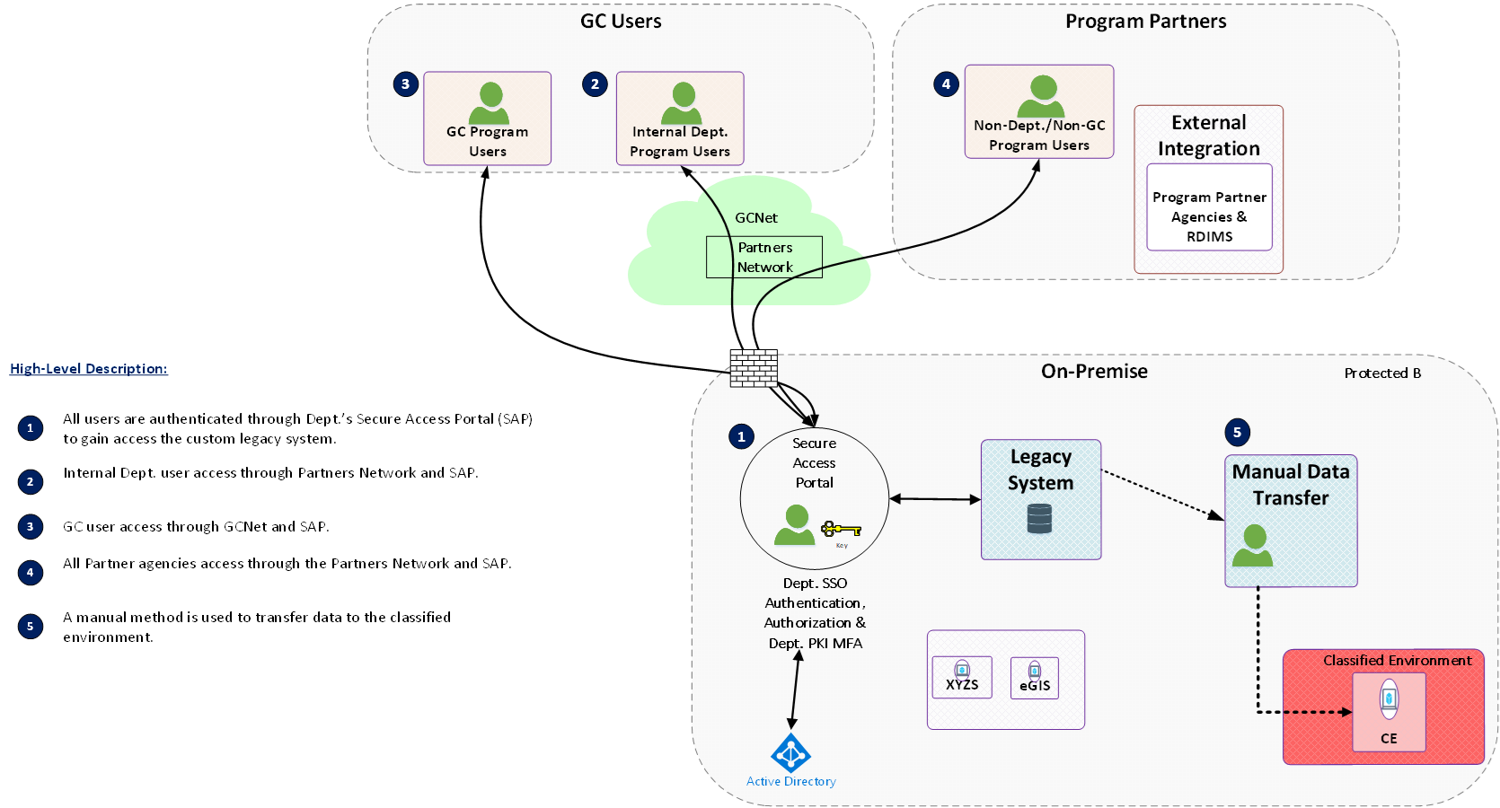
Current State Architecture Diagram
ARB, DASH, GC EARB
Gate 0, Gate 2
Example
Notes:
This slide should be included for ARB, DASH, and GC EARB.
This slide could be completed by the Project Architect or Program Lead.
Slide Instructions:
This slide contains a diagram of the current state architecture. It is placed immediately before the target state diagram to allow an easy “before and after” view of the architecture.
There is no definitive standard approach for presenting this information. A prior example is provided for illustration purposes.
As a suggested best practice, this example includes a numbered legend that provides additional details on selected elements of the diagram in a sequential order.
Alternate text should be provided that describes the visual content of the diagram. This may refer to the previous slide, which is intended to provide textual descriptions for the current state.
The diagonal text field with the watermark “Example” should also be deleted.

Slide 15
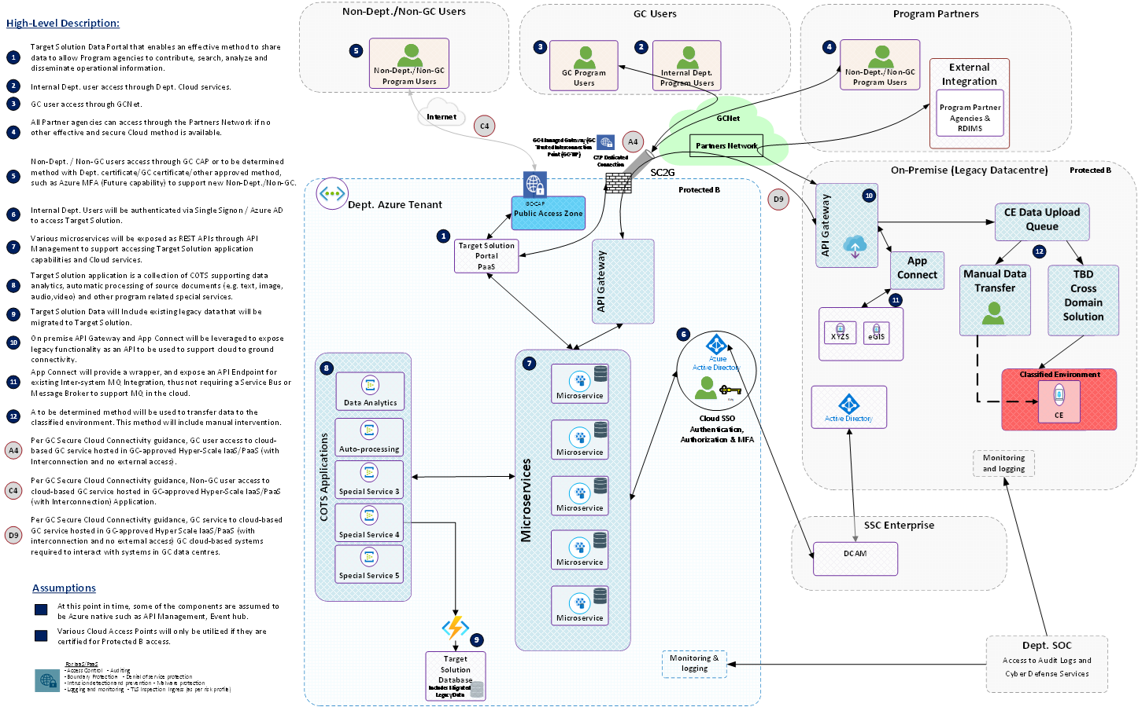
Target State Architecture Diagram
ARB, DASH, GC EARB
Gate 0, Gate 2
Example
Notes:
This slide should be included for ARB, DASH, and GC EARB.
This slide could be completed by your project architect or program lead.
For Gate 0, diagram is conceptual only
Slide Instructions:
This slide contains a diagram of the target state architecture. It is placed immediately after the current state diagram to allow an easy “before and after” view of the architecture.
There is no definitive standard approach for presenting this information. A prior example is provided for illustration purposes.
As a suggested best practice, this example includes a numbered legend that provides additional details on selected elements of the diagram in a sequential order.
Alternate text should be provided that describes the visual content of the diagram. This may refer to the following slide, which is intended to provide textual descriptions for the target state.
The diagonal text field with the watermark “Example” should also be deleted.

Slide 16
Target State Architecture Solution Summary
ARB, DASH, GC EARB
Gate 0, Gate 2
Architecture Layer | Key elements and solutions for each layer
Business | Improved user experience Reduced cost of ownership Alignment with TBS Policy Legal position to meet recordkeeping obligations
Information | Centralized management of information assets for HC and PHAC with IA practices evolved from previous EDRM instances and new SStMI. Business enablement via off network/vpn access to information.
Application | Cost savings related to reduction in number of existing corporate repositories
Technology | Single cloud-based technology platform
Security | Using approved solutions and M365 ICAM and security features
Example
Notes:
This slide should be included for ARB, DASH, and GC EARB.
This slide could be completed by your project architect or program lead.
For Gate 0, complete Business and Information only
Slide Instructions:
The table on this slide is based on the five layers of the Enterprise Architecture Framework.
Describe the Target State architecture.
Describe how the target state architecture addresses the business problem stated in the Concept Case.
Describe the solution in each layer of the EA Framework: Business, Information, Application, Technology and Security
The text in this table should clearly describe the visual content of the diagram on the previous slide and can serve as supporting speaking notes.
Table can be split across multiple slides if necessary
The table has been pre-populated with example content from a prior presentation. This should be adjusted or replaced for the current presentation.
The diagonal text field with the watermark “Example” should also be deleted.

Slide 17
Consultations
ARB
Gate 0 & Gate 2
TEAM / ORGANIZATION | RESULTS / OUTCOME
Accessibility team
Cloud team
DevOps team
Application Health (Tech Debt)
Enterprise Architecture
HC Chief Data Office / PHAC Data Mgmt Innovation & Analytics
IM Ops, Tools and SharePoint | To be completed before the ARB visit in alignment with the TBS Policy on Service and Digital and the TBS Standard on Systems that Manage Information and Data. Artefact: IM Accountability Profile (IMAP) and Information Architecture slides in the Appendix. ➔ Please engage your Information Management Advisor to support and assist.
IT Security
IT Service Delivery
M365 team including SharePoint as an App repository
Other Government Departments
Product Development/CoE
SSC (via SSM)
Technology Portfolio Office / EA
Other
Notes:
This slide should be included for ARB and DASH.
This slide could be completed by the Project Team with TPO support.
Note: If Consultation/Outreach is not necessary, enter Not Applicable
Teams/Organization Contact emails:
Accessibility team (Web Standards):web.standards-normes.web@hc-sc.gc.ca
Cloud team (AWS / Azure / D365 / Google, SSC): azureoperations-operationsazure@hc-sc.gc.ca
DevOps team: devops@hc-sc.gc.ca
Digital Strategy/Aging IT(DTPOD):TechnicalDebt.Dettetechnique@hc-sc.gc.ca
Enterprise Architecture (GC EA Framework Assessment): hc-phac.arb.cea.sc-aspc@hc-sc.gc.ca
HC Chief Data Office / PHAC Data Mgmt Innovation & Analytics (Data management): HC ocdo-bdpd@hc-sc.gc.ca PHAC datascience-sciencededonnees@phac-aspc.gc.ca
IM Ops, Tools and SharePoint (See Appendix 0 - INFORMATION MANAGEMENT Considerations): im.tools-outils.gi@hc-sc.gc.ca
IT Security (Authority to Operate / SRTM): itsecurity-tisecurite@hc-sc.gc.ca
IT Service Delivery (Desktop Engineering): Request through Service Gateway
M365 team including SharePoint as an App repository: m365-m365@hc-sc.gc.ca
Other Government Departments(Environmental scan): apm.core-noyau.de.la.gpa@hc-sc.gc.ca. GC Exchange. TBS/ EA CoP
Product Development/CoE (Database, SDLC, Data Analytics): Data and Analytics Platform Services (DaAPS) | services de la plateforme de données et d’analyse (SPDA) - Data and Analytics Platform Services (DaAPS) | Services de la Plateforme de Données et d’Analyse (SPDA) - Confluence
SSC (via SSM) (SSC services / Business Request): ssm-gsp@hc-sc.gc.ca
Technology Project Office / EA (Options Analysis / Technology Assessment/Solution Architecture): tpo-bpt@hc-sc.gc.ca

Slide 18
Summary of architecture/solution options and evaluation results
ARB, DASH, GC EARB
Gate 2
Solution Options: Evaluation Criteria: | 1 ePost Connect | 2 LiquidFiles (on-prem) | 3 LiquidFiles (Cloud) | 4 SharePoint OneDrive | 5 Azure Blob Storage
Enterprise and GC Architecture Fit | 3 | 3 | 4 | 4 | 2
Key Feature Support | X | 4 | 4 | X | 4
User Experience | 3 | 4 | 4 | 4 | 3
Implementation Effort | 3 | 4 | 3 | 3 | 0
Scalability | 4 | 3 | 4 | 4 | 4
Security | 3 | 4 | 4 | 4 | 4
License and Security Costs | 3 | 4 | 3 | 4 | 3
Long-term Viability | 3 | 3 | 3 | 4 | 3
Total Score | X | 29 | 29 | X | 23
Recommended Option: |  | Yes | Yes
Example
Rating | Interpretation
4 | Fully – The option fully meets the expectations defined by the criterion.
3 | Mostly – The option almost completely meets the expectations defined by the criterion.
2 | Partially – The option only partially meets the expectations defined by the criterion.
1 | Poorly – The option does a poor job of meeting the expectations defined by the criterion.
0 | None – The option does not meet the expectations defined by the criterion.
X | Non-Compliant – The option is non-compliant regarding a given mandatory criterion.
TPO Recommendations:
Notes:
This slide should be included for ARB, DASH, and GC EARB Gate 2 only.
This slide could be completed by the Project Architect or Program Lead.
Slide Instructions:
The slide contains two tables: an options evaluation grid; and a rating score reference table
The content of both tables is provided as examples and should be changed to suit the requirements of the current proposal under review.
Normally the evaluation table on this slide will be completed through a consensus review process by the project team involving multiple stakeholders, or possibly by a third-party review team (e.g. results of RFP process).
Top table contains the evaluation grid, with content to be filled in with results of any options analysis used for the current initiative (if one has been completed).
The top-left cell serves as a header for both the top row (Technology Options) and for the left column (Evaluation Criteria).
First left-most column contains the list of evaluation criteria, one criterion per row, and Total Score at the bottom.
Next five columns include headers with each of the evaluated options, and cells that list the respective score for each option rated against the corresponding evaluation criterion.
The table has been pre-populated with example content from a prior presentation. This should be adjusted or deleted for the current presentation.
Bottom table is a reference grid with two columns, the first containing a set of rating scores, and the second showing the corresponding interpretations.
It is intended to be used as a reference for evaluation of the options against the stated criteria in the top table. The content of the bottom reference table is as follows:
Rating Interpretation
4 Fully – The option fully meets the expectations defined by the criterion.
3 Mostly – The option almost completely meets the expectations defined by the criterion.
2 Partially – The option only partially meets the expectations defined by the criterion.
1 Poorly – The option does a poor job of meeting the expectations defined by the criterion.
0 None – The option does not meet the expectations defined by the criterion.
X Non-Compliant – The option is non-compliant regarding a given mandatory criterion.
The diagonal text field with the watermark “Example” should also be deleted.

Slide 19
TCO, Funding, Procurement and FinOps Summary
ARB, GC EARB
Gate 0, Gate 2
Criteria | Response
Estimated Life span of the target state architecture | Number of years that the organization plans to utilize the solution.
Total Cost of Ownership (TCO), CapEx, OpEX and other expenses over the lifespan including planning, acquisition, operations and disposal* | $ value Indicative or Substantive estimate?
What are the sources of funds for the digital initiative. | life span funding source for: Planning; Acquisition Operations/Disposal
How are operational costs (FinOps*) being managed and remediated? | Frequency and nature of operational costs reviews, governance oversight and remediation process.
Describe the procurement strategy for the digital initiative. | Contract vehicle Contract capacity for the life span of the digital initiative.
Example
*Total Cost of Ownership tool results or other
*Financial Operations, reference GC Cloud Cost Management playbook

Slide 20
EA Summary
ARB, DASH, GC EARB
Gate 0, Gate 2
EA Assessor:
EA Layer | Summary Assessment of each layer | Alignment
Business |  | Fully
Information | SharePoint is the sole official corporate repository in use across all HC and PHAC branches. SACR is designed to manage a division's day-to-day end-user created documents. SACR may not be a suitable replacement for custom applications used in existing processes. Extending the use of SharePoint to support business solutions and applications will be assessed on a case-by-case basis. https://mysource.hc-sc.gc.ca/sites/default/files/2024-06/IM%20Standard%20-%20SACR%20Rules.pdf | Fully
Application |  | Partially
Technology |  | Partially
Security |  | Not
To be completed by HC/PHAC or TBS EA Assessor
EA Recommendation and Proposed Conditions
Notes:
Slide Instructions:
To be completed by HC or TBS EA Team.
The slide contains 2 tables:
Top table will contain the observations of the TBS EA assessor for each of the five architecture layers, as well as an indicator of the degree of alignment (Fully, Partially, Not) based on a review of the Target Architecture and related EA Framework responses provided in the appendices.
Bottom table will contain the recommendation for GC EARB decision (i.e. Endorsement, Endorsement with Conditions) and a brief statement of any proposed conditions. This will often be adopted as the decision statement for the item in the Record of Discussions.
This slide is normally the last slide during EARB presentation
SharePoint is the sole official corporate repository in use across all HC and PHAC branches. SACR is designed to manage a division's day-to-day end-user created documents. SACR may not be a suitable replacement for custom applications used in existing processes. Extending the use of SharePoint to support business solutions and applications will be assessed on a case-by-case basis.
https://mysource.hc-sc.gc.ca/sites/default/files/2024-06/IM%20Standard%20-%20SACR%20Rules.pdf

Slide 21
Enterprise Solution – EA Recommendation
ARB, DASH, GC EARB
Gate 0, Gate 2
EA Assessor:
Facet | Summary | Alignment
Governance | (Please identify what is ready – what is not) | Fully
Culture |  | Partially
Solution |  | Not
To be completed by TBS EA Assessor
EA Recommendation
Notes:
Slide Instructions:
To be completed by TBS EA Team if solution is being proposed as an Enterprise Solution in Appendix 2.
The slide contains 2 tables:
Top table will contain the observations of the TBS EA assessor for each of the three facets of the Enterprise Solution Framework, as well as an indicator of the degree of alignment (Fully, Partially, Not), based on a review of the responses provided in Appendix 2.
Bottom table will contain the recommendation for GC EARB decision (i.e. Endorsement, Endorsement with Conditions) and a brief statement of any proposed conditions. This will often be adopted as the decision statement for the item in the Record of Discussions.
If used, this will be the last slide during EARB presentation

Slide 22
Glossary – List of Acronyms Used In This Presentation
ARB, DASH, GC EARB
Gate 0, Gate 2
Acronym | Definition
Notes:
This slide should be included for ARB, DASH, and GC EARB.
To be completed by the project team
Slide Instructions:
This slide contains a table with 2 columns: Left-side column has header “Acronym” and right-side column has header “Definition”
List all acronyms used in the presentation and provide a corresponding definition
The table has been partially pre-populated with examples from the appendices.

Slide 23
Business Capabilities Addressed
For GC EARB only
Business Capabilities | List the GC Business capabilities addressed (Level 2) | List of Departmental Business capabilities addressed (if applicable)
1. Legislation, Regulation and Policy Management | 1.3 Policy Management | 3.1 Strategic Policy Management
2. Enterprise Planning | 2.3 Program and Service Planning | 3.2 Program Management
3. Outcomes Management | 3.2 Performance Management 3.3 Reporting Framework Management | 2.5 Departmental Performance Management 8.1 Service Quality Assurance 8.2 Service Efficiency Assurance 11.7 Corporate Reporting
4. Relationship Management | 4.1 Stakeholder Awareness Management 4.2 Stakeholder Information Management 4.3 Stakeholder Interaction Management | 5.1 Client Intelligence Management 5.2 Client Awareness Management 5.3 Client Engagement Management 5.4 Client Management 5.5 Client Communications Management 7.2 Partner Relationship Management
5. Compliance Management | 5.1 Compliance and Investigation Management | 9.1 Client Compliance 9.3 Investigation Management
6. Program and Service Delivery | 6.1 Agreements Management 6.4 Dispute Resolution Management 6.7 Authorization Management 6.8 Payment Management | 6.1 Service Enrollment Management 6.3 Payment Management 6.4 Credential Management 6.6 Knowledge Discovery Management 6.9 Appeals & Dispute Resolution Management
7. Information Management | 7.1 Information Lifecycle Management 7.3 Research and Knowledge Management | 10.5 Information Management
8. Government Resources Management | 8.2 Financial Management 8.3 Human Resources Management 8.5 Technology Management 8.6 Work Management | 10.1 Financial Management 10.4 Human Resources Management 10.6 Technology Management 6.2 Service Workflow & Workload Management
9. Corporate Management | 9.1 Security Management 9.3 Business Transformation Management | 4.2 Change Design Management 4.3 Change Implementation Management 11.1 Security Management
Example
Notes:
This slide should be included for GC EARB only.
This slide should be completed by your Project Architect.
Slide Instructions:
This slide contains a table with three columns used to list the business capabilities addressed with this architecture.
More details on the Business Capability Model 2.0 reference material can be found at:
https://wiki.gccollab.ca/GC_Enterprise_Architecture/Business_Capability_Model
Delete all rows that are not applicable to the current presentation
This should focus on the top 3-5 relevant business capabilities
The table has been pre-populated with example content from a prior presentation. This should be adjusted or deleted for the current presentation.
The diagonal text field with the watermark “Example” should also be deleted.
The third column is optional and may be deleted. It contains a mapping to corresponding elements in the departmental business capability model, but if the department does not have one, it should be removed.

Slide 24
Appendix 1: GC EA Framework Business Architecture
For GC EARB only
Business architecture is a critical aspect for the successful implementation of the GC Enterprise Ecosystem Target Architecture. The architectural strategy advocates whole of government approach where IT is aligned to business services and solutions are based on re useable components implementing business capabilities in order to deliver a cohesive user experience. As such, it is essential that business services, stakeholder needs, opportunities to improve cohesion and opportunities for reuse across government be clearly understood. In the past these elements have not been a priority. It is expected that the IT culture and practices will have to change to make business architecture, in general, and these elements a primary focus.
B-1. Design services digitally from end to end to meet the Government of Canada users and other stakeholders’ needs | HOW will this be achieved?
Clearly identify internal and external users and other stakeholders and their needs for each policy, program and business service
Include policy requirement applying to specific users and other stakeholder groups, such as accessibility, gender-based plus analysis, and official languages in the creation of the service
Perform Algorithmic Impact Assessment (AIA) to support risk mitigation activities when deploying an automated decision system as per Directive on Automated Decision-Making
Model end to end business service delivery to provide quality, maximize effectiveness and optimize efficiencies across all channels (for example, lean process)
Notes:
This slide should be included for GC EARB only.
This slide should be completed by your project architect with assistance from enterprise architecture.
Slide Instructions:
The text box at the top of the body section of this slide contains static text with an overview statement about the Business Architecture layer of the GC EA Framework:
https://www.canada.ca/en/government/system/digital-government/policies-standards/government-canada-enterprise-architecture-framework.html
Below the text box is a table with two columns that is used to capture information related to the Business Architecture criteria from the Framework.
Left-side column is structured on the high-level criteria from the GC EA Framework. These statements are labeled with letter-number pairs (e.g. “B-1.”) and serve as headings for subsequent rows.
Below each high-level criterion heading is a listing of multiple rows with the related sub-criteria from the Framework.
Right-side column contains a heading cell with the question “HOW will this be achieved?” corresponding to each of the high-level criteria, and below this are a set of blank cells in the rows for the sub-criteria.
The presenting department should provide any relevant details in the blank cells to demonstrate how the corresponding sub-criteria requirements in the left-side column are being addressed in the Target Architecture of the current presentation.

Slide 25
Appendix 1: GC EA Framework Business Architecture - continued
For GC EARB only
B-2. Architect to be outcome driven and strategically aligned to the department and to the Government of Canada | HOW will this be achieved?
Identify which departmental/GC business services, outcomes and strategies will be addressed
Establish metrics for identified business outcomes throughout the life cycle of an investment
Translate business outcomes and strategy into business capability implications in the GC Business Capability Model to establish a common vocabulary between business, development, and operation
B-3. Promote horizontal enablement of the enterprise | HOW will this be achieved?
Identify opportunities to enable business services horizontally across the GC enterprise and to provide cohesive experience to users and other stakeholders
Reuse common business capabilities, processes and enterprise solutions from across government and private sector
Publish in the open all reusable common business capabilities, processes and enterprise solutions for others to develop and leverage cohesive horizontal enterprise services
Notes:
This slide should be included for GC EARB only.
This slide should be completed by your project architect with assistance from enterprise architecture.
Slide Instructions:
This slide contains a table that is used to capture information related to the Business Architecture criteria from the GC EA Framework:
https://www.canada.ca/en/government/system/digital-government/policies-standards/government-canada-enterprise-architecture-framework.html
The table is composed of two columns.
Left-side column is structured on the high-level criteria from the GC EA Framework. These statements are labeled with letter-number pairs (e.g. “B-1.”) and serve as headings for subsequent rows.
Below each high-level criterion heading is a listing of multiple rows with the related sub-criteria from the Framework.
Right-side column contains a heading cell with the question “HOW will this be achieved?” corresponding to each of the high-level criteria, and below this are a set of blank cells in the rows for the sub-criteria.
The presenting department should provide any relevant details in the blank cells to demonstrate how the corresponding sub-criteria requirements in the left-side column are being addressed in the Target Architecture of the current presentation.

Slide 26
Appendix 1: GC EA Framework Information Architecture
For all ARB visits
Information architecture includes both structured and unstructured data. The best practices and principles aim to support the needs of a business service and business capability orientation. To facilitate effective sharing of data and information across government, information architectures should be designed to reflect a consistent approach to data, such as the adoption of federal and international standards. Information architecture should also reflect responsible data management, information management and governance practices, including the source, quality, interoperability, and associated legal and policy obligations related to the data assets. Information architectures should also distinguish between personal and non personal data and information as the collection, use, sharing (disclosure), and management of personal information must respect the requirements of the Privacy Act and its related policies.
I-1. Collect data to address the needs of the users and other stakeholders | HOW will this be achieved?
Assess data requirements based program objectives, as well users, business and stakeholder needs
Collect only the minimum set of data needed to support a policy, program, or service
Reuse existing data assets where permissible and only acquire new data if required
Ensure data collected, including from third-party sources, are of high quality
Notes:
This slide should be included for GC EARB only.
This slide should be completed by your project architect with assistance from enterprise architecture.
Slide Instructions:
The text box at the top of the body section of this slide contains static text with an overview statement about the Information Architecture layer of the GC EA Framework:
https://www.canada.ca/en/government/system/digital-government/policies-standards/government-canada-enterprise-architecture-framework.html
Below the text box is a table with two columns that is used to capture information related to the Information Architecture criteria from the Framework.
Left-side column is structured on the high-level criteria from the GC EA Framework. These statements are labeled with letter-number pairs (e.g. “B-1.”) and serve as headings for subsequent rows.
Below each high-level criterion heading is a listing of multiple rows with the related sub-criteria from the Framework.
Right-side column contains a heading cell with the question “HOW will this be achieved?” corresponding to each of the high-level criteria, and below this are a set of blank cells in the rows for the sub-criteria.
The presenting department should provide any relevant details in the blank cells to demonstrate how the corresponding sub-criteria requirements in the left-side column are being addressed in the Target Architecture of the current presentation.

Slide 27
Appendix 1: GC EA Framework Information Architecture – continued 1
For all ARB visits
I-2. Manage and reuse data strategically and responsibly | HOW will this be achieved?
Define and establish clear roles, responsibilities, and accountabilities for data management
Identify and document the lineage of data assets
Define retention and disposition schedules in accordance with business value as well as applicable privacy and security policy and legislation
Ensure data are managed to enable interoperability, reuse and sharing to the greatest extent possible within and across departments in government to avoid duplication and maximize utility, while respecting security and privacy requirements
Contribute to and align with enterprise and international data taxonomy and classification structures to manage, store, search and retrieve data
I-3. Use and share data openly in an ethical and secure manner | HOW will this be achieved?
Share data openly by default as per the Directive on Open Government and Digital Standards, while respecting security and privacy requirements; data shared should adhere to existing enterprise and international standards, including on data quality and ethics
Ensure data formatting aligns to existing enterprise and international standards on interoperability; where none exist, develop data standards in the open with key subject matter experts
Ensure that combined data does not risk identification or re identification of sensitive or personal information
Notes:
This slide should be included for GC EARB only.
This slide should be completed by your project architect with assistance from enterprise architecture.
Slide Instructions:
This slide contains a table with two columns that is used to capture information related to the Information Architecture criteria from the GC EA Framework:
https://www.canada.ca/en/government/system/digital-government/policies-standards/government-canada-enterprise-architecture-framework.html
The table is composed of two columns.
Left-side column is structured on the high-level criteria from the GC EA Framework. These statements are labeled with letter-number pairs (e.g. “B-1.”) and serve as headings for subsequent rows.
Below each high-level criterion heading is a listing of multiple rows with the related sub-criteria from the Framework.
Right-side column contains a heading cell with the question “HOW will this be achieved?” corresponding to each of the high-level criteria, and below this are a set of blank cells in the rows for the sub-criteria.
The presenting department should provide any relevant details in the blank cells to demonstrate how the corresponding sub-criteria requirements in the left-side column are being addressed in the Target Architecture of the current presentation.

Slide 28
Appendix 1: GC EA Framework Information Architecture – continued 2
For all ARB visits
I-4. Design with privacy in mind for the collection, use and management of personal Information | HOW will this be achieved?
Ensure alignment with guidance from appropriate institutional ATIP Office with respect to interpretation and application of the Privacy Act and related policy instruments
Assess initiatives to determine if personal information will be collected, used, disclosed, retained, shared, and disposed
Only collect personal information if it directly relates to the operation of the programs or activities
Notify individuals of the purpose for collection at the point of collection by including a privacy notice
Personal information should be, wherever possible, collected directly from individuals but can be from other sources where permitted by the Privacy Act
Personal information must be available to facilitate Canadians’ right of access to and correction of government records
Design access controls into all processes and across all architectural layers from the earliest stages of design to limit the use and disclosure of personal information
Design processes so personal information remains accurate, up-to-date and as complete as possible, and can be corrected if required
De-identification techniques should be considered prior to sharing personal information
In collaboration with appropriate institutional ATIP Office, determine if a Privacy Impact Assessment (PIA) is required to identify and mitigate privacy risks for new or substantially modified programs that impact the privacy of individuals
Establish procedures to identify and address privacy breaches so they can be reported quickly and responded to efficiently to appropriate institutional ATIP Office
Notes:
This slide should be included for GC EARB only.
This slide should be completed by your project architect with assistance from enterprise architecture.
Slide Instructions:
This slide contains a table with two columns that is used to capture information related to the Information Architecture criteria from the GC EA Framework:
https://www.canada.ca/en/government/system/digital-government/policies-standards/government-canada-enterprise-architecture-framework.html
The table is composed of two columns.
Left-side column is structured on the high-level criteria from the GC EA Framework. These statements are labeled with letter-number pairs (e.g. “B-1.”) and serve as headings for subsequent rows.
Below each high-level criterion heading is a listing of multiple rows with the related sub-criteria from the Framework.
Right-side column contains a heading cell with the question “HOW will this be achieved?” corresponding to each of the high-level criteria, and below this are a set of blank cells in the rows for the sub-criteria.
The presenting department should provide any relevant details in the blank cells to demonstrate how the corresponding sub-criteria requirements in the left-side column are being addressed in the Target Architecture of the current presentation.

Slide 29
Appendix 1: GC EA Framework Application Architecture
For GC EARB only
Application architecture practices must evolve significantly for the successful implementation of the GC Enterprise Ecosystem Target Architecture. Transitioning from legacy systems based on monolithic architectures to architectures that oriented around business services and based on re useable components implementing business capabilities, is a major shift. Interoperability becomes a key element, and the number of stakeholders that must be considered increases.
A-1. Use open source solutions hosted in public cloud | HOW will this be achieved?
Select existing solutions that can be reused over custom built
Contribute all improvements back to the communities
Register open source software to the Open Resource Exchange
A-2. Use software as a service (SaaS) hosted in public cloud | HOW will this be achieved?
Choose SaaS that best fit for purpose based on alignment with SaaS capabilities
Choose a SaaS solution that is extendable
Configure SaaS and if customization is necessary extend as open source modules
A-3. Design for Interoperability | HOW will this be achieved?
Design systems as highly modular and loosely coupled services
Expose services, including existing ones, through APIs
Make the APIs discoverable to the appropriate stakeholders
Notes:
This slide should be included for GC EARB only.
This slide should be completed by your project architect with assistance from enterprise architecture.
Slide Instructions:
The text box at the top of the body section of this slide contains static text with an overview statement about the Application Architecture layer of the GC EA Framework:
https://www.canada.ca/en/government/system/digital-government/policies-standards/government-canada-enterprise-architecture-framework.html
Below the text box is a table with two columns that is used to capture information related to the Application Architecture criteria from the Framework.
Left-side column is structured on the high-level criteria from the GC EA Framework. These statements are labeled with letter-number pairs (e.g. “B-1.”) and serve as headings for subsequent rows.
Below each high-level criterion heading is a listing of multiple rows with the related sub-criteria from the Framework.
Right-side column contains a heading cell with the question “HOW will this be achieved?” corresponding to each of the high-level criteria, and below this are a set of blank cells in the rows for the sub-criteria.
The presenting department should provide any relevant details in the blank cells to demonstrate how the corresponding sub-criteria requirements in the left-side column are being addressed in the Target Architecture of the current presentation.

Slide 30
Appendix 1: GC EA Framework Technology Architecture
For GC EARB only
Technology architecture is an important enabler of highly available and adaptable solutions that must be aligned with the chosen application architecture. Cloud adoption provides many potential advantages by mitigating the logistical constraints that often negatively impacted legacy solutions hosted “on premises.” However, the application architecture must be able to enable these advantages.
T-1. Use cloud first | HOW will this be achieved?
Adopt the use of the GC Accelerators to ensure proper security and access controls
Enforce this order of preference: software as a service (SaaS) first, then platform as a service (PaaS), and lastly infrastructure as a service (IaaS)
Fulfill cloud services through SSC Cloud Brokering Services
Enforce this order of preference: public cloud first, then hybrid cloud, then private cloud, and lastly non cloud (on-premises) solutions
Design for cloud mobility and develop an exit strategy to avoid vendor lock-in
Notes:
This slide should be included for GC EARB only.
This slide should be completed by your project architect with assistance from enterprise architecture.
Slide Instructions:
The text box at the top of the body section of this slide contains static text with an overview statement about the Technology Architecture layer of the GC EA Framework:
https://www.canada.ca/en/government/system/digital-government/policies-standards/government-canada-enterprise-architecture-framework.html
Below the text box is a table with two columns that is used to capture information related to the Technology Architecture criteria from the Framework.
Left-side column is structured on the high-level criteria from the GC EA Framework. These statements are labeled with letter-number pairs (e.g. “B-1.”) and serve as headings for subsequent rows.
Below each high-level criterion heading is a listing of multiple rows with the related sub-criteria from the Framework.
Right-side column contains a heading cell with the question “HOW will this be achieved?” corresponding to each of the high-level criteria, and below this are a set of blank cells in the rows for the sub-criteria.
The presenting department should provide any relevant details in the blank cells to demonstrate how the corresponding sub-criteria requirements in the left-side column are being addressed in the Target Architecture of the current presentation.

Slide 31
Appendix 1: GC EA Framework Technology Architecture - continued
For GC EARB only
T-2. Design for performance, availability and scalability | HOW will this be achieved?
Ensure response times meet user needs, and critical services are highly available
Support zero-downtime deployments for planned and unplanned maintenance
Use distributed architectures, assume failure will happen, handle errors gracefully, and monitor performance and behaviour actively
Establish architectures that supports new technology insertion with minimal disruption to existing programs and services
Control technical diversity; design systems based on modern technologies and platforms already in use
T-3. Follow DevSecOps principles | HOW will this be achieved?
Use continuous integration and continuous deployments
Ensure automated testing occurs for security and functionality
Include your users and other stakeholders as part of the DevSecOps process, which refers to the concept of making software security a core part of the overall software delivery process
Notes:
This slide should be included for GC EARB only.
This slide should be completed by your project architect with assistance from enterprise architecture.
Slide Instructions:
This slide contains a table with two columns that is used to capture information related to the Technology Architecture criteria from the GC EA Framework:
https://www.canada.ca/en/government/system/digital-government/policies-standards/government-canada-enterprise-architecture-framework.html
The table is composed of two columns.
Left-side column is structured on the high-level criteria from the GC EA Framework. These statements are labeled with letter-number pairs (e.g. “B-1.”) and serve as headings for subsequent rows.
Below each high-level criterion heading is a listing of multiple rows with the related sub-criteria from the Framework.
Right-side column contains a heading cell with the question “HOW will this be achieved?” corresponding to each of the high-level criteria, and below this are a set of blank cells in the rows for the sub-criteria.
The presenting department should provide any relevant details in the blank cells to demonstrate how the corresponding sub-criteria requirements in the left-side column are being addressed in the Target Architecture of the current presentation.

Slide 32
Appendix 1: GC EA Framework Security Architecture
For GC EARB only
The GC Enterprise Security Architecture program is a government wide initiative to provide a standardized approach to developing IT security architecture, ensuring that basic security blocks are implemented across the enterprise as the infrastructure is being renewed.
S-1. Build security into the system life cycle across all architectural layers | HOW will this be achieved?
Identify and categorize information based on the degree of injury that could be expected to result from a compromise of its confidentiality, integrity and availability
Implement a continuous security approach, in alignment with Centre for Cyber Security’s IT Security Risk Management Framework; perform threat modelling to minimize the attack surface by limiting services
Apply proportionate security measures that address business and user needs while adequately protecting data at rest and data in transit
Design systems to be resilient and available in order to support service continuity
Notes:
This slide should be included for GC EARB only.
This slide should be completed by your project architect with assistance from enterprise architecture.
Slide Instructions:
The text box at the top of the body section of this slide contains static text with an overview statement about the Security Architecture layer of the GC EA Framework:
https://www.canada.ca/en/government/system/digital-government/policies-standards/government-canada-enterprise-architecture-framework.html
Below the text box is a table with two columns that is used to capture information related to the Security Architecture criteria from the Framework.
Left-side column is structured on the high-level criteria from the GC EA Framework. These statements are labeled with letter-number pairs (e.g. “B-1.”) and serve as headings for subsequent rows.
Below each high-level criterion heading is a listing of multiple rows with the related sub-criteria from the Framework.
Right-side column contains a heading cell with the question “HOW will this be achieved?” corresponding to each of the high-level criteria, and below this are a set of blank cells in the rows for the sub-criteria.
The presenting department should provide any relevant details in the blank cells to demonstrate how the corresponding sub-criteria requirements in the left-side column are being addressed in the Target Architecture of the current presentation.

Slide 33
Appendix 1: GC EA Framework Security Architecture – continued
For GC EARB only
S-2. Ensure secure access to systems and services | HOW will this be achieved?
Identify and authenticate individuals, processes or devices to an appropriate level of assurance, based on clearly defined roles, before granting access to information and services; leverage enterprise services such as Government of Canada trusted digital identity solutions that are supported by the Pan-Canadian Trust Framework
Constrain service interfaces to authorized entities (users and devices), with clearly defined roles; segment and separate information based on sensitivity of information, in alignment with ITSG-22 and ITSG-38. Management interfaces may require increased levels of protection
Implement HTTPS for secure web connections and Domain-based Message Authentication, Reporting and Conformance (DMARC) for enhanced email security
Establish secure interconnections between systems through secure APIs or leveraging centrally managed hybrid IT connectivity services
S-3. Maintain secure operations | HOW will this be achieved?
Establish processes to maintain visibility of assets and ensure the prompt application of security related patches and updates in order to reduce exposure to vulnerabilities, in accordance with GC Patch Management Guidance
Enable event logging, in accordance with GC Event Logging Guidance, and perform monitoring of systems and services in order to detect, prevent, and respond to attacks
Establish an incident management plan in alignment with the GC Cyber Security Event Management Plan (GC CSEMP) and report incidents to the Canadian Centre for Cyber Security (CCCS)
Notes:
This slide should be included for GC EARB only.
This slide should be completed by your project architect with assistance from enterprise architecture.
Slide Instructions:
This slide contains a table with two columns that is used to capture information related to the Security Architecture criteria from the GC EA Framework:
https://www.canada.ca/en/government/system/digital-government/policies-standards/government-canada-enterprise-architecture-framework.html
The table is composed of two columns.
Left-side column is structured on the high-level criteria from the GC EA Framework. These statements are labeled with letter-number pairs (e.g. “B-1.”) and serve as headings for subsequent rows.
Below each high-level criterion heading is a listing of multiple rows with the related sub-criteria from the Framework.
Right-side column contains a heading cell with the question “HOW will this be achieved?” corresponding to each of the high-level criteria, and below this are a set of blank cells in the rows for the sub-criteria.
The presenting department should provide any relevant details in the blank cells to demonstrate how the corresponding sub-criteria requirements in the left-side column are being addressed in the Target Architecture of the current presentation.

Slide 34

Appendix 2: Enterprise Solution Framework (if applicable)
For GC EARB only
Enterprise solutions definition
Enterprise solutions are internal and external Government of Canada assets that can be re-used in and across multiple parts of the organization.
Additional info: GC Enterprise Architecture/Enterprise Solutions - wiki (gccollab.ca)
ES-1. Governance | HOW will the questions for this facet be addressed?
What are the roles and responsibilities and who decides who fills them?
What is the financial and funding model for an enterprise solution?
Which business capabilities should be addressed first?
How will user expectations be addressed?
What is the path to enterprise-wide adoption?
Notes:
This slide should be included for GC EARB only.
This slide should be completed by your project architect with assistance from enterprise architecture.
Slide Instructions:
Appendix 2 is to be completed by the presenting department if solution is being proposed as an Enterprise Solution.
The text box at the top of the body section of this slide contains static text with a definition of Enterprise Solutions and a link to information on the GC Enterprise Architecture wiki:
https://wiki.gccollab.ca/GC_Enterprise_Architecture/Enterprise_Solutions
Below the text box is a table with two columns that is used to capture responses to questions in the for the first facet in the Enterprise Solution Framework: Governance.
Left-side column is structured on the facets from the Enterprise Solution Framework. These facets are labeled with letter-number pairs (e.g. “ES-1.”) and serve as headings for subsequent rows.
Below the facet heading is a listing of multiple rows with the related questions from the Framework.
Right-side column contains a heading cell with the question “HOW will the questions for this facet be addressed?” and below this are a set of blank cells to capture the responses to the questions.
The presenting department should provide any relevant details in the blank cells to provide responses to the questions in the left-side column for the proposed solution in the current presentation.

Slide 35
Appendix 2: Enterprise Solution Framework (continued)
For GC EARB only
ES-2. Culture | HOW will the questions for this facet be addressed?
Is everyone ready to buy-in to enterprise solutions?
How do we ensure participation?
How will open and transparent input be gathered?
What are the mind-set and skills needed to foster an enterprise solution culture?
ES-3. Solutions | HOW will the questions for this facet be addressed?
Which business problem are we solving?
Who can access the Enterprise Solution?
What data and technology standards are required?
Is the implementation secure enough?
Will it always be reliably online?
Notes:
This slide should be included for GC EARB only.
This slide should be completed by your project architect with assistance from enterprise architecture.
Slide Instructions:
Appendix 2 is to be completed by the presenting department if solution is being proposed as an Enterprise Solution.
This slide contains a table with two columns that is used to capture responses to questions in the for the second and third facets in the Enterprise Solution Framework: Culture and Solutions.
Left-side column is structured on the facets from the Enterprise Solution Framework. These facets are labeled with letter-number pairs (e.g. “ES-1.”) and serve as headings for subsequent rows.
Below the facet heading is a listing of multiple rows with the related questions from the Framework.
Right-side column contains a heading cell with the question “HOW will the questions for this facet be addressed?” and below this are a set of blank cells to capture the responses to the questions.
The presenting department should provide any relevant details in the blank cells to provide responses to the questions in the left-side column for the proposed solution in the current presentation.

Slide 36
Appendix 3:
Shared Services Canada (SSC) Involvement
For GC EARB only
SSC Scope
What is the scope of work required by Shared Services Canada?
When/How has SSC been involved in this project?
What SSC Services are to be impacted or consumed? | https://service.ssc-spc.gc.ca/en/services Include due dates for SSC deliverables.
What are the dependencies and assumptions? | (ex: authentication, cloud connectivity. If legacy Data Centre, which one and has capacity has been confirmed.)
SSC Contact
SSC BR number (if available) | BR Number
SSC Client Executive contact | Name/Title
SSC project contact | Name/Title
SSC architecture contact | Name/Title (if available)
Notes:
This slide should be included for GC EARB only.
This slide should be completed by your project architect with assistance from enterprise architecture.
Slide Instructions:
This slide consists of two tables presented one above the other. Both tables have the same format, with two columns, where the left-side column contains they type of detail to be provided, and the right-side column is a cell in which the requested details are to be entered.
Any text in the right-side cells may be replaced with the information indicated.
For help in completing this slide feel free to contact your Client Executive:
https://service.ssc-spc.gc.ca/en/contact/partclisupport/client-execs

Slide 37
Appendix 3: Additional Technical Details required by Shared Services Canada (SSC)
For GC EARB only
Solution’s Security Profile (e.g. PBMM, PBHM, etc.)
Maximum Allowable Downtime (Unplanned) / Year (in hours)
Availability Requirements: Med (95%), High (>=99 %)
Disaster Recovery Requirements: (None, Cold Site, Warm Site, Hot Site)
Authentication Method (DCAM, ICE/ECM, Sign-in Canada, Other)
Workload migrating off legacy?
Network Name(s) (e.g. Science Network, GCNet, GCSI, etc.)
Expected Network Traffic: (Video, Audio, Data, Interactive)
Sensitivity to Network Latency: (Very High, High, Medium, Low)
Approximate number of users:
Network Geographical Distribution: (Low, Moderate, Regional, National, Global spread)
Hosting Solution(s): (Legacy DC, EDC, Cloud – list all applicable)
Notes:
This slide should be included for GC EARB only.
This slide should be completed by your project architect with assistance from enterprise architecture.
Slide Instructions:
This slide consists of two tables presented side-by-side. Both tables have the same format, with two columns, where the left-side column contains they type of detail to be provided, and the right-side column is an empty cell in which the requested details are to be entered.
Some of the left-side cells include a brief list of possible response options. For those, complete the information on this slide by selecting values from the listed options, or providing an additional value where applicable
For help in completing this slide refer to the guidance on:
https://wiki.gccollab.ca/GC_EARB_Presenter_Template_%E2%80%93_SSC_Appendix_3_Guidelines

Slide 38
Appendix 3:
Summary of Cloud Access Scenarios and Usage Profiles
For GC EARB only
 | Cloud Access Scenarios (Reference: GC Connection Patterns)
 | GC Users |  | Non-GC Users | Application/API
 | Access from GC network | Access from External network | Access from External network | Non-GC Service to cloud-based GC service | On-prem GC service to cloud-based GC service | Cloud-based to a Cloud-based services
 |  |  |  |  |  | Same CSP | Different CSP
Departmental SaaS | A2 | B2 | C2 | D4 | D7 | D1 | D2
GC wide SaaS | A3 | B3 | C3 | D5 | D8
IaaS/PaaS (No interconnection with LDC/EDC) | A1 | B1 | C1 | D3 | -
IaaS/PaaS (Interconnection with LDC/EDC) | A4 (no external access) A5 (with external access) | B4 | C4 | D6 | D9 | -
Note: The patterns describe the different types of flows that may occur within a cloud-based environment. More than one connection pattern may be applicable to the solution architecture presented. The associated characteristics of each of these connection patterns as listed in the GC Secure Cloud Connectivity Requirements document and the cloud usage profiles (slide 14 GC Connection Patterns) should be taken into consideration while identifying the applicable cloud access scenarios.
Recommended GC Enterprise Security Services For Applicable Cloud Access Scenarios
SSC SCED Services |  |  | CCCS Cyber Defense Services
GC-TIP | GC-CAP | CASB | Maple Tap
A4, A5 | A5 | A2,A3 | A1, A4, A5
 | B1,B4 | B2,B3 | B1,B4
 | C1,C4 | C2,C3 | C1, C4
D9 | D3 | D4,D5,D7,D8 | D1,D2,D3,D6,D9
Please include the applicable cloud access scenario with brief description
Solution Component | User/system connections | Cloud tenant/ environment | Use Case | Brief Description
Target Solution Portal PaaS | GC Program Users | Dept. Azure Tenant | A4 | GC user access to cloud-based GC service hosted in GC-approved Hyper-Scale IaaS/PaaS (with Interconnection and no external access).
Target Solution Portal PaaS | Non-Dept./Non-GC Program Users | Dept. Azure Tenant | C4 | Non-GC user access to cloud-based GC service hosted in GC-approved Hyper-Scale IaaS/PaaS (with Interconnection) Application.
API Gateway | On-prem GC Service | Dept. Azure Tenant | D9 | On-prem GC service to cloud-based GC service hosted in GC-approved Hyper Scale IaaS/PaaS (with interconnection and no external access). GC cloud-based systems required to interact with systems in GC data centres.
Notes:
This slide should be included for GC EARB only.
This slide should be completed by your project architect with assistance from enterprise architecture.
Slide Instructions:
This slide contains three tables, as well as two text boxes with additional instructions.
The table on the top left is a static reference grid containing the codes of the Cloud Usage Profiles use cases based on the Cloud Connection Patterns presented to GC EARB.
Details of the Cloud Connection Patterns can be found in the presentation:
https://www.gcpedia.gc.ca/gcwiki/images/7/75/GC_Cloud_Connection_Patterns.pdf
The table on top right is a static reference grid used to determine which Cloud defense services are needed from SSC and CCCS, based on the Use Cases identified.
The table on the bottom is the fillable part of the template. It contains the data that will be used to derive the relevant Use Case codes.
Each row in the bottom table should correspond to a line of connectivity in the Target Architecture diagram that spans between a component in a Cloud environment and either a user or a component in an on-premise environment.
The example content that is provided in the last three rows is based on the example target architecture diagram on Slide 8 of the template.

Slide 39
AI Vendor Evaluation — Problem & Context
AI adoption is accelerating faster than governance → we need a structured evaluation model
Market Reality
HC/PHAC Context
Key Risks
Architectural Gap
Rapid LLM expansion
(Cohere, OpenAI, Gemini)
Multiple entry points
(CANChat, Copilot, etc.)
No standard approach
Growing use case inventory
AI Accelerator intake ↑
PATH / HAIL converging
Multiple clusters
Competing procurement paths
Fragmented decisions
Shadow AI expansion
Inconsistent compliance
Cost unpredictability
Vendor lock-in
No enterprise control plane
Evaluation = vendor-driven
Governance too late
No policy enforcement
Missing traceability
👉 We are making decisions without a repeatable, enterprise-aligned evaluation model

Slide 40
LLM Evaluation Rubric — Enterprise Model
Evaluation is architecture-first, not model-first
Strategy & Alignment
Governance
Security & Risk
• AI Roadmap fit
• PATH/HAIL compatibility
• Data sovereignty
• Compliance & ATO
• Auditability
• Privacy controls
• Threat surface
• Policy enforcement
Architecture Fit
Capability
"The best LLM is not the most capable — it is the one that can be governed, integrated, and scaled."
Operations & Cost
• API integration
• Runtime compat
• Control plane alignment
• Reasoning quality
• Use case fit
• Modality support
• FinOps transparency
• Scaling model
• Vendor viability
Responsible AI • Bias mitigation • Human-in-the-loop • Explainability & AIA-readiness

Slide 41
From Evaluation → Decision → Governance Integration
The rubric is not theoretical — it feeds governance and platform decisions
1
2
3
4
5
Input
Rubric Scoring
Output
Decision
Integration
Vendor
Use case
Data class
Governance ↑
Arch fit ↑
Capability
Heatmap
Strengths/gaps
Risk profile
Approve (conditions)
Restrict
Reject
Use Case Inventory
Accelerator
ARB artifacts
Strategic Impact
Standardizes AI decisions across HC/PHAC • Reduces SRTM duplication • Enables platform-based governance • Aligns with HC AI Strategy pillars
PATH = control plane • HAIL = runtime • Rubric = decision enforcement mechanism
👉 This is how we move from experimentation → enterprise AI

