Slide 1
LYNX 800/400 API/FW Architecture
Feb/23/2022

Slide 2
LYNX 800/400 API/FW Architecture
Feb/23/2022

Slide 3
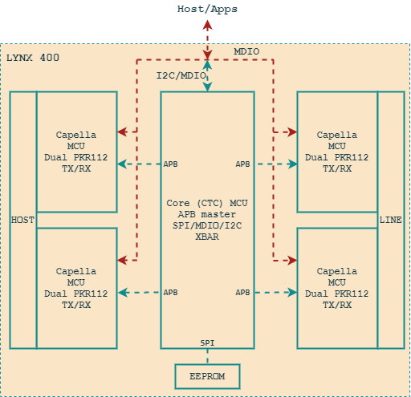
Lynx MCU Architecture
Lynx 400 is one CTC die, Lynx 800 is two CTC dies.
One CTC die includes:
1x Core (CTC) MCU
4x IP (Capella) MCU
Host can access Core/IP via:
MDIO: Direct access to Core/IP register
I2C: Direct access to Core, indirect access to IP (see for more detail in …).
The FW can be downloaded via:
MDIO/I2C
EEPROM

Slide 4
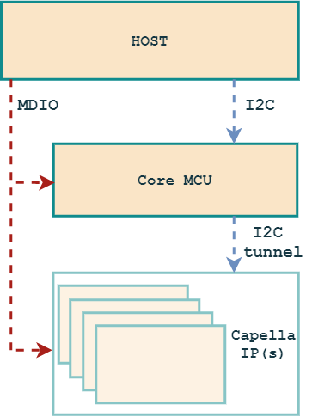
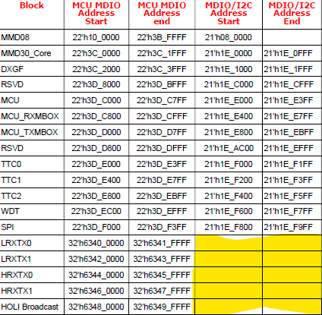
Indirect Access To CPL IP
MDIO mode: The Host can access direct to Core/IPs (MDIO Address Start-End)
I2C mode: The Host will access to
Direct to Core (CTC)
Indirect to IPs (Capella) via I2C tunnel. (The address space in the yellow area)
I2C tunnel:
The Core FW supports a mechanic to access to the CPL address space.
One action read/write needs around 9 steps access to Core MCU.
This is ready slow compare with the access directly.
Rules apply: MDIO <> I2C

Slide 5
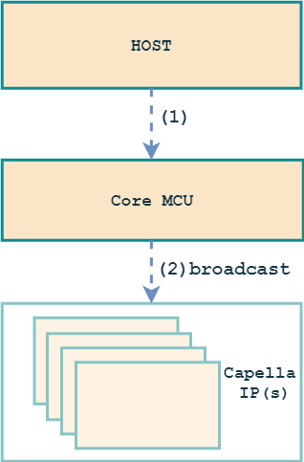
FW Download Methodology
Direct download to IRAM/DRAM:
The Host will write the FW image direct to Core MCU.
The Core FW will broadcast CPL FW to all CPL IPs MCU.
Do again for the die#2 in case of Lynx 800 (two CTC dies).
Load FW from EEPROM:
Burn FW image to EEPROM
Trigger to load FW from EEPROM to IRAM/DRAM (do the same on two dies).
FW image: CTC FW and CPL FW in one image.

Slide 6
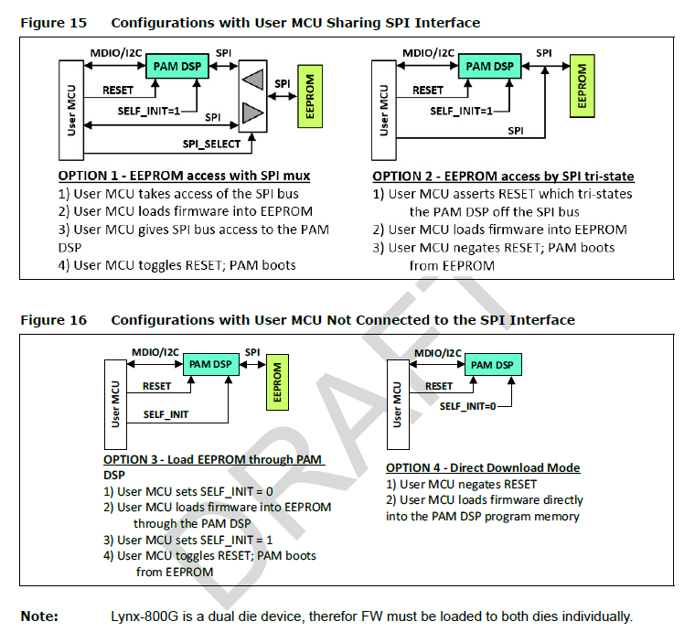
FW Architecture – MCU Boot
EEPROM with SPI mux
EEPROM by SPI tri-state
EEPROM through PAM DSP
Direct to IRAM/DRAM

Slide 7
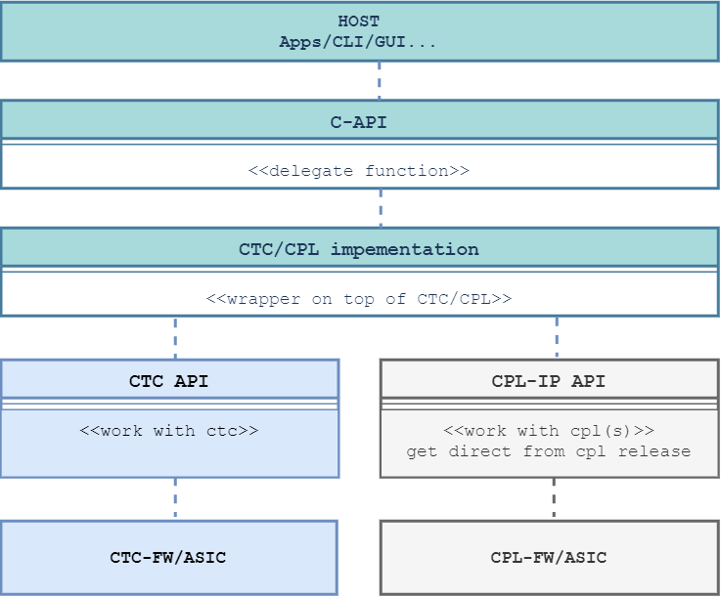
CAPI Architecture – API layering
CAPI is one API interface intend to can support multiple products.
Lynx API has two main layers:
CAPI: Interface to customer.
CTC/CPL Implementation layer: Adaption on top CPL API and direct setup the CTC/CPL.
CTC API: API will communicate to CTC FW and ASIC.
CPL API: All the same and will get from CPL release package. This will communicate direct to CPL FW and ASIC.
Lynx API code size:
 | Total | CAPI | Adapt | CPL
MIN | 117412 | 24321 | 51813 | 41298
MAX | 395326 | 38638 | 270427 | 86261

Slide 8
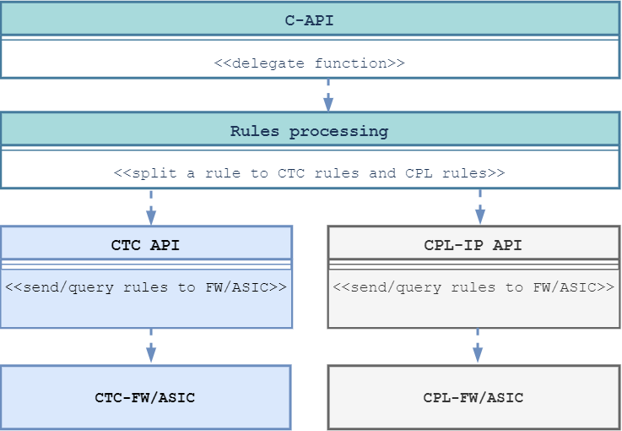
CAPI Architecture – Rules Apply Flow
Set a rules:
Collect a rules at CAPI layer.
Process a rules and split it to CTC-Rules and CPL-Rules.
Send and apply rules via Spare register to:
CTC-FW/ASIC
CPL-FW/ASIC
FW stores the rules as static memory, send/receive via Spare register.
Get/Query a rules via Spare register from:
CTC-FW/ASIC
CPL-FW/ASIC
The ISSUE is:
Too slow when apply the rules to CPL_IP (I2C indirect access via tunnel)

Slide 9
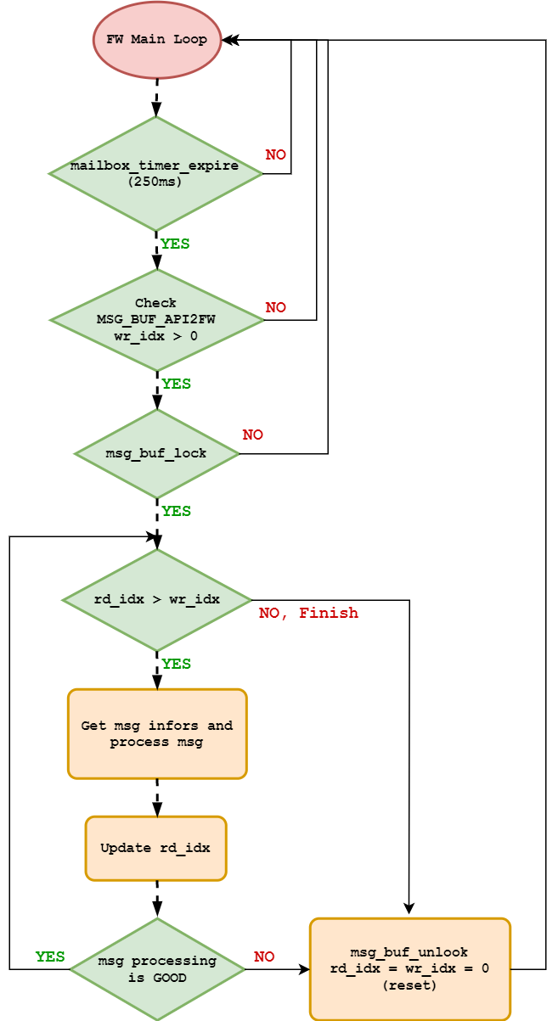
FW Architecture – Mailbox
Hardware Mailbox (unuse)
TXMAILBOX FIFO
RXMAILBOX FIFO
Software Mailbox:
MSG_BUF_API2FW
MSG_BUF_FW2API

Slide 10
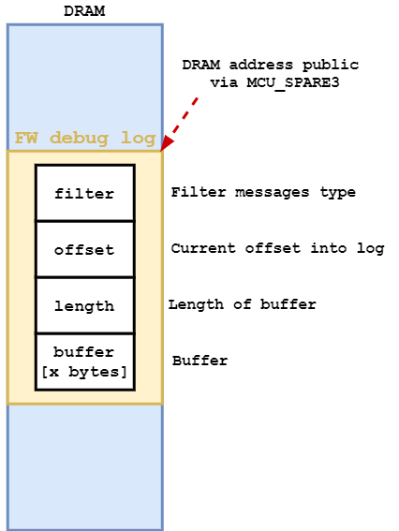
FW Architecture – Logger
Advertise log information:
Store logs in DRAM
Address/length
Size 3Kbytes
Query logs:
API read by PIF function (indirect to DRAM) to query the logs from FW.

Slide 11
CAPI Architecture – NEW
 | current | new | notes
rules store | static mem (DRAM) | static mem
rules transfer | spare register | ring buf: buf on spare register buf on DRAM | Lynx-API send/receive rule to CTC-FW (include cpl_rules)
rules send/receive | spare register | ipc messeger | Lynx-API to CTC-FW
soft-mailbox | static mem (DRAM)
logger | static mem (DRAM)

Slide 12
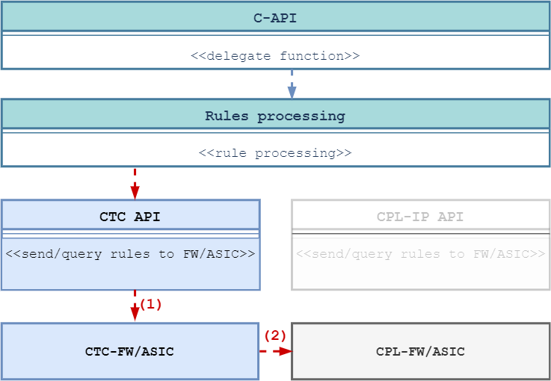
CAPI Architecture – Rules Apply Flow via CTC-FW
Set a rules:
Collect a rules at CAPI layer
Process a rules
(1) Send and apply rules via Ring-Message to CTC-FW/ASIC
(2) CTC-FW will handle and apply the rules to CPL-FW/ASIC via Spare register (No change)
Compare with the current mechanism.
ALL rules will be transfer via CTC-FW. This will improve the I2C access to CPL_IP issues.
What need to do: (CTC-FW, CTC-API, CPL-API)
Update API adapt layer to send ALL rules to CTC-FW/ASIC
Implement Ring-Message to send/receive in CTC-FW
Implement CPL rules handling in CTC-FW (move from API layer to FW)
DETAIL Rules transfer

Slide 13
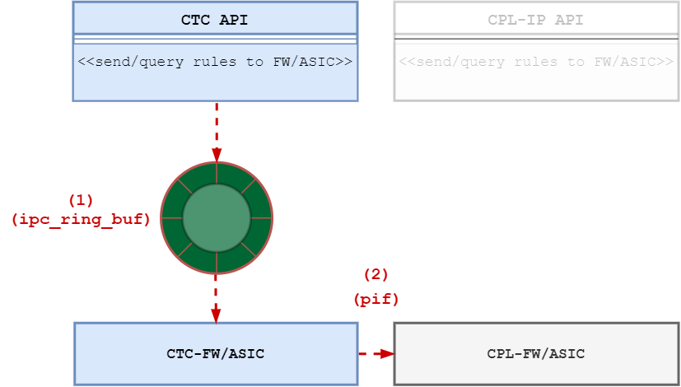
CAPI Architecture – Solution#1 (DO NOT USE)
(1)
Define a common ipc msg (encoder/decoder rules to msg buffer).
Define a ring buffer to transfer data between API/FW
Via DRAM memory (pif read/write)
Via Spare register
Rules, status send/receive via ipc + ring_buffer
(2)
Share CPL DRAM memory. Set/Get via pif read/write
=>
More change on CTC and CPL.
More delay when access via PIF

Slide 14
CAPI Architecture – Solution#1 (DO NOT USE)
NO# | TASK | NOTEs
1 | Add ipc messager at Lynx-API
2 | Add ipc messager at Lynx-FW (CTC-FW)
3 | Add ring buffer at Lynx-API
4 | Add ring buffer at Lynx-FW (Use DRAM memory)
5 | Rules send/receive using ipc/ring buffer
5.1 | Update C-API wrapper: send rules via Lynx-FW
5.2 | Update Lynx-FW: handle msg from C-API
5.3 | Update Lynx-FW: process msg, apply CPL Rules via share mem (pif access)
5.4 | Update CPL-FW: handle rules change/query

Slide 15
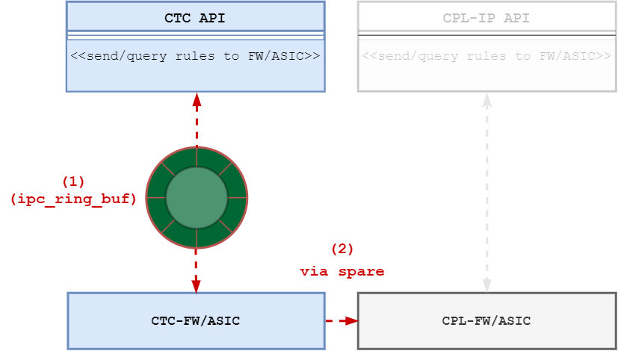
CAPI Architecture – Solution#2
(1)
Define a common ipc msg (encoder/decoder rules to msg buffer).
Define a ring buffer to transfer data between API/FW
Via DRAM memory (pif read/write)
Via Spare register
Rules, status send/receive via ipc + ring_buffer
(2)
Set/Get via spare register (NO CHANGE)
=> Most of update will be on CTC-FW/C-API.

Slide 16
CAPI Architecture – Solution#2
NO# | TASK | NOTEs
1 | Add ipc messager at Lynx-API
2 | Add ipc messager at Lynx-FW (CTC-FW)
3 | Add ring buffer at Lynx-API
4 | Add ring buffer at Lynx-FW (Use DRAM memory)
5 | Rules send/receive using ipc/ring buffer
5.1 | Update C-API wrapper: send rules via Lynx-FW
5.2 | Update Lynx-FW: handle msg from C-API
5.3 | Update Lynx-FW: process msg, apply CPL Rules via spare register
5.4 | Update CPL-FW: handle rules change/query | No update

Slide 17
CAPI - FW IPC
NO# | API | NOTEs
1 | hsc_bundle_start
2
3
4
5

Slide 18
ANLT ACC Application
more detail at (proposal from MikeT)

Slide 19
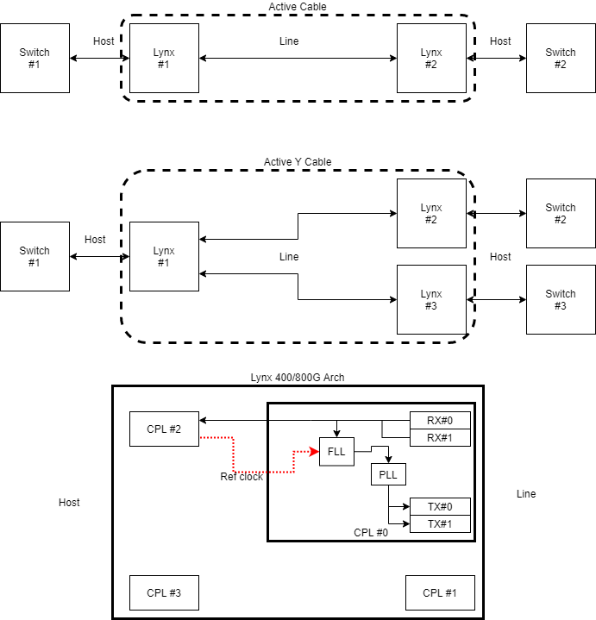
AN/LT at both Host and Line side
Configure: PAM4 (NRZ), AN/LT Re-timer Bundle (or Gearbox Bundle) for Ethernet Service
Assume: Plug Lynx#1 into Switch#1 and then plug Lynx#2 into Switch#2
Configure sequence:
Lynx#1: Power up
Lynx#1: Line/Host TX PLL ref from ERU (system clock)
Lynx#1: Configure Host and Line ANLT Bundle with default abilities.
Lynx#1: Line TX/RX: configure abilities = 4x100G, 4x50G. AN/LT restart
Lynx#1: Line RX/TX: AN ??, LT ??, DSP ??
Lynx#2: Power up
Lynx#2: Line/Host TX PLL ref from ERU (system clock)
Lynx#2: Configure Host and Line ANLT Bundle with default abilities.
Lynx#2: Host TX/RX: AN up, LT up, DSP up (Switch#2 ←→ Lynx#2), 4x50G
Lynx#2: Line TX/RX configure AN abilities = 4x50G, Restart AN/LT at Line side
Lynx#2: Line TX/RX: AN up, LT up, DSP up (Lynx#2 ←→ Lynx#1), 4x50G
Lynx#1: Line TX/RX: AN up, LT up, DSP up (Lynx#2 ←→ Lynx#1), 4x50G
Lynx#1: detect Host/Line AN abilities mismatch, Host side is 4x100G, Line side is 4x50G
Lynx#1: Host TX/RX: configure abilities = 4x50G. AN/LT restart
Lynx#1: Host TX/RX: AN up, LT up, DSP up (Lynx#1 ←→ Lynx#2), 4x50G
AN/LT Done with system clock.
Lynx#1,2: Line/Host PLL ref from FLL. (Switch clock source from system to RX source). Expect: AN/LT must not re-start on Switch #1,2 and Lynx#1,2(3)

Slide 20
CTC-Firmware state
Auto-Run if see bit is trigger!
CTC power-up
Load CTC-FW
Step A#1: Start AN with CAPS from user and latched RX_CAPS_HOST from Link Partner.
Step A#2: Start AN with CAPS from user and latched RX_CAPS_LINE from Link Partner.
Step A#3: Find HCD (RX_CAPS_HOST & RX_CAPS_LINE)
May move to A#1 if can not have HCD??
STEP B#0: Set up ANLT run at LINE and disable ANLT at HOST
STEP B#1 If LINE SIDE ANLT done, then start to ANLT handshake at HOST
If LINE ANLT can not be done and HCD mismatch → Back to Step#A1
STEP B#2: Wait ANLT done at HOST and LTX use PRBS-Y
If HOST ANLT can not be done and HDC mismatch → Back to Step#A1
STEP B#3 LRX check PRBS-Y to be sync in 50ms
STEP B#4: Wait LRX PRBS-13 pattern sync mean remote LTX switch FLL done, move to STEP B#5
STEP B#5 HTX FLL, and waiting to FLL done and move to STEP B#6
STEP B#6 HTX FLL done, then move to STEP B#7 to PRBS off
STEP B#7 PRBS off and traffic PCS will be active
STEP B#8 DONE, If any failure → Try to Step B#0 first…

Slide 21
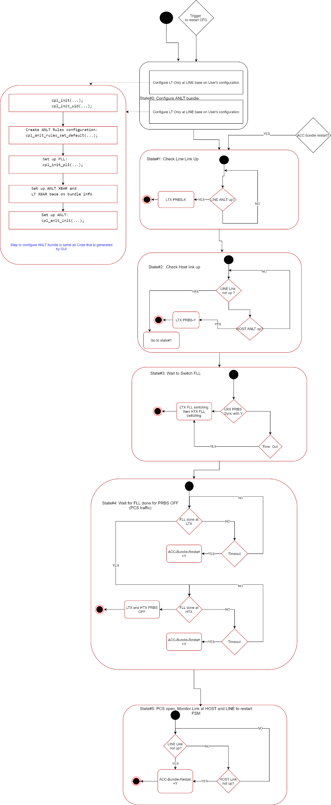
CTC-Firmware state

