Slide 1
Phishing URL Detection on PhiUSIIL
A Leakage-Aware Comparison of Classical, Character-Level, and Clustering Methods
Pranav Dhinakar · Jason Justice · Guna Pasupathy
AAI-501: Introduction to Artificial Intelligence — Group 2
Shiley-Marcos School of Engineering, University of San Diego
Professor Andrew Van Benschoten · August 2026
▶ Recording: [ add video link here before submission ]
Code: github.com/jjusticeusd/AAI-501-Final-Team-Project-Group2
Notes:
[Presenter: Guna (intro)]
Hi everyone — we're Group 2: Pranav, Jason, and Guna. Our final project is phishing URL detection on the PhiUSIIL dataset from the UCI repository.
Each of us owned one notebook and will present one part of the talk, roughly eight minutes each, and we'll close with a shared synthesis.
REMINDER BEFORE SUBMISSION: paste the YouTube/Vimeo link for this recording into the box on this slide — the course requires the video link on the title page.

Slide 2
THE ONE-LINE STORY
Our models hit 99.99% accuracy.
This talk is about why that was the wrong thing to celebrate.
1
The data & the leakage audit
Guna Pasupathy
Why PhiUSIIL is “too easy,” and what we did about it
2
Classical models & the cost of errors
Jason Justice
Three classifiers saturate — so the decisions move to thresholds and costs
3
Hard mode: CharCNN, clustering & SOTA
Pranav Dhinakar
A model that only sees URL characters, phishing “families,” and the literature
4
Does any of it hold up?
Guna Pasupathy
Significance tests, realistic base rates, and a cross-dataset stress test
✓
Synthesis & takeaways
All of us
Independent proofs, limitations, and what we'd tell the next team
AAI-501 · Group 2 · Phishing URL Detection on PhiUSIIL
2
Notes:
[Presenter: Guna]
Here's the whole project in one sentence: our models hit 99.99% accuracy, and this talk is about why that was the wrong thing to celebrate.
On most benchmarks, 99.99% would mean we're done. On this one, it was a warning sign. The dataset turns out to be so easy that accuracy stops being informative — so the real work of the project became figuring out WHY it's easy, proving it carefully, and then asking what a useful result even looks like when accuracy is saturated.
The talk has four parts. I'll start with the data and the leakage audit. Jason takes the classical models and shows that once accuracy saturates, the interesting decisions move into thresholds and costs. Pranav then makes the problem as hard as we could make it — a model that sees nothing but the raw URL string — plus clustering and the state-of-the-art comparison. Part four is our validity check: statistical significance, realistic base rates, and a cross-dataset stress test that produced our most surprising result. We close together with the synthesis.

Slide 3
01
The Data & the Leakage Audit
Presented by Guna Pasupathy
Notebook 01 — load, audit, explore
Three leakage checks, one surprise
The 49-feature “safe list” the rest of the project builds on
Notes:
[Presenter: Guna]
Part one is the foundation everything else sits on: the dataset, a three-part leakage audit, and the exploratory analysis. The short version: we went looking for one leaky column, found it — and then found something more interesting: the dataset stays almost perfectly separable even after you remove it.

Slide 4
PART 1 · THE PROBLEM
Can a model tell a phishing URL from a real one?
• Phishing — fake sites that impersonate real ones to steal credentials; still one of the most common attack vectors.
• Our task: binary classification — given a URL (and features about its page), label it phishing or legitimate.
• Why it's practical: this is exactly what browser warnings and mail gateways do at scale, millions of times a day.
• Course tie-in: supervised classification (LogReg, Random Forest, XGBoost), deep learning on character sequences, and unsupervised clustering — two algorithm families, compared experimentally.
LEGITIMATE
https://www.paypal.com/signin
PHISHING
http://paypa1-secure.com/login
One character off, one reassuring word added — that's often the whole trick.
AAI-501 · Group 2 · Phishing URL Detection on PhiUSIIL
4
Notes:
[Presenter: Guna]
Phishing is one of the most common ways scams and data breaches start: a fake site impersonates a real one and asks you to log in. Our task is the classic framing — given a URL and features describing it, classify it as phishing or legitimate.
The two example URLs on the right show why this is genuinely hard: the phishing one is a single character off from the real brand, with a reassuring word like 'secure' bolted on. Detection systems like browser warnings and mail gateways make this call millions of times a day, so even tiny error rates matter.
For the course requirements: we compare two different algorithm families — supervised classification with three classical models plus a character-level neural network, and unsupervised clustering — with controlled experimental comparisons throughout.

Slide 5
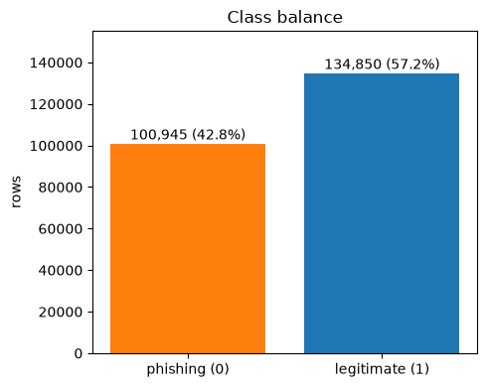
PART 1 · THE DATASET
PhiUSIIL — big, clean, labeled
235,795
54
labeled URLs (UCI ML Repository, id 967)
features — URL shape + crawled page content
57 / 43
0
legitimate vs phishing — mild imbalance, not severe
missing values — no heavy cleaning needed
Features come in two flavors: lexical (URL length, special characters, subdomains…) and page-content (lines of code, images, social links…) — that split becomes important later.
AAI-501 · Group 2 · Phishing URL Detection on PhiUSIIL
5
Notes:
[Presenter: Guna]
The dataset is PhiUSIIL from the UCI Machine Learning Repository — about 236 thousand labeled URLs with 54 features each. It's large, has zero missing values, and ships with features already engineered, so it comfortably meets the project's size and preprocessing requirements.
Two things to notice. First, the class balance: 57% legitimate, 43% phishing. Our proposal feedback assumed heavy imbalance, but it's actually mild — which shapes how we handle it later: class weights first, SMOTE only as a comparison experiment.
Second, the features come in two flavors: lexical features computed from the URL string itself, and page-content features that come from actually crawling the page — lines of code, images, social-media links. Keep that split in mind; it turns out to matter a lot for how easy this dataset is.

Slide 6
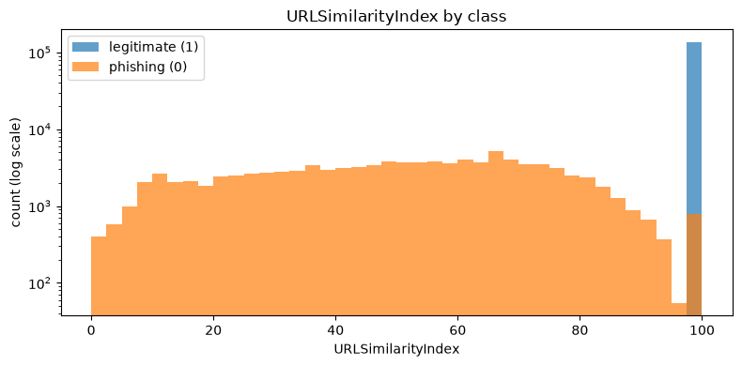
PART 1 · LEAKAGE CHECK 1
URLSimilarityIndex basically contains the answer
100.0
score of EVERY legitimate URL — exactly 100, std. dev. 0
99.6%
accuracy from this one column alone
But 786 phishing URLs also score 100 — so even the leak isn't perfect.
Takeaway The surprise: drop this column and the other ~50 features still reach 99.9%. The leak is real — but it's not the story.
AAI-501 · Group 2 · Phishing URL Detection on PhiUSIIL
6
Notes:
[Presenter: Guna]
First leakage check. URLSimilarityIndex measures how similar a URL is to known legitimate URLs — which means it more or less contains the answer. And the data confirms it: every single legitimate URL scores exactly 100, with zero variance. That's textbook leakage. A logistic regression using just this one column gets 99.6% accuracy.
The histogram is on a log scale because the legitimate spike at 100 — about 135 thousand rows — would flatten everything else. Interestingly, 786 phishing URLs also score 100, so even the leaky column can't reach perfect accuracy on its own.
But here's the finding that reframed our whole project: when we DROP the leaky column, the remaining fifty-ish features still hit 99.9%. So removing the obvious leak barely matters. The dataset is nearly this easy without it — and figuring out why became the real question.

Slide 7
PART 1 · LEAKAGE CHECK 2
“Too perfect” flags are collection artifacts
Feature | Legitimate | Phishing
IsHTTPS | 100% (no exceptions) | ~49%
HasSocialNet | 80% | 0.5%
HasCopyrightInfo | high | rare
HasDescription | high | rare
Our decision
• Keep these features for the tabular models…
• …but flag them in the report as collection artifacts, not real-world rules.
• Treat the URL-only model (Part 3) as the honest difficulty level.
• A rule “no HTTPS ⇒ phishing” is never wrong here — but that's not true of the real web. It reflects where the legitimate URLs were collected.
• Dropping the top-6 giveaway flags: accuracy barely moves. The easiness is spread across the whole feature set.
AAI-501 · Group 2 · Phishing URL Detection on PhiUSIIL
7
Notes:
[Presenter: Guna]
Second check: features that are 'too perfect.' The standout is IsHTTPS: 100% of legitimate URLs use HTTPS — zero exceptions — while only about half the phishing URLs do. So the rule 'no HTTPS means phishing' would literally never be wrong on this dataset. That's not how the real web works; it's a side effect of where the legitimate URLs were collected. Same pattern for HasSocialNet, HasCopyrightInfo, HasDescription — real sites have footers and meta tags, parked phishing pages usually don't.
We tested whether the easiness hides in these few columns: drop the top six giveaway flags and re-run the quick model — accuracy barely changes. The easiness is smeared across the whole feature set; there's no clean line where we could keep 'some' content features and get an honest problem.
So our decision: keep the features for the tabular models, clearly flag them as artifacts, and treat Pranav's URL-only model as the realistic difficulty level.

Slide 8
PART 1 · LEAKAGE CHECK 3
Duplicates, repeated domains — and how we split
425
9%
599
duplicate URLs → dropped before splitting
of rows share a domain with another row
junk numeric “TLDs” from IP hosts — all phishing
• Same URL (or domain) in train AND test = memorization, not learning. Top repeat offenders: ipfs.io, gateway.ipfs.io, cloudflare-ipfs.com — all gateways to the same service.
• Fix: GroupShuffleSplit on Domain — every domain lands entirely in train or entirely in test (80/20, fixed seed, shared by all notebooks).
• Reality check: grouped vs. random split makes essentially no difference to the score. The dataset wasn't inflated by repeats — it's just this easy. We keep the grouped split anyway: safer, and it costs nothing.
AAI-501 · Group 2 · Phishing URL Detection on PhiUSIIL
8
Notes:
[Presenter: Guna]
Third check: repetition. 425 URLs appear more than once, so we drop duplicates before splitting — otherwise the model gets tested on rows it literally saw in training. Beyond exact duplicates, about 9% of rows share a domain, and the top of that list is telling: ipfs.io, gateway.ipfs.io, cloudflare-ipfs.com — different strings, same underlying service.
Our fix is a domain-grouped split: GroupShuffleSplit on Domain, so every row from a domain lands on one side only. All three notebooks share this exact split — same seed — so every number in this talk is computed on the same test set.
The honest result: grouped versus random split makes essentially no difference. The score was never inflated by repeated domains; the dataset is just this easy. We keep the grouped split anyway because it's the defensible design.
One data-quality quirk worth a sentence: 599 rows have a number as their 'TLD' — for IP-address URLs, the dataset builders took the last octet of the IP. All 599 are phishing.

Slide 9
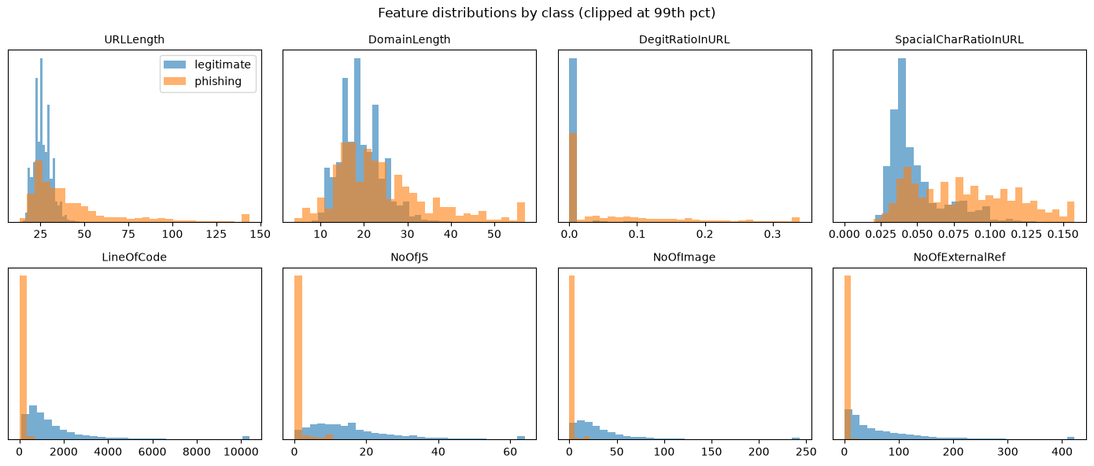
PART 1 · WHAT PHISHING ACTUALLY LOOKS LIKE
Most phishing pages are empty shells
12 vs 1,105
Median phishing page: 0 JS files, 0 images, 0 external references. Content features (bottom row) separate the classes almost alone; URL-shape features (top row) overlap heavily — a preview of why “URL-only” is the hard mode.
median lines of code — phishing vs legitimate page
AAI-501 · Group 2 · Phishing URL Detection on PhiUSIIL
9
Notes:
[Presenter: Guna]
Leakage aside, normal EDA: how do the two classes actually differ? The page-content features are dramatic. The median phishing page has 12 lines of code, zero JavaScript files, zero images, zero external references. The median legitimate page has over 1,100 lines. Most phishing pages are basically empty shells — someone registered a domain, dropped in a stub page, done.
Look at the two rows of distributions. The bottom row — content features — separates the classes almost by itself, with phishing piled up at zero. The top row — URL-shape features like length and special characters — overlaps a lot. Phishing URLs are a bit longer and messier, but nowhere near separable on their own.
That gap between rows is the whole plot of this talk: models with content features get an easy problem; a model with only the URL gets the harder, more realistic one. That's exactly the comparison Pranav runs in Part 3.

Slide 10
PART 1 · HAND-OFF
The audit in one slide
• Dropped: URLSimilarityIndex (leaky), URL / Domain / Title (identifiers).
• Kept but flagged: IsHTTPS & friends — collection artifacts.
• Dropped duplicates, grouped the split by Domain.
• Kept TLDLegitimateProb — we verified it was NOT computed from these labels (correlation ≈ 0.18, not ≈ 1).
49
“safe” features saved to a shared manifest — every notebook uses the same list
~99.9%
accuracy that survives the entire cleanup
Takeaway Cleaning didn't make the problem hard. So the question changed: from “how accurate?” to “why is this so easy — and what's still worth measuring?”
AAI-501 · Group 2 · Phishing URL Detection on PhiUSIIL
10
Notes:
[Presenter: Guna]
Here's where the audit lands. We drop the similarity index and the identifier columns; we keep the artifact-y flags but label them honestly; we de-duplicate and group the split by domain. One nice verification: TLDLegitimateProb — a trustworthiness score for the URL's top-level domain — could have been leakage if UCI had computed it from this dataset's own labels. If they had, its correlation with the per-TLD share of legitimate rows would be near 1. It's 0.18, so it's safe to keep.
The output is a manifest of 49 safe features, saved to a JSON file that notebooks 02 and 03 both load — so the whole team models on the identical agreed feature set.
And the punchline of Part 1: after ALL of that cleaning, the quick model still scores about 99.9%. We didn't make the problem hard — we proved it can't easily be made hard. That changes what a good result looks like, and that's where Jason picks up.

Slide 11
02
Classical Models & the Cost of Errors
Presented by Jason Justice
Notebook 02 — LogReg, Random Forest, XGBoost
An honest negative result about our own features
When accuracy saturates, thresholds and costs are where the decisions live
Notes:
[Presenter: Jason]
Thanks Guna. Part two: the classical supervised models. Three classifiers, an imbalance ablation, tuning, feature importance — and then the part I think is most useful: what you do with a model when accuracy is so high it stops telling you anything. Spoiler: you stop staring at accuracy and start making cost decisions.

Slide 12
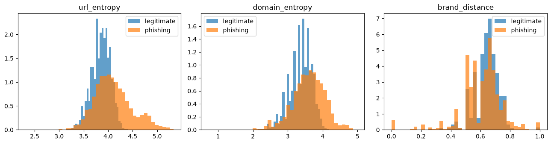
PART 2 · OUR “TWIST” FEATURES
Four signals the dataset doesn't already have
url_entropy / domain_entropy
brand_distance
Shannon entropy — randomly generated (DGA-style) domains look more random
smallest edit distance to a known brand — close-but-not-equal is the typosquat signal (paypa1, paypal-secure)
is_punycode
is_shortener
domain uses xn-- — internationalized homograph attacks
registered domain is a known URL shortener
AAI-501 · Group 2 · Phishing URL Detection on PhiUSIIL
12
Notes:
[Presenter: Jason]
PhiUSIIL already ships lexical ratios and page-content counts, so our engineered features had to add something genuinely new. We built four signals from the raw URL and domain strings.
Character-level Shannon entropy for the URL and the domain — machine-generated domains tend to look more random than human-chosen names. Brand distance — the smallest edit distance from the domain to a curated brand list, because a domain that's CLOSE to PayPal but not exactly PayPal is the classic typosquatting signal. And two flags: punycode domains, used in homograph attacks, and known URL shorteners.
The distributions at the bottom already hint at the honest result coming in two slides: the class separation is modest. These features are reasonable ideas — they're the kind of thing real security teams compute — but on THIS dataset, they're about to be upstaged by the features that ship in the box.

Slide 13
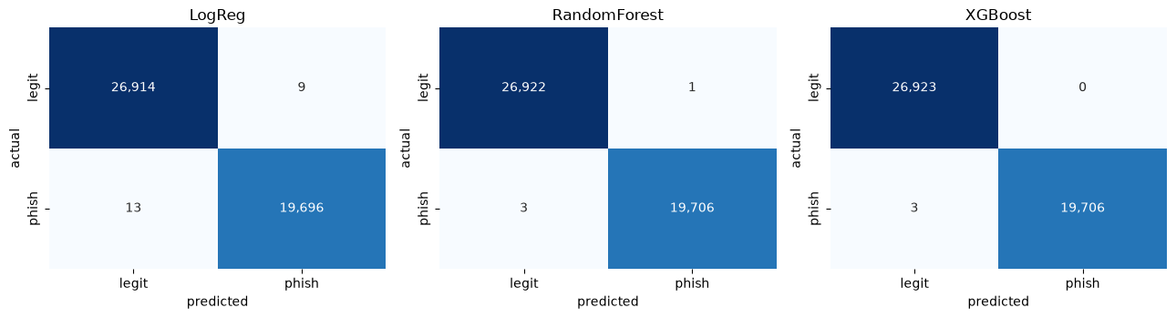
PART 2 · MODEL ROSTER
All three classifiers saturate
Model | Accuracy | Precision | Recall | F1 | PR-AUC
Logistic Regression | 0.9995 | 0.9995 | 0.9993 | 0.9994 | 1.0
Random Forest | 0.9999 | 0.9999 | 0.9998 | 0.9999 | 1.0
XGBoost | 0.9999 | 1.0000 | 0.9998 | 0.9999 | 1.0
Phishing = positive class
so precision & recall describe catching phishing.
Takeaway Tuning found the defaults. SMOTE vs. class weights vs. nothing: identical. At this ceiling, model ranking is noise — the dataset is the result.
AAI-501 · Group 2 · Phishing URL Detection on PhiUSIIL
13
Notes:
[Presenter: Jason]
The roster: logistic regression as the interpretable baseline, random forest, and XGBoost — all class-weighted, all on the same domain-grouped split, with phishing as the positive class so precision and recall describe catching phishing.
The results are almost comically saturated. Logistic regression 99.95, both ensembles 99.99, PR-AUC rounds to 1.0 across the board. Two experiments confirm there's nothing left to squeeze. The imbalance ablation — no balancing versus class weights versus SMOTE — produces virtually identical rows, which matches Guna's point that a 57/43 split is mild; resampling buys nothing. And randomized hyperparameter search with grouped cross-validation essentially handed back the default parameters. When tuning finds the defaults, your model isn't the bottleneck.
So the honest read: at this ceiling, the RANKING among models is noise. The interesting questions are elsewhere — starting with what the models actually learned.

Slide 14
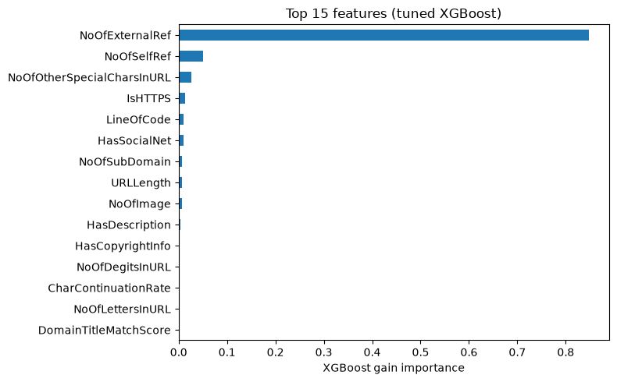
PART 2 · WHAT THE MODEL ACTUALLY USES
Our engineered features failed — and that's a finding
• Two views agree: XGBoost gain + permutation importance.
• Page-content & URL-structure columns dominate (IsHTTPS, LineOfCode, NoOfExternalRef…).
• Our four features rank 22nd–54th with ~zero gain.
Why report a failure?
Because it's true and it's informative: the shipped content features already carry all the signal here.
AAI-501 · Group 2 · Phishing URL Detection on PhiUSIIL
14
Notes:
[Presenter: Jason]
So what does the winning model actually use? We looked at feature importance two ways — XGBoost's built-in gain, and permutation importance, where you shuffle a feature and watch how much PR-AUC drops. Both views agree: page-content and URL-structure columns dominate — IsHTTPS, LineOfCode, the external-reference counts.
And our four engineered features? They land between rank 22 and rank 54 — the bottom of the table, with essentially zero gain. The features we designed, the 'twist' we were proud of, contribute nothing here.
We chose to report that as a first-class result rather than bury it, for two reasons. First, it's true, and pretending otherwise would be exactly the kind of dishonest reporting this project is arguing against. Second, it's genuinely informative: it says the shipped content features already carry all the separating signal on this dataset. Entropy and brand distance aren't bad ideas — they're just redundant HERE. One caveat from Guna's audit: the strong features are correlated with each other, so exact rankings shouldn't be over-read.

Slide 15
PART 2 · FEATURE SELECTION
Eight features do the work of forty-nine
Model | Accuracy | Precision | Recall | F1
XGBoost — all 49 features (tuned) | 0.9999 | 1.000 | 0.9998 | 0.9999
XGBoost — top 8 features only | 0.9994 | 0.999 | 0.9995 | 0.9993
The top 8:
NoOfExternalRef
NoOfSelfRef
NoOfOtherSpecialChars
IsHTTPS
LineOfCode
HasSocialNet
NoOfSubDomain
URLLength
Takeaway Actionable: a production filter could collect 8 signals per URL instead of 49 and lose almost nothing.
(Exactly the pattern the assignment calls out: if a top-K model matches the full model, that's a deployable simplification.)
AAI-501 · Group 2 · Phishing URL Detection on PhiUSIIL
15
Notes:
[Presenter: Jason]
Feature importance suggests most of the 49 features are along for the ride — so we tested that directly, the way the assignment brief suggests: retrain on just the top eight features and compare.
The result: 99.94% accuracy versus 99.99% for the full tuned model. Five features of external references and self references, special-character counts, HTTPS, lines of code, a social-network flag, subdomains, and URL length — eight signals recover essentially the entire model.
Why does this matter outside the classroom? Because in production, every feature has a cost. Some of these need a full page crawl; collecting 49 signals per URL at web scale is expensive. If eight cheap-ish signals get you 99.9%, that's a real engineering win — smaller pipeline, faster scoring, fewer things to break. It's the most directly actionable result in the classical part of the project.

Slide 16
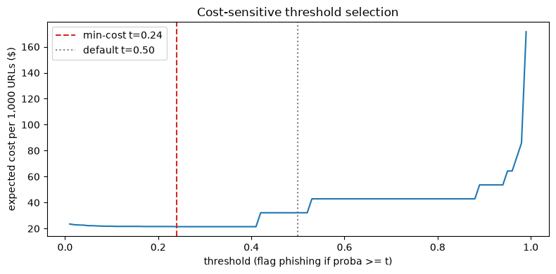
PART 2 · COST-SENSITIVE DECISIONS
Not all errors cost the same
$500 vs $5
illustrative cost: missed phishing (FN) vs wrongly blocked site (FP)
0.24
cost-minimizing threshold — not the default 0.5
Takeaway Sweeping the threshold cuts expected cost from $32.17 to $21.44 per 1,000 URLs — a 33% saving with zero model changes.
AAI-501 · Group 2 · Phishing URL Detection on PhiUSIIL
16
Notes:
[Presenter: Jason]
Here's where saturated accuracy stops being a dead end and becomes a design question: where do you want the few remaining errors to FALL? That depends on what each error costs, and for phishing the costs are wildly asymmetric. A false negative — phishing that gets through — risks credential theft and fraud; we set it an order of magnitude-plus higher than a false positive, which mostly costs user friction and a support ticket. Our numbers — 500 dollars versus 5 — are illustrative, loosely anchored to public breach-cost figures, not gospel.
With costs attached, you sweep the decision threshold and plot expected cost per thousand URLs — that's the curve. The minimum lands at a threshold of 0.24, well below the default 0.5, precisely because misses are pricier: the model should lean toward flagging.
The saving: 21 dollars 44 versus 32 dollars 17 per thousand URLs — a third of the cost gone, without touching the model. One line of code, if you know your costs.

Slide 17
PART 2 · DEPLOYMENT
The “right” metric depends on where the model sits
Browser warning
Mail / endpoint gateway
PRECISION-FIRST
RECALL-FIRST
Wrongly blocking a legit site is loud and visible — accept lower recall for near-perfect precision.
A missed phish reaching an inbox is the expensive outcome — quarantine silently, maximize recall.
Closer to reality than one cutoff — a three-tier policy on our test set:
ALLOW
WARN
BLOCK
26,926
2
19,704
Takeaway Same model, three different deployments — the threshold is a business decision, not a math constant.
AAI-501 · Group 2 · Phishing URL Detection on PhiUSIIL
17
Notes:
[Presenter: Jason]
Last piece of my section: there is no single 'right' operating point — it follows the deployment. A browser warning system, Google-Safe-Browsing style, is precision-first: wrongly blocking someone's legitimate site is loud, visible, and embarrassing, so you accept missing a bit more phishing to almost never cry wolf. A mail or endpoint gateway that quarantines silently is the opposite — recall-first — because the expensive event is a phish reaching an inbox.
And real filters usually aren't binary at all. We report a three-tier allow / warn / block policy: on our test set that's about 27 thousand URLs allowed, 19.7 thousand blocked, and a warning band in between — just 2 URLs here, because this model's scores are so polarized.
The theme of my whole section in one line: when accuracy saturates, the model stops being the interesting decision — the THRESHOLD is, and that's a business call, not a math constant. Now Pranav gets to make the problem actually hard.

Slide 18
03
Hard Mode: CharCNN, Clustering & SOTA
Presented by Pranav Dhinakar
Notebook 03 — deep learning on raw URL characters
Unsupervised “attack families” in the phishing class
Where our numbers sit in the published literature
Notes:
[Presenter: Pranav]
Thanks Jason. My section is 'hard mode.' Guna showed the content features make this dataset easy; Jason showed the classical models saturate on them. So I take everything away: a model that sees nothing but the raw characters of the URL — no features, no page content, nothing that can leak. Then clustering, to ask what KINDS of phishing are in here, and finally the state-of-the-art comparison.

Slide 19
PART 3 · ONE DECISION FIRST
How strictly should train/test be separated?
Grouping strategy | Groups | Accuracy | F1
Exact Domain (NB01/NB02) | 220,086 | 0.9995 | 0.9996
PaaS-aware eTLD+1 | 197,709 | 0.9993 | 0.9994
Naive eTLD+1 (strictest) | 175,509 | 0.9990 | 0.9992
• Stricter grouping = registered domain (eTLD+1): collapses ipfs.io / gateway.ipfs.io / cf-ipfs.com into one group so siblings can't straddle the split.
• Across a 44,577-group range of strictness, accuracy moves 0.9995 → 0.9990. Monotonic — the direction leakage predicts — but negligible.
• Decision: adopt NB02's exact-Domain split so the CNN shares the identical test set and every comparison is apples-to-apples.
AAI-501 · Group 2 · Phishing URL Detection on PhiUSIIL
19
Notes:
[Presenter: Pranav]
Before training anything, one design decision: how strictly to separate train and test. Guna grouped by the exact domain string, and flagged that this under-groups — ipfs.io and gateway.ipfs.io count as different domains but are the same service. The stricter option groups by registered domain, eTLD-plus-one via tldextract, which collapses those siblings.
We ran three strictness levels through the same quick model. From 220 thousand groups down to 175 thousand — a range of nearly 45 thousand groups — accuracy moves from 0.9995 to 0.9990. The drop is monotonic with strictness, which is exactly the direction leakage would predict, but it's negligible in size. That's Guna's finding confirmed a second, independent way: the dataset is easy no matter how conservatively you draw the split.
Since the score is grouping-invariant, we adopt notebook 02's exact-Domain split unchanged — which means my character model is evaluated on the IDENTICAL test rows as Jason's XGBoost. Every comparison you're about to see is apples to apples.

Slide 20
PART 3 · THE MODEL
A small CNN that reads URLs character by character
raw URL
embedding
3 parallel convs
global max-pool
dropout 0.4 → sigmoid
→
→
→
→
≤ 200 chars, 67-char vocab
each char → 48-d vector
widths 3 / 5 / 7 × 128 filters
keep strongest n-gram hits
phishing probability
~96k
1 epoch
0
parameters — tiny by deep-learning standards
to converge (val PR-AUC 0.9988)
features it can leak from — it sees only the characters
Takeaway Leakage-immune by construction: no URLSimilarityIndex, no page content, no engineered features. Just the string.
AAI-501 · Group 2 · Phishing URL Detection on PhiUSIIL
20
Notes:
[Presenter: Pranav]
The model is a character-level convolutional network, adapted from Kim's classic text-CNN. The pipeline: take the URL as a plain string, up to 200 characters, which covers about the 99th percentile of lengths. Each character becomes a 48-dimensional learned vector. Then three convolutions run in parallel with window sizes 3, 5, and 7 — think of them as pattern detectors for character 3-grams, 5-grams, and 7-grams: things like 'xn--', '.tk/', or 'login'. Global max-pooling keeps each filter's strongest hit anywhere in the URL, dropout regularizes, and one output unit gives the phishing probability. Class weighting handles the mild imbalance.
Two things worth stressing. It's small — about 96 thousand parameters, which trains on a laptop in minutes, and it converged after a single epoch. And it's leakage-immune BY CONSTRUCTION: it cannot see the similarity index, the page content, or our engineered features, because its entire input is the character sequence. If leakage explains the earlier numbers, this model should do much worse.

Slide 21
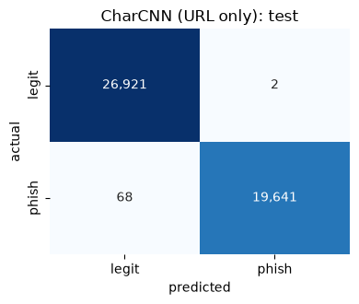
PART 3 · HARD MODE RESULTS
It nearly ties the models that see everything
0.9985
0.9993
accuracy — URL characters only
PR-AUC (precision 0.9999, recall 0.9965)
1 / 69
0.0015
false positives / false negatives on 46,632 test URLs
the entire accuracy gap to full-feature XGBoost
Takeaway The separability isn't in the leaky columns — it's in the raw URL strings themselves. That's the project's central finding, proved a third way.
AAI-501 · Group 2 · Phishing URL Detection on PhiUSIIL
21
Notes:
[Presenter: Pranav]
Here's the punchline of the deep-learning section. The character model — which sees nothing but the URL string — scores 99.85% accuracy with a PR-AUC of 0.9993. On the 46 thousand test URLs it makes exactly one false positive and 69 false negatives. The gap to Jason's full-feature XGBoost is 0.0015 in accuracy. Hard mode… wasn't hard.
Think about what that means: a model denied every feature we worried about — the similarity index, the page content, the engineered features — essentially ties the models that see all 49. So the separability isn't hiding in a leaky column; it goes all the way down to the raw characters. The legitimate and phishing URLs in this dataset come from systematically different sources — real registered domains on one side; IP hosts, IPFS gateways, and random tokens on the other — and those differences are visible character by character.
One caveat for honesty: the exact-domain split still lets platform siblings — like different apps on web.app — land on both sides. The grouping analysis says that's not the main driver, but a character model is more exposed to it than a linear one.

Slide 22
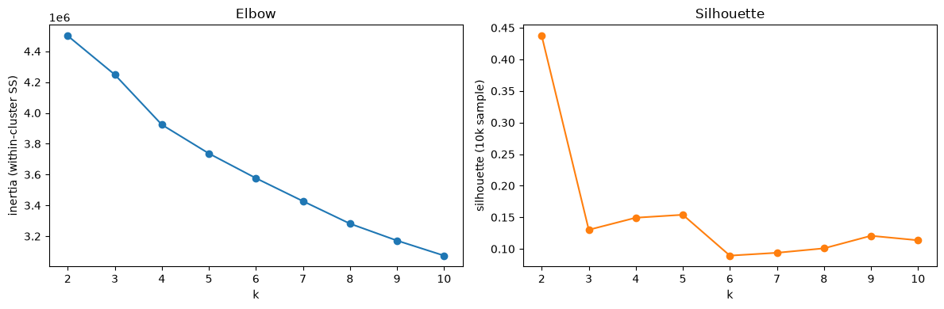
PART 3 · UNSUPERVISED
What KINDS of phishing are in here? Choosing k
k = 2
k = 5
Method: KMeans on phishing rows only, using the 49 safe features (label held out); HDBSCAN as a density-based cross-check.
strongest structure (silhouette 0.44): empty shells vs. content pages
chosen for interpretable families (silhouette 0.15 — soft strata)
AAI-501 · Group 2 · Phishing URL Detection on PhiUSIIL
22
Notes:
[Presenter: Pranav]
Classification answers 'is this phishing?' Clustering asks a different question: what KINDS of phishing does this dataset contain? This is also our second algorithm family for the course requirement. We cluster only the phishing rows, on the 49 safe features, with the label held out — and we deliberately do NOT feed cluster IDs back into any classifier, to avoid opening a fresh leakage question.
Choosing k honestly: the silhouette score has a sharp peak at k equals 2, at 0.44 — the strongest structure in phishing is a single binary split, empty shells versus pages with content, which matches Guna's EDA exactly. But two clusters is too coarse to be interesting, so we take the local peak among higher k values: k equals 5, with a silhouette around 0.15.
That low number is worth being upfront about: 0.15 means these are overlapping, descriptive strata — useful names for regions of the data — not five crisply separated islands. We'll verify that honestly with a density-based method in a moment.

Slide 23
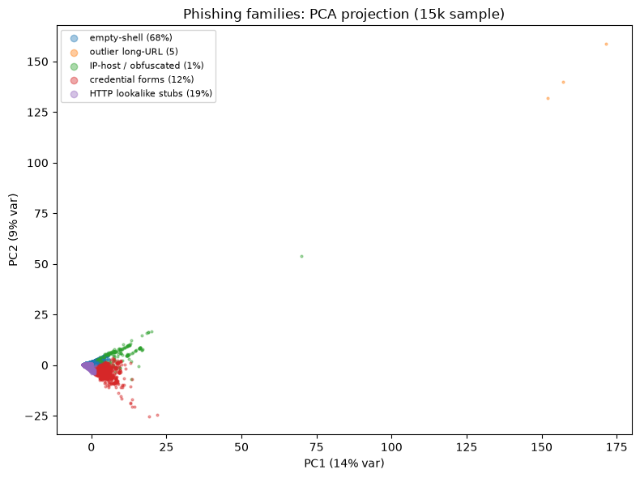
PART 3 · THE FAMILIES
One giant family of empty shells — plus real attack types
Family | Share | Signature
Empty-shell pages | 68.4% | no title, no forms, ~40 lines of code — parked stubs
HTTP lookalike stubs | 18.7% | brand-matching titles, short clean URLs, only 17% HTTPS
Credential-harvesting forms | 11.7% | password + submit + hidden fields — fake logins
IP-host / obfuscated | 1.1% | obfuscation flags, 39% IP-hosted, parameter-heavy URLs
Outlier micro-cluster | 5 rows | ~4,128-char URLs — a KMeans artifact, not a family
• PCA: one dense mass (PC1+PC2 = 22.9% var) — not five islands.
• HDBSCAN: 25 micro-clusters + 30% noise — kit-level pockets, confirms soft structure.
Takeaway Phishing splits into “steal credentials directly” vs. “look legitimate cheaply” — but the boundaries are soft, and saying so is part of the result.
AAI-501 · Group 2 · Phishing URL Detection on PhiUSIIL
23
Notes:
[Presenter: Pranav]
Profiling the five centroids gives recognizable attack families. The dominant one, 68% of all phishing rows, is empty-shell pages — no title, no forms, about 40 lines of code. Parked stubs. Then two genuinely active attack types that separate cleanly: HTTP lookalike stubs, about 19% — pages whose titles match their domain so they look brand-consistent, but only 17% use HTTPS — and credential-harvesting forms, about 12%, with the password-field, submit-button, hidden-field signature of a fake login page. A small 1% group is IP-hosted and obfuscated. And one 'family' of exactly 5 rows is really a KMeans artifact — five URLs over 4,000 characters long grabbed their own centroid.
We stress-tested this structure. The PCA projection shows one dense overlapping mass, not five islands. And HDBSCAN, a density-based method, finds 25 micro-clusters — probably near-identical phishing KITS, templated pages reused across many URLs — while calling 30% of rows noise. It also refuses to reproduce the 5-row cluster, confirming it was an artifact.
So the honest summary: a few dominant modes, many kit-level pockets, and a continuous remainder. Naming the strata is useful; pretending they're crisp would be overclaiming.

Slide 24
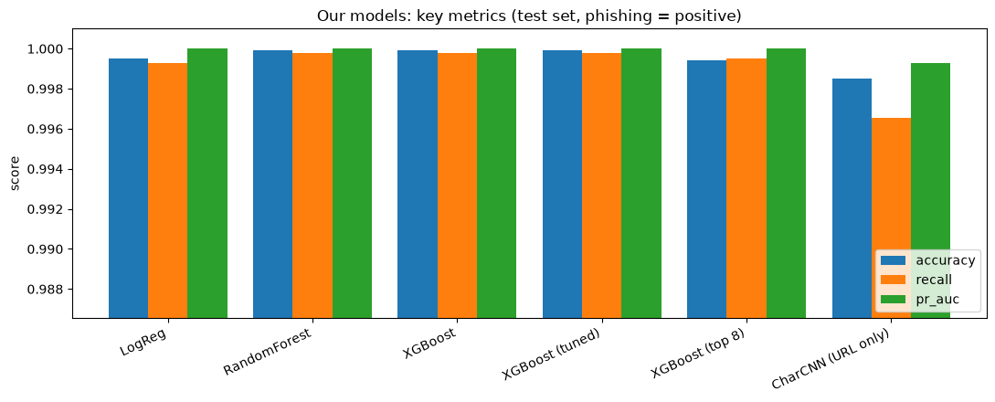
PART 3 · STATE OF THE ART
Everyone lands in the same band — including us
• Published PhiUSIIL results: 99.5–100% — our five supervised models all land inside the band.
• URL-only literature on harder corpora: 97–99% (Sahingoz 2019: 97.98%). We're above it because the DATASET is easier, not because our architecture is better.
Our claim, in full:
“about 99.85% on PhiUSIIL.” Full stop. No SOTA claim.
AAI-501 · Group 2 · Phishing URL Detection on PhiUSIIL
24
Notes:
[Presenter: Pranav]
Finally, where do we sit in the literature? Two framing rules kept us honest. First, numbers are only comparable within a dataset — accuracy on PhiUSIIL and accuracy on another corpus are different measurements. Second, several published numbers come from secondary citations we couldn't independently verify, and sources sometimes disagree — so we flag those and treat them as directional.
On PhiUSIIL itself, the dataset authors and a stack of independent reproductions all report between 99.5 and 100 percent, across completely different model families. Our five supervised models land inside that band — we reproduce the known ceiling; we're not an outlier. For URL-only models on harder, cross-source corpora, the literature brackets roughly 97 to 99 percent — Sahingoz 2019's random forest at 97.98% is the firmest number. Our CharCNN sits above that band, and we want to be crystal clear about why: because PhiUSIIL is more separable at the string level, NOT because our architecture is stronger.
So our claim, in full, is: about 99.85% on PhiUSIIL. Full stop. No state-of-the-art claim — and writing it that way is deliberate.

Slide 25
04
Does Any of It Hold Up?
Presented by Guna Pasupathy
Notebook 04 — validity & error analysis
Statistical significance, realistic base rates
The misses that matter — and a cross-dataset stress test
Notes:
[Presenter: Guna]
Thanks Pranav. One more part before we wrap up: the follow-up questions all those beautiful numbers raise. Are the differences between our models even statistically meaningful? What do benchmark numbers mean at real-world phishing rates? What do the URLs we still miss look like? And the harshest test of all: does a model trained on this benchmark work on data collected by someone else? That last one produced the most surprising result of the whole project.

Slide 26
PART 4 · SIGNIFICANCE
Two regimes, one statistically real gap
Regime | Errors on 46,632 | Accuracy (95% CI)
Full — 49 clean features | 2 (0 FP / 2 FN) | 0.99996 [0.99989, 1.00000]
URL-only — 21 features | 90 (12 FP / 78 FN) | 0.99807 [0.99764, 0.99846]
• URL-only = the pre-click setting: nothing that needs fetching the page. The confidence intervals don't overlap; the gap is real.
• Our engineered features fail here too: adding them changes accuracy 0.9981 → 0.9980, ranks 14–22 of 26. Notebook 02's open question is now closed — in both regimes.
• Dropping IsHTTPS costs only ~0.0004 — the URL-only result doesn't secretly lean on the collection artifact.
1.7e-24
McNemar's exact test p-value — not noise
Takeaway The full-feature model really is better on this test set. Now — what do these numbers mean outside the test set?
AAI-501 · Group 2 · Phishing URL Detection on PhiUSIIL
26
Notes:
[Presenter: Guna]
First question: with 2 errors versus 90, is the difference between the full-feature and URL-only models even meaningful, or just noise? It would be easy to wave hands, so we tested it. Bootstrap confidence intervals for the two accuracies don't overlap, and McNemar's exact test — the right test when two models share one test set — gives a p-value around ten to the minus twenty-four. The gap is real.
Two smaller findings along the way. Our engineered features fail in this regime too: adding them to the URL-only model actually costs a false negative, and they rank in the bottom half of the importance table. That closes the question Jason's section left open — a negative result in both regimes. And dropping IsHTTPS, the collection artifact, costs only four parts in ten thousand, so the URL-only number isn't secretly riding on it.
So the gap is statistically real. The next slide asks whether it matters in the real world — and that's where things get uncomfortable.

Slide 27
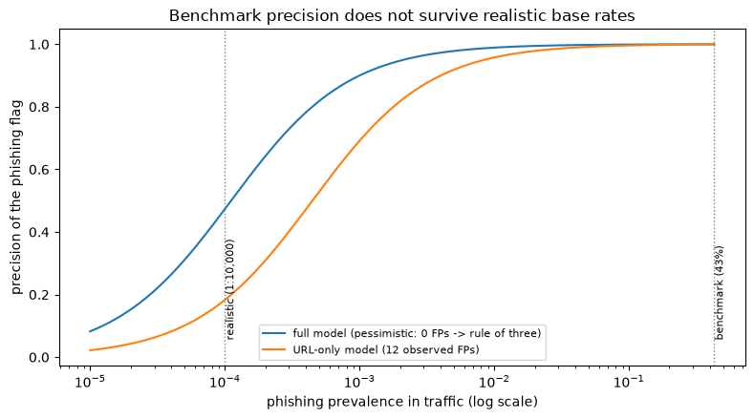
PART 4 · BASE RATES
99.8% accuracy does not survive real traffic
18%
precision of the 99.81%-accurate URL-only model at 1-in-10,000 prevalence
≤ 47%
what even the zero-FP full model can be certified to there (rule of three)
Takeaway Our test set is 42% phishing; real traffic is ~1 in 10,000. Benchmark precision is a property of the benchmark — deployment claims need far more legitimate-URL testing.
AAI-501 · Group 2 · Phishing URL Detection on PhiUSIIL
27
Notes:
[Presenter: Guna]
This is the chart we'd keep if we could keep only one. Our test set is 42% phishing. Real traffic — a browser, a mail gateway — sees maybe one phishing URL in a thousand, often one in ten thousand. Precision depends on that prevalence, and the formula is unforgiving.
Follow the orange curve: the URL-only model, 99.81% accurate on the benchmark, drops to about 18% precision at one-in-ten-thousand. Five of every six warnings would be false alarms — users would learn to ignore them.
The blue curve needs one subtlety: the full model had ZERO observed false positives, but zero observed doesn't mean zero rate. The rule of three says an event never seen in n trials could still occur at up to three-over-n, so with our 27 thousand legitimate test URLs, even the perfect-looking model can only be CERTIFIED to about 47% precision at realistic rates. Our test set is simply too small to prove deployment-grade precision — and that's true of every paper on this benchmark, not just us.

Slide 28
PART 4 · ERROR ANALYSIS
The 78 misses are exactly the dangerous ones
Median feature | Missed phish | Caught phish
IsHTTPS | 1 | 0
TLDLegitimateProb | 0.523 | 0.018
URLLength | 29 | 33
support-lcioud-maps.info
iCloud, l/i swapped
coinbesaprime-logi.com
Coinbase, compounded
Pattern: the model catches sloppy phish and misses the well-crafted ones — HTTPS, reputable TLDs, short clean strings.
bendigo-verification.com
a bank + a calming word
Why brand_distance still failed:
whole-string edit distance can't see “coinbase” inside a compound domain. Token-level matching = future work.
Takeaway The residual errors aren't random — they're the crafted brand impersonations, the ones that actually fool people.
AAI-501 · Group 2 · Phishing URL Detection on PhiUSIIL
28
Notes:
[Presenter: Guna]
So who are the 78 phishing URLs the URL-only model still misses? Not a random sample — they're the WELL-CRAFTED ones. Compare medians: the missed phish use HTTPS (median 1 versus 0 for the caught ones), sit on reputable TLDs — median legitimacy score 0.52 versus 0.02 — and have short, clean strings.
Look at the examples: support-lcioud-maps.info — that's iCloud with the l and i swapped. Coinbesaprime-logi.com — Coinbase, buried in a compound word. Bendigo-verification.com — a real bank's name plus a calming word. The model catches the sloppy phish and misses exactly the ones that fool people.
The ironic part: these are precisely the URLs our brand-distance feature was designed for, and it still didn't help. Whole-string edit distance can't see that 'coinbase' is INSIDE 'coinbesaprime-logi' — the brand is a substring, not a near-neighbor in edit distance. A token-level brand matcher is the concrete future-work fix, and this error analysis is the evidence for why it should work.

Slide 29
PART 4 · THE STRESS TEST
Trained on PhiUSIIL, tested on someone else's data
99.7% → 45.3%
76%
same lexical model: PhiUSIIL test → Sahingoz (2019) corpus — worse than the 54.7% all-legitimate baseline
of the model rode on ONE feature: path_len
0 vs 29
70.0%
median path length of legitimate URLs — PhiUSIIL (homepages) vs the external corpus (real browsing)
host-only model on external data — modest, but honest and real (87.9% on PhiUSIIL)
Takeaway Artifact #3: “URL has a path ⇒ phishing.” Invisible inside the benchmark, fatal outside it — only cross-dataset testing could catch it.
AAI-501 · Group 2 · Phishing URL Detection on PhiUSIIL
29
Notes:
[Presenter: Guna]
And now the stress test. We trained a model on PhiUSIIL using about 20 lexical features recomputed from the raw URL text with our own code — deliberately not PhiUSIIL's shipped columns, no IsHTTPS — and tested it, with no retraining, on the phishing corpus from Sahingoz and colleagues, the same paper our SOTA section cited. About 55 thousand usable URLs.
On PhiUSIIL's own test split: 99.7%. On the external corpus: 45.3% — WORSE than a model that just guesses 'legitimate' for everything. It flagged essentially every legitimate URL as phishing.
The feature importances explain it: path length alone carried 76% of the model. PhiUSIIL's legitimate URLs are homepages — median path length zero — while real browsing produces deep links, median 29 characters. So the model had learned 'URL has a path, therefore phishing.' That's the third collection artifact this project caught, after URLSimilarityIndex and IsHTTPS — and the only one that's invisible from inside the benchmark. A hostname-only model is the honest floor: about 70% externally — real transferable signal, but nowhere near what any benchmark number advertises. One caveat: the external corpus is from 2019, so this mixes collection differences with temporal drift — but every real deployment faces exactly those shifts.

Slide 30
CLOSING · SYNTHESIS
We tried to make it harder three times. It refused.
Drop the leak
Tighten the split
Remove ALL features
99.9%
0.9990
0.9985
remove URLSimilarityIndex → remaining features barely move
44,577-group range of strictness → accuracy shifts by 0.0005
CNN on raw URL characters only → still ties the tabular models
Takeaway Three independent designs, one conclusion: PhiUSIIL's separability is intrinsic to the data — it goes all the way down to the raw characters.
That consistency — not any single accuracy number — is the project's result.
AAI-501 · Group 2 · Phishing URL Detection on PhiUSIIL
30
Notes:
[Presenter: Pranav (or rotate)]
Let's put the three parts side by side, because the synthesis IS the result. We attacked the same suspicion — 'this benchmark is too easy, something must be leaking' — from three independent directions.
Guna removed the obviously leaky column: the rest of the features still score 99.9%. We tightened the train/test split across a range of nearly 45 thousand groups of strictness: accuracy moved by five parts in ten thousand. And we took away every feature entirely, leaving only raw characters: 99.85%.
Three different experimental designs, three different failure modes they were probing — and the number would not move. The only consistent explanation is that the separability is intrinsic to how this dataset was collected: its legitimate and phishing URLs differ systematically, all the way down to the character level.
That consistency is the contribution. Not a new accuracy ceiling — an explanation of why the ceiling exists, established three ways on one shared test set.

Slide 31
CLOSING · BEING HONEST ABOUT THE EDGES
Limitations & next steps
Limitations
Next steps
• The external corpus is from 2019: the 45.3% collapse mixes collection differences with years of temporal drift — both real, not separable here.
• Saturated metrics: accuracy ordering among our models is noise; we say so rather than rank them.
• Illustrative costs: the $500 / $5 asymmetry is defensible but not sourced from our own deployment.
• Platform siblings (web.app, firebaseapp.com) can still straddle the split; the CNN is more exposed to this than the linear model.
• Token-level brand matching: the error analysis shows whole-string edit distance misses compound-domain typosquats like coinbesaprime-logi.
• Kit-level clustering: feed the micro-cluster structure HDBSCAN surfaced into an operational grouping of phishing campaigns.
• Fully platform-aware split: close the last grouping gap the eTLD+1 analysis identified.
AAI-501 · Group 2 · Phishing URL Detection on PhiUSIIL
31
Notes:
[Presenter: Jason (or rotate)]
Before the takeaways, the honest edges of this work.
First, the cross-dataset result needs its own caveat: the external corpus is from 2019, so the collapse from 99.7 to 45.3 percent mixes collection differences with several years of temporal drift. We can't separate the two — but a real deployment wouldn't get to separate them either; it faces both.
Second, when metrics are this saturated, ranking models is noise — we deliberately don't crown a winner. Third, the cost analysis uses illustrative numbers; the method stands, but a real deployment would plug in its own costs. And fourth, platform siblings on shared hosting can still land on both sides of our split; the grouping analysis suggests it's minor, but the character model is the most exposed to it.
Next steps, in order of confidence: a token-level brand matcher, which the error analysis directly motivates; turning the kit-level micro-clusters HDBSCAN found into an operational campaign grouping; and a fully platform-aware split to close the last grouping gap.

Slide 32
CLOSING
What we'd tell the next team
Audit before you model.
Report the clean AND the realistic regime.
An hour of leakage checking reframed our entire project — and saved us from a meaningless 100%.
Full features for comparability; URL-only for honesty. One number alone misleads.
Negative results are results.
When metrics saturate, decisions move.
Our engineered features failed and our clusters are soft — saying so is the scientific part.
Thresholds, costs, and operating points are where the real choices live.
Near-perfect accuracy should be explained, not celebrated.
Thank you! Code, notebooks & full report: github.com/jjusticeusd/AAI-501-Final-Team-Project-Group2
AAI-501 · Group 2 · Phishing URL Detection on PhiUSIIL
32
Notes:
[Presenter: Guna (or rotate)]
We'll close with the four things we'd tell the next team handed a benchmark like this.
One: audit before you model. The leakage checks took a fraction of the project's time and completely reframed it — without them we'd have submitted a meaningless 100%.
Two: report both regimes. The full-feature number gives comparability with the literature; the URL-only number tells the truth about difficulty. Either one alone misleads.
Three: negative results are results. Our engineered features failed; our clusters have soft boundaries. Saying that plainly is what makes the rest of the report trustworthy.
Four: when metrics saturate, the decisions move — into thresholds, costs, and operating points. That's where the engineering actually happens.
If you remember one sentence: near-perfect accuracy should be explained, not celebrated. Thanks for watching — the repository with all code, notebooks, and the full report is on screen.

