Slide 1
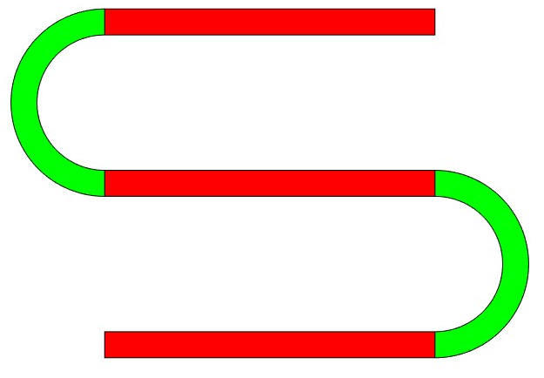
Length ‘L’
r
Radius ‘r’
Thickness ‘t’

