Slide 1
Mechatronics 2: Project
Group 12
Jack Vranicar
12/3/2025

Slide 2
Objective
Jack V
The objective of this project is to create a dexterous manipulator capable of pick and place operations

Slide 3
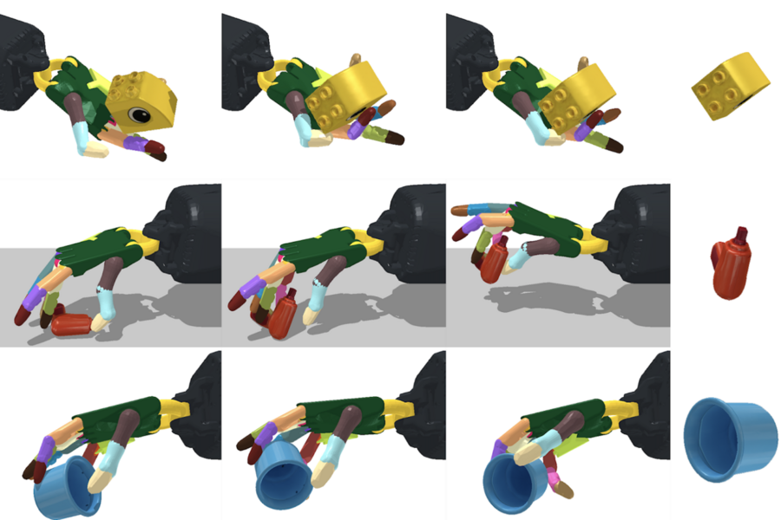
Dexterous Manipulators
Jack V
Dexterous manipulators interact with other objects by using finger-like appendages to form different grasps.
Common grasping tasks for a dexterous manipulator

Slide 4
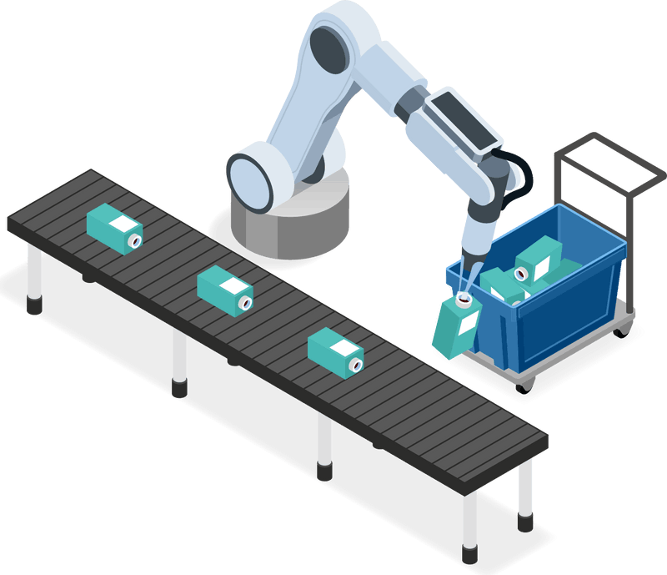
Pick and Place Operations
Jack V
Pick and place operations are common in industrial settings where items must be moved from one place to another.
These tasks are more demanding than traditional sorting methods as they require precise knowledge of the objects pose at the beginning and end of the operation.
Pose refers to the objects position in 6 degrees of freedom

Slide 5


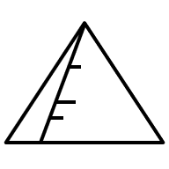


Competition Overview
Jack V

Slide 6
Competition Overview
Jack V
Duck Detected

Slide 7
Competition Overview
Jack V

Slide 8
Competition Overview
Jack V
Duck Placed, Ready for Next Object

Slide 9
Our Design: Mechanism
Jack V
MOTOR

Slide 10
Our Design: Hall Effect
Jack V
MOTOR

Slide 11
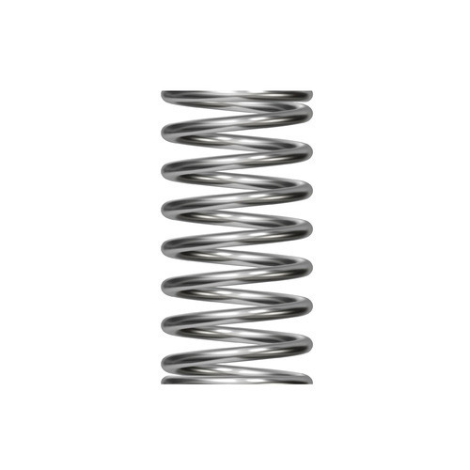
Our Design: Hall Effect
Jack V
Hall Effect Sensor
Magnet

