Slide 1
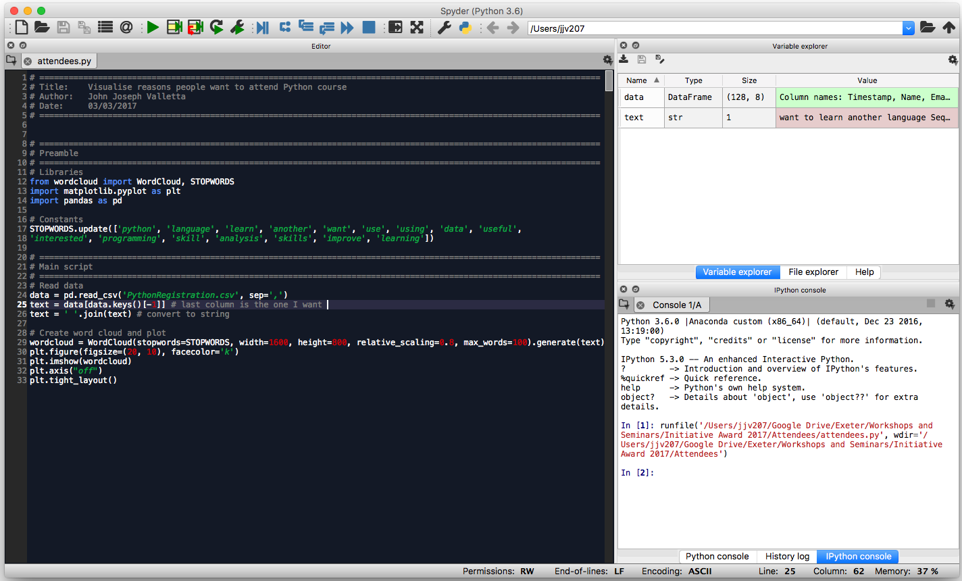
Run Script
Variable Explorer
Text Editor
IPython Console

