Slide 1
Cuisine
Vs
Location
Prepared By
JJV

Slide 2
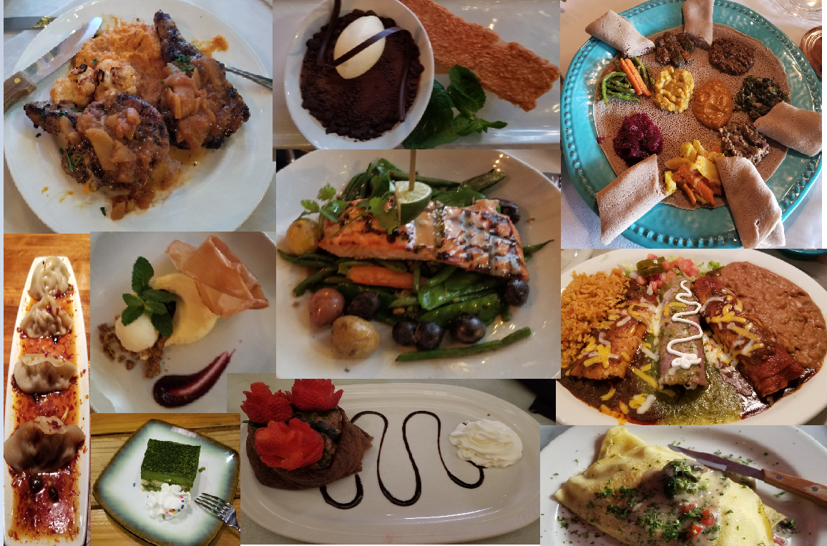
Introduction
The mathematical approach described in this report provides a solution for the two problem mentioned below
* At a particular location, what would be the best type of restaurant to invest in ?
* For a particular cuisine, where would the best location be to open a restaurant ?
This report will be of interest to two types of audience:
* An Investor who wants to cash in on the appeal of a location
* A Chef who is trained in a specific culinary style

Slide 3
Data USED
This report concentrates on the city on Toronto in Ontario, Canada. The data sets used in this report are as mentioned below:
Toronto Neighborhood Data
Source – Wikipedia
File Containing Latitude & Longitude Information
Source - File provided by the Instructor
Restaurant Information
Source - Foursquare Application
Restaurant Rating
Source - Foursquare Application

Slide 4
METHODOLOGY
The methodology used for this report is a variation of the content-based recommendation system. The content in this case is the existing restaurant information in a location.
The approach taken in this report involves reviewing all the restaurant categories and then grouping them based on the region they originate from or based on the similarity of the ingredients used.
The ratings for individual restaurants are read from the Foursquare application and a weighted average of the ratings per cuisine category group.
This resulting data frame gives us information about the preferences of the customers in the Toronto region.
This weighted average ratings data frame along with the Toronto neighborhood information data frame will be used to derive the results for the two questions we are trying to answer as part of this report.

Slide 5
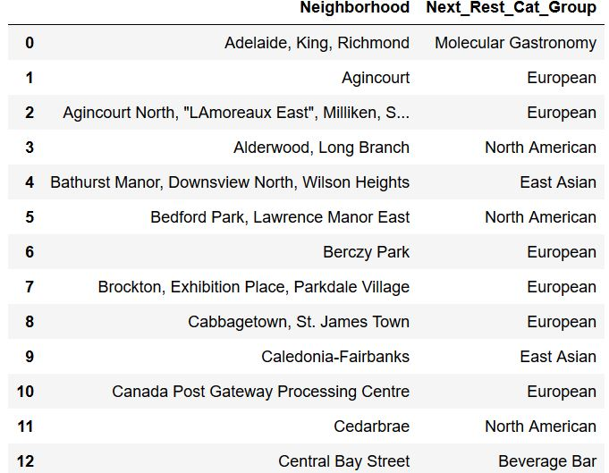
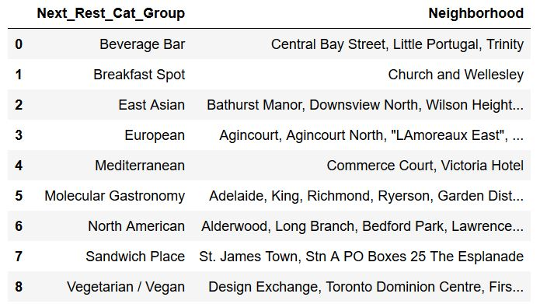

Results
Date Frame representing the results, which are of interest for an Investor
Date Frame representing the results, which are of interest for a Chef

Slide 6
Discussion
Neighborhoods
The East Asian group has the highest weighted average ratings, followed by the European and the North American groups.
For the neighborhood of Agincourt; it already has restaurants belonging to the categories East Asian and Sandwich Place. Therefore, based on the analysis, the next best suited option for the locality will be a restaurant of the category European.
Cuisine
If a Chef is interested in opening a restaurant serving Mediterranean dishes, the most suited location would be Commerce Court or Victoria Hotel, as they do not already have restaurants belonging to this group.

Slide 7
Conclusion
Usages of this Report –
As a first step by an Investor or a Chef to begin their search.
Extrapolated to fit other cities with a similar postal identification structure (postal code, borough, and neighborhood) with ease.
With minor code change can be extrapolated to fit other cities with a different type of postal identification factors.
Can also be extrapolated for other type of industries like clothing, retail stores, banks etc. provided we can get the location, venue and rating information from Foursquare or other applications.

Slide 8
Thank You

