Slide 1
CIS453 Where Are We?
More Importantly:
Where are we going?
When are we going to get there?
How are we going to get there?

Slide 2
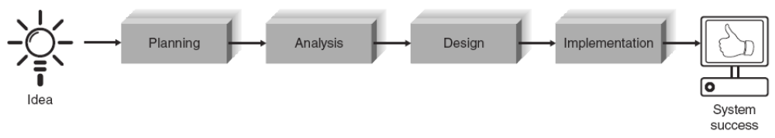
Where Are We and What’s Next?
Here
✓
✓

Slide 3
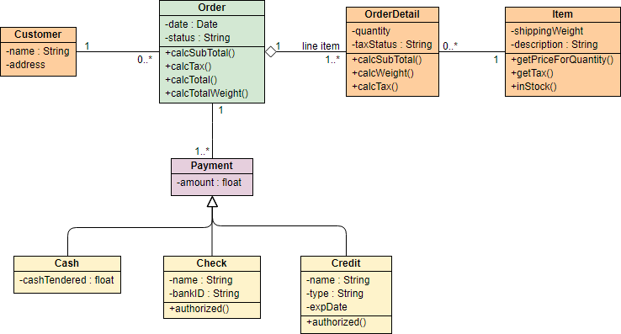
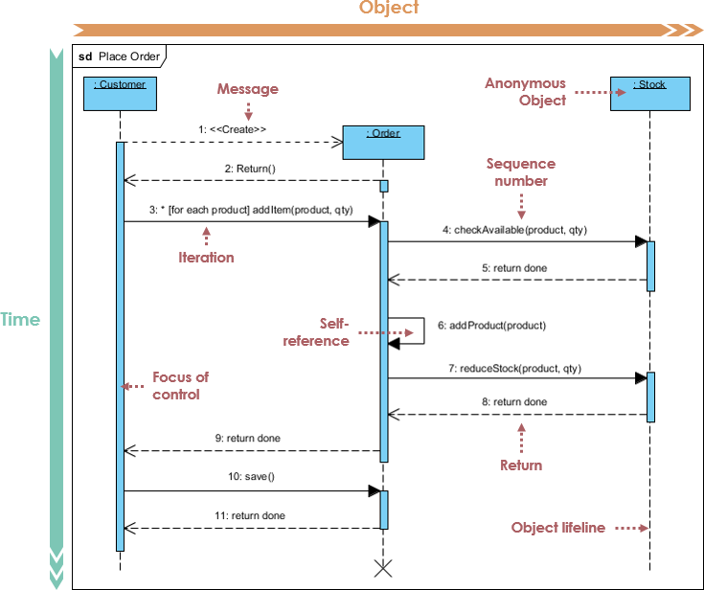
How Are We Going To Get There
More CRC Cards
Class Diagrams
Sequence Diagrams

Slide 4
How/When?
You are going to swap projects with another group.
You are going to pick 2 Use Case from that project
You are going to come up with the design based upon their model and SRS.
Next 4-5 Weeks

Slide 5
Starting TODAY
The following group pairs will SWAP SRS Projects
As you read through the other group’s material, you will develop a design.
You will find issues; many of them. You will work with that group to further understand what they intended.
You will add detail to the other groups information; especially requirements.
You will deliver CRC cards, Class Diagrams and Sequence Diagrams as part of your design.
There will also be other artifacts that we will discuss.

