Slide 1
System Analysis and Design
Eighth Edition
Alan Dennis, Barbara Wixom, Roberta M. Roth
Chapter 6
Behavioral Modeling

Slide 2
Objectives
Behavioral Modeling with Sequence Diagrams

Slide 3
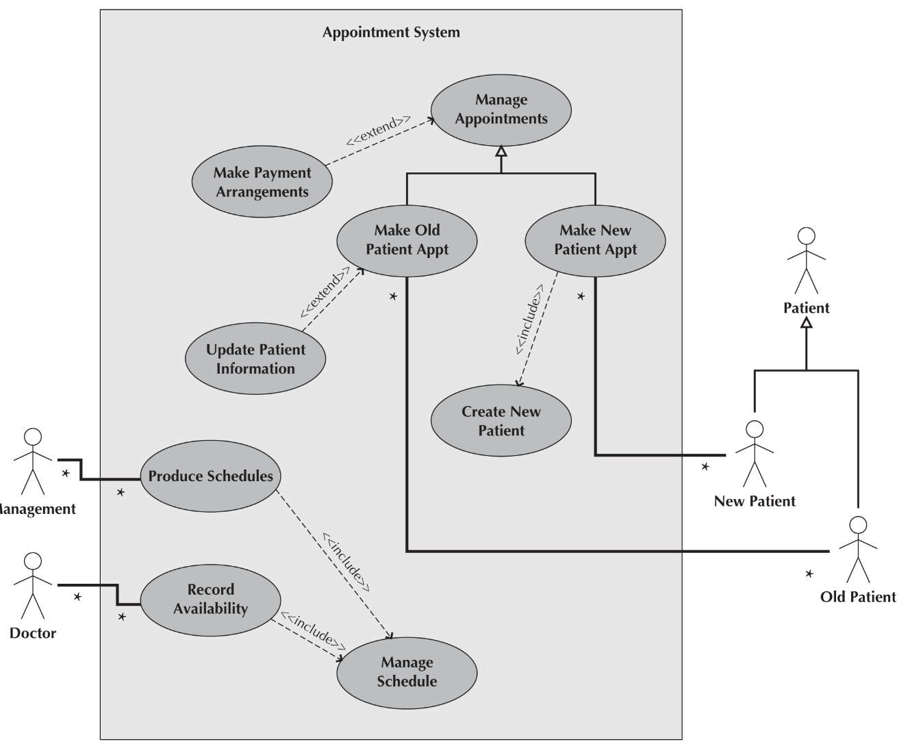
Appointment Case Study

Slide 4
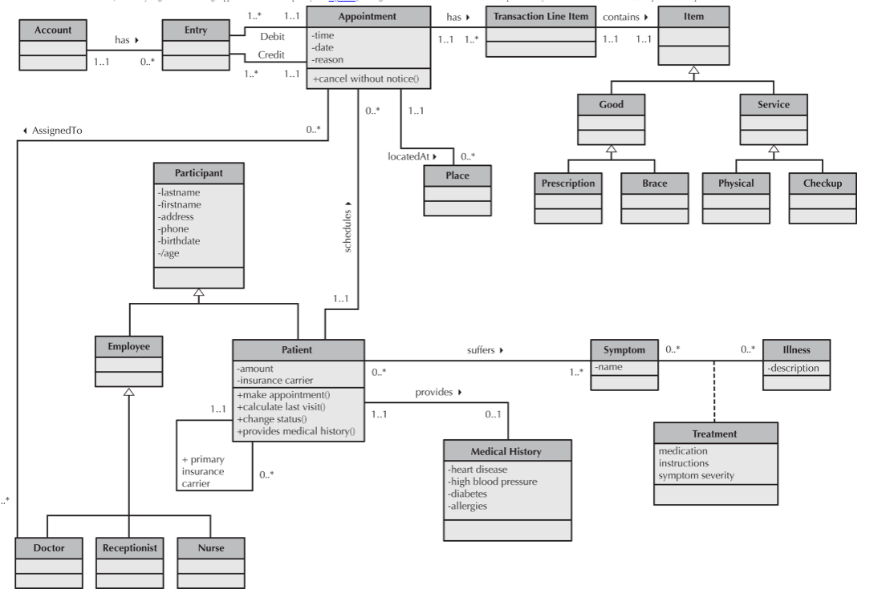
Appointment Case Study

Slide 5
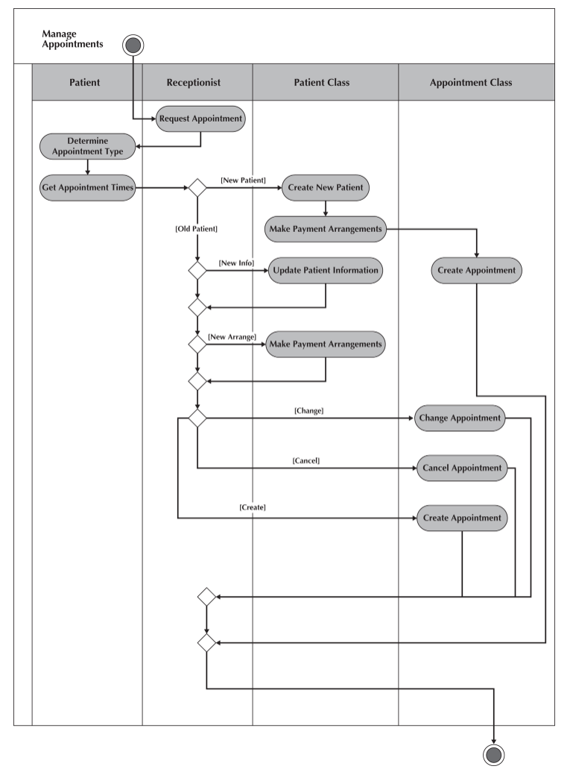
Appointment Case Study

Slide 6
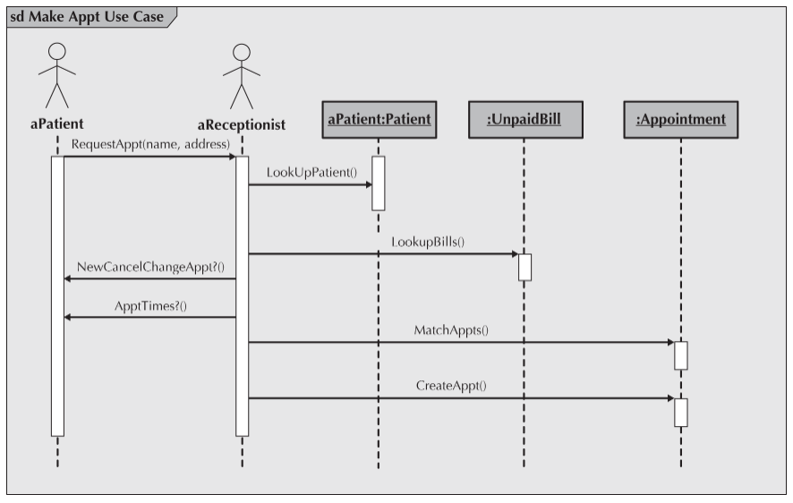

Slide 7
Element of a Sequence Diagram
The Sequence Diagram above shows an instance sequence diagram that depicts the objects and messages for the Make Old Patient Appt use case.
In this specific instance, the Make Old Patient Appt process only portrays the successful scenario of creating an appointment.
Actors and objects that participate in the sequence are placed across the top of the diagram using actor symbols and object symbols.
Notice that the actors and objects are aPatient, aReceptionist, aPatient, UnpaidBill, and Appointment.2 For each of the objects, the name of the class of which they are an instance is given after the object's name (e.g., aPatient means that aPatient is an instance of the Patient class).

Slide 8
Element of a Sequence Diagram
A dotted line runs vertically below each actor and object to denote the lifeline of the actors and objects over time.
Sometimes an object creates a temporary object; in this case, an X is placed at the end of the lifeline at the point where the object is destroyed (not shown).
A thin rectangular box, called the execution occurrence, is overlaid onto the lifeline to show when the classes are sending and receiving messages.
A message is a communication between objects that conveys information with the expectation that activity will ensue. Many different types of messages can be portrayed on a sequence diagram. However, in the case of using sequence diagrams to model use cases, two types of messages are typically used: operation call and return.

Slide 9
Element of a Sequence Diagram
Operation call messages passed between objects are shown using solid lines connecting two objects with an arrow on the line showing which way the message is being passed.
Argument values for the message are placed in parentheses next to the message's name.
A return message is depicted as a dashed line with an arrow on the end of the line portraying the direction of the return.
The information being returned is used to label the arrow. However, because adding return messages tends to clutter the diagram, unless the return messages add a lot of information to the diagram, they can be omitted.

Slide 10
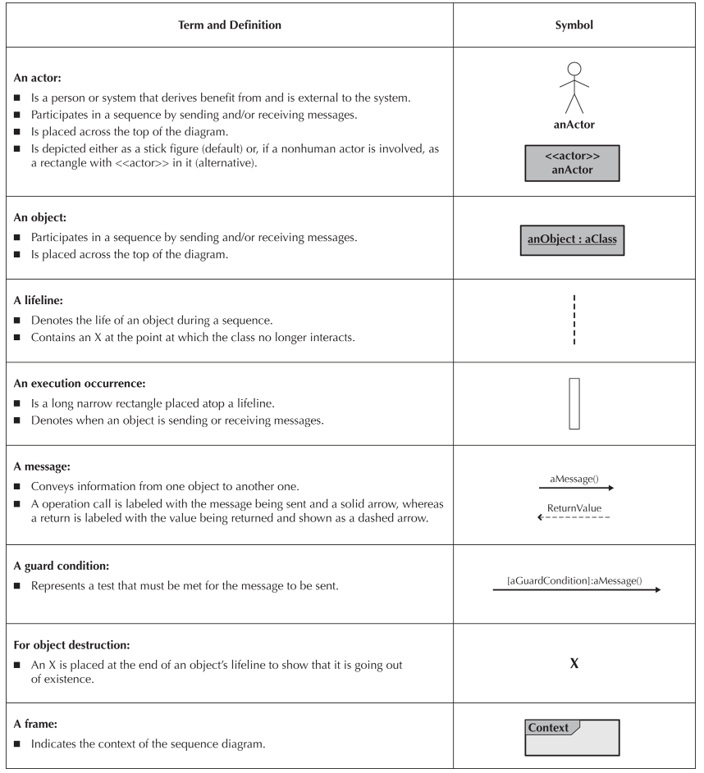
Element of a Sequence Diagram

