Slide 1
System Analysis and Design
Eighth Edition
Alan Dennis, Barbara Wixom, Roberta M. Roth
Chapter 2
Project Selection and Management

Slide 2
Objectives
Explain how projects are selected in some organizations.
Describe various approaches to the systems development life cycle (SDLC) that can be used to structure a development project.
Explain how to select a project methodology based on project characteristics.
Describe project staffing issues and concerns.
Describe and apply techniques to coordinate and manage the project.
Explain how to manage risk on the project.

Slide 3
Introduction
Most IT departments face a demand for IT projects that exceeds the department’s ability to supply them
Project portfolio management, a process of selecting, prioritizing, and monitoring project results, has become a critical success factor for IT departments facing too many potential projects
Once selected, a systems development project undergoes a thorough process of project management
Project management is the process of planning and controlling the project within a specified time frame, at minimum cost, with the desired outcomes
A project manager has the primary responsibility for managing the hundreds of tasks and roles that need to be carefully coordinated

Slide 4
Project Selection
Many IT organizations tackle several important initiatives simultaneously
These endeavors are managed as a program by the IT steering committee
Investments in information systems projects today are evaluated in the context of an entire portfolio of projects
Portfolio management takes into consideration the different kinds of projects that exist in an organization
A good project portfolio will have the most appropriate mix of projects for the organization’s needs
The approval committee must be selective about where to allocate resources because the organization has limited funds

Slide 5
Ways to Classify Projects

Slide 6
Project Selection Issues
Project portfolio perspective – how does the project fit within the entire portfolio of projects
Trade-offs needed: select projects to form a balanced project portfolio
Viable projects may be rejected or deferred due to project portfolio issues

Slide 7
Creating the Project Plan
Projects are launched after being selected by the approval committee
The project manager then follows a set of project management guidelines as they organizes, guides, and directs the project from inception to completion
Sometimes referred to as the project management life cycle
The project manager must make myriad decisions regarding the project, including determining the best project methodology, determining a staffing plan, and establishing mechanisms to coordinate and control the project

Slide 8
Project Methodology Options
The SDLC provides the foundation for the processes used to develop an information system
A methodology is a formalized approach to implementing the SDLC
There are many different systems development methodologies, and they vary in terms of the progression that is followed through the phases of the SDLC

Slide 9
Project Characteristics that will Affect the Methodology Selection Decision
Characteristic | Description
Clarity of User Requirements | How well do the users and analysts understand the functions and capabilities needed from the new system?
Familiarity with Technology | How much experience does the project team have with the technology that will be used?
System Complexity | How much complexity is anticipated in the new system? Does the new system include a wide array of features? Will the system have to integrate with many existing systems?
System Reliability | Will this system need to be highly reliable or is some downtime tolerable?
Short Time Schedules | Is the project time frame tight?
Schedule Visibility | Are the project sponsors, users, or organizational managers anxious to see progress?

Slide 10
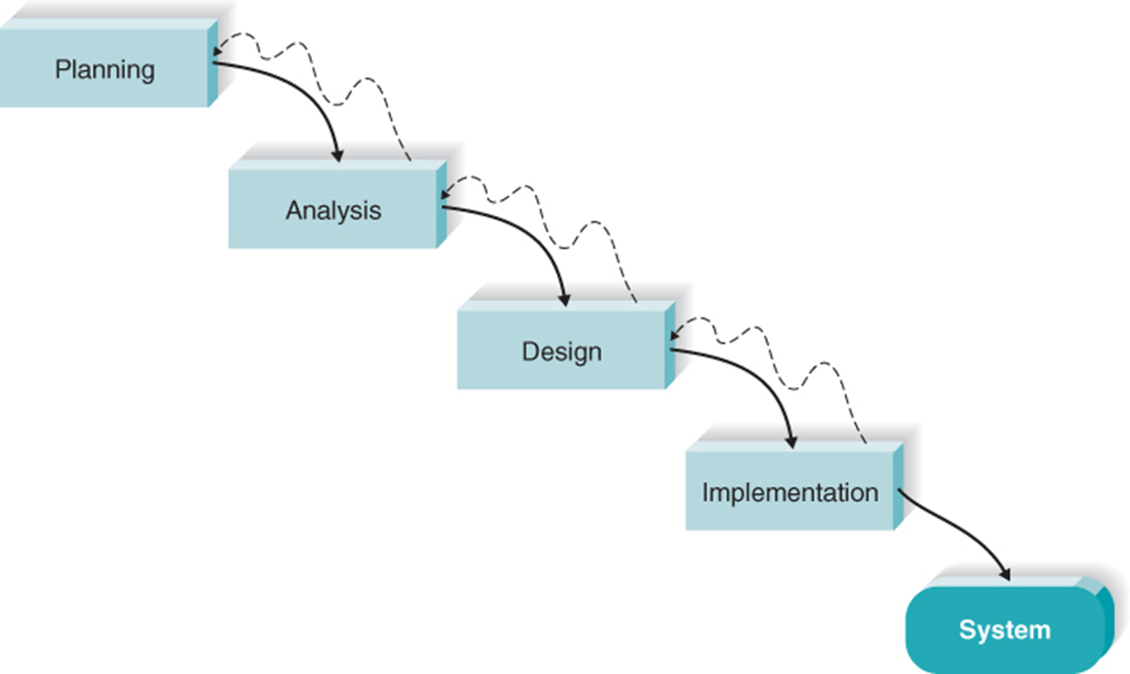
Waterfall Development
Move from phase to phase
The key deliverables for each phase are typically voluminous
Emphasis on deliverables from one phase flowing into the next phase

Slide 11
Waterfall Methodology Assessment
Strengths
System requirements identified long before construction begins
Requirements are “frozen” as project proceeds – no moving targets allowed
Weaknesses
Must wait a long time before there is “visible” evidence of the new system
Takes a long time from start to finish

Slide 12
Several Important Variants of Waterfall Development
Parallel development
V-model

Slide 13
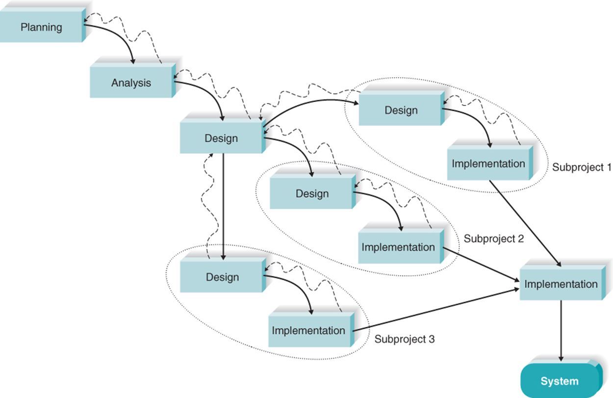
Parallel Development Methodology
Subdivide the project into subprojects that can be worked on at the same time
Reduce the overall project length

Slide 14
Parallel Methodology Assessment
Strengths
Reduces overall project time (compared to Waterfall)
Reduces the need for rework; with shorter time frame, less chance of requirements changing
Weaknesses
Creating subprojects requires careful design decisions
Integrating subprojects at the end can be complex and difficult

Slide 15
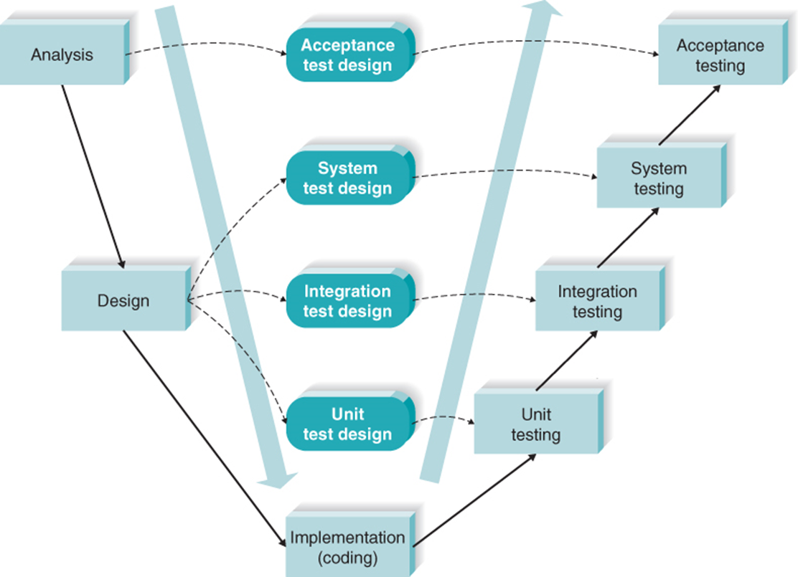
V-Model Development Methodology
Emphasizes system quality through text plan development
Simple and straightforward and improves the overall quality of systems through its emphasis on early development of test plans

Slide 16
V-Model Methodology Assessment
Strengths
Simple and straightforward
Quality improves through the emphasis on testing
Including Quality Assurance expertise early in the project strengthens system quality
Weaknesses
Rigid
Difficult to use in a dynamic business environment

Slide 17
Rapid Application Development (RAD)
Incorporates special techniques and tools
C A S E tools
J A D sessions
Visual programming languages
Code generators
Goal – get some portion of system developed quickly and into the users’ hands

Slide 18
Three R A D Approaches
Iterative development
A series of versions developed sequentially
System Prototyping
Create prototype (model) of system and “grow” it into the final system
Throw-away prototyping
Prototype alternative designs in an experimental way
Build system following prototype design but discard the actual prototype

Slide 19
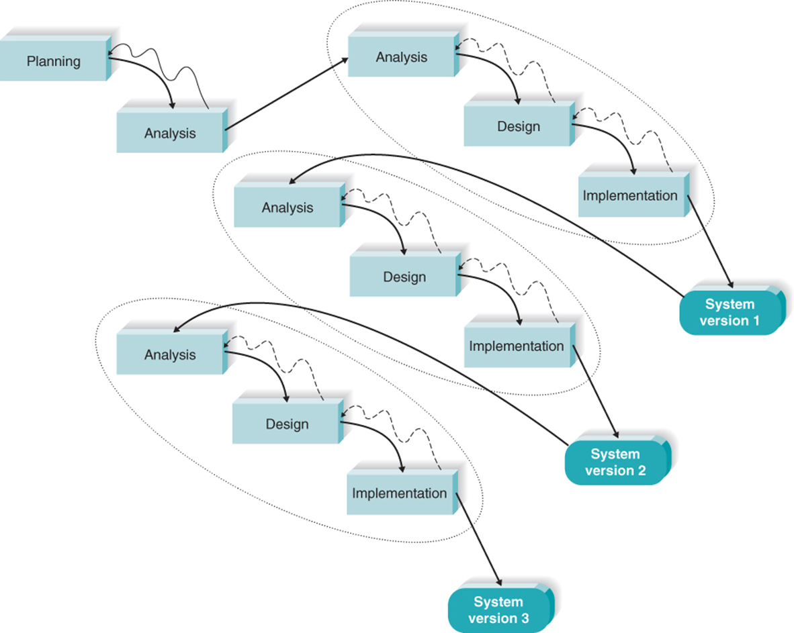
Iterative Development Methodology
Breaks the overall project into a series of versions that are developed sequentially
Develop system in series of versions

Slide 20
Iterative Development Methodology Assessment
Strengths
Users get a system to use quickly
Users identify additional needs for later versions based on real experiences with current version
Weaknesses
Users faced with using an incomplete system for a time
Users must be patient and wait for fully-functional system

Slide 21
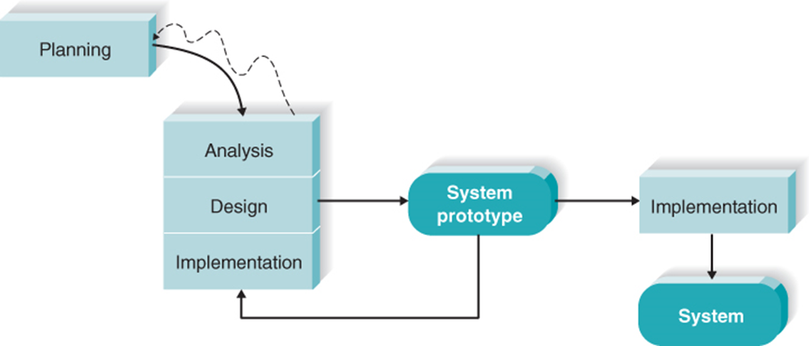
System Prototyping Development Methodology
Create a rough version of system quickly
Following reaction and comments from the users, the developers reanalyze, redesign, and reimplement a second prototype
Cycle continues until everyone agrees

Slide 22
System Prototyping Methodology Assessment
Strengths
Users get to work with prototype very quickly
Feedback cycles let users identify changes and refine real requirements
Weaknesses
Superficial analysis may cause problems
Initial design decisions may be poor
Overlooked features may be hard to add later

Slide 23
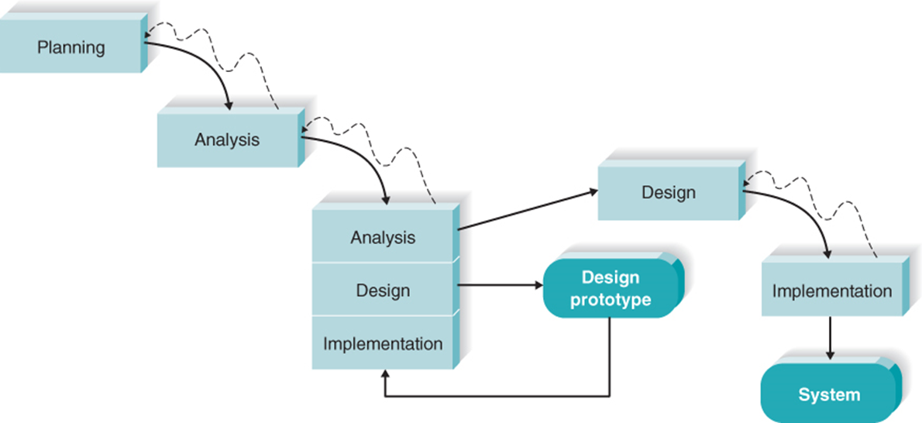
Throwaway Prototyping Development Methodology
Adds emphasis on experimenting with design options before design is finalized
Design options are thrown-away, but learning from them is factored into final design

Slide 24
Throwaway Prototyping Methodology Assessment
Strengths
Uncertainty is minimized
Important issues are understood before building the final system
Weakness
May take longer (compared to system prototyping)

Slide 25
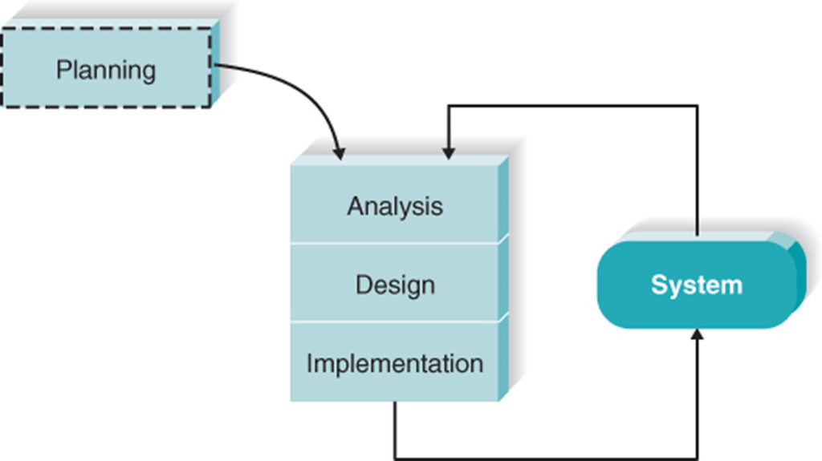
Agile Development Methodology
Extreme Programming (XP), Scrum, and others
Focus on short cycles that produce a complete software product
Highly adaptable in dynamic environments

Slide 26
Agile Methodologies Assessment
Strengths
Fast delivery of results
Works well in projects with undefined or changing requirements
Weaknesses
Requires discipline
Significant user involvement is essential
Initial high learning curve
Works best in smaller projects

Slide 27
Agile Versus Waterfall-Based Methodologies
Agile development approaches have existed for several decades
Created in part because of dissatisfaction with the sequential, inflexible structure of waterfall-based approaches
Presently, agile development has made inroads into software development organizations, and studies show an even split between agile and waterfall users

Slide 28
Criteria for Selecting a Methodology

Slide 29
Staffing Plan
The first step to staffing is determining the average number of staff needed for the project
Divide the total person-months of effort by the optimal schedule
The more a team grows, the more difficult it becomes to manage

Slide 30
Staffing Considerations
Match skills to project needs whenever possible
Consider technical skills and interpersonal skills
All IS work is done in teams
Technical skills are not sufficient – need to be able to work with others
Use training and outside sources (consultants, vendor support) when skills are not readily available
Staffing levels will change over a project’s lifetime
Adding staff adds overhead; not always productive

Slide 31
Increasing Complexity with Larger Teams

Slide 32
Possible Reporting Structure

Slide 33
Motivation
Use monetary rewards cautiously
Use intrinsic rewards
Recognition
Achievement
The work itself
Responsibility
Advancement
Chance to learn new skills

Slide 34
Motivational Don’ts

Slide 35
Handling Conflict
Group cohesiveness is the attraction that members feel to the group and to other members of the group
It contributes more to productivity than do project members’ individual capabilities or experiences
Defining the roles on the project and holding team members accountable for their tasks is a good way to begin mitigating potential conflict on a project
Project charters can help

Slide 36
Conflict Avoidance Strategies
Clearly define plans for the project
Make sure the team understands how the project is important to the organization
Develop detailed operating procedures and communicate these to the team members
Develop a project charter
Develop schedule commitments ahead of time
Forecast other priorities and their possible impact on the project

Slide 37
Coordinating Project Activities
The act of coordinating project activities continues throughout the entire project until a system is delivered
This step includes putting efficient development practices in place and mitigating risk

Slide 38
Computer- Aided Software Engineering Tools
CASE is a category of software that automates all or part of the development process
Some CASE software packages are primarily used during the analysis phase to create integrated diagrams of the system and to store information regarding the system components
Upper CASE
Other CASE software packages are design- phase tools that create the diagrams and then generate code for database tables and system functionality
Lower CASE

Slide 39
CASE Benefits and Drawbacks
Benefits…
Tasks are much faster to complete and alter
Development information is centralized
Information is illustrated through diagrams
CASE can reduce maintenance costs
Improve software quality and enforce discipline
Drawbacks
The advanced CASE tools are complex applications that require significant training and experience to achieve real benefits
Often, CASE serves only as a glorified diagramming tool

Slide 40
CASE Repository
The central component of any CASE tool is the CASE repository
Also known as the information repository or data dictionary
Stores the diagrams and other project information
As the project evolves, project team members perform their tasks by using CASE and have access to each project team member’s additions to the CASE repository

Slide 41
Standards
Standards are created to ensure that team members are performing tasks in the same way and following the same procedures
Standards can range from formal rules for naming files to forms that must be completed when goals are reached to programming guidelines
Standards work best when they are created at the beginning of the project and well communicated to the entire project team

Slide 42
A Sampling of Project Standards
Types of Standards | Examples
Documentation | The date and project name should appear as a header on all documentation. All margins should be set to 1 inch. All deliverables should be added to the project folder and recorded in its table of contents.
Coding | All modules of code should include a header that lists the programmer, last date of update, and a short description of the purpose of the code. Indentation should be used to indicate loops, if-then-else statements, and case statements. On average, every program should include one line of comments for every five lines of code.
Procedural | Record actual task progress in the work plan every Monday morning by 10 A.M. Report to project update meeting on Fridays at 3:30 P.M. All changes to a requirements document must be approved by the project manager.

Slide 43
A Sampling of Project Standards Continued
Types of Standards | Examples
Specifications requirement | Name of the program to be created Description of the program ’ s purpose Special calculations that need to be computed Business rules that must be incorporated into the program Pseudocode Due date
User interface design | Labels will appear in boldface text, left- justified, and followed by a colon. The tab order of the screen will move from top left to bottom right. Hot keys will be provided for all updatable fields.

Slide 44
Documentation
Another technique that project teams put in place during the planning phase is good documentation
Often, the documentation is stored on a file server available to the entire team
Project binder
A simple way to set up your documentation is to create a folder hierarchy and use subfolders to separate content according to the major phases of the project

Slide 45
Managing and Controlling the Project
The science of project management is in making trade-offs among three important concepts:
The size of the system (in terms of what it does)
The time to complete the project (when the project will be finished)
The cost of the project
The project manager must work with the project sponsor to shift these appropriately as the project progresses
Once the project begins, the project manager monitors the progress of the team on the project tasks as the project team members make periodic status reports

Slide 46
Refining Estimates
Even projects with high-quality estimates will need refinement
Project managers must adjust estimated time throughout the project

Slide 47
Project Estimates Require Refinement
Phase | Deliverable | Typical Margins of Error for Well-Prepared Estimate Cost (%) | Typical Margins of Error for Well-Prepared Estimate Schedule Time (%)
Planning phase | System request | 400 | 60
 | Project plan | 100 | 25
Analysis phase | System proposal | 50 | 15
Design phase | System specifications | 25 | 10

Slide 48
Managing Scope
Beware of scope creep
Implement formal change approval process
Defer additional requirements as future system enhancements

Slide 49
Timeboxing
Timeboxing sets a fixed deadline for a project and delivers the system by that deadline no matter what, even if functionality needs to be reduced
Time estimating techniques may reveal that the project requires more time than we have available
Timeboxing helps in these situations
Set a tight but realistic deadline. Identify core, essential functional requirements
Team limits its focus just to essential functions
High quality is stressed
Other functions will be added later
Repeat to add refinements and enhancements

Slide 50
Steps for Timeboxing
Set the date for system delivery
Prioritize the functionality that needs to be included in the system
Build the core of the system (the functionality ranked as most important)
Postpone functionality that cannot be provided within the time frame
Deliver the system with core functionality
Repeat steps 3 through 5, to add refinements and enhancements

Slide 51
Managing Risk
Risk management is the process of assessing and addressing the risks that are associated with developing a project
Typically, project teams create a risk assessment, or a document that tracks potential risks along with an evaluation of the likelihood of the risk and its potential impact on the project
Most project managers keep abreast of potential risks, even prioritizing them according to their magnitude and importance
Over time, the list of risks will change

Slide 52
Chapter Review
Explain how the practice of project portfolio management may influence the selection of IS projects.
Discuss the skills needed to be a successful systems analyst.
List and explain the project characteristics that affect the selection of a project methodology.
List and explain three methodologies that are based on the waterfall concept.
List and explain three methodologies that are based on RAD.
Explain the XP Agile methodology.

Slide 53
Chapter Review Continued
For each methodology included in the chapter, summarize the project characteristics that make that methodology the best choice and the poorest choice. Explain why.
Discuss the three main tasks involved when staffing a project.
Describe various ways to influence the motivation of project team members.
Explain the purpose and content of a project charter.
Describe the role of CASE tools in coordinating the project.
Describe the value of standards to the project team.

Slide 54
Chapter Review Continued
Discuss the project manager’s balancing act involving size, time, and cost.
Describe how scope creep affects a project.
Discuss the technique of timeboxing and how it affects a project team.

Slide 55
Key Terms
Agile development
CASE repository
Chief information
officers (CIOs)
Computer-aided
software
engineering (CASE)
Design prototype
Documentation
Feature creep
Functional lead
Group cohesiveness
Integrated CASE
Interpersonal skills
Iterative development
Lower CASE
Methodology
Motivation
Parallel development
Project binder
Project management
Project manager
Project portfolio
management
Rapid application
development (RAD)
Reporting structure
Risk assessment
Risk management
Scope creep
Staffing plan
Standards
System prototyping
Technical lead
Technical skills
Throwaway prototyping
Timeboxing
Trade-offs
Upper CASE
Versions
V-model
Waterfall development

