Slide 1
System Analysis and Design
Eighth Edition
Alan Dennis, Barbara Wixom, Roberta M. Roth
Chapter 4
Understanding Processes with Use Cases and Process Models

Slide 2
Objectives
Explain the purpose of use cases in the analysis phase of the SDLC.
Describe the various parts of a use case and the purpose of each part.
Describe how use cases contribute to the functional requirements.
Describe how use cases inform the development of test plans.
Explain the process used to create a use case.
Explain the rules and style guidelines for data flow diagrams.
Describe the process used to create data fl ow diagrams.
Create data flow diagrams.

Slide 3
Introduction
A key aspect of determining the requirements for the new system is understanding the user requirements
The things the users need to accomplish with the new system
Use cases help us understand and clarify the users’ required interactions with the system and can help us more fully understand the functional requirements of the new system
A use case represents how a system interacts with its environment
Use cases are especially valuable for business system applications and websites
Process models have been a part of structured systems analysis and design techniques for many years

Slide 4
What Is a Use Case?
A use case depicts a set of activities performed to produce some output result
Each use case describes how an event triggers actions performed by the system and the user
Everything in the system can be thought of as a response to some trigger event

Slide 5
Basic Information
Each use case has a name and number, and brief description.
The priority may be assigned to indicate the relative significance.
The actor refers to a person, another system, or a hardware device that interacts with the system to achieve a useful goal.
The trigger for the use case – the event that causes the use case to begin.
Events triggers can be external or temporal

Slide 6
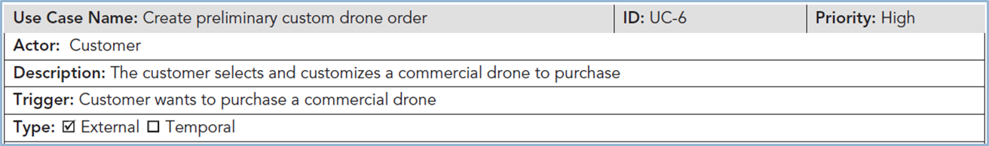
Create Preliminary Custom Drone Order Use Case—Casual Format

Slide 7
Preconditions
It is important to define clearly what needs to be accomplished before each use case begins
Preconditions define the state the system must be in before the use case commences

Slide 8
Normal Courses
The normal course lists the steps that are performed when everything flows smoothly in the system
Sometimes called the happy path

Slide 9
Postconditions
In this section of the use case, we define the final products of this use case
These postconditions also serve to define the preconditions for the next use case in the series

Slide 10
Exceptions
To be complete, a use case should describe any error conditions or exceptions that may occur as the use case steps are performed
These are not normal branches in decision logic but are unusual occurrences or errors that could potentially be encountered and will lead to an unsuccessful result
We want to be sure that the system does not fail while in use because of an error

Slide 11
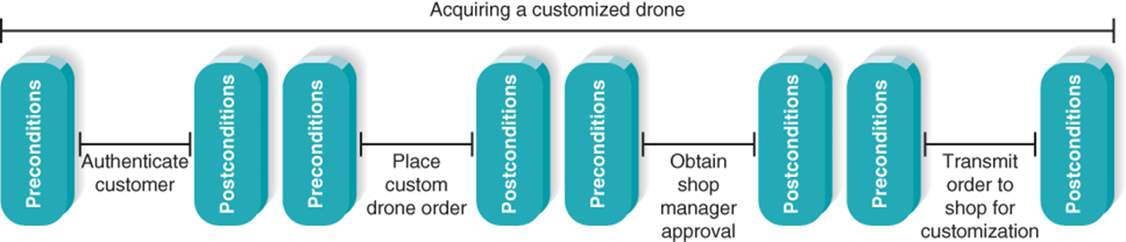
Use Cases in Sequence
Uses cases often performed in sequence
No single use case should be too large
Important to define initial and ending states

Slide 12
Additional Use Case Issues
Alternative paths
Summary of inputs and outputs
Frequency of use
Business rules
Special requirements
Assumptions
Notes and issues

Slide 13
More Elaborate Use Cases are Especially Valuable When…
User representatives are not actively engaged with the development team throughout the project
The application is complex and has a high risk associated with system failures
Comprehensive test cases will be based on the user requirements
Collaborating remote teams need a detailed, shared understanding of the user requirements

Slide 14
Use Case Practical Tips
Use gradual refinement
Concentrate on describing the user’s objectives with the system completely and accurately
Keep both audiences in mind – users and developers
Create use cases only when needed to clarify what the system must do from the user’s perspective
Not needed for simple events

Slide 15
Use Cases and the Functional Requirements
Use cases are useful tools to clarify user requirements
Use cases convey only the user’s point of view
Transforming the user’s view into the developer’s view through functional requirements is one of the system analyst’s key contributions
The derived functional requirements tell the developers more about what the system must do

Slide 16
Steps for Writing for Use Cases
Identify the use cases
Identify the major steps within each use case
Identify elements within steps
Confirm the use case

Slide 17
Creating Use Cases
Identify events the system must respond to – develop event-response list
Create use case form for the complex events
For each use case:
Identify the major steps
Identify elements with each major step (inputs and outputs)
Confirm use case with users through role-playing
Revise functional requirements as needed

Slide 18
Identify the Major Steps for Each Use Case
The analyst should ask the users what tasks need to be completed before the use case steps can begin
Next, the user–system interactions should be outlined as a series of steps in the Normal Course section of the form
Each step should be about the same size as the others
Occasionally, a use case is so simple that further refinement is not needed
Once the steps have been outlined at the proper level of detail, the postconditions can be completed

Slide 19
Identify Elements within Steps
The last column (“Information for Steps”) must be completed, and arrows may be drawn to describe inputs and outputs from the steps
The goal at this point is to identify the major inputs and outputs for each step
The users and analysts then return to the steps in the use case and begin tracing the flow of the steps
It is not unusual at this point for users to discover that they forgot to list the entire steps
The Summary area for inputs and outputs found at the end of the use case form is completed once the team is satisfied with the steps, inflows, and outflows

Slide 20
Confirm the Use Case
The final step is for the users to confirm that the use case is correct as written
Review the use case with the users to make sure that each step and each input and output are correct

Slide 21
Data Flow Diagrams
Data flow diagramming is a technique that diagrams the business processes and the data that pass among them
We use data flow diagrams (DFDs) to describe the to-be system’s interactions with its environment, processes, flows of data, and data stores
Logical process models are models that describe processes, without suggesting how they are conducted
Physical models provide information that is needed to ultimately build the system
Covered in a later chapter

Slide 22
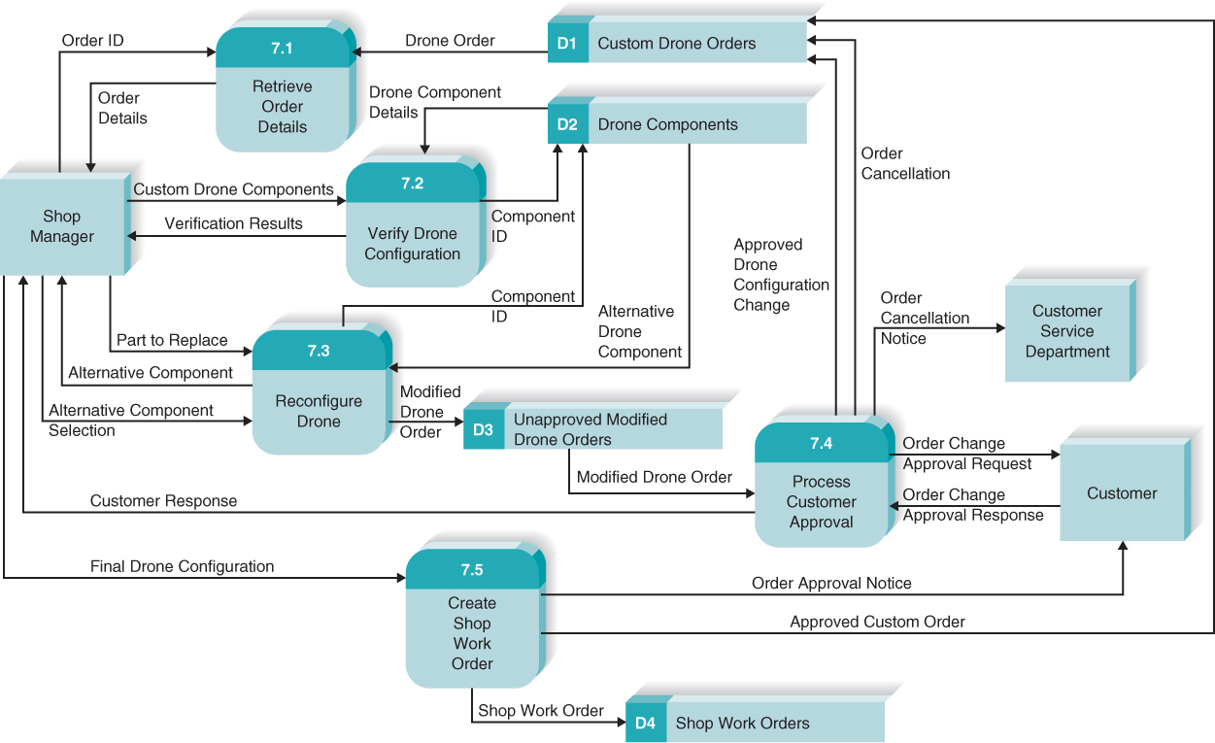
Reading Data Flow Diagrams

Slide 23
Data Flow Diagram Elements

Slide 24
Elements of Data Flow Diagrams (Process)
An activity or function performed for a specific business reason
Can be manual or computerized
Includes the following:
A number
A name (verb phrase)
A description
At least one output data flow
At least one input data flow

Slide 25
Elements of Data Flow Diagrams (Logical Process)
Logical process models omit any processes that simply move or route data and leave the data unchanged.
You do include logical processes that:
Perform computations (e.g., calculate grade point average)
Make decisions (e.g., determine availability of ordered products)
Sort, filter or otherwise summarize data (e.g., identify overdue invoices)
Organize data into useful information (e.g., generate a report or answer a question)
Trigger other processes (e.g., turn on the furnace or instruct a robot)
Use stored data (create, read, update or delete a record)

Slide 26
Elements of Data Flow Diagrams (Data Flow)
A single piece of data or a logical collection of data
Data Flow names describe the content of the data flow but not how it is implemented
Always starts or ends at a process
Includes the following:
A name (noun)
Description
One or more connections to a process

Slide 27
Elements of Data Flow Diagrams (Data in Motion)
An input of data to a process, or the output of data (or information) from a process
The creation, deletion, or update of data in a file or database (called a data store on the DFD)
A data flow is depicted as a solid-line with arrow
Control flows (non-data flows) trigger processes, such as ‘time to run the weekly payroll’
The control flow is depicted as a dashed-line with arrow

Slide 28
Elements of Data Flow Diagrams (Data Store)
Most information systems capture data for later use.
A data store is a collection of data that is stored in some way
Include the following:
A number
A name (noun)
Description
One or more input data flows (somewhere in process model)
One or more output data flows (somewhere in process model)

Slide 29
Elements of Data Flow Diagrams (Data Store) Continued
If data flows are data in motion, think of data stores as data at rest
Data stores should describe “things” about which the business wants to store data
Data flows leaving the data store are data retrievals
Data flows entering the data store are updates or new data added

Slide 30
Elements of Data Flow Diagrams (External Entity)
A person, organization, or system that is external to the system
Has interactions with the system (adds data to system or receives data from system)
Include the following:
A name (noun)
Description

Slide 31
Using Data Flow Diagrams to Define Business Processes
Business processes are too complex to be shown on a single D F D
A deliberate hierarchy is created with multiple “levels” of D F Ds
To build the hierarchy, use decomposition
Child diagrams show a portion of the parent diagram in greater detail

Slide 32
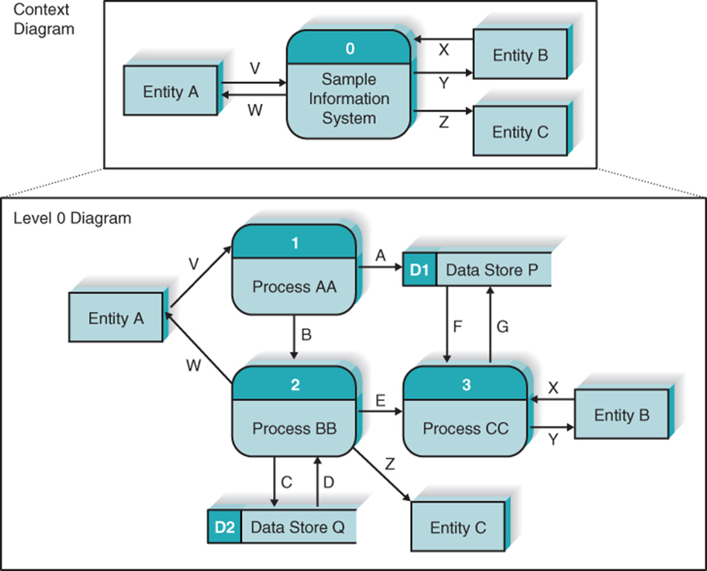
DFD Hierarchy (1 of 3)

Slide 33
DFD Hierarchy (2 of 3)
Processes on Level 0 diagram each decompose into separate Level 1 diagrams
Processes on Level 1 diagrams may or may not be decomposed into separate Level 2 diagrams
Processes are decomposed until each process is a single-purpose, primitive process

Slide 34
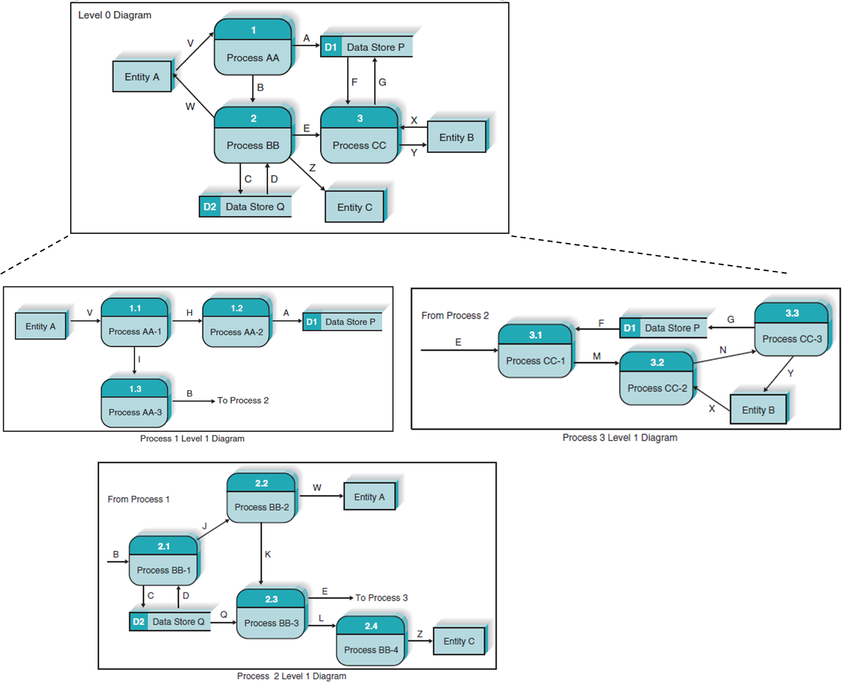
DFD Hierarchy (3 of 3)

Slide 35
Balancing
Ensures that information presented at one level of a DFD is accurately represented in the next level DFD
Data flows on parent diagram are carried down to child diagram
Child diagram adds new processes and new data flows

Slide 36
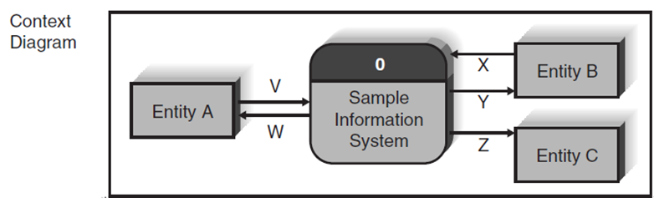
Context Diagram
Top-level DFD in every process model
Shows the context into which the business process fits
Shows the overall business process as just one process (process ‘zero’)
Shows all the external entities that receive information from or contribute information to the system

Slide 37
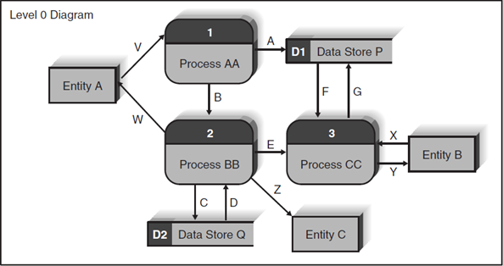
Level 0 Diagram
Shows all the major processes that comprise the overall system
Internal components of process 0
Shows how the major processes are interrelated by data flows
Shows external entities and the major processes with which they interact
Adds stored data via the data stores

Slide 38
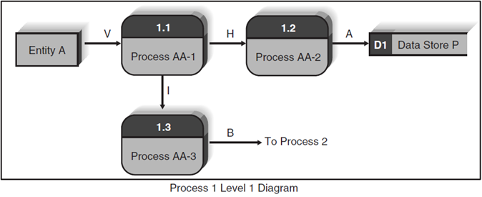
Level 1 Diagrams
Create one level 1 diagram for every major process on level 0 diagram
Shows the internal processes that comprise a single process on the level 0 diagram
Shows how information moves to and from each of these processes
If a parent process is decomposed into, say, three child processes, then these three child processes wholly and completely make up the parent process

Slide 39
Level 2 Diagrams
Shows all processes that comprise a single process on the level 1 diagram
Shows how information moves to and from each of these processes
Level 2 diagrams may not be needed for all level 1 processes
Correctly numbering each process helps the user understand where the process fits into the overall system

Slide 40
Diagram Numbering
Correctly numbering each process helps the user understand where the process fits into the overall hierarchy
Context Diagram is always “Process 0”
Level 0 processes are always numbered with integer value (1, 2, 3, and so on)
Level 1 processes always have one “dot”: parent number “dot” unique number (1.1, 1.2, 1.3, and so on)
Level 2 processes always have two “dots”: parent number “dot” unique number (1.1.1, 1.1.2, 1.1.3, and so on)

Slide 41
Alternative Data Flows
Where a process can produce different data flows given different conditions
We show both data flows and use the process description to explain why they are alternatives
Tip -- alternative data flows often accompany processes with IF statements

Slide 42
Process Descriptions
Text-based process descriptions provide more information about the process than the DFD alone
CASE tools enable easy creation of descriptions
If the logic underlying the process is quite complex, more detail may be needed in the form of:
Structured English
Decision trees
Decision tables

Slide 43
Creating Data Flow Diagrams (1 of 2)
Build the context diagram
Identify the external entities and the major inflows they supply and the outflows they receive
Identify all major processes encompassed by the Context Diagram
Each major event / use case is “handled” by a process
Create DFD “fragments” for each event / use case
Each DFD fragment is a mini-diagram showing the process and the external entities and data stores with which it interacts

Slide 44
Creating Data Flow Diagrams (2 of 2)
Organize DFD fragments into level 0 diagram
Decompose each level 0 process into a level 1 diagram; decompose level 1 processes into level 2 diagrams as needed; etc.
Validate DFDs with user to ensure completeness and correctness

Slide 45
Illustration – Developing DFDs
Creating the context diagram
Create a DFD “fragment” based on a use case
Merge DFD “fragment” diagrams into the Level 0 diagram
Develop level 1 diagrams for every process on the level 0 diagram

Slide 46
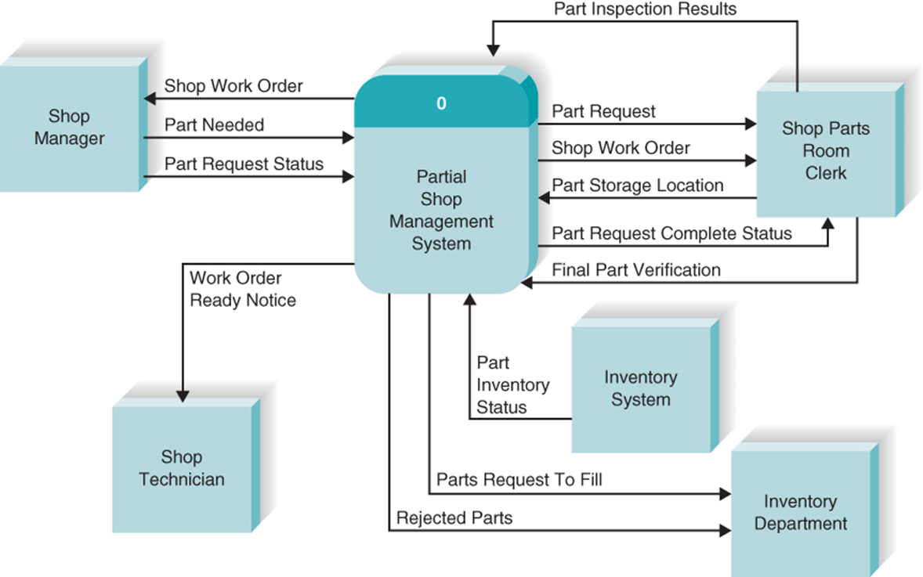
Creating the Context Diagram

Slide 47
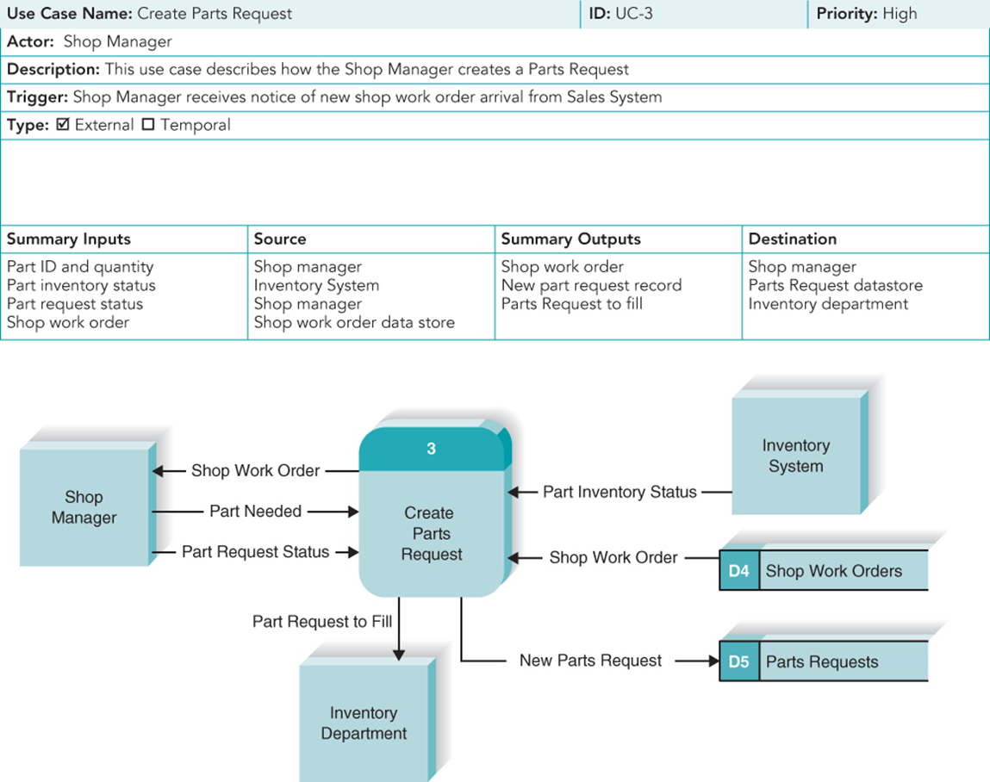
Create a DFD “Fragment” Based on a Use Case

Slide 48
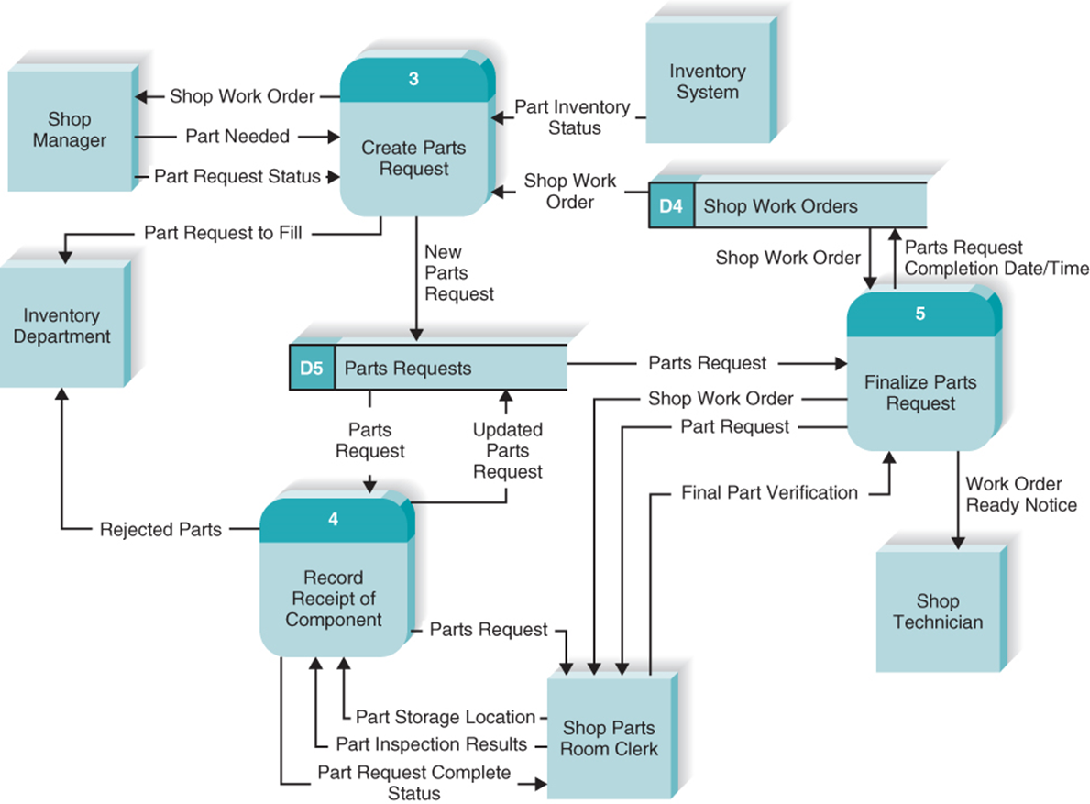
Merge DFD “Fragment” Diagrams into the Level 0 Diagram

Slide 49
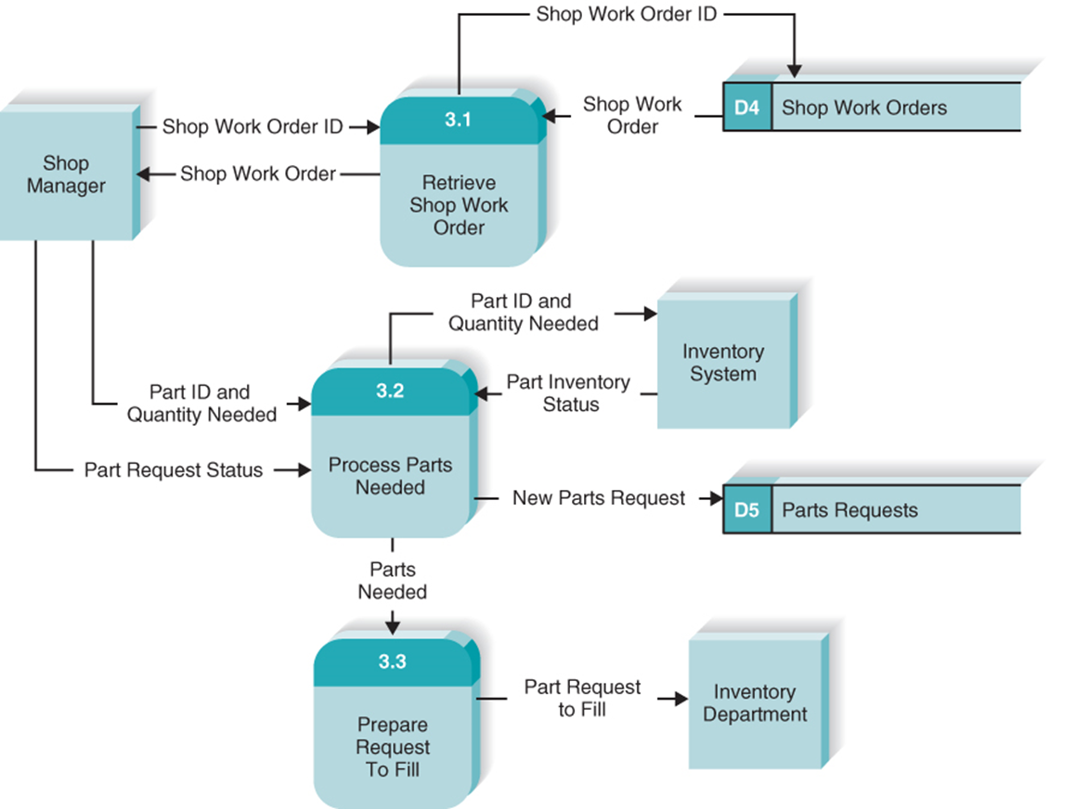
Level 1 – Process 3: Create Parts Request

Slide 50
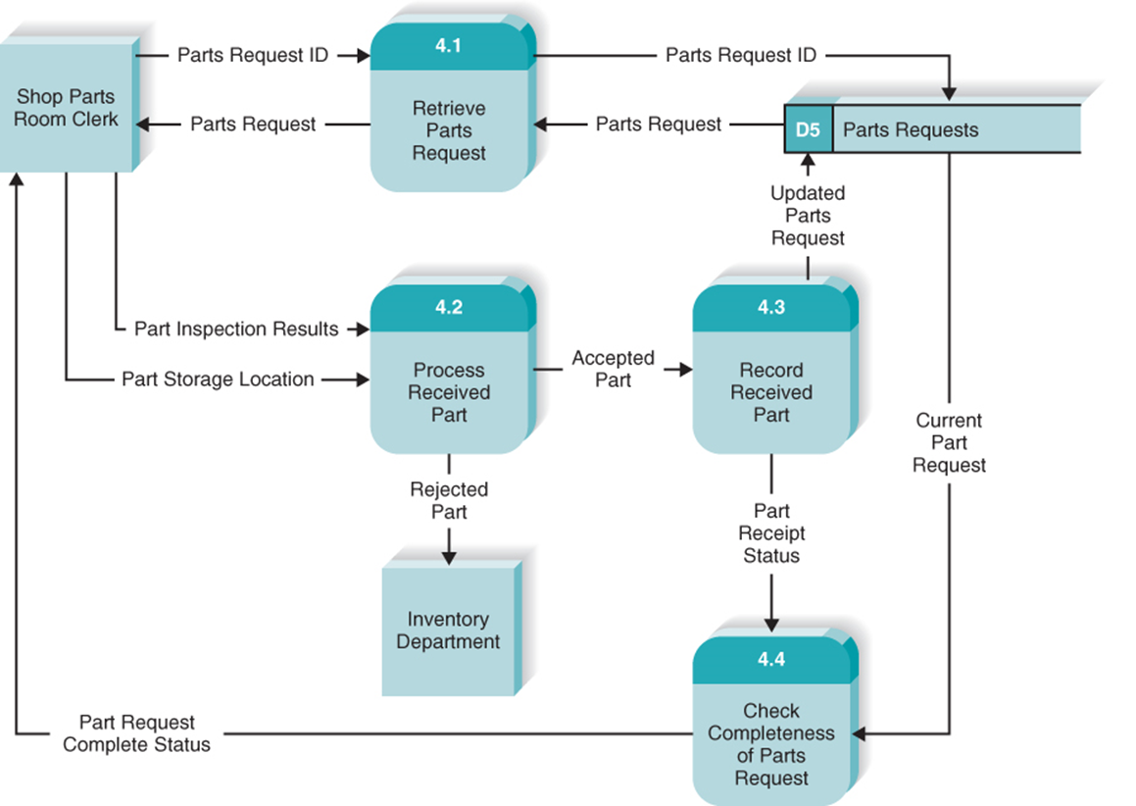
Level 1 – Process 4: Record Receipt of Components

Slide 51
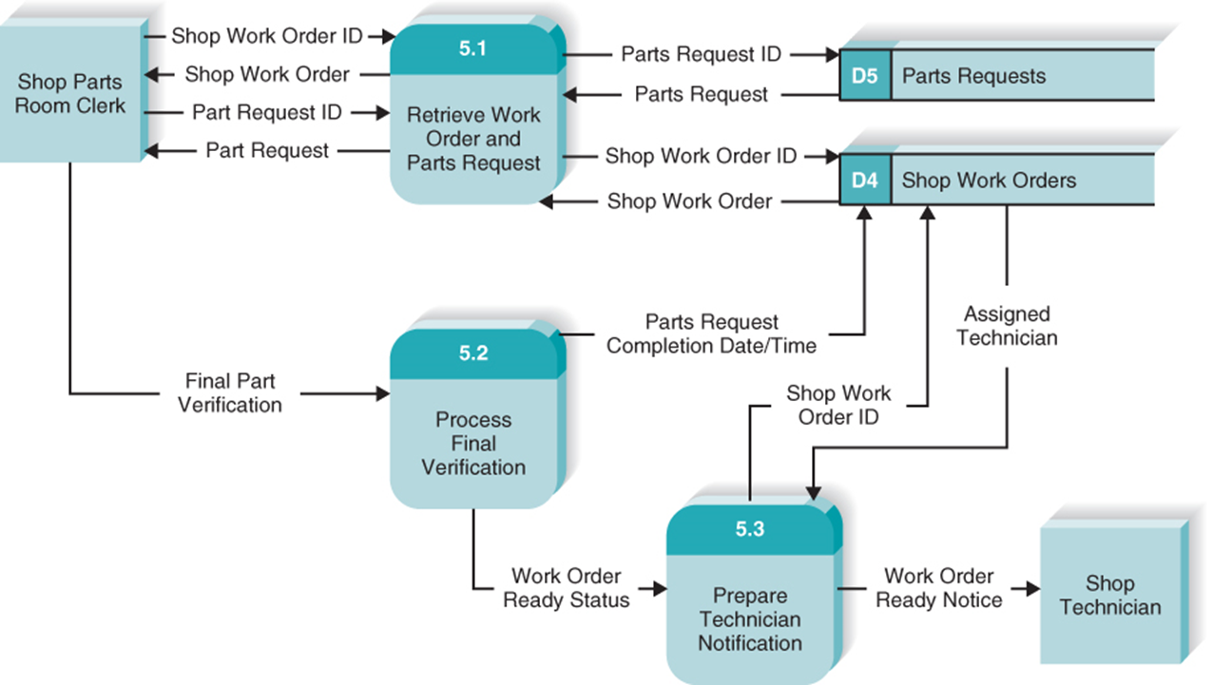
Level 1 – Process 5: Finalize Parts Request

Slide 52
Validating the Data Flow Diagrams (1 of 2)
Within D F D
Process | Every process has a unique name that is an action-oriented verb phrase, a number, and a description. Every process has at least one input data flow. Every process has at least one output data flow. Output data flows usually have different names than input data flows because the process changes the input into a different output in some way. There are between three and seven processes per D F D.
Data Flow | Every data flow has a unique name that is a noun, and a description. Every data flow connects to at least one process. Data flows only in one direction (no two-headed arrows). A minimum number of data flow lines cross.
Data Store | Every data store has a unique name that is a noun, and a description. Every data store has at least one input data flow (which means to add new data or change existing data in the data store) on some page of the process model. Every data store has at least one output data flow (which means to read data from the data store) on some page of the process model.
External Entity | Every external entity has a unique name that is a noun, and a description. Every external entity has at least one input or output data flow.

Slide 53
Validating the Data Flow Diagrams (2 of 2)
Across D F Ds
Context diagram | Every set of D F Ds must have one context diagram.
Viewpoint | There is a consistent viewpoint for the entire set of D F Ds.
Decomposition | Every process is wholly and completely described by the processes on its children D F Ds.
Balance | Every data flow, data store, and external entity on a higher level D F D is shown on the lower-level D F D that decomposes it.
Semantics
Appropriate Representation | User validation Role-play processes
Consistent Decomposition | Examine lowest-level D F Ds
Consistent Terminology | Examine names carefully

Slide 54
Common D F D Errors
Syntax errors – violating “drawing” rules
Every data flow must connect to a process
Every process must have at least one inflow and one outflow
Semantics errors – errors in the meaning of the diagrams
Walk-through diagrams with users
Verify that inputs shown are logically sufficient to produce the outputs
Check for consistent levels of decomposition
Check for consistent use of terminology

Slide 55
Chapter Review (1 of 3)
Explain the purpose of a use case in the analysis phase of the SDLC.
Explain why use cases are commonly used in the analysis phase.
Discuss the various sections found in a use case form and the purpose and content of each section.
Explain how use cases help the systems analyst create a more in-depth understanding of the system’s functional requirements.
Describe how use cases can contribute to the development of test plans for the new system.

Slide 56
Chapter Review (2 of 3)
Discuss the four steps of the process used to create use cases.
Define the meaning and purpose of the four basic symbols found on a data flow diagram.
Explain the meaning and purpose of a process model’s context diagram.
Explain the meaning and purpose of a process model’s level 0 diagram.
Explain the meaning and purpose of a process model’s level 1 diagrams.

Slide 57
Chapter Review (3 of 3)
Explain the concept of decomposition and why process models are created as a hierarchy of DFDs.
Describe several common syntax and semantic errors found on DFDs.
Discuss the process used to create a process model.
Discuss how the process model contributes to the development of the new information system.

Slide 58
Key Terms
Actor
Balancing
Bundle
Children
Context diagram
Data flow
Data flow diagram
(DFD)
Data store
Decision tables
Decision trees
Decomposition
DFD fragment
Essential use cases
Event-driven modeling
Event triggers
External entity
External trigger
Happy path
IF statements
Inputs
Iteration
Layout
Level 0 diagram or level 0 DFD
Level 1 diagram, or level 1 DFD
Level 2 DFD
Logical process model
Outputs

Slide 59
Key Terms Continued
Parent
Physical model
Postconditions
Preconditions
Primary actor
Priority
Process
Processes
Process model
Role-play
Semantics error
Step
Structured English
Syntax error
Temporal trigger
Trigger
Use case
Use case packages
User requirements
User role
Viewpoint
Visualization

