Slide 1
System Analysis and Design
Eighth Edition
Alan Dennis, Barbara Wixom, Roberta M. Roth
Chapter 5
Data Modeling

Slide 2
Objectives
Explain the rules and style guidelines for creating entity relationship diagrams (ERDs).
Create an ERD.
Describe the use of a data dictionary and metadata.
Explain how to balance ERDs and data fl ow diagrams.
Describe the process of normalization.

Slide 3
Introduction
A data model is a formal way of representing the data that are used and created by a business system
Shows the people, places and things about which data is captured and the relationships among them
Logical data model shows the organization of data without indicating how it is stored, created, or manipulated
Physical data model shows how the data will actually be stored in databases or files

Slide 4
The Entity Relationship Diagram
Entity relationship diagram (ERD) is a popular way to depict the data model
On an ERD, similar kinds of information are listed together and placed inside boxes called entities
Lines are drawn between entities to represent relationships among the data
Special symbols are added to the diagram to communicate high-level business rules that need to be supported by the system
The ERD implies no order

Slide 5
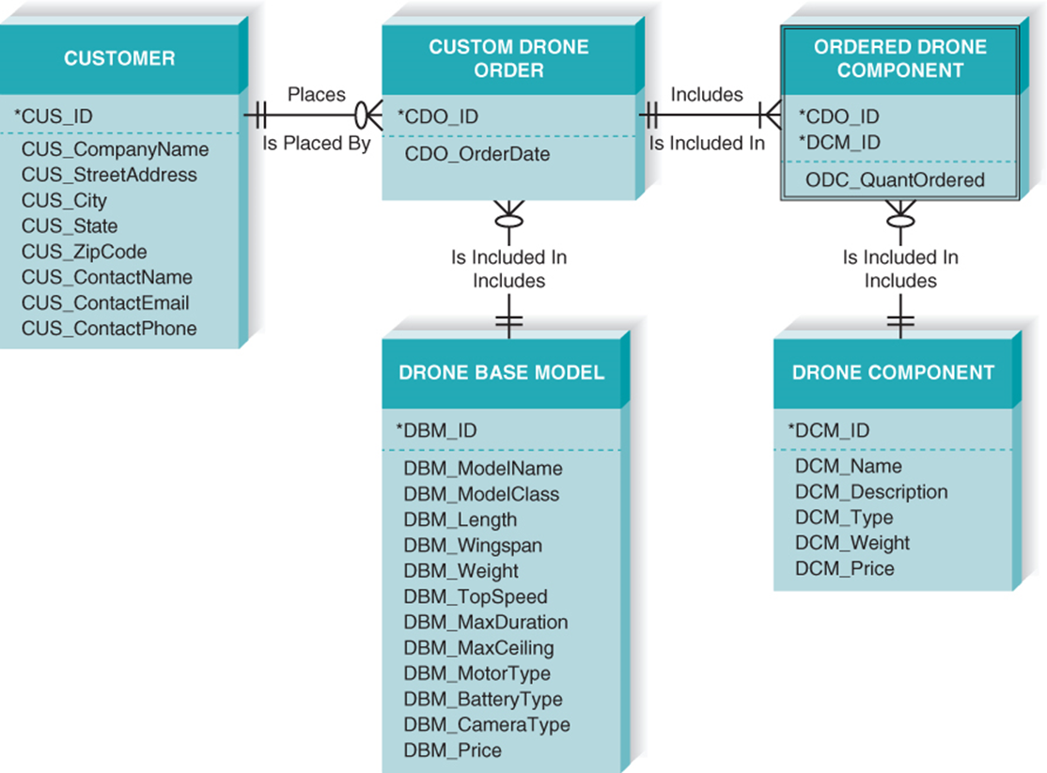
Reading an Entity Relationship Diagram

Slide 6
Using the ERD to Show Business Rules
Business rules are constraints that are followed when the system is in operation
ERD symbols can show when one instance of an entity must exist for an instance of another to exist
The customer instance must exist before custom drone order instances can be created for that customer
The drone component instance must exist before ordered drone components instances can be created for that drone component

Slide 7
Using the ERD to Show Business Rules Continued
ERD symbols can show when one instance of an entity can be related to only one or to many instances of another entity
One customer instance can create many custom drone order instances; each custom drone order instance is created by only one customer instance
A drone can be included on many chemical requests; a chemical request is for only one chemical
ERD symbols show when the existence of an entity instance is optional for a related entity instance
A customer instance may exist without being included on any custom drone order instances

Slide 8
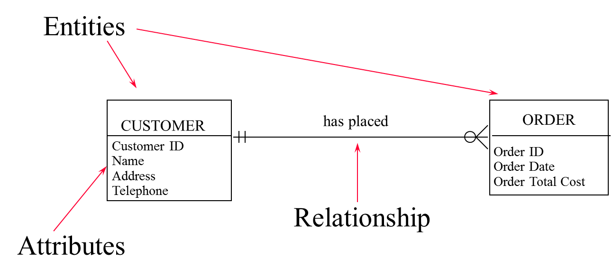
An ERD Example

Slide 9
Elements of an Entity Relationship Diagram
Entity
Attribute
Relationships
Cardinality
Modality

Slide 10
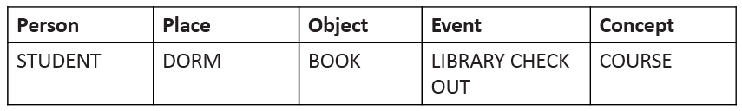
Entity
A person, place, event, or thing about which data is collected
Must be multiple occurrences to be an entity

Slide 11
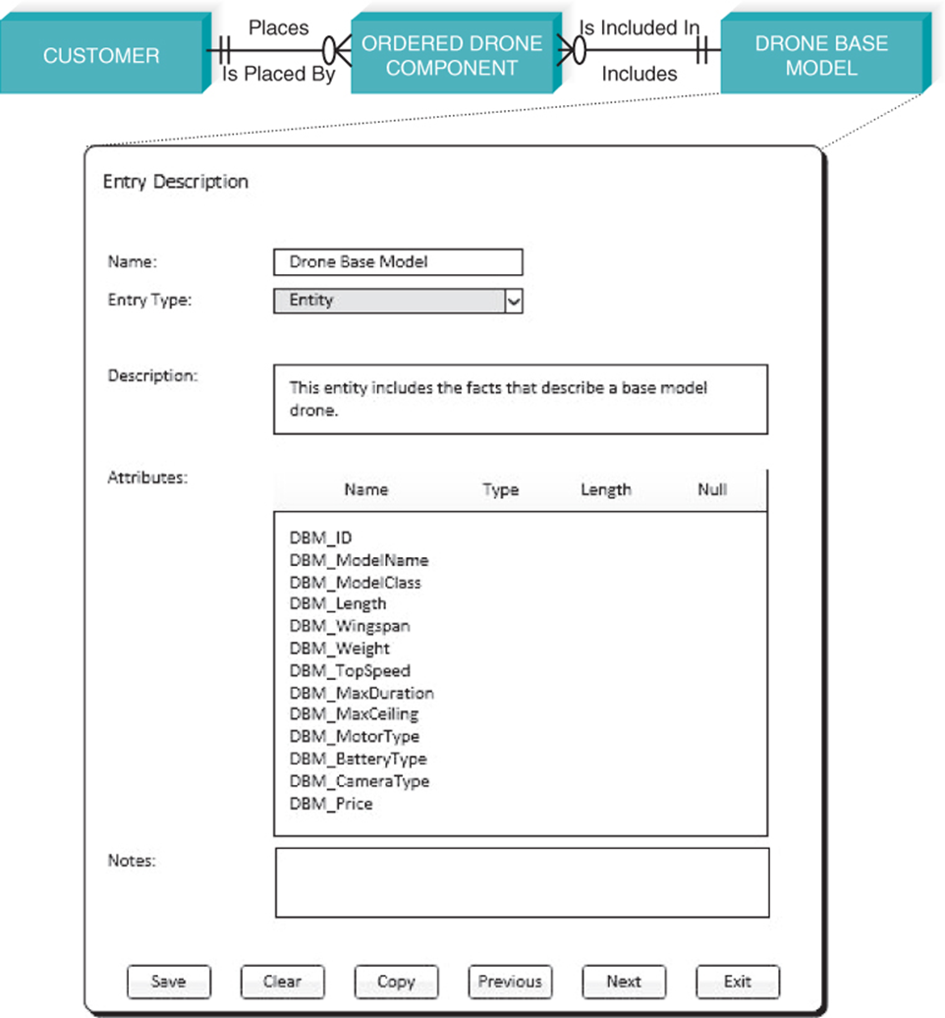
CASE Entry for Entity

Slide 12
Attributes
Information captured about an entity
Only those used by the organization should be included in the model
Attribute names are nouns
Sometimes entity name is added at the beginning of the attribute name for clarity

Slide 13
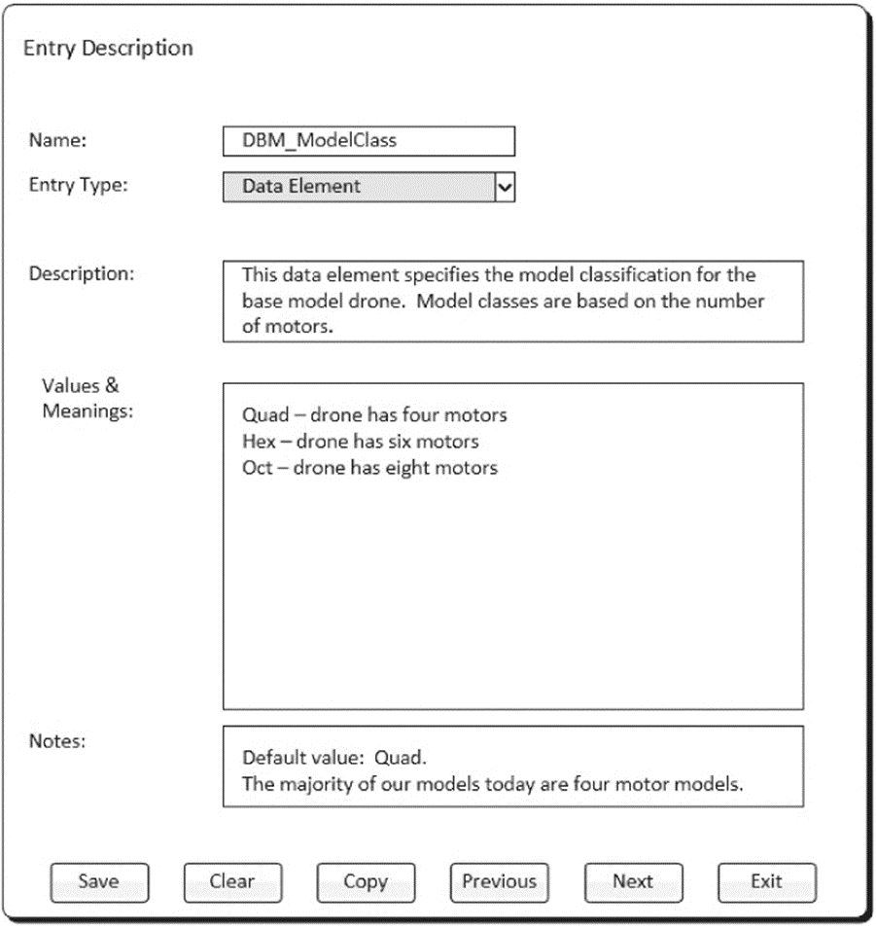
CASE Entry for Attribute

Slide 14
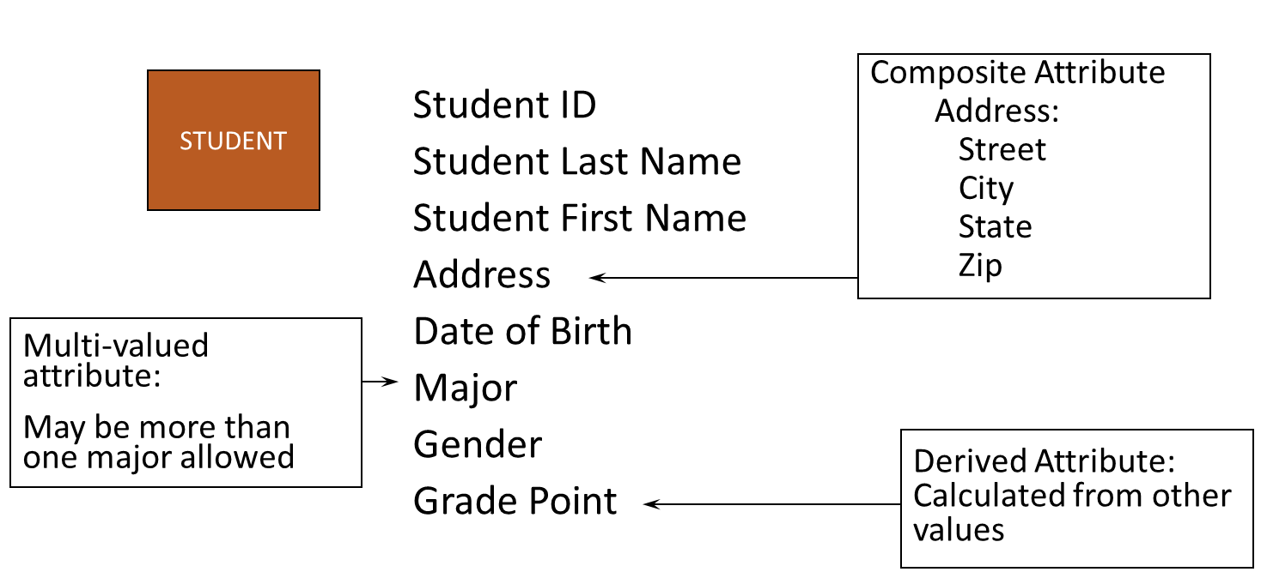
Attributes – Understand Them!

Slide 15
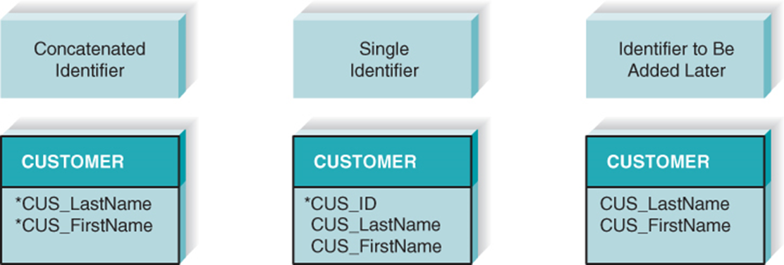
Identifier Types
One or more attributes can serve as the entity identifier, uniquely identifying each entity instance
Concatenated identifier consists of several attributes
An identifier may be “artificial,” such as creating an I D number
Final decision on identifiers may postponed to the Design Phase

Slide 16
Relationships
Associations between entities
The first entity in the relationship is the parent entity; the second entity in the relationship is the child entity
Relationships should have active verb names
Relationships go in both directions

Slide 17
Cardinality
Cardinality refers to the number of times instances in one entity can be related to instances in another entity
One instance in an entity refers to one and only one instance in the related entity (1:1)
One instance in an entity refers to one or more instances in the related entity (1:N)
One or more instances in an entity refer to one or more instances in the related entity (M:N)

Slide 18
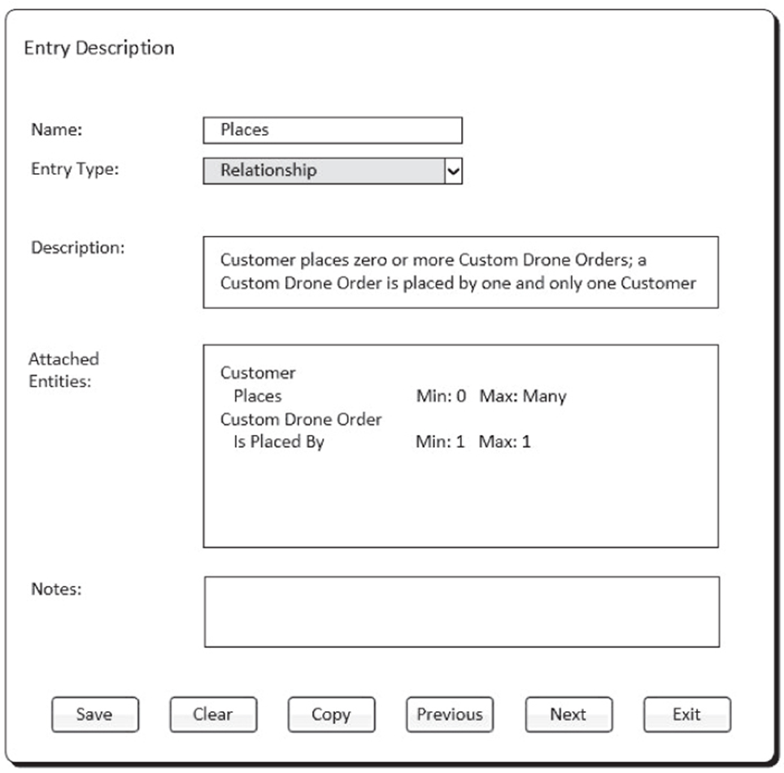
CASE Entry for Relationships

Slide 19
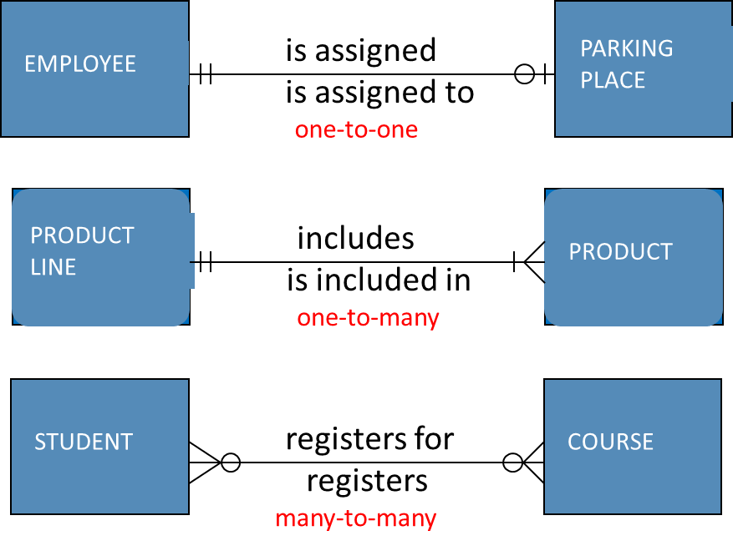
Binary Relationships

Slide 20
Modality
Refers to whether or not an instance of a child entity can exist without a related instance in the parent entity
Not Null - an instance in the related entity must exist for an instance in another entity to be valid
Null - no instance in the related entity is necessary for an instance in another entity to be valid

Slide 21
The Data Dictionary and Metadata
Every CASE tool has a data dictionary
Where the analyst goes to define or look up information about the entities, attributes, and relationships on the ERD
The information you see in the data dictionary is called metadata
Data about data
Metadata are stored in the data dictionary so that they can be shared

Slide 22
Types of Metadata Captured by the Data Dictionary

Slide 23
Creating an Entity Relationship Diagram
Drawing the ERD is an iterative process of trial and revision
ERDs can become quite complex
Steps in building ERDs…
Identify the entities
Add appropriate attributes for each entity
Draw the relationships that connect associated entities

Slide 24
Identify the Entities
Identify major categories of information
If available, check the process models for data stores, external entities, and data flows
Check the major inputs and outputs from the use cases
Verify that there is more than one instance of the entity that occurs in the system

Slide 25
Add Attributes and Assign Identifiers
Identify attributes of the entity that are relevant to the system under development
Check the process model repository entries for details on data flows and data stores
Check the data requirements of the requirements definition
Interview knowledgeable users
Perform document analysis on existing forms and reports
Select the entity’s candidate identifier (final decision may be postponed until Design phase)

Slide 26
Notice the Identifiers Selected for each Entity

Slide 27
Identify Relationships
Start with an entity and identify all entities with which it shares relationships
Describe the relationship with the appropriate verb phrase
Determine the cardinality and modality by discussing the business rules with knowledgeable users

Slide 28
ERD Building Tips
Data stores of the D F D generally correspond to entities
Only include entities with more than one instance
Do not include entities associated with implementation of the system (e.g., archive files of older data)
They will be added later

Slide 29
Advanced Syntax - Intersection Entities
A new entity is created to store information about two entities sharing an M:N relationship
Remove the M:N relationship between two entities and insert new entity between them
Create two 1:N relationships: original entities are parents to the new child intersection entity
Name the intersection entity
Migrate parent entity primary keys to new entity as foreign keys (possibly also concatenated primary key)

Slide 30
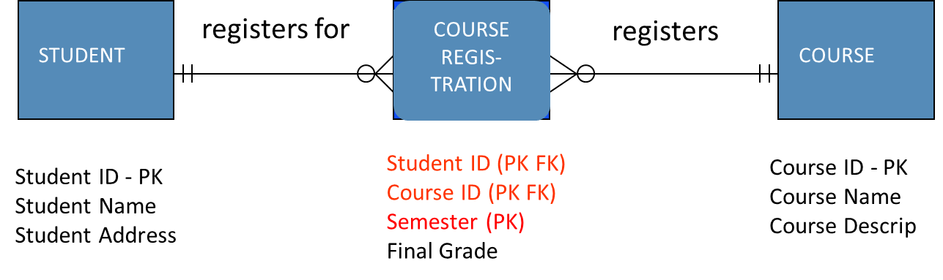
Resolving M:N with an Intersection Entity

Slide 31
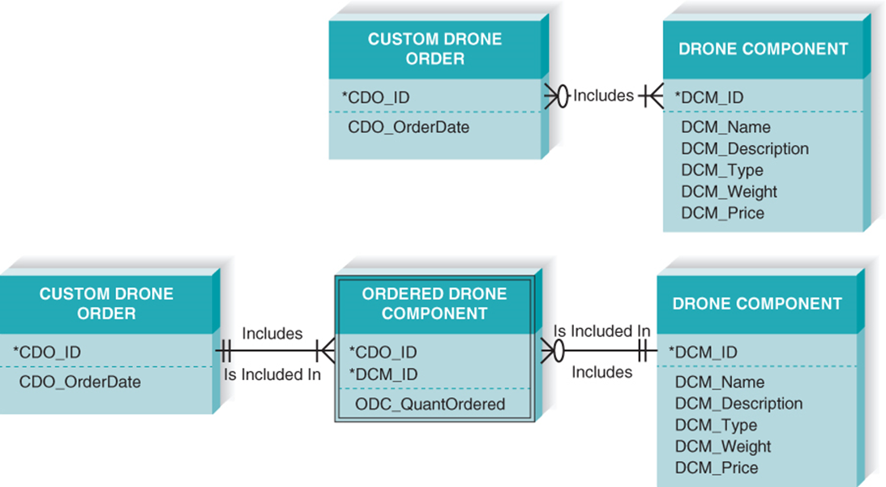
Resolving M:N Relationship

Slide 32
Other Syntax
An independent entity is an entity that can exist without the help of another entity
When a relationship includes an independent child entity, it is called a non‑identifying relationship
There are situations when a child entity requires attributes from the parent entity to uniquely identify an instance
Called a dependent entity
When relationships have a dependent child entity, they are called identifying relationships

Slide 33
Validating an Entity Relationship Diagram
Creating ERDs is pretty tough
There are some general design guidelines that you can keep in mind as you build ERDs
Once the ERDs are drawn, you can use a technique called normalization to validate that your models are well formed

Slide 34
Design Guidelines
Best practices rather than rigid rules
Entities should have many occurrences
Avoid unnecessary attributes
Clearly label all components
Apply correct cardinality and modality
Break attributes into lowest level needed
Labels should reflect common business terms
Assumptions should be clearly stated

Slide 35
Data Modeling Guidelines Summary

Slide 36
Normalization
Normalization is a process whereby a series of rules are applied to a logical data model or a fi le to determine how well formed it is
Normalization rules help analysts identify entities that are not represented correctly in a logical data model, or entities that can be broken out from a file
Three normalization rules described in the appendix

Slide 37
Balancing ERDs with Data Flow Diagrams
All analysis activities are interrelated
Process models contain two data components
Data flows and data stores
The D F D data components need to balance the ERD’s data stores (entities) and data elements (attributes)
Many CASE tools provide features to check for imbalance
Check that all data stores and elements correspond between models
Data that is not used is unnecessary
Data that has been omitted results in an incomplete system
Do not follow thoughtlessly -- check that the models make sense!

Slide 38
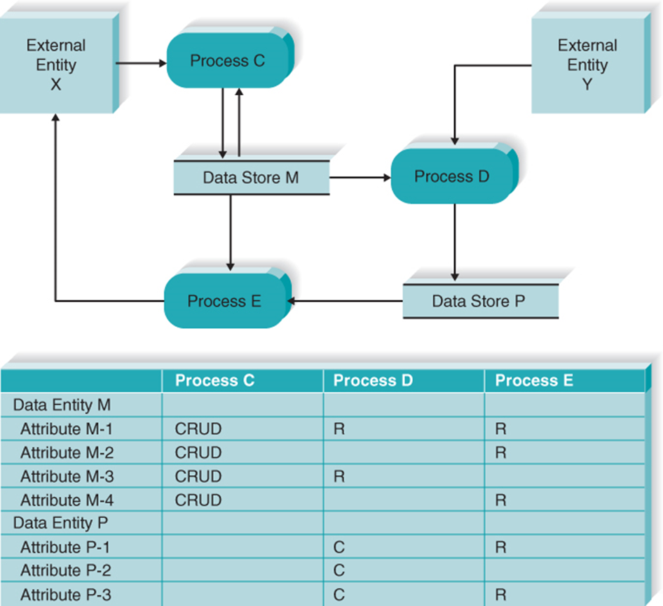
Use of a CRUD Matrix

Slide 39
Chapter Review
Define the meaning and purpose of the entity and relationship shown on an entity relationship diagram (ERD).
Explain the meaning and purpose of attributes included in a data model.
Explain what is meant by an entity’s identifier.
Explain the meaning of the cardinality and modality of a relationship.
Explain the concept of metadata and how it is compiled in the project repository.
Discuss the process used to create a data model.
Describe how to ensure that the process model and data model are balanced through the use of the CRUD matrix.
Discuss how the normalization process is performed and how it contributes to the quality of the data model (from chapter appendix).

Slide 40
Key Terms
1:1 relationships
1:N relationships
Assumptions
Attribute
Balance
Business rules
Cardinality
Child entity
Clients
Concatenated identifier
Create, read, update, delete (CRUD) matrix
Data dictionary
Data model
Dependent
Dependent entity
Derived attributes
Entity
Entity relationship diagram (ERD)
First normal form (1NF)
Identifier
Identifying relationships
Independent entity
Instances
Intersection entity
Logical data model
Metadata
M:N relationship
Non-identifying relationship
Normalization
Parent entity
Partial dependency
Physical data model
Relationships
Repeating attributes
Repeating attribute groups
Second normal form
(2NF)
Subject area
Third normal form (3NF)
Transitive dependency

