Slide 1
System Analysis and Design
Eighth Edition
Alan Dennis, Barbara Wixom, Roberta M. Roth
Chapter 5
Structural Modeling

Slide 2
Objectives
Understand the rules and style guidelines for creating CRC cards, class diagrams, and object diagrams.
Understand the processes used to create CRC cards, class diagrams, and object diagrams.
Be able to create CRC cards, class diagrams, and object diagrams.
Understand how to verify and validate the structural models.
Understand how to verify and validate the structural models with the functional models.

Slide 3
Introduction
A structural model is a formal way of representing the objects that are used and created by a business system.
It illustrates people, places, or things about which information is captured and how they are related to one another.
The structural model is drawn using an iterative process in which the model becomes more detailed and less conceptual over time.
In analysis, analysts draw a conceptual model, which shows the logical organization of the objects without indicating how the objects are stored, created, or manipulated.
Because this model is free from any implementation or technical details, the analysts can focus more easily on matching the model to the real business requirements of the system.

Slide 4
Structural Models
The goal of the analyst is to discover the key objects contained in the problem domain and to build a structural model. Object‐oriented modeling allows the analyst to reduce the semantic gap between the underlying problem domain and the evolving structural model.
An exact mapping between the structural model and the problem domain may not be possible. In fact, it might not even be desirable.
One of the primary purposes of the structural model is to create a vocabulary that can be used by the analyst and the users.
Structural models represent the things, ideas, or concepts contained in the domain of the problem, and their relationships. By creating a structural model of the problem domain, the analyst creates the vocabulary necessary for the analyst and users to communicate effectively.
It is important to remember that at this stage of development, the structural model does not represent software components or classes in an object‐oriented programming language, even though the structural model does contain analysis classes, attributes, operations, and the relationships among the analysis classes.

Slide 5
Class/Object Diagrams
Class diagrams can be used to depict the structural model.
They can be used at many different levels of analysis:
System Level Context Diagram
Software Level Class designs
The classes on the diagram provide the structural element necessary for that level of analysis.
On system diagrams, the classes represent subsystems, that are too high level to actually implement
On software diagrams, the classes represent actual things that the software engineer codes.

Slide 6
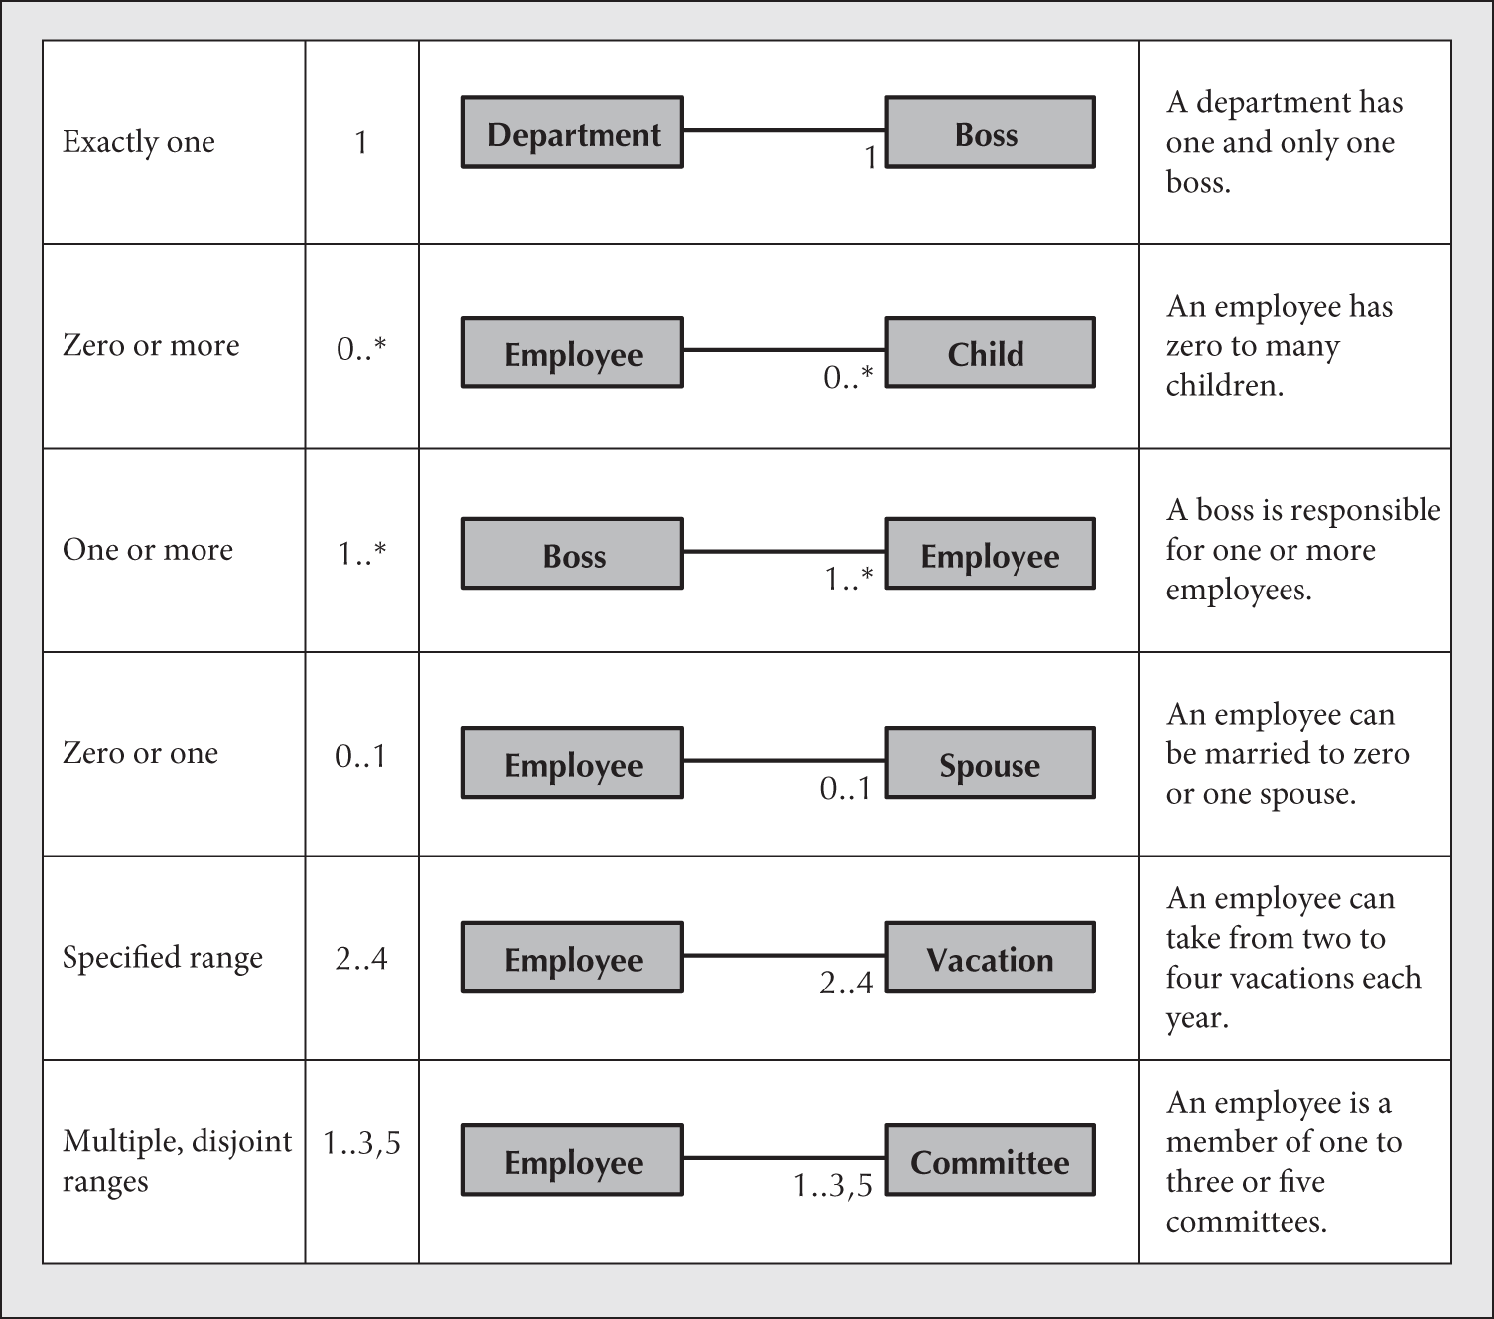
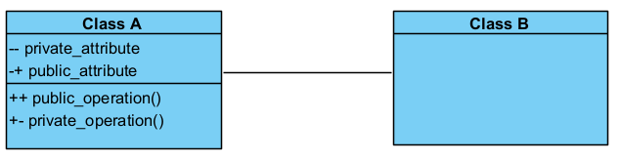
Classes, Attributes, Operations

Slide 7
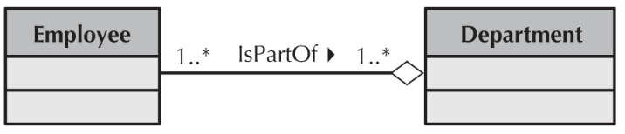
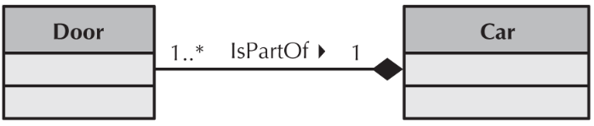
Class Associations - Aggregation
Loose Aggregation
Employee has a Life Span < Department
Strict Aggregation (Composition)
Door Life Span = Car

Slide 8
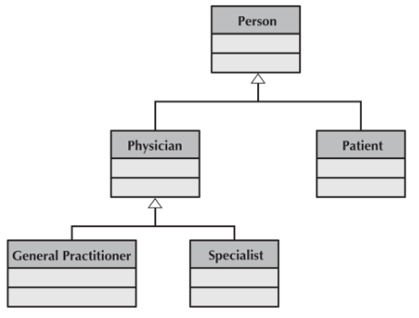
Class Associations – Generalization (Inheritance)
Most General Base Class
Most Specific Derived Class

Slide 9
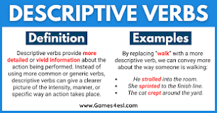
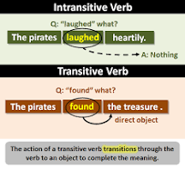
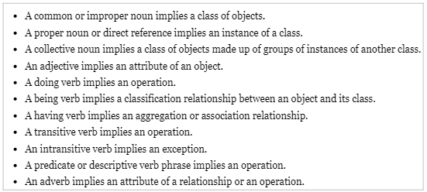
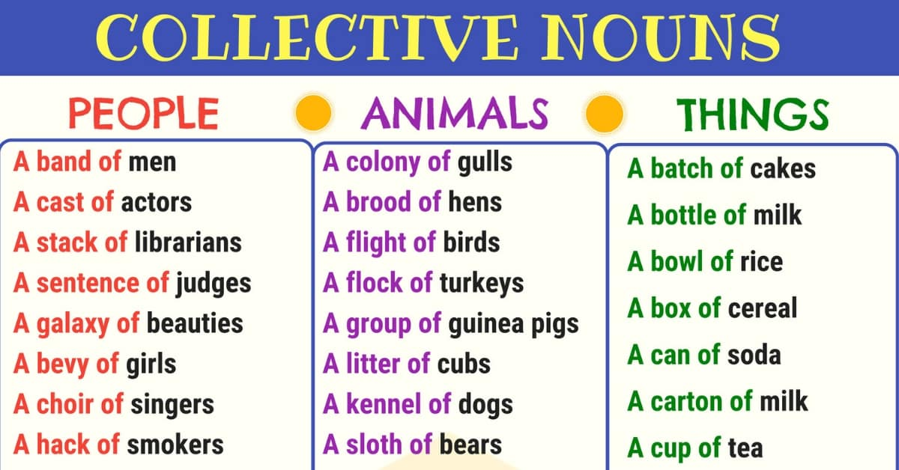
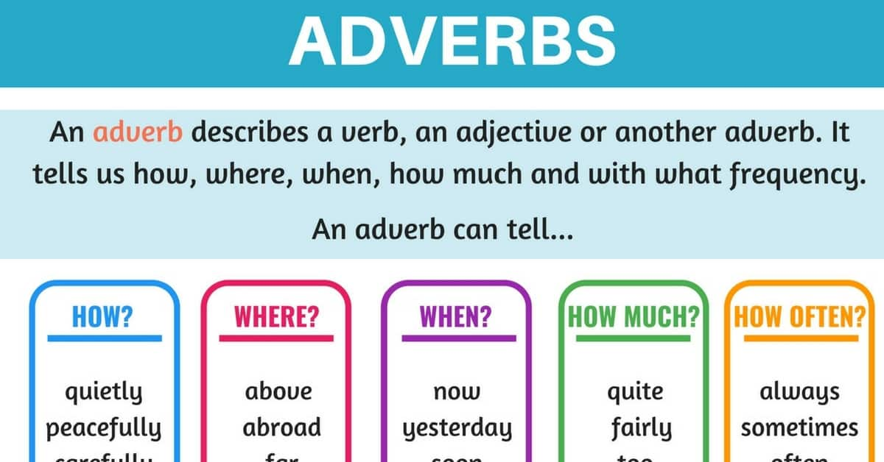
Brainstorming Classes
https://7esl.com/

Slide 10
Chapter Review
Describe the purpose of a structural model.
Describe the different elements of a structural model.
Explain the difference between abstract and concrete classes.
Describe the three general types of relationships typically used in a structural model.
Create a structural model using textual analysis of use‐case descriptions, brainstorming, and patterns.
Explain the purpose of a CRC card in structural modeling.
Create a structural model using CRC cards.
Describe the different elements of a CRC card.
Describe how to role‐play CRC cards using use‐case scenarios.

Slide 11
Chapter Review - Cont
Describe the different elements of a class diagram.
Describe the four basic operations that can be represented on a class diagram.
Explain the differences between the types of relationships supported on a class diagram.
Create a class diagram that represents a structural model.
Describe the different elements of an object diagram.
Create an object diagram that represents an instantiation of a portion of a class diagram.
Verify and validate the evolving structural model using role‐playing and walkthroughs.
Verify and validate the structural model by ensuring the consistency of the CRC cards and class diagram.
Verify and validate both the structural and functional models by balancing the two.

Slide 12
Key Terms
A‐kind‐of
A‐part‐of
Abstract class
Aggregation association
Assemblies
Association
Association class
Attribute
Brainstorming
Class
Class diagram
Class‐Responsibility‐Collaboration (CRC)
Client
Collaboration
Conceptual model
Concrete class
Constructor operation
Contract
CRC cards
Decomposition
Derived attribute
Destructor operation
Doing responsibility
Domain classes

Slide 13
Key Terms - Cont
Generalization association
Has‐parts
Information hiding
Instance
Instantiation
Knowing responsibility
Method
Multiplicity
Object
Object diagram
Operation
Package
Parts
Pattern
Private
Protected
Public
Query operation
Responsibility
Role‐playing
Roles
Server
Specialization
State
Static model
Static structure diagram
Structural model
Subclass
Substitutability
Superclass
SVDPI
Tangible things
Textual analysis
Update operation
View
Visibility
Wholes

