Slide 1
System Analysis and Design
Eighth Edition
Alan Dennis, Barbara Wixom, Roberta M. Roth
Chapter 6
Moving into Design

Slide 2
Objectives
Explain the initial transition from analysis to design.
Create a system specification.
Describe three ways to acquire a system: custom, packaged, and outsourced alternatives.
Create an alternative matrix.

Slide 3
Transition from Requirements to Design
In systems analysis we figure out…
What the business needs
In system design we figure out…
How to build the system that fulfills those needs
All the “logical” work from systems analysis is converted to the “physical”

Slide 4
Design phase
Decide how to build the system
Create system requirements that describe all technical details for building the system
System specification
Final deliverable from design phase
Conveys exactly what system the development team will implement during the implementation phase

Slide 5
Activities of the Design Phase

Slide 6
Elements of System Specification
Recommended System Acquisition Strategy
System Acquisition Weighted Alternative Matrix
Architecture Design
Hardware and Software Specification
Interface Design
Physical Process Model
Program Design Specifications
Physical Data Model
Data Storage Design
Updated CRUD Matrix
Updated CASE Repository Entries

Slide 7
Ways to Acquire a New System
Custom development (build from scratch) in-house
Purchase software package (and possibly customize it)
Install on our own computers, or
Obtain access from a software provider (host)
Outsource development to third party, who might
Build system from scratch for us, or
Purchase software for us, customize and install it

Slide 8
Custom Development
Pros
Get exactly what we want
New system built consistently with existing technology
and standards
Build and retain technical skills and functional
knowledge in-house
Allows team flexibility and creativity
Unique solutions created for strategic advantage
Cons
Requires significant time and effort
May add to existing backlogs
May require skills we do not have
Often costs more
Often takes more calendar time
Risk of project failure

Slide 9
Purchased Software
Application service providers (ASP) supply access to software on a pay-as-you-go basis
Many applications today are “in the cloud”…
ASP – provider hosts someone else’s software
SaaS – software vendor hosts its own software
Considerable savings – no hosting infrastructure needed; host provides everything
Risks include
Fear of losing confidential information
Performance

Slide 10
Purchased Software Continued
Analyze the vendor as well as the software functionality
Verify vendor claims with others
Look carefully at vendor support
Assess long-term viability of vendor as an on-going business
A new software company may have a great idea, but can they survive as a business over the long haul?
If the vendor is an acquisition target, what will happen to the product?

Slide 11
Packages (Purchased or Obtained from ASP or SaaS)
Pros
No need to “reinvent the wheel” for common business needs
Tested, proven product
Cost savings
Time savings
Utilize vendors’ expertise
Some customization may be possible
Cons
Rarely a perfect fit
Organizational processes must adapt to software
Reliance on vendor for maintenance and future
enhancements
Will not develop in-house
functional and
technical skills
Unique needs may go unmet
May require system integration

Slide 12
Systems Integration
Building systems by combining packages, existing (legacy) systems, and custom software written for integration
Integrating data between various parts of the system is the key challenge
Many consultants specialize in systems integration

Slide 13
Outsourced Development
Pros
Hire expertise we do not have
May save time and money
Lower risk
Cons
No opportunity to build in-house
expertise
Reliance on vendor
Future options limited
Security—potential
loss of confidential info
Performance based on contract terms

Slide 14
Outsourcing
Hiring an external vendor, developer, or service provider to supply the system
Can also obtain custom system created by outsourcer
Can reduce costs and/or add value (resources, experience)
Risks include
Losing confidential information
Losing control over future development
Losing learning opportunities

Slide 15
Outsourcing Contracts
Time and arrangements
You agree to pay for whatever time and expenses are needed to get the job done
Fixed-price
You will pay exactly what is agreed to
Value-added
The outsourcer reaps some percentage of the completed system’s benefits

Slide 16
Outsourcing Guidelines
Keep lines of communication open
Define and stabilize requirements before signing the contract
View the relationship as a partnership
Select vendor, developer, or provider carefully
Assign someone to manage the relationship
Do not outsource what you do not understand
Emphasize flexible requirements, long-term relationships, and short-term contracts

Slide 17
Influences on the Acquisition Strategy
Business need
In-house experience
Project skills
Project management
Time frame

Slide 18
Acquisition Strategy Selection Factors
 | When to Use Custom Development | When to Use a Packaged System | When to Use Outsourcing
Business need | The business need is unique. | The business need is common. | The business need is not core to the business.
In-house experience | In-house functional and technical experience exists. | In-house functional experience exists. | In-house functional or technical experience does not exist.
Project skills | There is a desire to build in-house skills. | The skills are not strategic. | The decision to outsource is a strategic decision.
Project management | The project has a highly skilled project manager and a proven methodology. | The project has a project manager who can coordinate vendor’s efforts. | The project has a highly skilled project manager at the level of the organization that matches the scope of the outsourcing deal.
Time frame | The time frame is flexible. | The time frame is short. | The time frame is short or flexible.

Slide 19
Selecting an Acquisition Strategy
Start by collecting information
What tools and technologies are needed for a custom development project?
What vendors make products that address the project needs?
What service providers would be able to build this application if outsourced?

Slide 20
Request for Proposals (RFP)
Solicits proposals from vendor, developer, or service provider
Explains the system to be built and criteria for selecting among applicants
Request for Information (RFI) -- a shorter and less detailed version
Request for Quote (RFQ) – use when you just need a price

Slide 21
Typical RFP Contents
Description of desired system
Special technical needs or circumstances
Evaluation criteria
Instructions on how to respond
Desired schedule
Other information that will help the submitter to make a more complete or accurate proposal

Slide 22
Alternative Matrix
Combine several feasibility analyses into one matrix
Include technical, economic, and organizational feasibilities
Assign weights to indicate the relative importance of the criteria
Assign scores to indicate how well the alternative meets the criteria

Slide 23
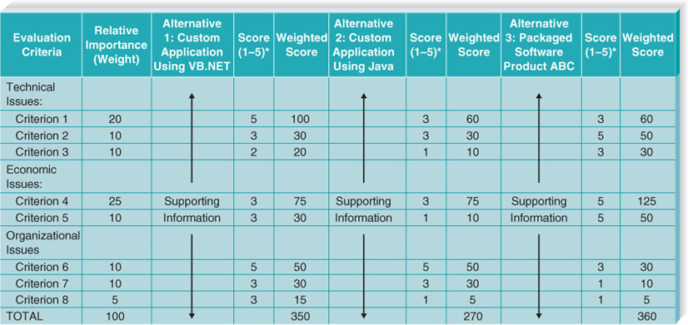
Sample Alternative Matrix

Slide 24
Chapter Review
Identify and describe the steps associated with the design phase of the project.
Explain the meaning and purpose of the components of the system specification.
Explain the pros and cons of obtaining the new system through a custom development project.
Explain the pros and cons of obtaining the new system through a purchasing a software package.

Slide 25
Chapter Review Continued
Explain the pros and cons of obtaining the new system through an outsourcing firm.
Explain how the characteristics of the project influence the selection of the acquisition strategy.
Explain the use of RFPs, RFIs, and RFQs as ways of gathering information from vendors.
Discuss the use of an alternatives matrix to systematically evaluate and compare alternatives.

Slide 26
Key Terms
Alternative matrix
Application service provider (ASP)
Custom development
Design phase
Enterprise resource planning (ERP)
Fixed-price contract
Outsourcing
Packaged software
Request for information
(RFI)
Request for proposal
(RFP)
Request for quote
(RFQ)
Software as a Service
(SaaS)
System requirement
Systems integration
System specification
Time and arrangements deal
Value-added contract
Weighted alternative matrix
Workaround

