Slide 1
System Analysis and Design
Eighth Edition
Alan Dennis, Barbara Wixom, Roberta M. Roth
Chapter 6
Moving into Design

Slide 2
Objectives
Explain the initial transition from analysis to design.
Create a system specification. ✓
Already in the process of doing this as part of analysis.
Describe three ways to acquire a system: custom, packaged, and outsourced alternatives.
Create an alternative matrix.

Slide 3
Content Outline
Design phase
Decide how to build the system
Create system requirements that describe all technical details for building the system
This process was already started as part of the efforts we have done to date.
We created a draft Software Requirements Specification\
Verify Analysis Models
Design Artifacts
Update SRS, as agreed to with Stakeholders.
Final Deliverables are the Design Model and the Final SRS
Conveys exactly what system the development team will implement during the implementation phase

Slide 4
Transition from Requirements to Design
In systems analysis we figure out…
What the business needs
In system design we figure out…
How to build the system that fulfills those needs
All the “logical” work from systems analysis is converted to the “physical”

Slide 5
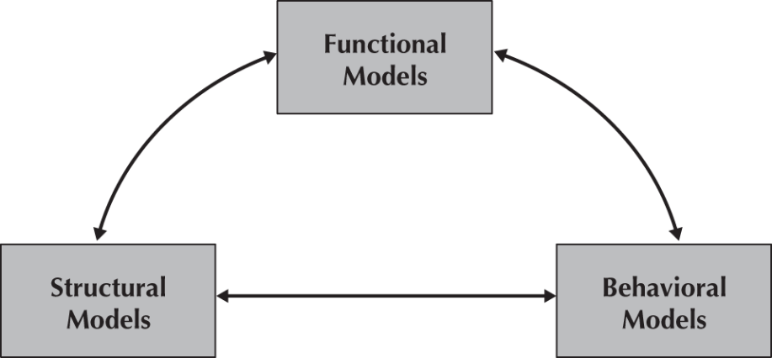
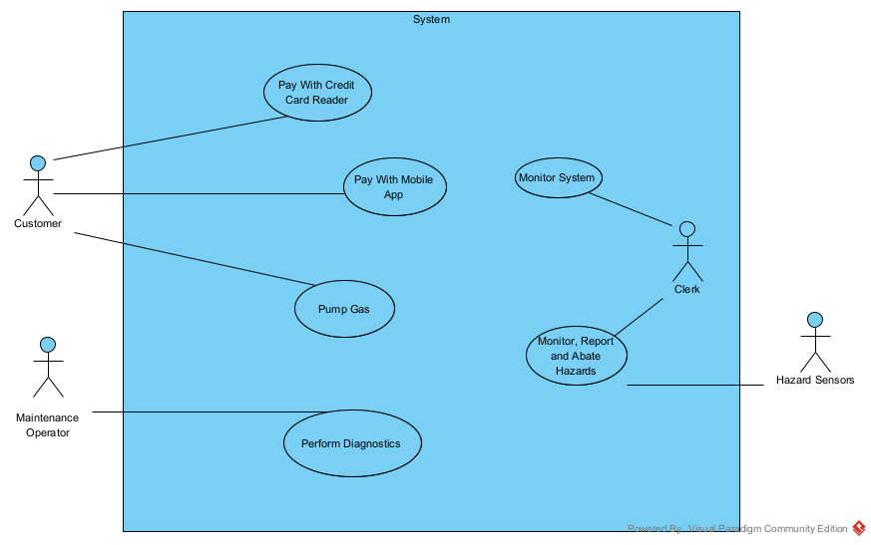
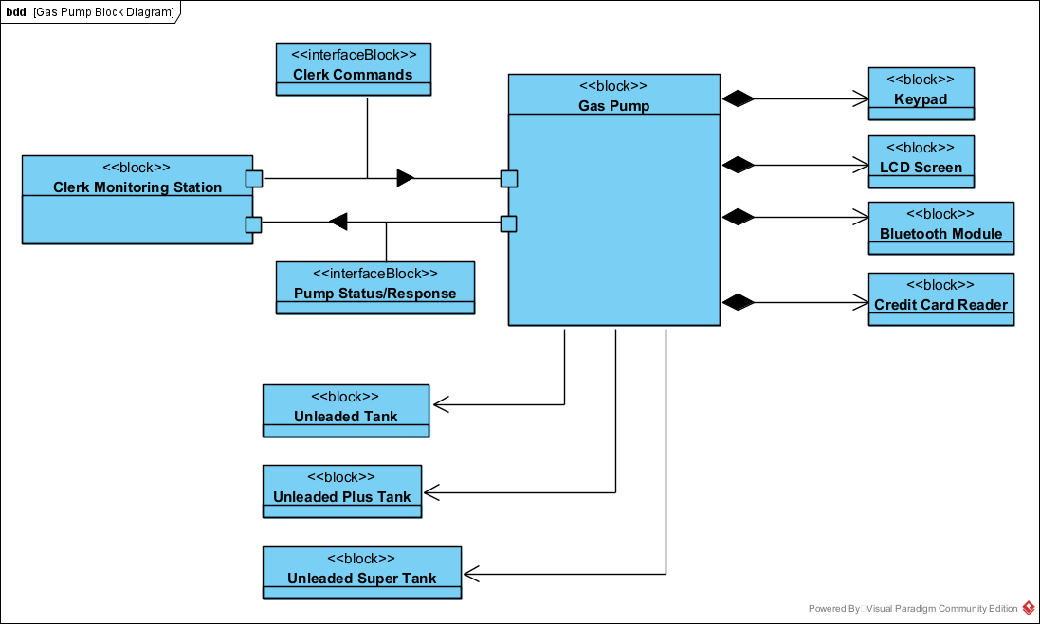
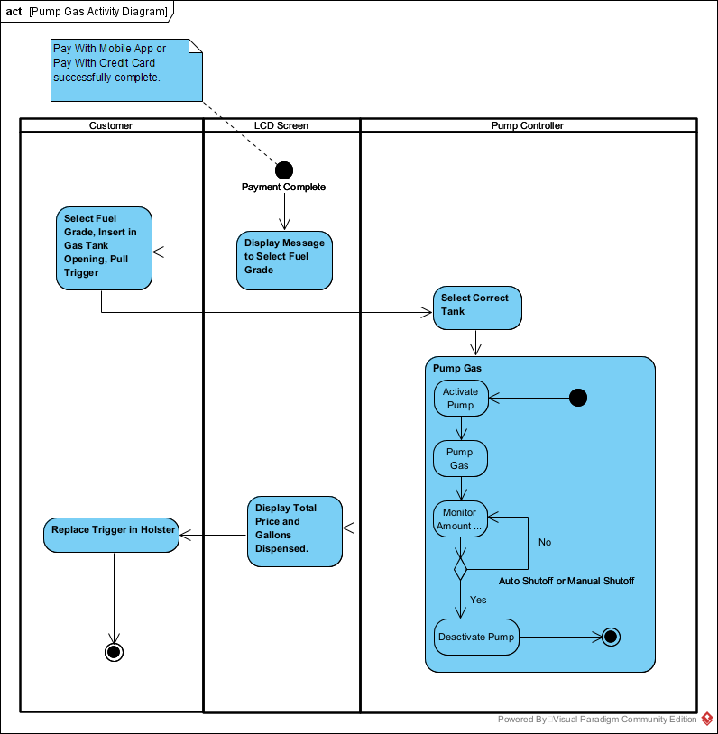
Models Thus Far
Functional Model – Describe System to be built.
User Requirements Gathering Process
Use Case Cases
Use Case Diagram
Use Case Template Description
Structural Model – Describe Overall Structure That Helps to Understand The System Context
Classes/Blocks
System Block Diagram
Class Diagram
Block Definition Diagram
Behavioral Model – Describe User Interactions of the System to Model Requirements
Use Case Scenarios
Activity Diagrams

Slide 6
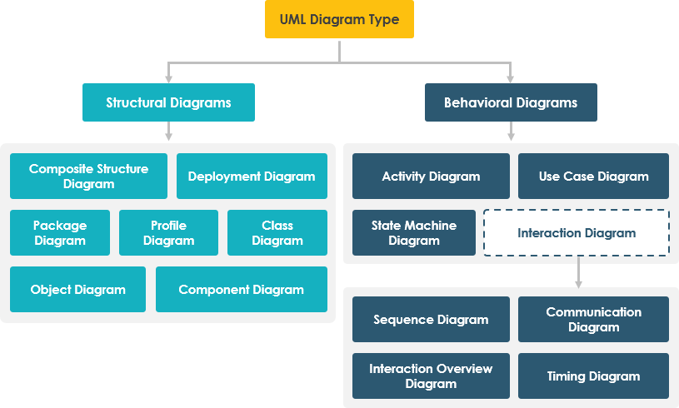
UML Diagram Types
Created
Will Create

Slide 7
Class Diagrams
Same thing, more detail.
During system analysis, class diagrams can be used to depict high level system components to help visualize the requirements in Activity Diagram.
The “system level” classes are not meant to be implemented. They are only seen as a means to an end. The “end” being an analysis model for viewing our requirements.
During design, software engineers view the analysis and develop classes that will be used to actually implement the requirements through software level capabilities
Requirements analysis models are meant to be the “what”, software design information is the “how”

Slide 8
CRC Cards
Class – Responsibility – Collaboration
Used to document the responsibilities and collaborations of a class.
Low‐tech approach that can complement a typical high‐tech Unified Process approach that uses Computer-Aided Software Engineering (CASE tools).
We use an extended form of the CRC card to capture all relevant information associated with a class.
https://agilemodeling.com/artifacts/crcmodel.htm

Slide 9
Responsibilities
Knowing responsibilities are those things that an instance of a class must be capable of knowing.
An instance of a class typically knows the values of its attributes and its relationships.
Doing responsibilities are those things that an instance of a class must be capable of doing.
An instance of a class can execute its operations, or
It can request a second instance, which it knows about, to execute one of its operations on behalf of the first instance.

Slide 10
Collaborations
The structural model describes the objects necessary to support the business processes modeled by the Use Cases.
Most Use Case implementations involve a set of several classes, not just one class.
These classes form collaborations.
Collaborations allow the analyst to think in terms of clients, servers, and contracts.
A client object is an instance of a class that sends a request to an instance of another class for an operation to be executed.
A server object is the instance that receives the request from the client object.
A contract formalizes the interactions between the client and server objects. This “contract” is in the form of the public methods of the server class.

Slide 11
Back to Nouns and Verbs
For design level class diagrams, review your uses cases, activity diagrams and even requirements.
Pick out the nouns and verbs as before.
“Discover” you initial set of class, attributes and operations
Then, step inside these classes…..

Slide 12
Anthropomorphism
Pretending inanimate objects have human characteristics.
Step inside the object, and ask yourself these questions:
Who or what are you?
What do you know?
What can you do for me?
Answer these questions while filling out the CRC Cards

Slide 13
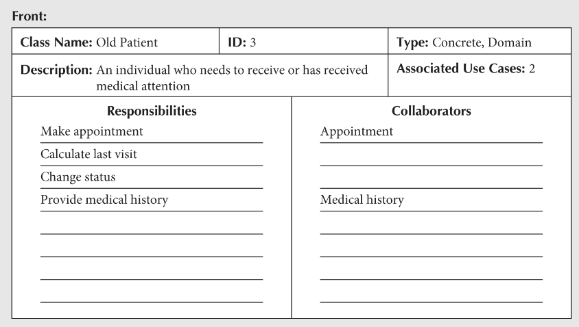
CRC Card Elements - Front

Slide 14
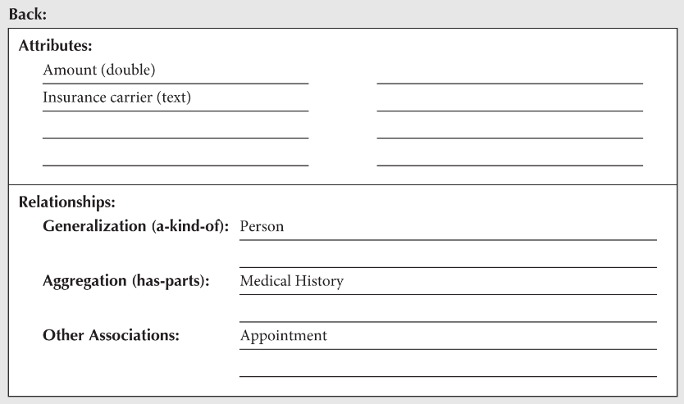
CRC Card Elements - Back

