Slide 1
System Analysis and Design
Eighth Edition
Alan Dennis, Barbara Wixom, Roberta M. Roth
Chapter 6
Moving into Design

Slide 2
Objectives
Explain the initial transition from analysis to design.
Create a system specification. ✓
Already in the process of doing this as part of analysis.
Describe three ways to acquire a system: custom, packaged, and outsourced alternatives.
Create an alternative matrix.

Slide 3
Content Outline
Design phase
Decide how to build the system
Create system requirements that describe all technical details for building the system
This process was already started as part of the efforts we have done to date.
We created a draft Software Requirements Specification\
Verify Analysis Models
Design Artifacts
Update SRS, as agreed to with Stakeholders.
Final Deliverables are the Design Model and the Final SRS
Conveys exactly what system the development team will implement during the implementation phase

Slide 4
Transition from Requirements to Design
In systems analysis we figure out…
What the business needs
In system design we figure out…
How to build the system that fulfills those needs
All the “logical” work from systems analysis is converted to the “physical”

Slide 5
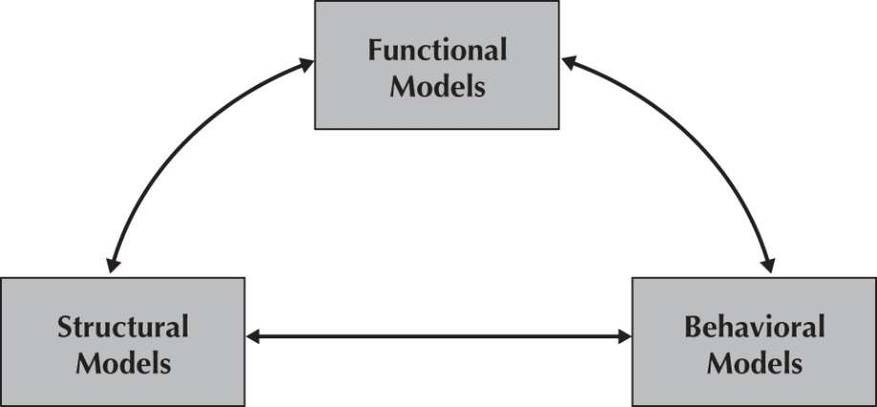
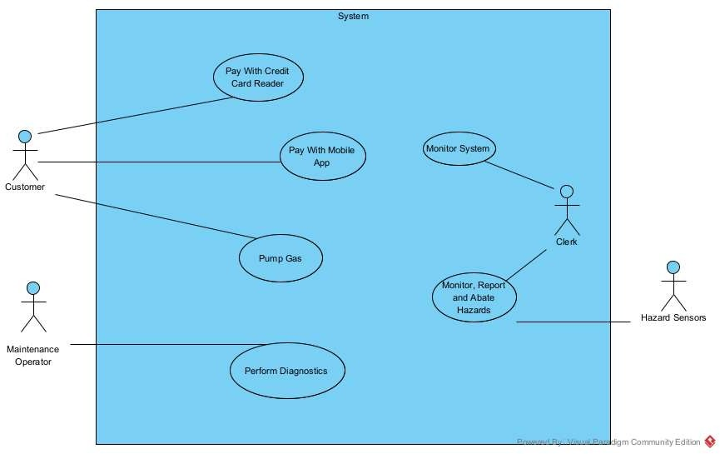
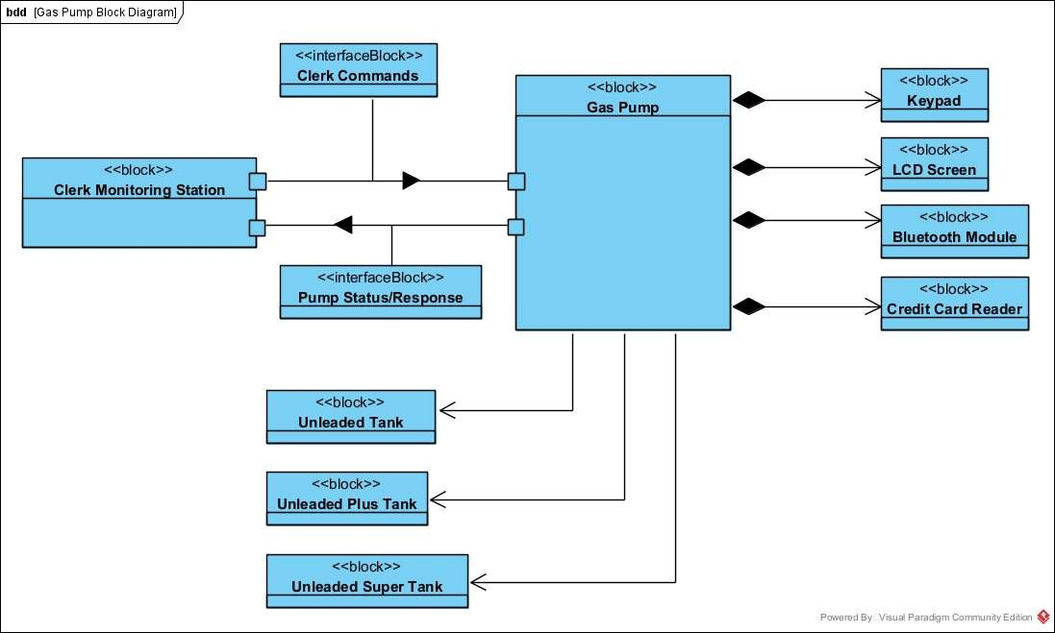
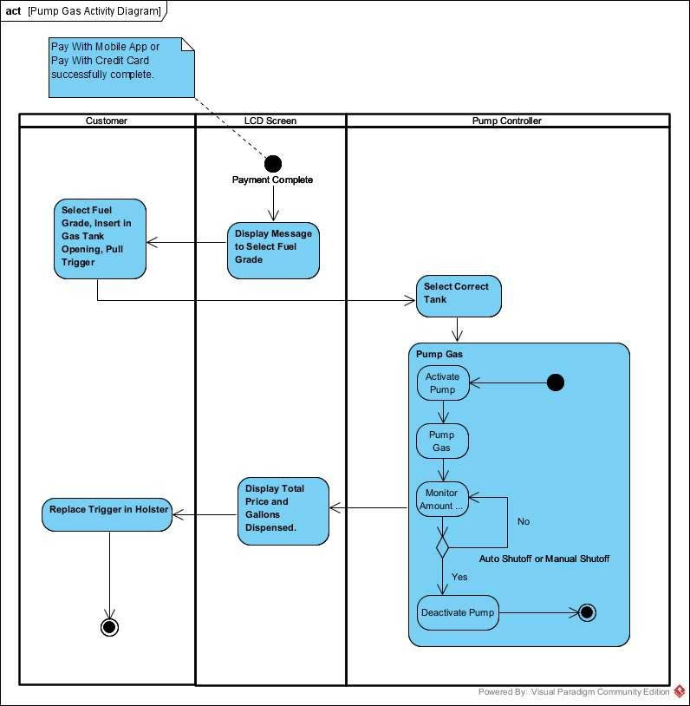
Models Thus Far
Functional Model – Describe System to be built.
User Requirements Gathering Process
Use Case Cases
Use Case Diagram
Use Case Template Description
Structural Model – Describe Overall Structure That Helps to Understand The System Context
Classes/Blocks
System Block Diagram
Class Diagram
Block Definition Diagram
Behavioral Model – Describe User Interactions of the System to Model Requirements
Use Case Scenarios
Activity Diagrams

Slide 6
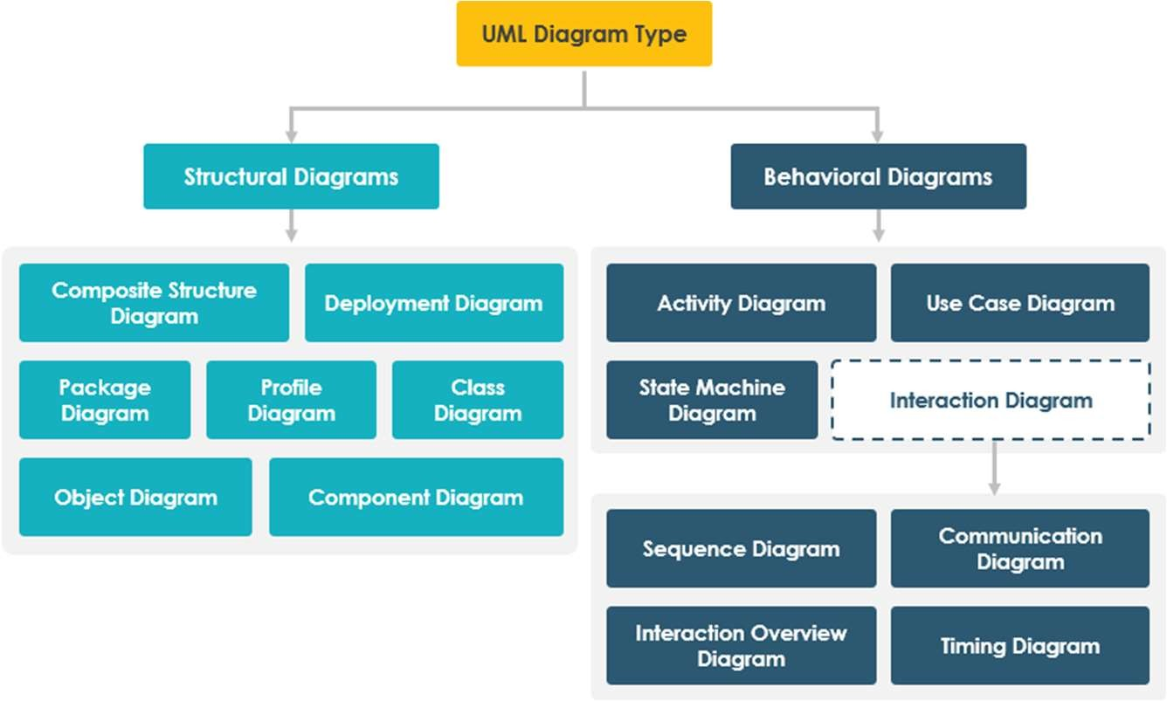

UML Diagram Types
UML Diagram Overview
Created Will Create

Slide 7
Class Diagrams
Same thing, more detail.
During system analysis, class diagrams can be used to depict high level system components to help visualize the requirements in Activity Diagram.
The “system level” classes are not meant to be implemented. They are only seen as a means to an end. The “end” being an analysis model for viewing our requirements.
During design, software engineers view the analysis and develop classes that will be used to actually implement the requirements through software level capabilities
Requirements analysis models are meant to be the “what”, software design information is the “how”

Slide 8
CRC Cards
Class – Responsibility – Collaboration
Used to document the responsibilities and collaborations of a class.
Low-tech approach that can complement a typical high-tech Unified Process approach that uses Computer-Aided Software Engineering (CASE tools).
We use an extended form of the CRC card to capture all relevant information associated with a class.
https://agilemodeling.com/artifacts/crcmodel.htm

Slide 9
Responsibilities
Knowing responsibilities are those things that an instance of a class must be capable of knowing.
An instance of a class typically knows the values of its attributes and its relationships.
Doing responsibilities are those things that an instance of a class must be capable of doing.
An instance of a class can execute its operations, or
It can request a second instance, which it knows about, to execute one of its operations on behalf of the first instance.

Slide 10
Collaborations
The structural model describes the objects necessary to support the business processes modeled by the Use Cases.
Most Use Case implementations involve a set of several classes, not just one class.
These classes form collaborations.
Collaborations allow the analyst to think in terms of clients, servers, and contracts.
A client object is an instance of a class that sends a request to an instance of another class for an operation to be executed.
A server object is the instance that receives the request from the client object.
A contract formalizes the interactions between the client and server objects. This “contract” is in the form of the public methods of the server class.

Slide 11
Back to Nouns and Verbs
For design level class diagrams, review your uses cases, activity diagrams and even requirements.
Pick out the nouns and verbs as before.
“Discover” you initial set of class, attributes and operations
Then, step inside these classes…..

Slide 12
Anthropomorphism
Pretending inanimate objects have human characteristics.
Step inside the object, and ask yourself these questions:
Who or what are you?
What do you know?
What can you do for me?
Answer these questions while filling out the CRC Cards

Slide 13
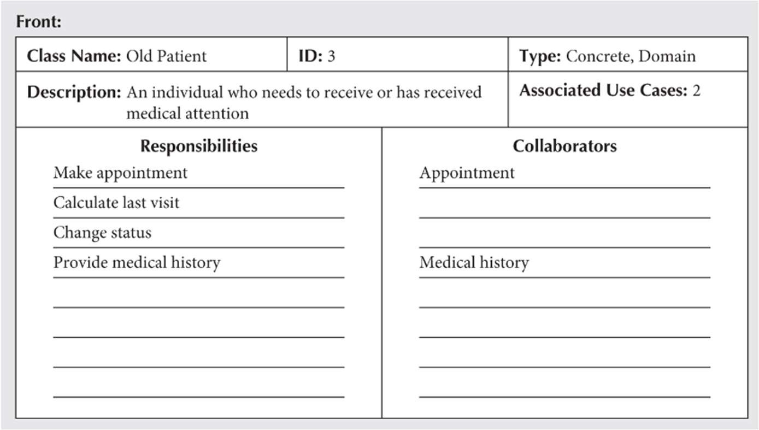
CRC Card Elements - Front

Slide 14
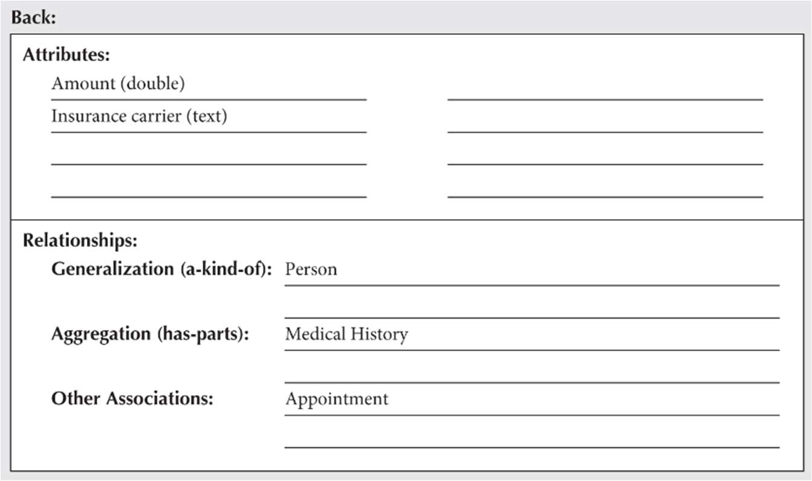
CRC Card Elements - Back

Slide 15
CRC Modeling https://agilemodeling.com/artifacts/crcmodel.htm
So how do you create CRC models? Iteratively perform the following steps:
Find classes. Finding classes is fundamentally an analysis task because it deals with identifying the building blocks for your application. A good rule of thumb is that you should look for the three-to-five main classes right away, such as Student, Seminar, and Professor in Figure 4 (refer to webpage). I will sometimes include UI classes such as Transcript and Student Schedule, both are reports, although others will stick to just entity classes. Also, I’ll sometimes include cards representing actors when my stakeholders are struggling with the concept of a student in the real world (the actor) versus the student in the system (the entity).
Find responsibilities. You should ask yourself what a class does as well as what information you wish to maintain about it. You will often identify a responsibility for a class to fulfill a collaboration with another class.

Slide 16
CRC Modeling (cont)
Define collaborators. A class often does not have sufficient information to fulfill its responsibilities. Therefore, it must collaborate (work) with other classes to get the job done. Collaboration will be in one of two forms: a request for information or a request to perform a task. To identify the collaborators of a class for each responsibility ask yourself “does the class have the ability to fulfill this responsibility?”. If not then look for a class that either has the ability to fulfill the missing functionality or the class which should fulfill it. In doing so you’ll often discover the need for new responsibilities in other classes and maybe even the need for a new class or two.
Move the cards around. To improve everyone’s understanding of the system, the cards should be placed on the table in an intelligent manner. Two cards that collaborate with one another should be placed close together on the table, whereas two cards that don’t collaborate should be placed far apart. Furthermore, the more two cards collaborate, the closer they should be on the desk. By having cards that collaborate with one another close together, it’s easier to understand the relationships between classes.

