Slide 1
System Analysis and Design
Eighth Edition
Alan Dennis, Barbara Wixom, Roberta M. Roth
Chapter 7
Architecture Design

Slide 2
Objectives
Describe the fundamental components of an information system.
Describe client–server, server- based, and mobile application architectures.
Describe how cloud computing can be incorporated as a system architecture component.
Explain how operational, performance, security, cultural, and political requirements affect the architecture design.
Create a hardware and software specification.

Slide 3
Introduction
Architecture design
Plans for how the system will be distributed across computers and what hardware and software will be used for each computer
Hardware and software specification
Describes the hardware/software components in detail to aid those responsible for purchasing those products

Slide 4
Elements of an Architecture Design
Objective is to assign the software components of the information system to the hardware devices of the system in the most advantageous way
The major architectural components of any system are the software and the hardware
Software systems can be divided into four basic functions:
Data storage: Most information systems require data to be stored and retrieved
Data access logic: the processing required to access stored data
Application logic: the logic documented in the D F Ds, use cases, and functional requirements
Presentation logic: the display of information to the user and the acceptance of the user’s commands

Slide 5
Three Primary Hardware Components
Client computers: Input-output devices employed by users (e.g., PCs, laptops, handheld and mobile devices, smart phones)
Servers: Larger multi-user computers used to store software and data
Network: Connects the computers

Slide 6
Client–Server Architectures
Client-server architectures balance the processing between client devices and one or more server devices
Generally, clients are responsible for the presentation logic
The server(s) are responsible for the data access logic and data storage
Application logic location varies depending on the C-S configuration chosen

Slide 7
Four Benefits of Client-Server
Scalable: it is easy to increase or decrease the storage and processing capabilities of the servers
Can support different types of clients and servers through middleware
Middleware is a type of system software designed to translate between different vendors’ software
The presentation logic, the application logic, and the data processing logic can be independent
If the thin client-server architectures use Internet standards
If a server fails, only the applications requiring that server are affected – highly reliable

Slide 8
Client–Server Tiers
Two-tiered
Three-tiered
n-tiered

Slide 9
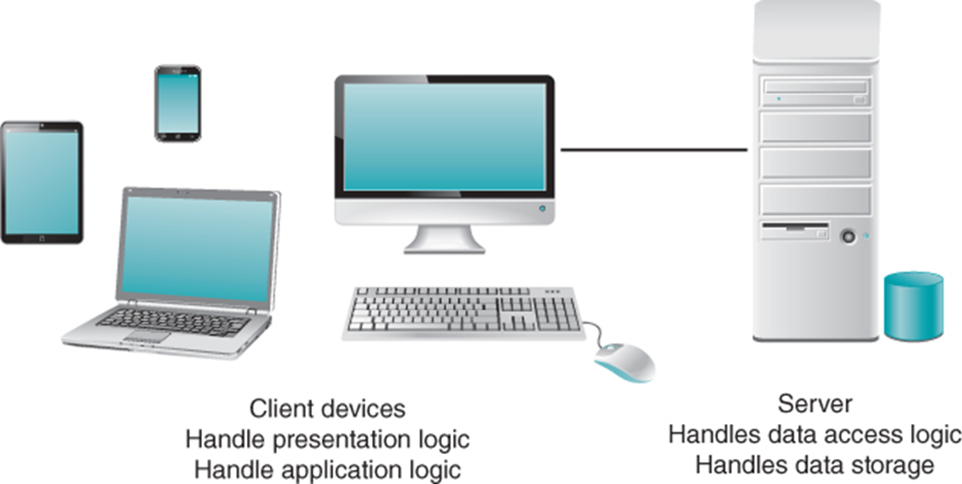
Two-Tiered Client-Server Architecture
Thick client – most of application logic on the client side (shown here)
Thin client – little application logic on the client side; most shifted to server side

Slide 10
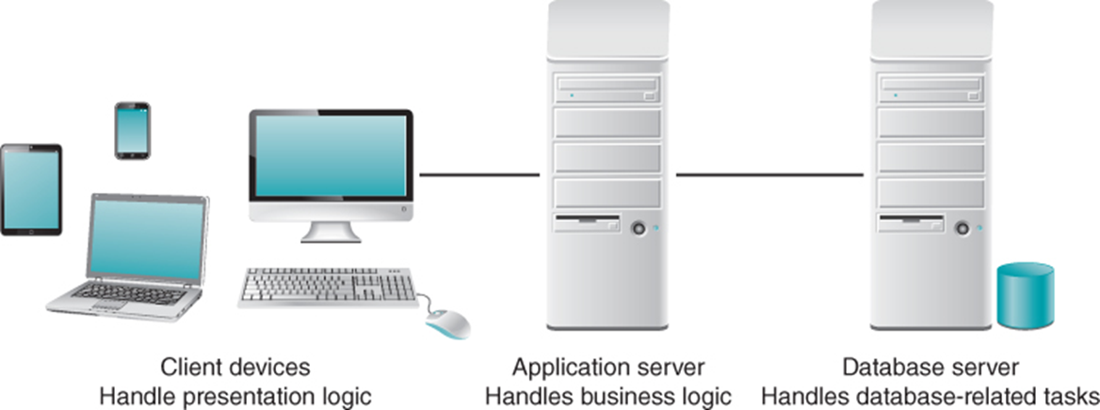
Three-Tiered Client-Server Architecture
Adds “specialized” servers
Typically, the user interface runs on a desktop PC or workstation and uses a standard graphical user interface
The application logic may consist of one or more separate modules running on a workstation
A relational DBMS running on a database server contains the data access logic and data storage

Slide 11
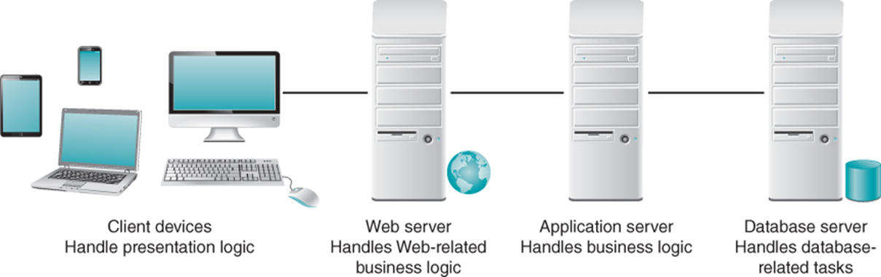
n-Tiered Client-Server Architecture
Adds “specialized” servers
Distributes the work of the application (the middle tier) among multiple layers of more specialized server computers
The primary advantage of an n-tiered client–server architecture is that it separates out the processing that occurs to better balance the load

Slide 12
Adding “Tiers” in the Architecture
ADVANTAGES | DISADVANTAGES
Modular business logic components are shareable across applications Separating the processing among multiple servers makes it possible to balance the server loads efficiently. | More tiers place a higher load on the network. More difficult to implement since the servers must communicate effectively.

Slide 13
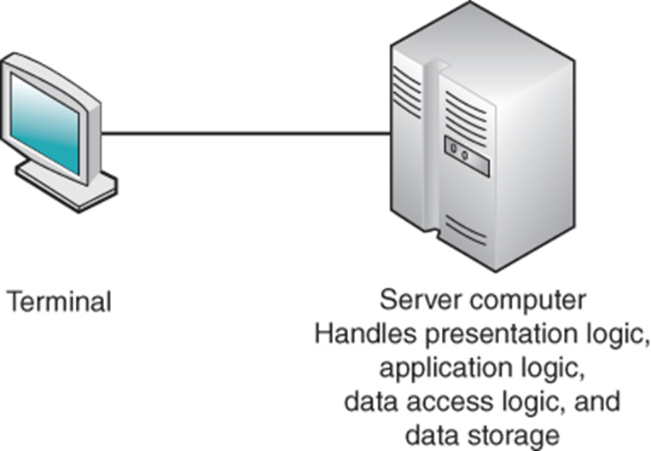
Server-Based Architecture
The very first computing architectures were server-based
The server was a mainframe computer and the client was a “dumb” terminal
This remarkably simple architecture often works very well
Server-based system architectures are common today in situations where systems process very high transaction volumes and strong security is required

Slide 14
Zero Client (a.k.a. Ultrathin Client)
Zero client is a server-based computing model that is often used today in a virtual desktop infrastructure (VDI)
Typically a small box that connects a keyboard, mouse, monitor, and Ethernet connection to a remote server
The server hosts everything
Benefits:
Reduced power usage
Less expensive devices
No vulnerability to malware
Efficient and secure
Administration is easy
Limits nonbusiness uses of the client computer

Slide 15
Mobile Application Architecture
Rich client – involves processing on the mobile device using its resources. Presentation logic, business logic, and data access logic on the client side
Thin Web-based client – business and data access logic on the server side; always connected to server
Rich Internet application – browser-based; uses some technologies on client device to provide a rich user interface

Slide 16
Mobile Application Options
Native app – written to run on specific device with specific operating system
Cross-platform frameworks – develop in web-based technologies and use framework to deploy to multiple devices
Mobile Web app – browser-based; platform independent
Most limited user experience

Slide 17
Advances in Architecture Configurations
Advances in hardware, software, and networking have given rise to many new architecture options
Virtualization: Creation of a virtual device or resource
Cloud computing: Computing resources obtained as a service

Slide 18
Virtualization
Server virtualization involves partitioning a physical server into smaller virtual servers
Software is used to divide the physical server into multiple virtual environments
A physical server device can be used to provide many virtual servers that are independent of each
Storage virtualization involves combining multiple network storage devices into what appears to be single storage unit
A storage area network (SAN) uses storage virtualization to create a high-speed subnetwork of shared storage devices

Slide 19
Cloud Computing
Cloud computing – everything from computing power to computing infrastructure, applications, business processes to personal collaboration can be delivered as a service wherever and whenever needed
Cloud computing can be implemented in three ways: private cloud, public cloud, and hybrid clouds
The “cloud” can be defined as the set of hardware, networks, storage, devices, and interfaces that combine to deliver aspects of computing as a service

Slide 20
Advantages of Cloud Computing
Elasticity: the resources allocated can be increased or decreased quickly, based on demand
Cloud customers can obtain cloud resources in a straightforward fashion
Cloud services typically have standardized APIs (application program interfaces)
Customers are billed for resources as they are used

Slide 21
Comparing Architecture Options
Most systems are built to use the existing infrastructure in the organization, so often the current infrastructure restricts the choice of architecture
Each of the architectures discussed has its strengths and weaknesses
Client-server architectures are strongly favored on the basis of the cost of infrastructure
Cloud computing deserves consideration today

Slide 22
Creating an Architecture Design
The architecture design specifies the overall architecture and the placement of software and hardware that will be used
Architecture design is an extraordinarily complex process
Most organizations are moving to client–server architectures for cost and scalability reasons
Creating an architecture design begins with the nonfunctional requirements
There are four primary types of nonfunctional requirements that can be important in designing the architecture
Operational requirements
Performance requirements
Security requirements
Cultural and political requirements

Slide 23
Operational Requirements
Requirement | Definition | Example
Technical Environment | Special hardware, software, and network requirements imposed by business requirements | All office locations have always-on network connection permitting real-time database updates
System Integration | The extent to which the system will operate with other systems | The system will read and write to the main inventory database
Portability | The extent to which the system will need to operate in other environments | The system must operate with mobile devices (Android and iOS)
Maintainability | Expected business changes to which the system should be able to adapt | The system must accommodate new manufacturing plants

Slide 24
Performance Requirements
Requirement | Definition | Example
Speed | Time within which the system must perform its function | Network transaction response time <= 4 seconds
Capacity | Total and peak number of users and the volume of data expected | Maximum of 2000 simultaneous users at peak use times
Availability and Reliability | Extent to which the system will be available to the users and the permissible failure rate due to errors | 99% uptime performance

Slide 25
Security Requirements
Requirement | Definition | Example
System Value Estimates | Estimated business value of the system and its data | A complete loss of all system data would cost $20 million
Access Control | Limitations on who can access what data | Inventory item changes can be made only by managers for items in their own department
Encryption and Authentication | Defines what data will be encrypted where and whether authentication will be needed for user access | Data will be encrypted from the user’s computer to the Web site to provide secure ordering
Virus Control | Controls to limit viruses | All uploaded files will be checked for viruses before being saved in the system

Slide 26
Encryption and Authentication Requirements
One of the best ways to prevent unauthorized access to data is encryption
A means of disguising information by the use of mathematical algorithms (or formulas)
There are two fundamentally different types of encryption: symmetric and asymmetric
A symmetric encryption algorithm is one in which the key used to encrypt a message is the same as the one used to decrypt it
In an asymmetric encryption algorithm, the key used to encrypt data is different from the one used to decrypt it
Public key encryption also permits authentication (or digital signatures)

Slide 27
Cultural/Political Requirements
Requirement | Definition | Example
Multilingual | The language(s) the system users will need | The system will operate in English, French, and Spanish
Customization | Specification of what aspects of the system can be changed by local users | Country managers will be able to define new fields in the product database to capture country-specific information
Making Unstated Norms Explicit | Explicitly stating assumptions that differ from country to country | All weights will be stated in pounds and in kilograms
Legal | The laws and regulations that impose system requirements | Personal customer information cannot be transferred from European Union countries to US

Slide 28
Cultural and Political Requirements
Cultural and political requirements are specific to the countries in which the system will be used
Global applications often have multilingual requirements, which means that they must support users who speak different languages and write with non-English letters
The other challenge often is screen space
For global applications, the project team will need to give some thought to customization requirements: how much of the application will be controlled by a central group and how much of the application will be managed locally
Many countries have unstated norms that are not shared internationally
Legal requirements are imposed by laws and government regulations

Slide 29
Designing the Architecture
Technical environment requirements, driven by business requirements, often define the application architecture
If not, other nonfunctional requirements become important

Slide 30
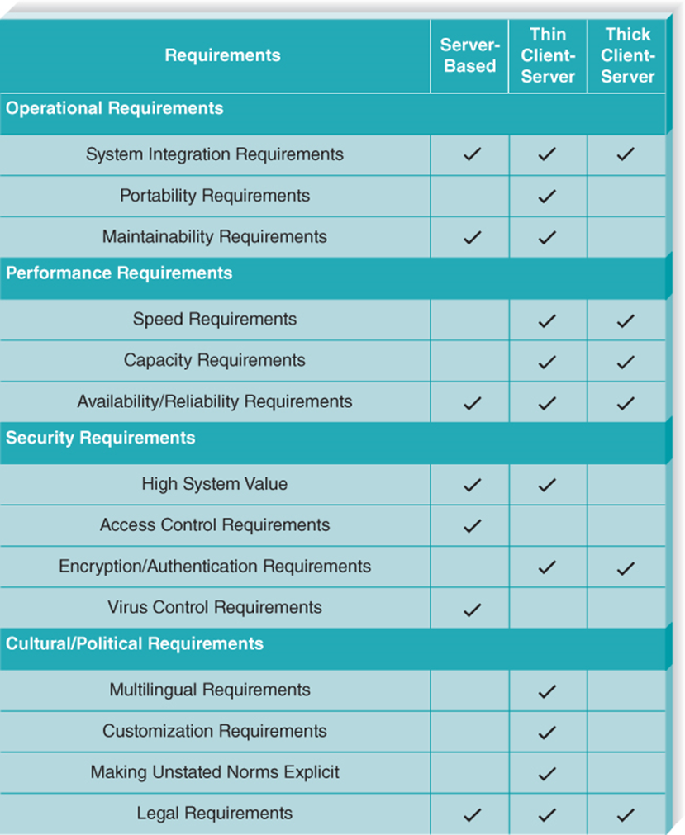
Nonfunctional Requirements and the Architecture Design

Slide 31
Hardware Software Specification
The hardware and software specification is a document that describes what hardware and software are needed to support the application
First, you will need to define the software that will run on each component
Next, you must create a list of the hardware needed to support the future system
Finally, you need to describe, in as much detail as possible, the minimum requirements for each piece of hardware

Slide 32
Sample Hardware and Software Specifications
 | Standard Client | Standard Web Server | Standard Application | Standard Database
 |  |  | Server | Server
Operating System | Windows 10 Pro | Linux | Linux | Linux
Special Software | Real Audio | Apache | Java | Oracle
 | Adobe Acrobat Reader
Hardware | 1 TB disk drive | 8 TB disk drive | 8 TB disk drive | 32 TB disk drive
 | Intel®-Core™ i5-8400 six core processor | Xeon E5-4600 v4 | Xeon E5-4600 v4 | R A I D
 | 22-inch LED Monitor |  |  | Xeon 28 core processor
Network | Always-on Broadband, preferred | Dual 100 Mbps Ethernet | Dual 100 Mbps Ethernet | Dual 100 Mbps Ethernet

Slide 33
Factors in Hardware and Software Selection
Factor | Definition
Functions and Features | What specific functions and features are needed (e.g., size of monitor, software features)?
Performance | How fast do the hardware and software operate (e.g., processor, number of database writes per second)?
Legacy Databases and Systems | How well do the hardware and software interact with legacy systems (e.g., can it write to this database)?
Hardware and OS Strategy | What are the future migration plans (e.g., the goal is to have all of one vendor’s equipment)?
Cost of Ownership | What are the costs beyond purchase (e.g., incremental license costs, annual maintenance, training costs, and salary costs)?
Political Preferences | People are creatures of habit and are resistant to change, so changes should be minimized.
Vendor Performance | Some vendors have reputations or prospects that are different from those of a specific hardware or software system that they currently sell.

Slide 34
Chapter Review
Identify and describe the four basic functions of a software system.
Describe the basic premise of the client–server architecture.
Explain the difference between thick clients and thin clients.
Discuss the “tiered” approach to client–server architectures.
Explain the architectural options for mobile applications.
Discuss several ways to create mobile applications and the pros and cons of each.
Explain the use of nonfunctional requirements in the creation of the architecture design.
Describe the purpose and typical content of the hardware and software specification.

Slide 35
Key Terms
24/7
Access control requirements
Application logic
Application program interfaces
(API)
Architectural components
Architecture design
Asymmetric encryption algorithm
Authentication
Availability and reliability requirements
Blockchain
Capacity requirements
Certificate authority (CA)
Client computers
Client–server architectures cloud computing
Cloud computing
Concurrent multilingual system
Controls
Cultural and political requirements
Customization requirements
Data access logic
Data storage
Discrete multilingual system
Elasticity
Encryption
Encryption and authentication requirements
Fat client
Functions
Graphical user interface (GUI)

Slide 36
Key Terms Continued
Hardware and software specification
Invertible
Legal requirements
Mainframe
Maintainability requirements
Microcomputer
Middleware
Mission critical system
Multilingual requirements
Network
n-tier architecture
Performance requirements
Portability requirements
Presentation logic
Private key
Public key
Public key encryption
Response time
Rich client
Rich Internet application (RIA)
Scalable
Security requirements
Servers
Server-based architecture
Server virtualization
Speed requirements
Storage area network (SAN)

Slide 37
Key Terms Continued
Storage virtualization
Symmetric encryption algorithm
System integration requirements
System Value
Technical environment requirements
Terminal
Thick client
Thin client
Thin Web-based client
Three-tiered architecture
Two-tiered architecture
Ultra thin client
Unstated norms
Virtualization
Virus
Virus Control Requirements
Zero client

