Slide 1
System Analysis and Design
Eighth Edition
Alan Dennis, Barbara Wixom, Roberta M. Roth
Chapter 8
User Interface Design

Slide 2
Objectives
Explain the concept of usability regarding the user interface.
Describe several fundamental user interface design principles.
Explain the process of user interface design.
Explain ways to understand the perspectives of the users of the user interface.
Describe ways to define the structure of the user interface.
Explain the standards that should be established for the user interface.
Describe various ways to prototype the user interface.
Discuss ways to evaluate and test the user interface.
Discuss special concerns associated with touch-screen-enabled user interfaces.
Be able to design a highly usable user interface.

Slide 3
Introduction
System Interface: “connections” with other systems, where systems exchange information with each other
Designed as a part of program design.
User Interface: “connections” with users. Focus of this chapter.
The navigation mechanism provides the way for users to tell the system what to do
The input mechanism defines the way the system captures information
The output mechanism defines the way the system provides information to users or other systems
Graphical user interface (GUI): most common type of interface in use today

Slide 4
The Usability Concept
The system is easy to use and easy to learn
Tasks are completed more efficiently and with more accuracy
Mistakes with system are reduced
User satisfaction with new system is increased
Adoption of system is more likely

Slide 5
Principles for User Interface Design
Layout
Content awareness
Aesthetics
Usage level
Consistency
Minimize user effort

Slide 6
Principles of User Interface Design
Principle | Description
Layout | The interface should be a series of areas on the screen that are used consistently for different purposes—for example, a top area for commands and navigation, a middle area for information to be input or output, and a bottom area for status information.
Content awareness | Users should always be aware of where they are in the system and what information is being displayed.
Aesthetics | Interfaces should be functional and inviting to users through careful use of white space, colors, and fonts. There is often a trade-off between including enough white space to make the interface look pleasing and losing so much space that important information does not fit on the screen.
Usage level | Although ease of use and ease of learning often lead to similar design decisions, there is sometimes a trade-off between the two. Infrequent users of software will prefer ease of learning, whereas frequent users will prefer ease of use.
Consistency | Consistency in interface design enables users to predict what will happen before they perform a function. It is one of the most important elements in ease of learning, ease of use, and aesthetics.
Minimize user effort | The interface should be simple to use. Most designers plan on having no more than three mouse clicks from the starting menu until users perform work.

Slide 7
Layout
The screen is often divided into three boxes
Navigation area (top)
Status area (bottom)
Work area (middle)
Information can be presented in multiple areas
Like areas should be grouped together

Slide 8
More Layout Concepts
Areas and information should minimize user movement from one to another
Ideally, areas will remain consistent in
Size
Shape
Placement for entering data
Reports presenting retrieved data

Slide 9
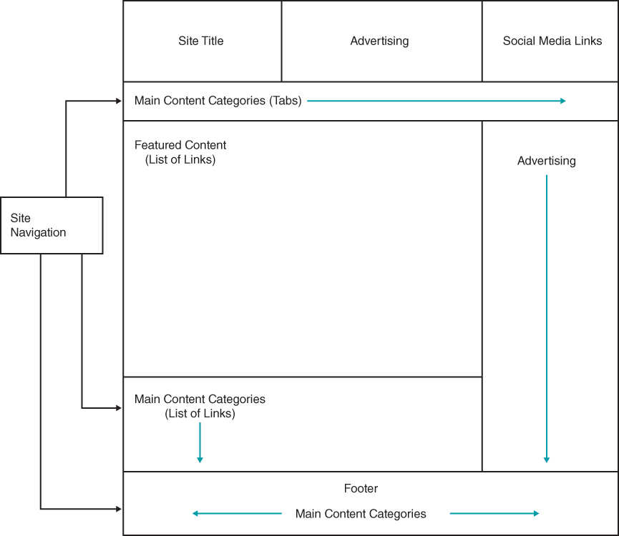
Model Layout for Web Page
Note use of multiple layout areas for site navigation
As the user navigates to each part of the site, the overall page layout is the same
This use of multiple layout areas also applies to inputs and outputs

Slide 10
Content Awareness
All interfaces should have titles
Menus should show
Where you are
Where you came from to get there
It should be clear what information is within each area
Fields and field labels should be selected carefully
Use dates and version numbers to aid system users

Slide 11
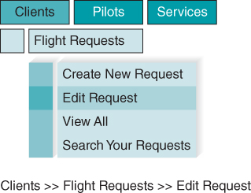
Content Awareness Continued
Note the use of highlighting to indicate menu selections
Breadcrumbs provide additional clues on navigational path

Slide 12
Aesthetics
Interfaces need to be functional and inviting to use
Avoid squeezing in too much, particularly for novice users
Design text carefully
Be aware of font and size
Avoid using all capital letters
Colors and patterns should be used carefully
Use colors to separate or categorize items

Slide 13
Usage Level
Some people will be frequent, heavy users of the system
Frequent users desire ease of use – quick and easy completion of job tasks
For systems primarily used by frequent users, include ways to perform tasks directly (hot keys, short-cut keys, etc.)
Other people may use the system infrequently
Infrequent users desire ease of learning – quick and easy ways to figure out what to do
For systems primarily used by infrequent users, include careful menu designs, tool tips, and extensive help systems
User interface design should anticipate the types of users expected
For systems with both user types, incorporate both user preferences in design as much as possible

Slide 14
Consistency
Elements are the same throughout the application
Enables users to predict what will happen
Reduces learning curve
Considers elements within an application and across applications
Pertains to many different levels
Navigation controls
Terminology
Report and form design

Slide 15
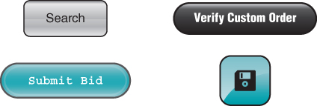
Example of Inconsistent Elements
These buttons all came from the same application
Note the different button styles, colors, and font styles
Inconsistency is likely to cause uncertainty and confusion

Slide 16
Minimize User Effort
Interfaces should be designed to minimize the amount of effort needed to accomplish tasks
Three clicks rule
Users should be able to go from the start or main menu of a system to the information or action they want in no more than three mouse clicks or three keystrokes

Slide 17
Special Issues of Touch Screen Design
Ideal for information display but not data entry
Place content at top and navigation controls at bottom so finger does not obscure content area
Place labels on top of navigation controls
Size objects correctly for “fat fingers”
Include adequate spacing between objects
Consider needs of left-handed and right-handed users
Bright colors/backgrounds can help reduce glare and hide fingerprints
Use each device’s standardized gesture interactions to enhance the user’s ease of learning and ease of use

Slide 18
Android Device Common Navigational Gestures
Gesture | Meaning/Function
Tap | Users can navigate to destinations by touching elements
Scroll and pan | Users can slide surfaces vertically, horizontally, or omnidirectionally to move continuously through content
Drag | Users can slide surfaces to bring them into and out of view
Swipe | Users can move surfaces horizontally to navigate between peers, like tabs
Pinch | Users can scale surfaces to navigate between screens

Slide 19
Android Device Common Transform Gestures
Gesture | Meaning/Function
Double tap or Pinch | Users can zoom into and out of content
Compound gestures | Users can fluidly transition between various gestures
Pick up and move | Users can reorder content with a long press and drag

Slide 20
Android Device Common Action Gestures
Gesture | Meaning/Function
Tap or Long press | Users can interact with elements and access additional functionality
Swipe | Users can slide elements to complete actions upon passing a threshold

Slide 21
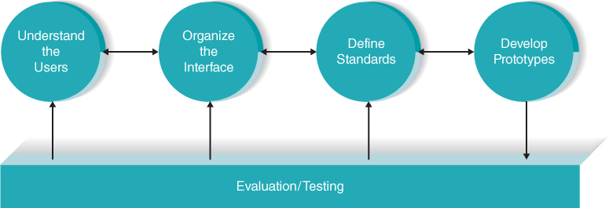
User Interface Design Process
Understand the users
Organize the interface
Define standards
Develop prototypes
Evaluation / testing

Slide 22
Understand the Users
Users likely will have very different goals and intentions when using the system
Use personas to develop characterizations of various user groups
Interests
Typical behaviors
Goals and objectives
Expectations
Plan a user interface that will be satisfying for that particular user group
Use scenarios outline the steps users perform to accomplish their work
Presented in a simple narrative tied to the related DFD
Document the most common paths through the use case so interface designs will be easy to use for those situations

Slide 23
Organize the Interface
Define the basic components of the interface and how they work together to provide functionality to users.
Use Interface Structure Diagram (ISD)
Shows how all screens, forms, and reports are related
Shows how user moves from one to another
Like DFD in using boxes and lines
Boxes denote screens
Lines show movement from one to another
Different from DFD in having no standard rules or format
For Web sites, use site map
Show how all the information on the site fits together
Helps establish the hierarchy of information on the site

Slide 24
Define Standards
Clarify decisions on all key interface elements to ensure consistency
Basic common elements across individual screens, forms, and reports within the application
Interface metaphor (e.g., calendar, checkbook, shopping cart)
Interface objects (e.g., customer/client; employee/associate)
Interface actions (e.g., buy/purchase/check out; exit/quit)
Interface icons (pictures) representing status or actions (e.g., trashcan for delete; disk for save)
Interface templates (layout guide for all screens)

Slide 25
Interface Design Prototyping
A mock-up or simulation of screens, forms, or reports
Common methods include:
Paper sketches
Wireframe diagrams
Storyboarding
Wireflow diagrams
H T M L prototype
Language prototype

Slide 26
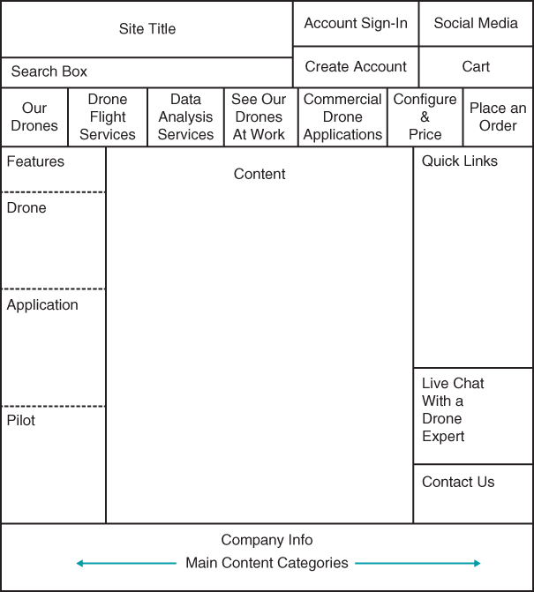
Wireframe Example

Slide 27
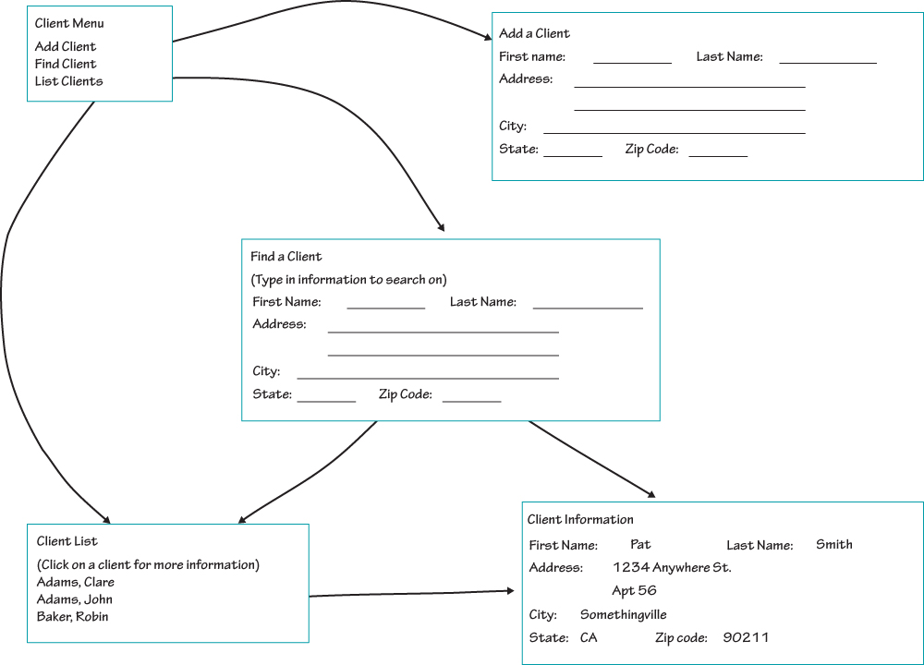
Storyboard Example

Slide 28
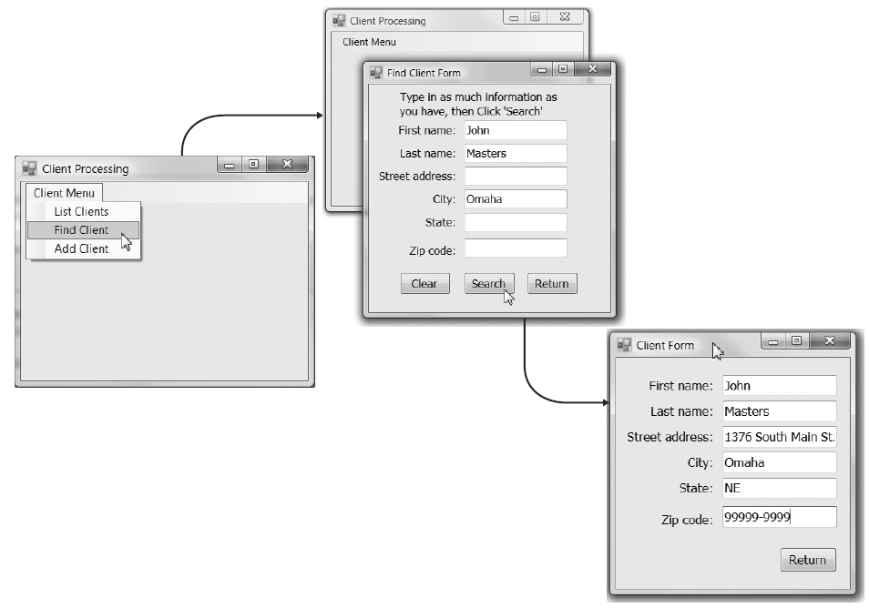
Language Prototype Example

Slide 29
Interface Evaluation/Testing
Heuristic evaluation
Compare design to checklist
Walkthrough evaluation
Team simulates movement through components
Interactive evaluation
Users try out the system
Formal usability testing
Expensive
Detailed use of special lab testing

Slide 30
Navigation Design
Assume users
Have not read the manual
Have not attended training
Do not have external help readily at hand
All controls should be clear and understandable and placed in an intuitive location on the screen
Prevent mistakes
Limit choices
Never display commands that can not be used (or “gray them out”)
Confirm actions that are difficult or impossible to undo
Simplify recovery from mistakes
Use consistent grammar order (action-object, object-action)

Slide 31
Menu Tips
Menus enable users to select action from an organized display of action categories and options
Broad and shallow design is preferred
Logical categories can be objects (customers; orders) or actions (insert, design)
Common menu formats include menu bars, drop-down menus, popup menus, tab menus, icon tool bars, and image maps.
Menus may become less popular with trend toward touchscreens

Slide 32
Common Types of Menus

Slide 33
Types of Menus
Type of Menu | Description | When to Use
Menu bar | List of commands at the top of the screen. Always on screen. | Main menu for system
Drop-down menu | Menu that drops down immediately below another menu. Disappears after one use. | Second-level menu, often from menu bar.
Hyperlink menu | A set of items arranged as a menu, usually along one edge of the screen. | Main menu for Web-based system.
Embedded hyperlinks | A set of items embedded and underlined in text. | As a link to ancillary, optional Information.
Pop-up menu | Menu that pops up and floats over the screen. Disappears after one use. | As a shortcut to commands for experienced users.
Tab menu | Multipage menu with one tab for each page that pops up and floats over the screen. Remains on screen until closed. | When user needs to change several settings or perform several related commands.

Slide 34
Types of Menus Continued
Type of Menu | Description | When to Use
Tool bar | Menu of buttons (often with icons) that remains on the screen until closed. | As a shortcut to commands for experienced users.
Image map | Graphical image in which certain areas are linked to actions or other menus. | Only when the graphical image adds meaning to the menu.

Slide 35
Message Tips
Common message types include:
Error message
Confirmation message
Acknowledgment message
Delay message
Help message
Strive for clear, concise, and complete messages
Should be grammatically correct and free of jargon and abbreviations (unless they are the users’)
Avoid negatives and humor (it gets old)

Slide 36
Types of Messages
Type of Message | Description | When to Use
Error message | Informs the user that he or she has attempted to do something to which the system cannot respond. | When user does something that is not permitted or not possible.
Confirmation message | Asks the user to confirm that he or she really wants to perform the action selected. | When user selects a potentially dangerous choice, such as deleting a file.
Acknowledgment message | Informs the user that the system has accomplished what it was asked to do. | Seldom or never; users quickly become annoyed with all the Unnecessary mouse clicks.
Delay message | Informs the user that the computer system is working properly. | When an activity takes more than seven seconds.
Help message | Provides additional information about the system and its components. | In all systems.

Slide 37
Input Design
The goal is to simply and easily capture accurate information for the system
Reflect the nature of the inputs
Find ways to simplify their collection

Slide 38
Use Online and Batch Processing Appropriately
Online processing immediately records the transaction in the appropriate database
Batch processing collects inputs over time, holds them temporarily, and then processes all the transactions at one time in a batch
Batch processing simplifies data communications and other processes; but master files are not updated real time

Slide 39
Capture Data at the Source
Reduces duplicate work
Reduces processing time
Decreases cost
Decreases probability of error

Slide 40
Source Data Automation
Bar code readers / scanners
Optical character recognition
Magnetic stripe readers
Smart cards
RFID (Radio Frequency Identification) tags

Slide 41
Minimize Keystrokes
Keyboard entry is slow and error-prone
Never ask use to key-enter information that can be obtained other ways
Lookups
Dropdown lists
Default values

Slide 42
User Input Options

Slide 43
Types of Selection Controls
Type of Control | Description | When to Use
Check box selection list | Presents a complete list of choices, each with a square box in front. | When several items can be selected from a list of items.
Radio button selection list | Presents a complete list of mutually exclusive choices, each with a circle in front. | When only one item can be selected from a set of mutually exclusive items.
On-screen selection list | Presents a list of choices in a box. | Seldom or never—only If there is insufficient room for check boxes or radio buttons.
Drop-down selection list | Displays selected item in one-line box that opens to reveal list of choices. | When there is insufficient room to display all choices.
Combo box selection list | A special type of drop-down List box that permits user to type as well as scroll the list. | Shortcut for experienced users.
Up-down numeric control | Scroll arrows move up or down through numeric range. | When entering a numeric value.

Slide 44
Input Validation
Apply a judicious amount of input validation to ensure accuracy
Types include:
Completeness check
Format check
Range check
Check digit check
Consistency check
Database checks

Slide 45
Types of Input Validation
Type of Validation | Description | When to Use
Completeness check | Ensures that all required data have been entered. | When several fields must be entered before the form can be processed.
Format check | Ensures that data are of the right type (e.g., numeric) and in the right format (e.g., month, day, year). | When fields are numeric or contain coded data.
Range check | Ensures that numeric data are within correct minimum and maximum values. | With all numeric data, if possible.
Check digit check | Check digits are added to numeric codes. | When numeric codes are used.
Consistency checks | Ensure that combinations of data are valid. | When data are related.
Database checks | Compare data against a data base (or file) to ensure that they are correct. | When data are available to be checked.

Slide 46
Output Design
Understand report usage
Reference or cover-to-cover?
Frequency?
Real-time or batch reports?
Manage information load
All needed information, no more
Minimize bias
Utilize various report types (detail, summary, exception, graphical) and media to satisfy users’ output requirements

Slide 47
Types of Report
Type of Report | Description | When to Use
Detail report | Lists detailed information about all the items requested. | When user needs full information about the items.
Summary report | Lists summary information about all items. | When user needs brief information on many items.
Turnaround document | Outputs that “turn around” and become inputs. | When a user (often a customer) needs to return an output to be processed.
Graphs | Charts used in addition to and instead of tables of numbers. | When users need to compare data among several items.

Slide 48
Chapter Review
Identify and describe the five basic rules of user interface design.
Describe the concept of usability with respect to a system’s user interface. Why is this concept important to the interface designer?
Explain three unique aspects of designing for a touch screen user interface.
Discuss the five components of the user interface design process.
Explain the unique issues associated with design of the system’s navigation mechanism.
Discuss ways to improve the quality of input data captured by the system.
Explain the best ways to produce output from the system.

Slide 49
Key Terms
Acknowledgment message
Action–object order
Aesthetics
Bar code reader
Batch processing
Batch reports
Bias
Breadcrumbs
Button
Check box selection list
Check digit check
Completeness check
Confirmation message
Consistency
Consistency check
Content awareness
Database check
Default value
Delay message
Density
Detail report
Drop-down menu
Drop-down selection list
Ease of learning
Ease of use
Edit check
Error message
Exception report

Slide 50
Key Terms Continued
Field label
Fields
Form
Format check
Grammar order
Graph
Graphical user interface (GUI)
Help message
Heuristic evaluation
Hot keys
HTML prototype
Human–computer interaction (HCI)
Image map
Information load
Input mechanism
Interactive evaluation
Interface action
Interface design prototype
Interface evaluation
Interface icon
Interface metaphor
Interface object
Interface standards
Interface structure design
Interface structure diagram (ISD)
Interface template

Slide 51
Key Terms Continued
Language prototype
Layout
Magnetic stripe readers
Menu
Menu bar
Navigation mechanism
Object–action order
Online processing
On-screen selection list
Optical character recognition
Output mechanism
Personas
Pop-up menu
Radio button selection list
Radio frequency identification
(RFID) tag
Range check
Real-time information
Real-time reports
Report
Screen
Site map
Smart card
Source data automation
Storyboard
Summary report
System interface
Tab menu
Text box
Three-clicks rule

Slide 52
Key Terms Continued
Tool tip
Transaction processing
Turnaround document
Usability
Usability testing
Usage level
Use scenario
User experience (UX)
User interface
Validation
Walk-through evaluation
Web pages
White space
Wireflow diagram
Wireframe diagram

