Slide 1
System Analysis and Design
Eighth Edition
Alan Dennis, Barbara Wixom, Roberta M. Roth
Chapter 9
Program Design

Slide 2
Objectives
Be able to revise logical DFDs into physical DFDs.
Be able to create a structure chart.
Be able to write a program specification.
Be able to write instructions using pseudocode.
Become familiar with event-driven programming.

Slide 3
Introduction
Various implementation decisions will be made about the new system, such as what programming language(s) will be used
The data flow diagrams (DFDs) created during analysis are modified to show these implementation decisions, resulting in a set of physical DFDs
The analysts then determine how the processes of the system will be organized, using a structure chart to depict their decisions
Detailed instructions called program specifications are developed so that during construction, the programmers know exactly what they should be creating

Slide 4
Moving from Logical to Physical Process Models
During analysis, the systems analysts identified the processes and data flows that are needed to support the functional requirements of the new system
These processes and data flows are described on the logical DFDs
The logical DFDs do not contain any indication of how the system will actually be implemented
During design, physical process models are created to show implementation details and explain how the final system will work

Slide 5
The Physical Data Flow Diagram
The physical data flow diagram (DFD) contains the same components as the logical DFD
The difference between the two models is that a physical DFD contains additional details that describe how the system will be built
There are five steps to perform to make the transition to the physical DFD

Slide 6
Steps to Create the Physical Data Flow Diagram
Step | Explanation
1. Add implementation references. | Using the existing logical DFD, add the way in which the data stores, data flows, and processes will be implemented to each component.
2. Draw a human–machine boundary. | Draw a line to separate the automated parts of the system from the manual parts.
3. Add system-related data stores, data flows, and processes. | Add system-related data stores, data flows, and processes to the model (components that have little to do with the business process).
4. Update the data elements in the data flows. | Update the data flows to include system-related data elements.
5. Update the metadata in the CASE repository. | Update the metadata in the CASE repository to include physical characteristics.

Slide 7
Physical DFD for Shop Manager Approval of Custom Drone Order Level 1 DFD

Slide 8
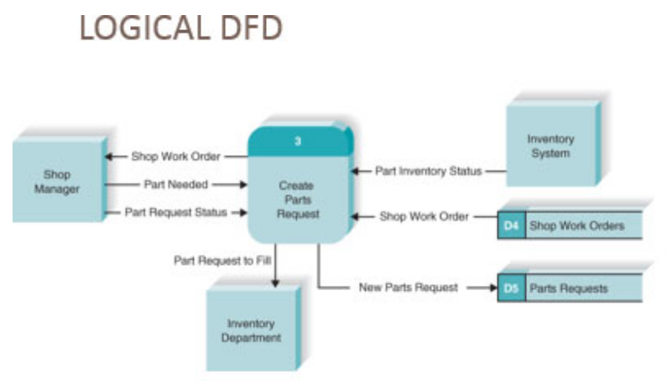
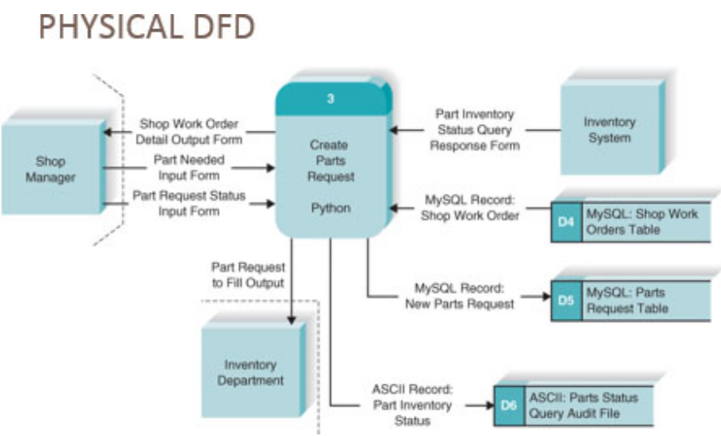
Contrasting a Logical and Physical DFD of DrōnTeq’s

Slide 9
Designing Programs
Program design - creating instructions for the programmers
The top-down, modular approach - begin with the “big picture” and gradually add detail
Program design document – all structure charts and specifications needed by programmers to implement the system

Slide 10
Using a Top-Down Modular Approach

Slide 11
Good Program Design
First, analysts create a high- level diagram that shows the various components of a program, how the components should be organized, and how the components interrelate
Known as the structure chart
Next, program specifications are written to describe exactly what needs to be included in each program module
Pseudocode is a technique similar to structured English that is used to communicate what needs to be written
At the end of program design, the project team compiles the program design document, which includes all of the structure charts and program specifications

Slide 12
Structure Chart
Important program design technique
Shows all components of code in a hierarchical format
Sequence
Selection
Iteration
Illustrates the organization and interactions of the different program modules

Slide 13
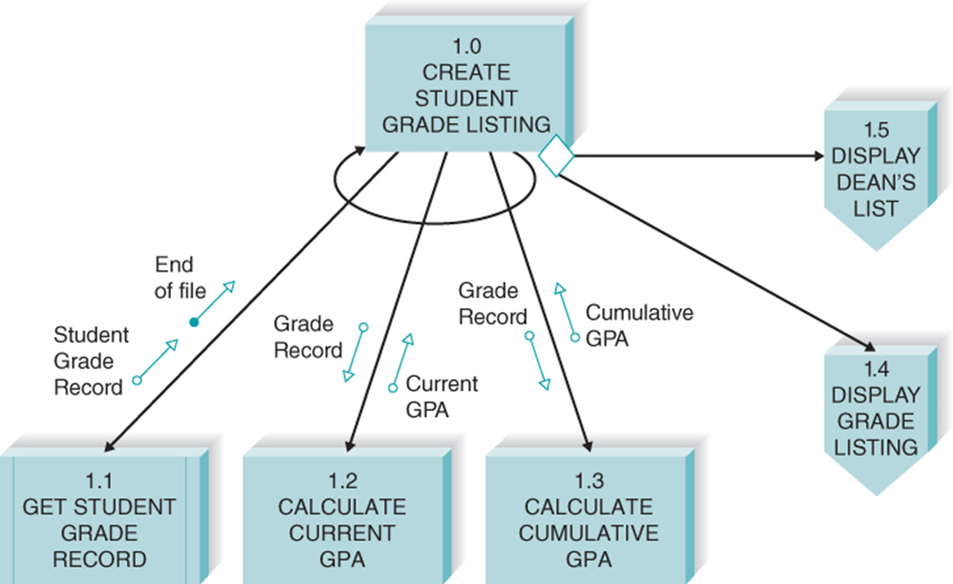
Example Structure Chart

Slide 14
Structure Chart Elements

Slide 15
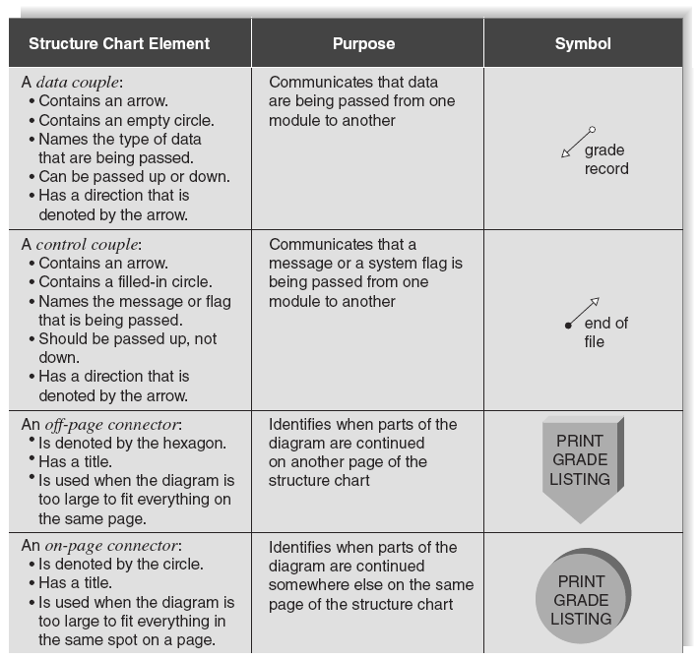
Structure Chart Elements Continued

Slide 16
Syntax: Module
A structure chart is composed of modules
These are lines of program code that perform a single function
The modules are depicted by a rectangle and connected by lines
A control module is a higher-level component that contains the logic for performing other modules
The components that it calls and controls are considered subordinate modules
At times, modules are standardized and used in many places throughout the system
These are called library modules
The lines that connect the modules communicate the passing of control

Slide 17
Syntax: Module Continued
There are two symbols that describe special types of control that can appear on the structure chart
The curved arrow, or loop, indicates that the execution of some or all subordinate modules is repeated
A conditional line (depicted by a diamond) denotes that execution of one or more of the subordinate modules occurs in some cases but not in others
A circle is used to connect parts of the structure chart when there are space constraints and a diagram needs to be continued on another part of the page

Slide 18
Syntax: Couples
Couples, shown by arrows, are drawn on the structure chart to show that information is passed between modules
Arrowhead shows direction
Control couples, drawn with the use of arrows with filled-in circles, are used to pass parameters or system-related messages back and forth among modules
In general, control flags should be passed from subordinates to control modules, but not the other way around

Slide 19
Building the Structure Chart
Processes in the DFD tend to represent one module on the structure chart
Afferent processes – provide inputs to system
Central processes – perform critical system operations
Efferent processes – handle system outputs
Each process of a DFD tends to represent one module on the structure chart
The DFD leveling can correspond to the structure chart hierarchy
The difficulty comes when determining how the components on the structure chart should be organized

Slide 20
Transform and Transaction Structures

Slide 21
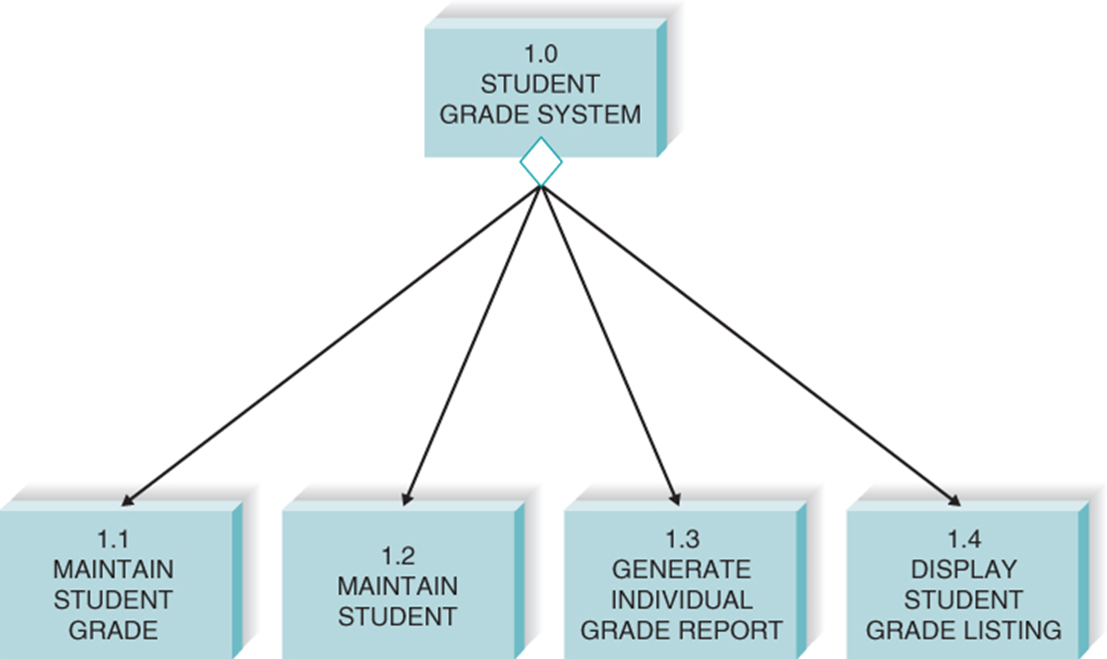
Transaction Structure
Transaction structure – control module calls subordinate modules, each of which handles a particular transaction
Few afferent processes
Many efferent processes
Higher up levels of structure chart
Concerned with coordinating the production of outputs

Slide 22

Transform Structure
Transform structure – control module calls several subordinate modules in sequence
Each subordinate performs a step in a process that transforms an input into an output
Many afferent processes
Few efferent processes
Lower levels of structure chart
Concerned with using inputs to create a new output

Slide 23
Steps in Building the Structure Chart
Identify top level modules and decompose them into lower levels
Add control connections
Add couples
Review and revise again and again until complete

Slide 24
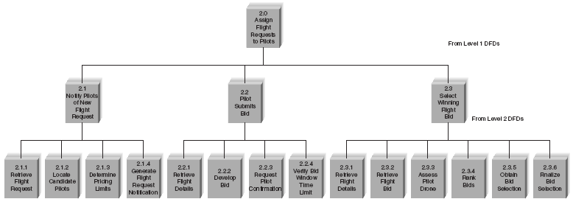
Step 1: Identify Modules and Levels for the Structure Chart

Slide 25
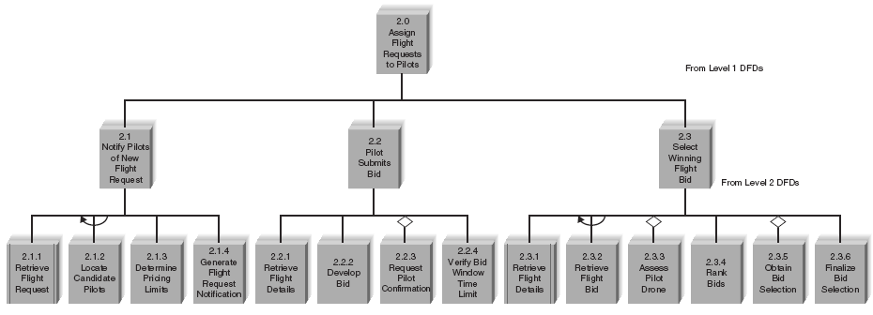
Step 2: Add Special Connections to the Structure Chart

Slide 26
Step 3: Add Couples to the Structure Chart

Slide 27
Design Guidelines
High quality structure charts result in programs that are modular, reusable and easy to implement
Measures include:
Cohesion
Coupling
Appropriate levels of fan-in and fan-out

Slide 28
Build Modules with High Cohesion
Cohesion refers to how well the lines of code within each structure chart module relate to each other
A module should perform only one task, making it highly cohesive
There are various types of cohesion, some of which are better than others

Slide 29
Types of Cohesion from Good to Bad
Type of Cohesion | Definition
Functional | Module performs one problem-related task.
Sequential | Output from one task is used by the next.
Communicational | Elements contribute to activities that use the same inputs or outputs.
Procedural | Elements are performed in sequence but do not share data.
Temporal | Activities are related in time.
Logical | List of activities; which one to perform is chosen outside of module.
Coincidental | No apparent relationship.

Slide 30
Cohesion Decision Tree

Slide 31
Factoring
Process of dealing with “low” cohesion by separating out a function from one module into a module of its own
Separates tasks into different modules
Reduces use of control flags

Slide 32
Build Loosely Coupled Modules
Coupling involves how closely modules are interrelated
The second guideline for good structure chart design states that modules should be loosely coupled
That way, modules are independent from each other
The numbers and kinds of couples on the structure chart reveal the presence of coupling between modules

Slide 33
Types of Coupling from Good to Bad
Type of Coupling | Definition
Data | Modules pass fields of data or messages.
Stamp | Modules pass record structures.
Control | Module passes a piece of information that intends to control logic.
Common | Modules refer to the same global data area.
Content | Module refers to the inside of another module.

Slide 34
Fan-In / Fan-Out
Fan-in describes the number of control modules that communicate with a subordinate
A module with high fan-in has many different control modules that call it
This is a very good situation
Structures with high fan-in promote the reusability of modules and make it easier for programmers to recode
We want to avoid a large number of subordinates associated with a single control (fan-out)

Slide 35
High Fan-In (a) and Low Fan-in (b)

Slide 36
High Fan-Out

Slide 37
Low Fan-Out

Slide 38
Checklist for Structure Chart Quality
Library modules have been created whenever possible.
The diagram has a high fan-in structure.
Control modules have no more than seven subordinates.
Each module performs only one function (high cohesion).
Modules sparingly share information (loose coupling).
Data couples that are passed are actually used by the accepting module.
Control couples are passed from “low to high.”
Each module has a reasonable amount of code associated with it.

Slide 39
Program Specification
No standard approach
Include program information
Note events that trigger actions
List inputs and outputs
Include pseudocode
Provide additional notes and comments as needed

Slide 40
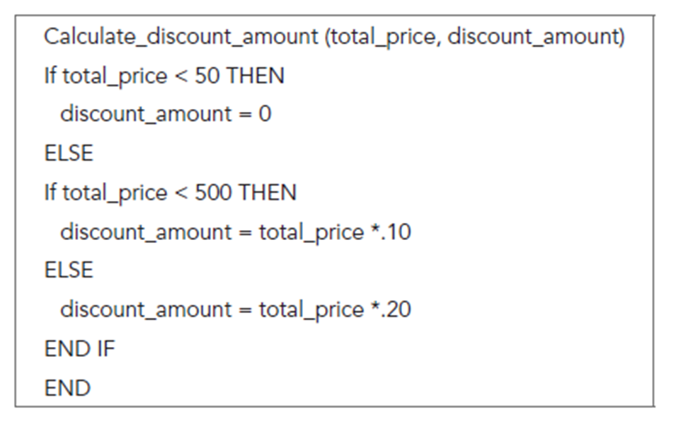
Sample Pseudocode

Slide 41
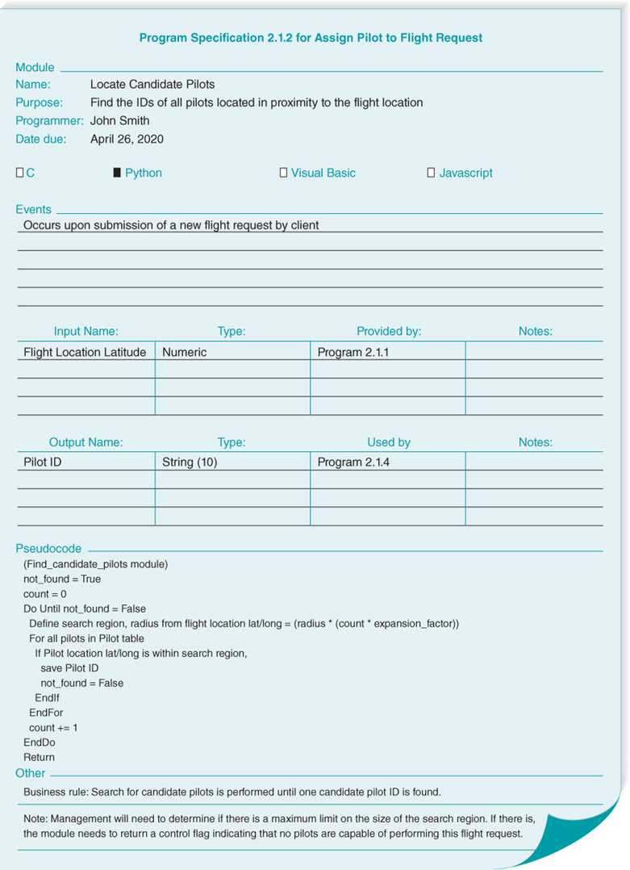
Sample Program Specification

Slide 42
Chapter Review
Identify and describe the five steps involved in converting the logical process models to physical process models.
Describe the purpose and components of a structure chart.
Explain the two primary structures shown in a structure chart and the purpose of each.
Discuss the four steps involved in creating structure charts.
Explain the structure chart design guideline of high cohesion. List and discuss the seven kinds of cohesion.

Slide 43
Chapter Review Continued
Explain the structure chart design guideline of low coupling.
List and discuss the five kinds of coupling.
Explain how the concepts of fan-in and fan-out pertain to structure charts.
Explain the recommended content of a program specification document.
Describe pseudocode and explain how it differs from structured English.

Slide 44
Key Terms
Afferent processes
Central processes
Cohesion
Coincidental cohesion
Conditional line
Connector
Content coupling
Control couples
Control module
Couples
Coupling
Data couples
Data coupling
Efferent processes
Event
Event-driven
Factoring
Fan-in
Fan-out
Functional cohesion
Human–machine boundary
Iteration
Library module
Loop
Module

Slide 45
Key Terms Continued
Off-page connector
On-page connector
Physical data flow diagram (DFD)
Physical process model
Program design
Program specification
Pseudocode
Selection
Sequence
Structure chart
Subordinate module
Temporal cohesion
Top-down modular approach
Transaction structure
Transform structure

