Slide 1
System Analysis and Design
Eighth Edition
Alan Dennis, Barbara Wixom, Roberta M. Roth
Chapter 10
Data Storage Design

Slide 2
Objectives
Become familiar with several fi le and database formats.
Describe several goals of data storage.
Be able to revise a logical ERD into a physical ERD.
Be able to optimize a relational database for data storage and data access.
Become familiar with indexes.
Be able to estimate the size of a database.

Slide 3
Introduction
Data storage function: how data is stored and handled by programs that run the system.
Data storage design:
Select the data storage format
Convert the logical data model into a physical data model to reflect implementation decisions
Ensure that DFDs and ERDs balance
Design the selected data storage format to optimize its processing efficiency

Slide 4
Data Storage Formats
Two main types of data storage formats:
Files: electronic lists of data, optimized to perform a particular transaction
Database: a collection of groupings of information that are related to each other in some way
Database Management System (DBMS): software that creates and manipulates the databases

Slide 5
Files
Data file: an electronic list of information that is formatted for a particular transaction
Sequential organization is typical
Record associations with other records created by pointers
Also called linked lists because of the way the records are linked together using pointers

Slide 6
Types of Files
Master files – store core information that is important to the application
Look-up files – contain static values
Transaction files – store information that can be used to update a master file
Audit files – record “before” and “after” images of data as the data is altered
History files (or archive files) – store past transactions

Slide 7
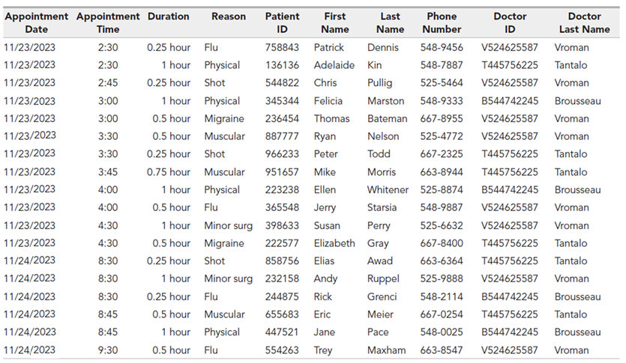
Appointment File Example

Slide 8
Types of Databases
Legacy database
Relational database
Object database
Multidimensional database
NoSQL database

Slide 9
Legacy Databases
Databases which are based on older technology; seldom used to develop new applications
Two major types:
Hierarchical databases use hierarchies, or inverted trees, to represent relationships
Network databases are collections of records that are related to each other through pointers

Slide 10
Relational Databases
The most popular kind of database for application development today
Based on collections of tables, each of which has a primary key
Tables are related to each other by the placing the primary key from one table into the related table as a foreign key
Most relational database management systems (RDBMS) support referential integrity
Ensures that values linking the tables together are valid and correctly synchronized
Structured Query Language (SQL) is the standard language for accessing the data in the tables

Slide 11
Appointment Database

Slide 12
Object Databases
Based on object orientation
All things should be treated as objects having both data (attributes) and processes (behaviors)
Object-oriented database management systems (OODBMs) are mainly used to support multimedia applications or systems that involve complex data.
Play a minor role in the DBMS market currently

Slide 13
Multidimensional Databases
A type of relational database used extensively in data warehousing.
Data warehousing is the practice of taking and storing data in a data warehouse (that is a large database) that supports business intelligence (BI) systems
Data marts are smaller databases based on data warehouse data; support BI for specific departments or functional areas of the organization
Stores data to support aggregations of data on multiple dimensions
When the data are first loaded into a multidimensional database, the database precalculates the data across the multiple dimensions and stores the answers for fast access

Slide 14
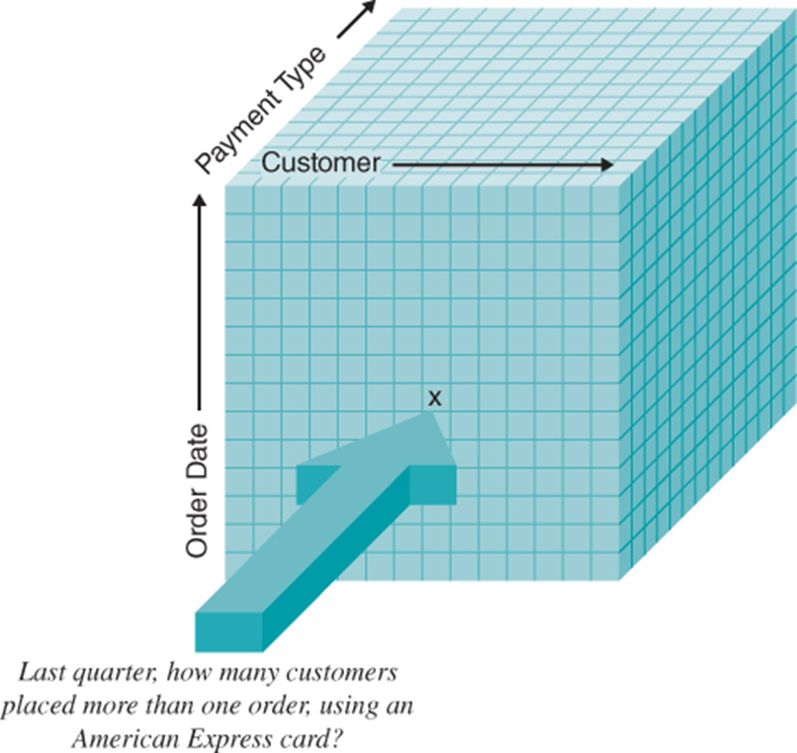
Multidimensional Databases Example

Slide 15
NoSQL Databases
Newest database approach; not based on the relational model or SQL
Rapid processing on replicated database servers in the cloud
Various types include:
Document-oriented databases: manage collection of documents of varying forms and structures (example: Mongo DB)
Wide column databases: store data in records holding very large numbers of dynamic columns (potentially billions of columns). Example: Bigtable, Cassandra, Dynamo
Graph databases: a collection of nodes and edges using graph theory to store, map, and query relationships

Slide 16
Selecting a Storage Format
Each of the file and database data storage format has its strengths and weaknesses
Factors to consider in selecting a storage format:
Data types
Type of application system
Existing storage formats
Future needs

Slide 17
Comparison of Data Storage Formats
 | Files | Legacy databases | Relational databases | Object databases | Multidimensional databases | NoSQL databases
Major strengths | Files can be designed for fast performance; good for short-term data storage. | Very mature products | Leader in the database market; can handle fast updating and querying needs | Able to handle complex data | Configured to answer business intelligence questions quickly | Designed for huge, varied data sets
Major weaknesses | Redundant data; data must be updated using programs. | Not able to store data as efficiently; limited future | Cannot handle complex data | Limited market acceptance; skills are hard to find. | Highly specialized use; skills are hard to find | New in the market, highly specialized use; skills are hard to find
Data types supported | Simple | Not recommended for new systems | Simple | Complex (e.g., video, audio, images) | Aggregated | Mixed data sets with structured and unstructured components
Application system types supported | Transaction processing | Not recommended for new systems | Transaction processing and decision making | Transaction processing | Business intelligence | Business intelligence; finding patterns and relationships in mixed data
Existing data formats | Organization dependent | Organization dependent | Organization dependent | Organization dependent | Organization dependent | Organization dependent
Future needs | Limited future prospects | Poor future prospects | Good future prospects | Uncertain future prospects | Uncertain future prospects | New, uncertain future prospects

Slide 18
Moving from a Logical to Physical Data Model
The logical entity relationship diagrams (ERD) depicts the “business view” of the data; omits implementation details
Having determined the data storage format, physical data models are created to show implementation details and to explain more about the “how” of the final system

Slide 19
The Physical Entity Relationship Diagram
The physical ERD includes entities, relationships, and attributes
Adds references to how data will be stored
Much more metadata is defined

Slide 20
Steps to Create the Physical ERD
Step | Explanation
Change entities to tables or files | Beginning with the logical ERD, change the entities to tables or files and update the metadata.
Change attributes to fields | Convert the attributes to fields and update the metadata.
Add primary keys | Assign primary keys to all entities.
Add foreign keys | Add foreign keys to represent the relationships among entities.
Add system-related components | Add system-related tables and fields.

Slide 21
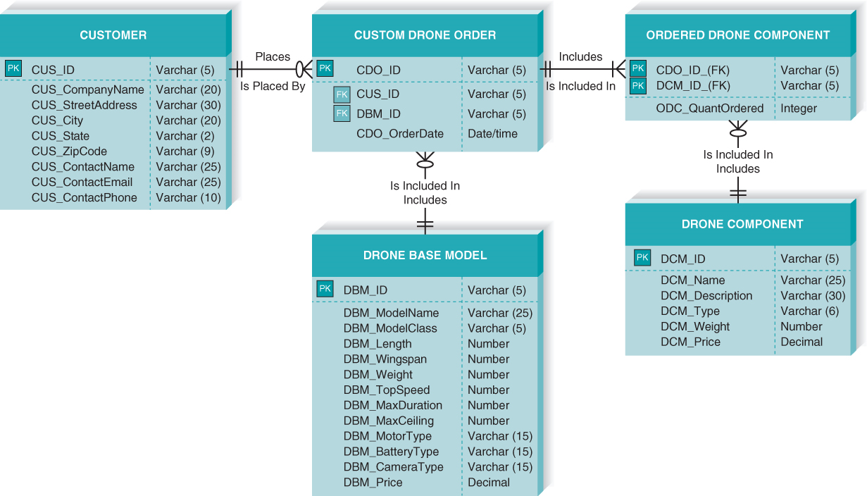
Example Physical ERD

Slide 22
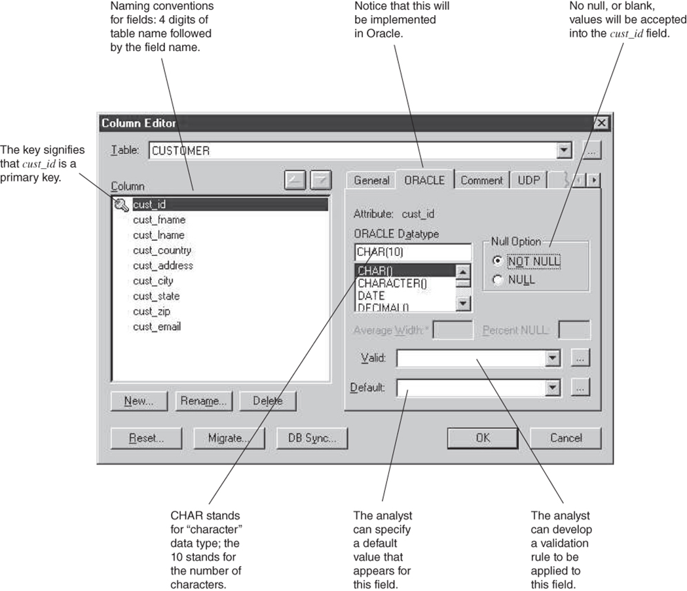
Physical Aspects of Data Element in Metadata

Slide 23
Revising the CRUD Matrix
It is important to verify that the system’s DFD and ERD models are balanced
In design, logical models are converted into physical models
Changes in the form of new processes, new data stores, and new data elements may occur
The CRUD matrix should be revised

Slide 24
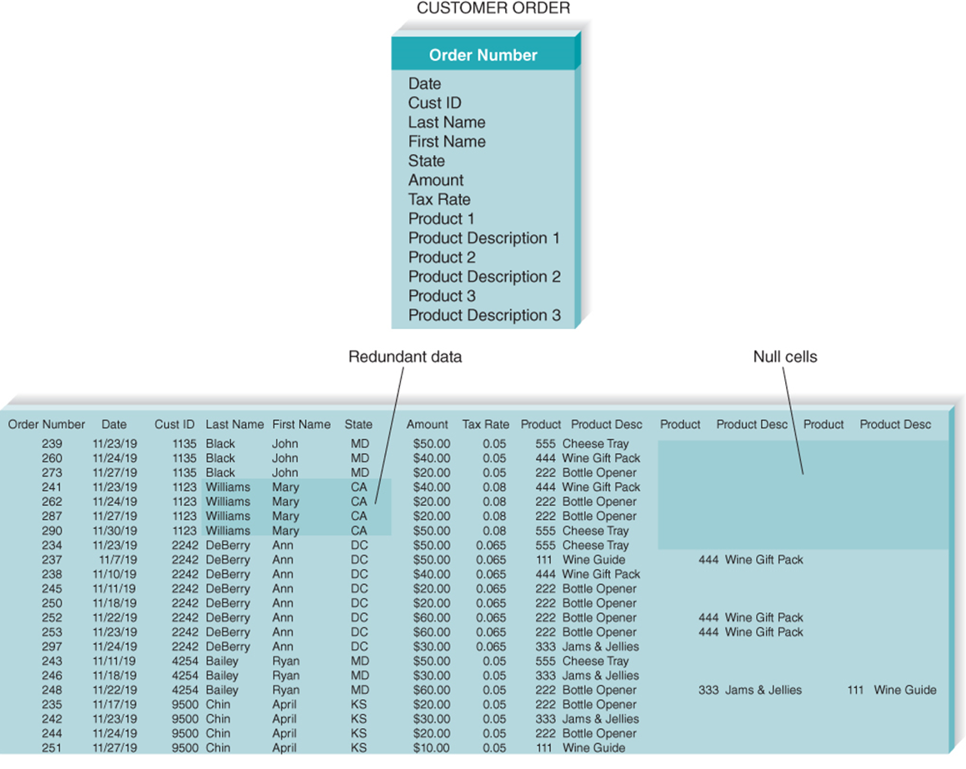
Optimizing Data Storage
The data storage format is now optimized for processing efficiency
Two primary dimensions:
Storage efficiency
Speed of access
Limit data redundancy; very few null values
Best way to achieve efficiency is normalization

Slide 25
Optimizing Access Speed
After optimizing for data storage efficiency, data are spread out across many tables
For a large relational database, it is necessary to optimize access speed
Techniques of optimizing access speed:
Denormalization
Clustering
Indexing
Estimating the size of data for hardware planning

Slide 26
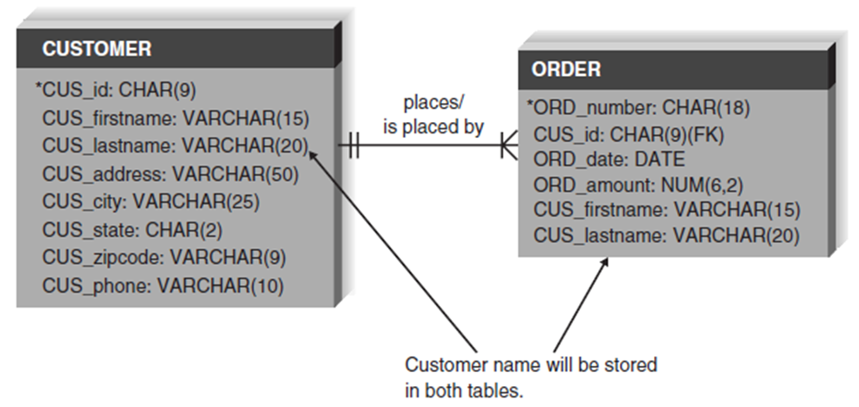
Denormalization
Add redundancy back into the design
Reduce the number of joins required during processing to enhance data access speed

Slide 27
Reasons to Denormalize
Reason | Description
Look-up table | Include a code’s description in the table using that code if the description is often used.
1:1 Relationships | Combine tables if they are related 1:1 and if they usually are accessed together.
1:N Relationships | Place fields from the parent (1) table into the child (N) table if the parent fields are used frequently with child information.
Star schema design | Data marts often are modeled with star schema design, which uses denormalization to maximize BI query performance.

Slide 28
Clustering
Placing records together physically so that like records are stored close together.
Intrafile clustering: Similar records in the table are stored together
Interfile clustering: Combining records from more that one table that typically are retrieved together

Slide 29
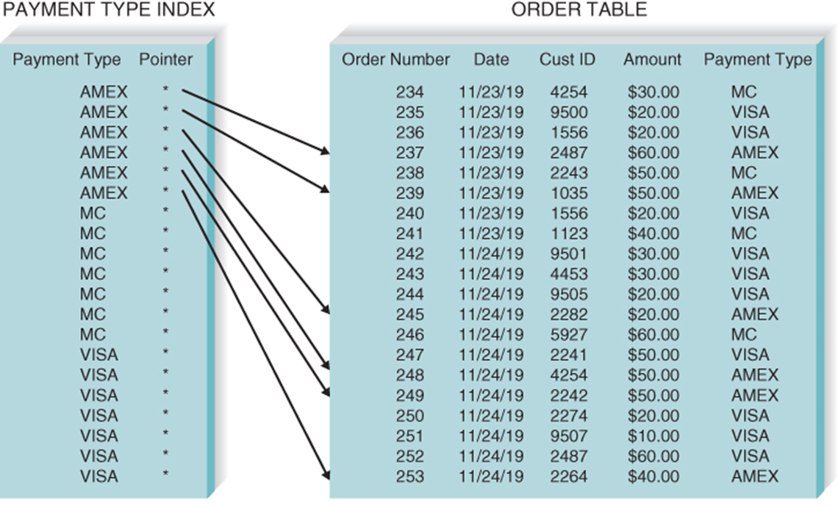
Indexing
A data storage index is a minitable (similar to an index of a book) containing values from one or more columns in a table and the location of the values within the table
Indexes require overhead; they take up storage space

Slide 30
Indexing Guidelines
Use indexes sparingly for transaction systems
Use many indexes to improve response times in business intelligence systems
For each table, create a unique index that is based on the primary key
For each table, create an index that is based on the foreign key to improve the performance of joins
Create an index for fields that are used frequently for grouping, sorting, or criteria

Slide 31
Estimating Storage Size
Volumetrics – technique of estimating the amount of data that the hardware must support
Steps:
Calculate the amount of raw data - all the data stored within the database tables
Calculate the overhead requirements based on the DBMS vendor’s recommendations
Record the number of initial records loaded into the table, as well as the expected growth per month

Slide 32
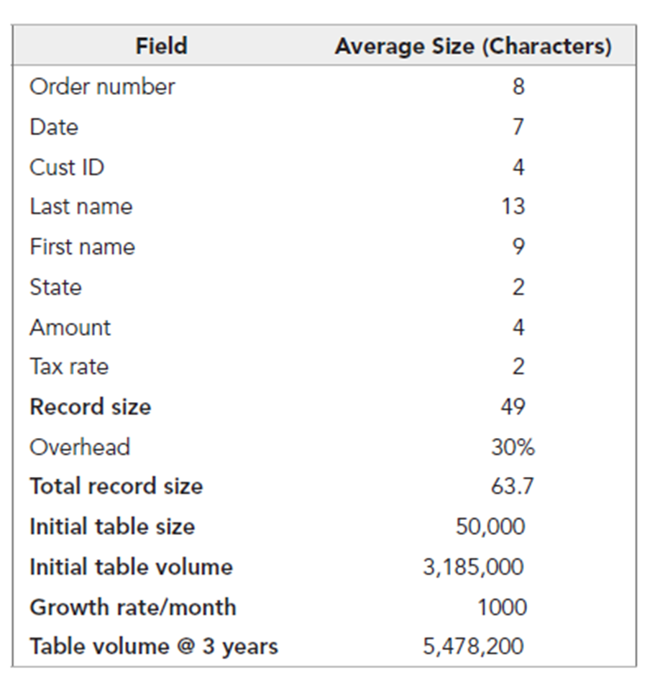
Sample Volumetrics Calculation

Slide 33
Chapter Review
Identify and describe the purpose of the five type of files that are used to store business information.
Identify and describe the purpose of the five type of databases that are used to store business information.
Discuss the considerations to be made when selecting a data storage format.
Discuss the five steps involved in converting the logical data model to a physical data model.
Explain the modifications that may need to be made when updating the CRUD matrix

Slide 34
Chapter Review Continued
Explain how to optimize the data storage design for storage efficiency.
Explain the several reasons to apply denormalization to the data storage design.
Explain the purpose and types of clustering that can be applied to the data storage design.
Explain the purpose of indexing when applied to the data storage design.

Slide 35
Key Terms
Aggregated
Audit file
Business intelligence (BI)
Clustering
Database
Database management system (DBMS)
Data mart
Data warehousing
Default value
Denormalization
End-user
DBMS
Enterprise DBMS
Executive information system (EIS)
Expert system (ES)
Files
Foreign key
Hierarchical databases
History file
Index
Interfile cluster
Intrafile clustering
Legacy database
Linked list
Logical entity relationship diagram
Look-up table
Look-up files

Slide 36
Key Terms Continued
Management information system (MIS)
Master files
Multidimensional database
Network databases
Normalization
NoSQL databases
Object database
Object-oriented
(DBMS)
Overhead
Physical data model
Physical entity relationship diagram
Pointer
Primary key
Raw data
Referential integrity
Relational database
Set
Star schema design
Structured Query Language
(SQL)
Table scan
Transaction file
Transaction processing systems
Valid value
Volumetrics

