Slide 1
System Analysis and Design
Eighth Edition
Alan Dennis, Barbara Wixom, Roberta M. Roth
Chapter 11
Moving into Implementation

Slide 2
Objectives
Be familiar with the system construction process.
Explain different types of tests and when to use them.
Describe how to develop user documentation.

Slide 3
Introduction
As the implementation phase begins, foremost on people’s minds is construction of the new system
A major component of building the system is writing programs
The implementation phase consists of developing and testing the system ’ s software, documentation, and new operating procedures
During this phase, it is also the responsibility of the systems analysts to finalize the system documentation and develop the user documentation

Slide 4
Managing the Programming Process
Assigning the programmers
Coordinating the activities
Managing the schedule

Slide 5
The Programmer Paradox
More is not always better than less!
After the “right” number of people are assigned to a programming task, adding more people slows down rather than speeds up completion of the project
Projects requiring a large team should be broken into a series of independent, smaller parts

Slide 6
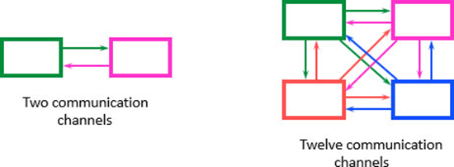
Assigning Programmers
Minimize the number of programmers
Match programming tasks with programmer capabilities
When skills are deficient, apply mentoring and training

Slide 7
Coordinating Activities
Weekly (hopefully brief) meetings
Create and follow standards
Organize programmers’ work areas
Development area
Testing area
Production area
Implement change control mechanisms
Use program log to monitor program changes
Many CASE tools are set up to track the status of programs and help manage programmers as they work

Slide 8
Managing the Schedule
Use initial time estimates as a baseline
Revise time estimates as construction proceeds
Fight against scope creep
Monitor “minor” slippage
Create risk assessment and track changing risks
Fight the temptation to lower quality to meet unreasonable schedule demands

Slide 9
Avoid Classic Mistakes
Research-oriented development
If you use state-of-the art technology, lengthen planned time
Using “low-cost” personnel
If using a significant number of entry level personnel, lengthen planned time
Lack of code control
Use source code library to keep programmers from changing the same code at the same time
Inadequate testing
Always allocate sufficient time for formal testing

Slide 10
Testing
Writing programs is a fun, creative activity
Testing and documentation are not fun
Testing helps ensure that the system performs as outlined in the specifications
It is dangerous to test early modules without an overall testing plan
It may be difficult to reproduce sequence of events causing an error
Testing must be done systematically and results documented carefully

Slide 11
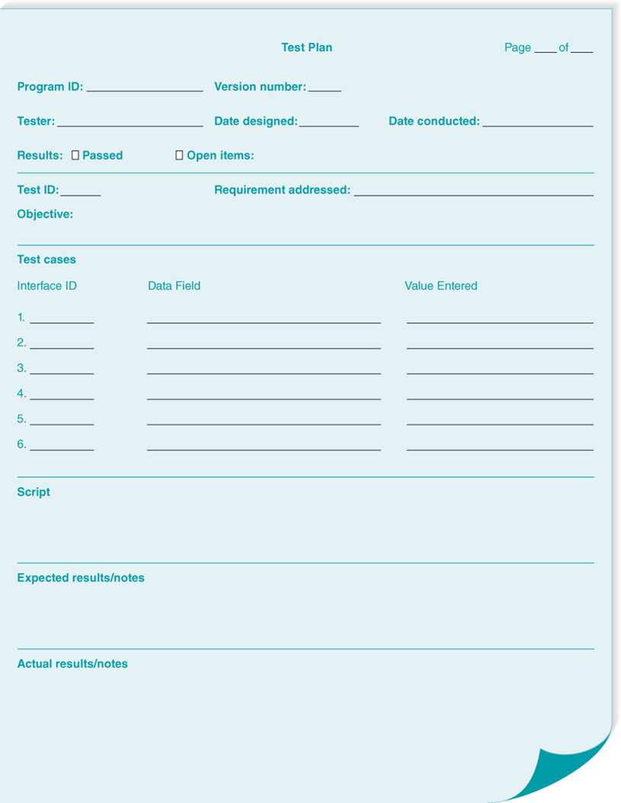
Test Planning
Testing starts with the tester’s developing a test plan that defines a series of tests that will be conducted
Today, automated testing tools enable comprehensive testing of all relevant test conditions

Slide 12
Categories of Testing
Stub testing
Tests control structures before all modules are written
Unit testing
Tests each module – Does it performs its function?
Integration testing
Tests the interaction of modules - do they work together?
System testing
Tests to assure that the software works well as part of the overall system
Acceptance testing
Tests to assure that the system serves organizational needs

Slide 13
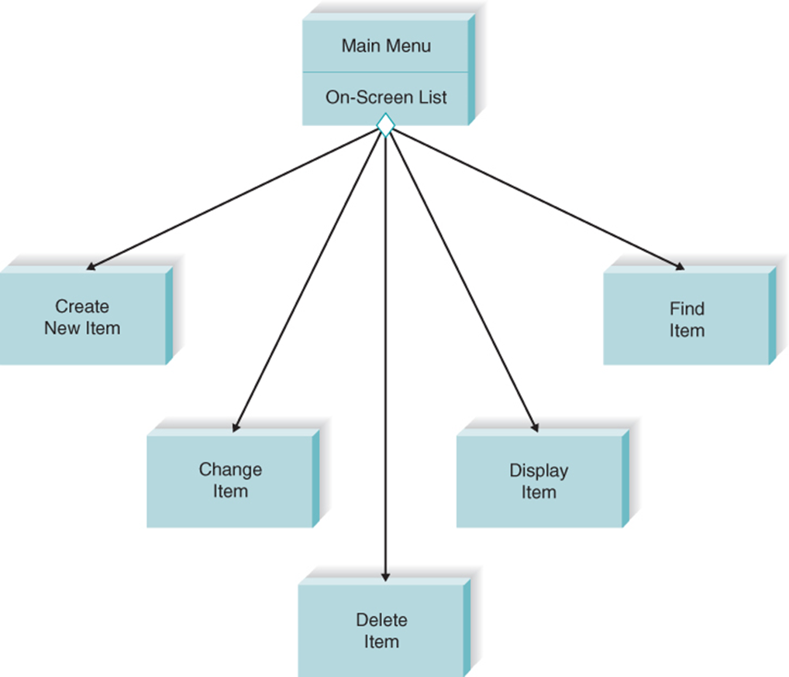
Stub Testing
Not all program modules are likely to be finished at the same time
Programmer usually writes stubs for the unfinished modules to enable the modules around them to be tested
A stub displays a simple test message on the screen or returns some hardcoded value

Slide 14
Four General States of Tests
Unit tests
Integration tests
System tests
Acceptance tests

Slide 15
Error Discovery Rates for Different Stages of Tests

Slide 16
Unit Testing
Unit tests focus on one unit—a program or a program module that performs a specific function that can be tested
Performed after programmer has developed and tested the code and believes it to be error free
Black Box Testing
Focuses on whether the unit meets requirements stated in specification
White-Box Testing
Looks inside the module at actual code

Slide 17
Integration Tests
User interface testing
Tests each interface function
Use-scenario testing
Ensures that each use scenario works correctly
Data flow testing
Tests each process in a step-by-step fashion
System interface testing
Ensures data transfer between systems

Slide 18
System Tests
Requirements testing
Ensures that integration did not cause new errors
Usability testing
Tests how easy and error-free the system is in use
Security testing
Assures that security functions are handled properly
Performance testing
Assures that the system works under high volumes of activity (example: simultaneous users, peak transaction volume)
Documentation testing
Analysts check the accuracy of documentation

Slide 19
Acceptance Tests
Alpha testing
Performed by users to assure they accept the system; frequently repeats earlier tests
Beta testing
Uses real data, not test data. Actual users monitor for errors or needed improvements.
User sign-off following acceptance testing indicates the system is ready to be placed into production

Slide 20
Developing Documentation
Documentation provides information to make the system easier to use and repair
System documentation
Intended to help programmers and analysts understand and maintain the system after it is installed
User documentation
Intended to help users operate the system

Slide 21
Producing Documentation
High quality documentation takes about 3 hours per page or 2 hours per screen
The task should not be left to the end of the project
Time required to develop, and test user documentation should be built into project plan
On-line documentation is predominant today

Slide 22
Value of Online Documentation
Searching is simplified
Information can be presented in multiple formats
New methods of interacting with documentation are possible (example: tool tips, animated demos, narrated demos)
Less costly than paper documentation

Slide 23
Types of User Documentation
Type of Documentation | Use
Reference documents | Designed to be used when the user needs to learn how to perform a specific function
Procedures manuals | Describe how to perform business tasks
Tutorials | Teach people how to use major components of the system

Slide 24
Guidelines for Crafting Documentation Topics
Do not omit any step because you “assume” the user knows how to do that step
Use the active voice with direct instructions
Use consistent terms
Use simple, friendly language
Use parallel grammatical structure
Use steps correctly (as actions)
Use short paragraphs

Slide 25
Chapter Review
Identify and describe the essential aspects of managing the programming process.
Identify and describe the elements of a test plan.
Identify and describe the focus and types of unit testing.
Identify and describe the focus and types of integration testing.
Identify and describe the focus and types of system testing.
Identify and describe the focus and types of acceptance testing.
Identify and describe the focus and types of user documentation.

Slide 26
Key Terms
Acceptance tests
Alpha testing
Beta testing
Black-box testing
Change control
Construction
Data flow testing
Documentation navigation control
Documentation testing
Documentation topic
Hardcoded
Integration tests
Performance testing
Procedures manuals
Program log
Reference documents
Requirements testing
Scope creep
Security testing
Stub
System documentation
System interface testing
System tests
Test case
Test plan
Tutorials
Unit tests
Usability testing
User documentation
User interface testing
Use scenario testing

