Slide 1
System Analysis and Design
Eighth Edition
Alan Dennis, Barbara Wixom, Roberta M. Roth
Chapter 12
Transition to the New System

Slide 2
Objectives
Explain the system installation process.
Describe the elements of a migration plan.
Explain different types of conversion strategies and when to use them.
Describe several techniques for managing change.
Outline postinstallation processes.

Slide 3
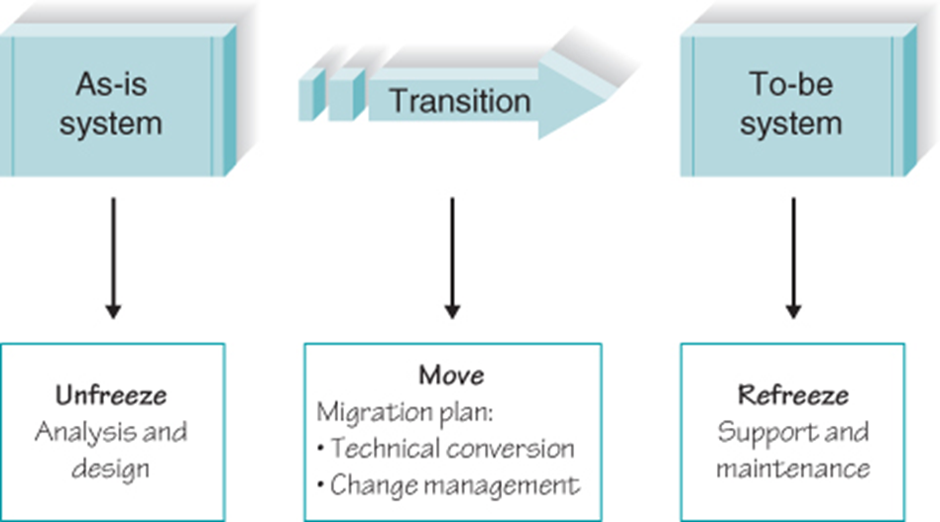
Making the Transition to the New System
Transitioning to new systems involves managing change from pre-existing norms and habits.
Change management involves:
Unfreezing -- loosening up peoples’ habits and norms
Moving -- transition from old to new systems
Refreezing -- institutionalize and make efficient the new way of doing things

Slide 4
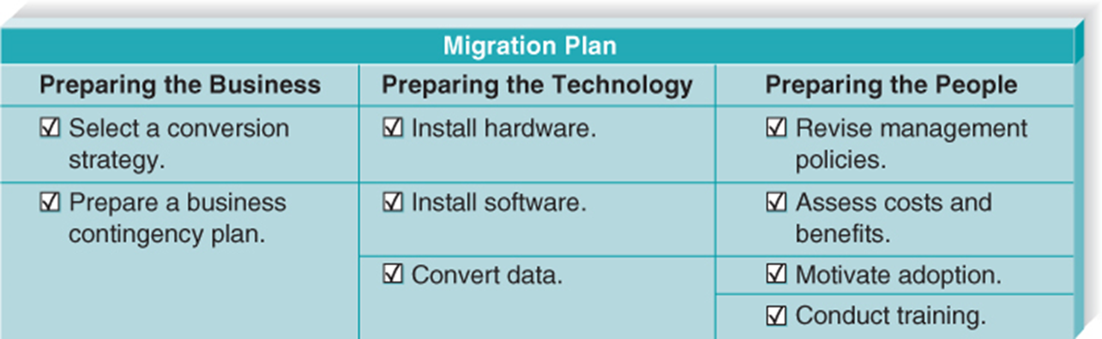
The Migration Plan
What activities will be performed when and by whom
Technical aspects
Installing hardware and software
Converting data
Organizational aspects
Training users on the system
Motivating employees to use the new system to aid in their work

Slide 5
Business Contingency Plan
What do we do if things go very wrong during conversion?
Technical glitches may occur during the transition
Is the old system still available?
If not, how do we keep the business running?
Can manual procedures be used for a short time?
Be prepared for the worst-case scenario!
Think about the consequences of being unable to operate normally…lost sales, unhappy customers… could we stay afloat?

Slide 6
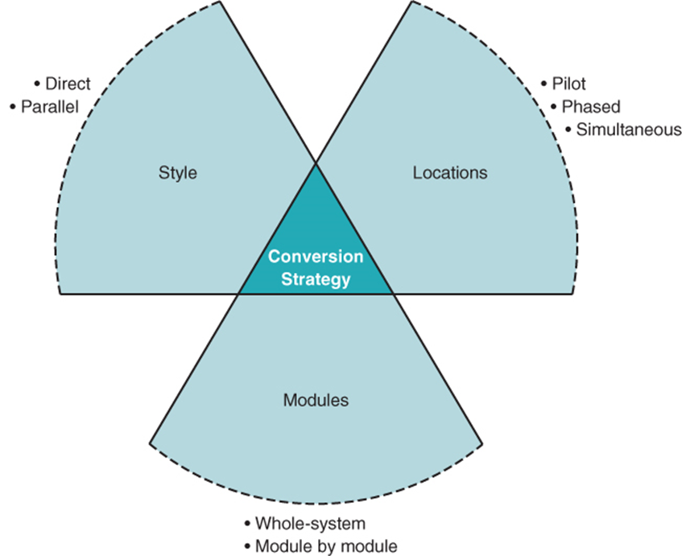
Selecting the Conversion Strategy
The process by which the new system is introduced into the organization is called the conversion strategy
Those implementing this strategy must consider:
How abruptly the change is made (the conversion style)
The organizational span of the introduction (conversion locations)
The extent of the system that is introduced (conversion modules)

Slide 7
Conversion Style
Direct conversion
The new system instantly replaces the old
Parallel conversion
A more gradual introduction
For a time both old and new systems are used
The old is abandoned when the new is proven fully capable
Reduces risk by providing the organization with a fallback position if major problems are encountered with the new system

Slide 8
Conversion Locations
Pilot conversion
One or more locations are converted to work out bugs before extending to other locations
Has the advantage of limiting the effect of the new system to just the pilot location
Must be able to tolerate different locations using different systems and business processes for a certain length of time
Phased conversion
Locations are converted in sets
Sometimes there is a deliberate delay between the phases, so that any problems with the system are detected before too much of the organization is affected
Simultaneous conversion
All locations are converted at the same time

Slide 9
Conversion Modules
It may be desirable to decide how much of the new system will be introduced into the organization at a time
When the modules within the system are separate and distinct, organizations may convert to the new system one module at a time, using modular conversion
Whole system conversion
All modules converted in one step
Modular conversion
When modules are loosely associated, they can be converted one at a time

Slide 10
Key Factors in Selecting a Conversion Strategy
Risk
Seriousness of consequences of remaining bugs
Cost
Parallel requires paying for two systems for a period of time
Simultaneous requires more staff to support all locations
Time
Parallel, phased, and modular require more time

Slide 11
Determining a Conversion Strategy: Risk
To minimize risk…
Parallel conversion style
Pilot conversion location
Conversion by modules
Riskiest conversion strategy:
Direct conversion style
Simultaneous conversion location
Conversion of whole system

Slide 12
Determining a conversion strategy: Cost
To minimize cost…
Direct conversion style
Pilot or phased conversion location
Conversion of whole system
Highest cost conversion strategy:
Parallel conversion style
Simultaneous conversion location
Conversion of modules

Slide 13
Determining a Conversion Strategy: Time
To minimize time…
Direct conversion style
Simultaneous conversion location
Conversion of whole system
Longest time conversion strategy:
Parallel conversion style
Phased conversion location
Conversion of modules

Slide 14
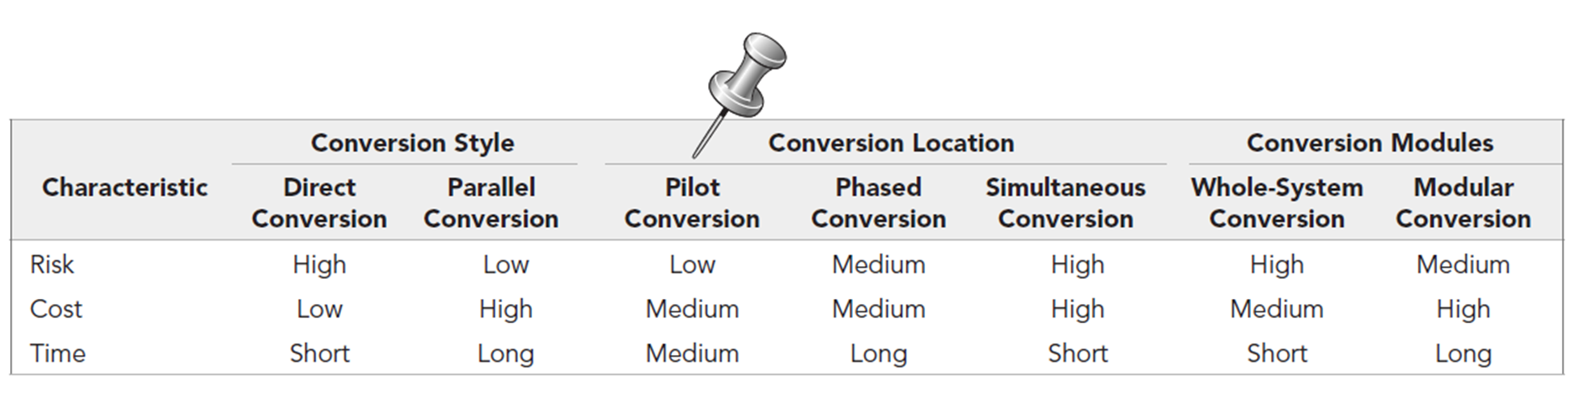
Summary of Conversion Strategies

Slide 15
Preparing a Business Contingency Plan
With new systems, it is appropriate to always expect the worst
Keeping small technology glitches in the new system from turning into major business disasters is known as business contingency planning
One of the limitations of problem prevention through perfect project management techniques is the constant pressure of budget constraints and limited time that most projects face

Slide 16
Preparing the Technology
There are three major steps involved in preparing the technical aspects of the new system for operations:
Install the hardware
Install the software
Convert the data
Although it may be possible to do some of these steps in parallel, they usually must be performed sequentially at any one location
Data conversion is usually the most technically complicated step in the migration plan

Slide 17
Preparing People for the New System
The sponsor is the business person who initiated the request for the new system
The change agent is the person(s) who lead the change effort
The potential adopter(s) are the people who must change

Slide 18
Steps in Change Management
Revise management policies
Assess costs and benefits models of potential adopters
Motivate adoption
Enable people to adopt

Slide 19
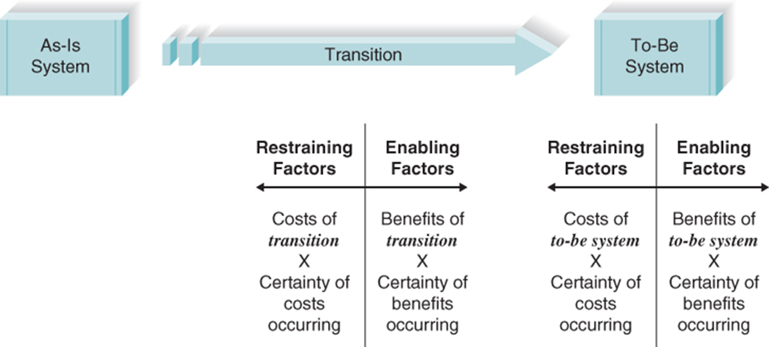
Understanding Resistance to Change
Even changes that benefit an organization do not necessarily benefit each individual
Adapting to new work processes requires effort, for which there may be no additional compensation

Slide 20
Revising Management Policies
No computer system will be successfully adopted unless management policies support its adoption
Management tools for supporting adoption
Standard operating procedures (SOPs)
Measurements and rewards
Resource allocation
SOPs become the habitual routines for how work is performed
Measurements explicitly define meaning because they provide clear and concrete evidence about what is important to the organization
Rewards reinforce measurements because “what gets measured gets done”

Slide 21
Assessing Costs and Benefits
The next step in developing a change management plan is to develop two clear and concise lists of costs and benefits provided by the new system
The first list is developed from the perspective of the organization
The second list of costs and benefits is developed from the viewpoints of the different potential adopters expected to change, or stakeholders in the change
An analysis of the costs and benefits for each set of potential adopters or stakeholders will help pinpoint those who will likely support the change and those who may resist the change
There must also be a compelling reason for the organization to need the change
The likelihood of successful change is increased when the cost of the transition to individuals who must change is low

Slide 22
Motivating Adoption
The single most important factor in motivating a change is providing clear and convincing evidence of the need for change
There are two basic strategies to motivating adoption: informational and political
With an informational strategy , the goal is to convince potential adopters that the change is for the better
With a political strategy, organizational power, not information, is used to motivate change
Both strategies are often used simultaneously

Slide 23
Change Management Planning
Potential adopters generally are:
20-30% Ready adopters
20-30% Resistant adopters
40-60% Reluctant adopters
Strategies should focus on supporting and encouraging ready adopters and helping them win over the reluctant adopters
‘Ignore’ the resistant adopters

Slide 24
Enabling Adoption: Training
Every new system requires new skills
New skills may involve use of the technology itself
New skills may be needed to handle the changed business processes

Slide 25
More on Training
What to train:
IT specialists tend to focus training around system features
Instead, focus on helping users accomplish their tasks
Use scenarios provide an outline for common activities and a basis to plan training
Types of training
Classroom
One-on-one
Computer-based

Slide 26
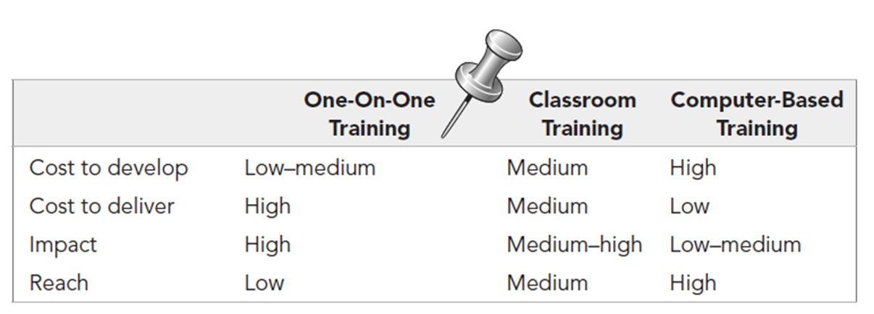
Selecting a Training Method

Slide 27
Postimplementation Activities
Provide support
Assistance in using the system
Provide maintenance
Repair or fix discovered bugs or errors
Add minor enhancements to provide added value
Assess the project
Analyze what was done well
Discover what activities need improvement in the future

Slide 28
System Support
Once the project team has installed the system and performed the change management activities, the system is officially turned over to the operations group.
This group is responsible for the operation of the system, whereas the project team is responsible for the development of the system
On-demand training at time of user need
Online support
Frequently asked questions (FAQ)
Help desk
Phone service for known issues
Level 1 Support – Broad knowledge
Unresolved issues passed to Level 2 Support – specialists in the application system

Slide 29
Elements of a Problem Report
Time and date of the report
Name, e-mail address, and telephone number of the support person taking the report
Name, e-mail address, and telephone number of the person who reported the problem
Software and/or hardware causing the problem
Location of the problem
Description of the problem
Action taken
Disposition (problem fixed or forwarded to system maintenance)

Slide 30
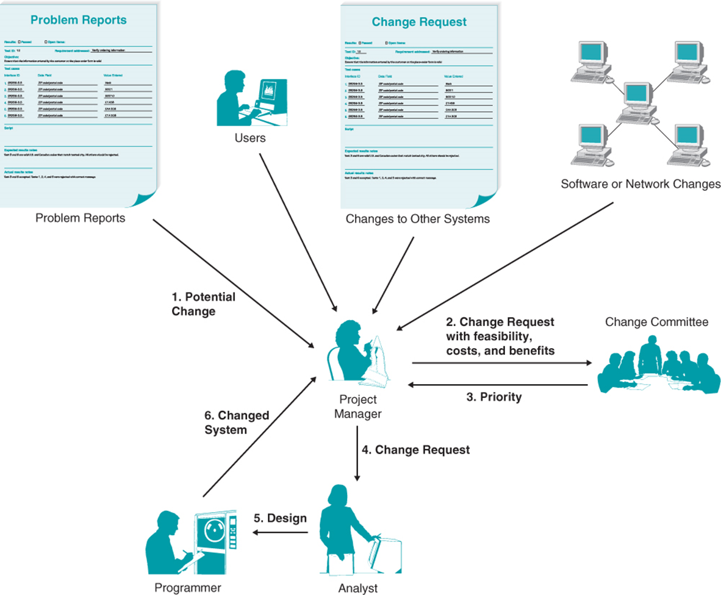
System Maintenance
Problem reports from the operations group
Requests for enhancements from users
Requests from other systems development projects
Change requests from senior management

Slide 31
Project Assessment
Important for continued project improvement
Were cost estimates accurate?
Did expected benefits actually materialize?
Was this project really worth doing?
Especially important for junior personnel to improve quickly

Slide 32
Project Team Review
Each member prepares 2-3 page document regarding her or his actions during the project
Focus on improvement not penalties
Excellent behaviors are acknowledged and diffused to others
Team leader summarizes and distributes lessons learned

Slide 33
System Review
Examine the extent to which the costs and benefits of the system are realized
Use this information to help in more accurately estimating costs and benefits for future projects

Slide 34
Chapter Review
Identify and describe Lewin’s three-step model of organizational change.
Explain how the activities of systems analysis and design help with the unfreezing process.
What is the purpose of the migration plan?
Identify and describe the three dimensions of the conversion strategy and how choices made will impact the cost, time, and risk of conversion.
Discuss the role and importance of business contingency planning during system migration.

Slide 35
Chapter Review Continued
Identify and discuss the main reasons underlying people’s resistance to change.
Identify and describe ways to overcome resistance to change.
Discuss the role and purpose of postimplementation support.
Describe the sources of change requests.
Discuss the best way to provide ongoing system maintenance.
Discuss what is gained from conducting a post-project review?

Slide 36
Key Terms
Business contingency plan
Change agent
Change management
Change request
Classroom training
Computer-based training (CBT)
Conversion location
Conversion modules
Conversion strategy
Conversion style
Direct conversion
Frequently asked questions (FAQs)
Help desk
Informational strategy
Installation
Institutionalize
Level 1 support
Level 2 support
Management policies
Measurements
Migration plan
Modular conversion
One-on-one training
On-demand training
Online support
Operations group

Slide 37
Key Terms Continued
Parallel conversion
Phased conversion
Pilot conversion
Political strategy
Postimplementation
Potential adopter
Problem report
Project assessment
Project team review
Ready adopters
Refreeze
Reluctant adopters
Resistant adopters
Resource allocation
Rewards
Simultaneous conversion
Sponsor
Standard operating procedures (SOPs)
System maintenance
System request
System review
System support
Training
Transition
Unfreeze
Whole-system conversion

