Slide 1
 | Spring 2012
 | EECS810 – Principles of Software Engineering Bharath Padmanabhan
UNIFIED MODELING LANGUAGE (UML) OVERVIEW
Unified Modeling Language (UML) is a graphical language for visualizing, specifying, constructing, and documenting the artifacts of a software-intensive system. It offers a standard way to write a system’s blueprints, including conceptual things such as business processes and system functions as well as concrete things such as programming language statements, database schemas, and reusable software components.

Slide 2
Table of Contents
Introduction .................................................................................................................................................. 1
Modeling ....................................................................................................................................................... 1
Static (or structural) view.......................................................................................................................... 1
Dynamic (or behavioral) view ................................................................................................................... 1
Diagrams Overview ....................................................................................................................................... 1
Structure Diagrams ................................................................................................................................... 2
1. Class Diagram................................................................................................................................ 2
2. Component Diagram..................................................................................................................... 2
3. Composite Structure Diagram....................................................................................................... 2
4. Deployment Diagram .................................................................................................................... 3
5. Object Diagram ............................................................................................................................. 3
6. Package Diagram........................................................................................................................... 4
7. Profile Diagram ............................................................................................................................. 4
Behavior Diagrams .................................................................................................................................... 5
1. Activity Diagram............................................................................................................................ 5
2. State Machine Diagram................................................................................................................. 6
3. Use Case Diagram ......................................................................................................................... 6
Interaction Diagrams ................................................................................................................................ 7
1. Communication Diagram .............................................................................................................. 7
2. Interaction Overview Diagram...................................................................................................... 8
3. Sequence Diagram ........................................................................................................................ 9
4. Timing Diagram ............................................................................................................................. 9
References .................................................................................................................................................. 10

Slide 3
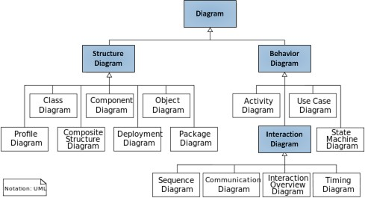
Unified Modeling Language (UML) Overview
Introduction
Unified Modeling Language (UML) is a standardized general-purpose modeling language in the field of object-oriented software engineering. UML includes a set of graphic notation techniques to create visual models of object-oriented software systems. UML combines techniques from data modeling, business modeling, object modeling, and component modeling and can be used throughout the software development life-cycle and across different implementation technologies.
Modeling
There is a difference between a UML model and the set of diagrams of a system. A diagram is a partial graphic representation of a system’s model. The model also contains documentation that drives the model elements and diagrams (such as written use cases).
UML diagrams represent two different views of a system model:
Static (or structural) view
This view emphasizes the static structure of the system using objects, attributes, operations, and relationships. Ex: Class diagram, Composite Structure diagram.
Dynamic (or behavioral) view
This view emphasizes the dynamic behavior of the system by showing collaborations among objects and changes to the internal states of objects. Ex: Sequence diagram, Activity diagram, State Machine diagram.
Diagrams Overview
UML 2.2 has 14 types of diagrams divided into multiple categories as shown in the figure below.

Slide 4
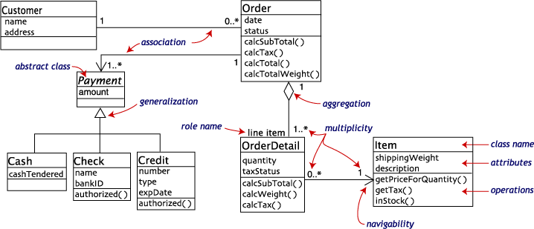
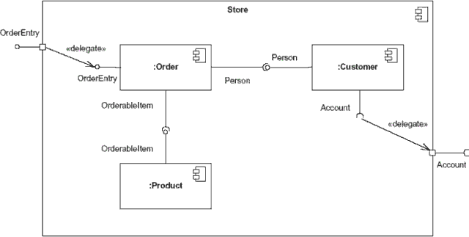
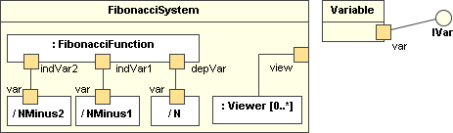
Unified Modeling Language (UML) Overview
Structure Diagrams
These diagrams emphasize the things that must be present in the system being modeled. Since they represent the structure, they are used extensively in documenting the software architecture of software systems.
1. Class Diagram
Describes the structure of a system by showing the system’s classes, their attributes, and the relationships among the classes.
2. Component Diagram
Describes how a software system is split-up into components and shows the dependencies among these components.
3. Composite Structure Diagram
Describes the internal structure of a class and the collaborations that this structure makes possible.

Slide 5
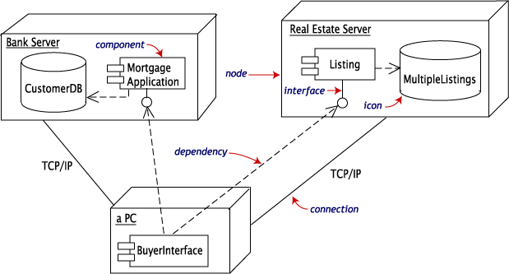
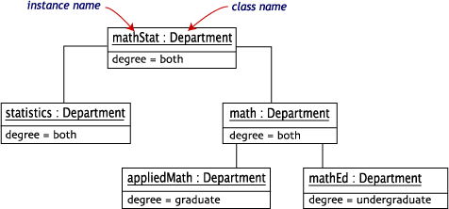
Unified Modeling Language (UML) Overview
4. Deployment Diagram
Describes the hardware used in system implementations and the execution environments and artifacts deployed on the hardware.
5. Object Diagram
Shows a complete or partial view of the structure of an example modeled system at a specific time.

Slide 6
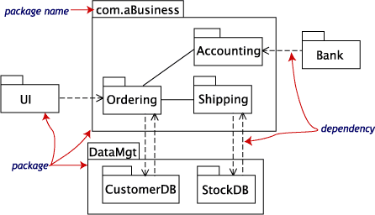
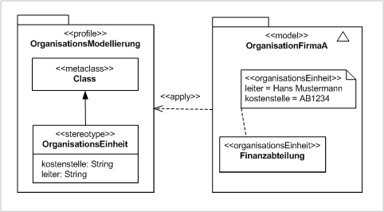
Unified Modeling Language (UML) Overview
6. Package Diagram
Describes how a system is split-up into logical groupings by showing the dependencies among these groupings.
7. Profile Diagram
Operates at the metamodel level to show stereotypes as classes with the <<stereotype>> stereotype, and profiles as packages with the <<profile>> stereotype. The extension relation (solid line with closed, filled arrowhead) indicates what metamodel element a given stereotype is extending.

Slide 7
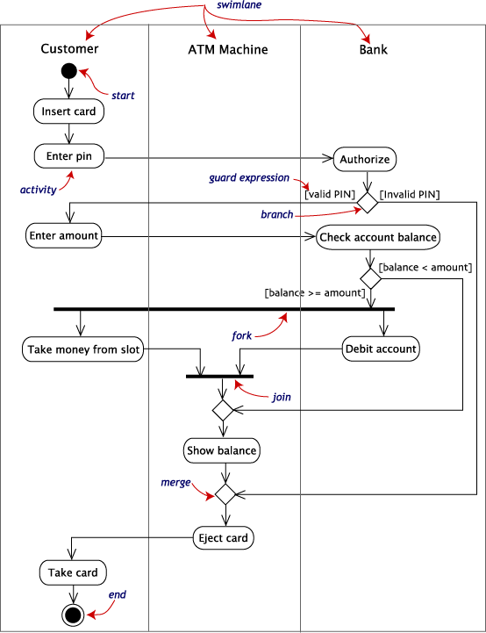
Unified Modeling Language (UML) Overview
Behavior Diagrams
These diagrams emphasize what must happen in the system being modeled. Since they illustrate the behavior of a system, they are used extensively to describe the functionality of software systems.
1. Activity Diagram
Describes the business and operational step-by-step workflows of components in a system. An activity diagram shows the overall flow of control.

Slide 8
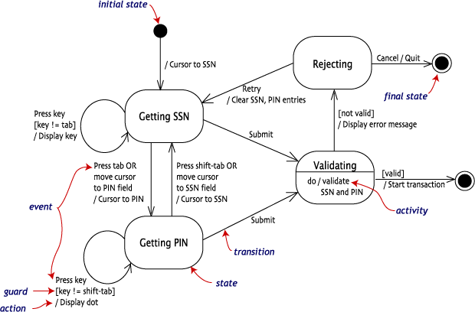

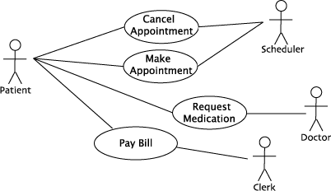
Unified Modeling Language (UML) Overview
2. State Machine Diagram
Describes the states and state transitions of the system.
3. Use Case Diagram
Describes the functionality provided by a system in terms of actors, their goals represented as use cases, and any dependencies among those use cases.

Slide 9
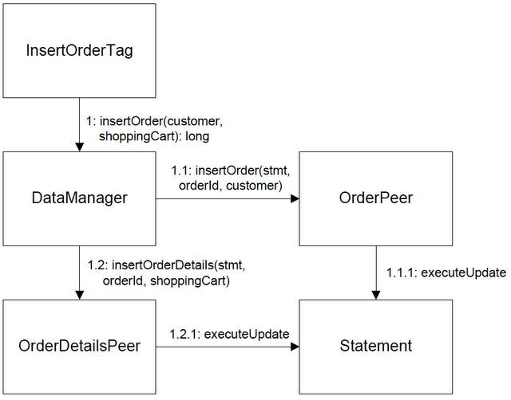
Unified Modeling Language (UML) Overview
Interaction Diagrams
These diagrams are a subset of behavior diagrams, emphasizing the flow of control and data among the things in the system being modeled.
1. Communication Diagram
Shows the interactions between objects or parts in terms of sequenced messages. They represent a combination of information taken from Class, Sequence, and Use Case Diagrams describing both the static structure and dynamic behavior of a system.

Slide 10
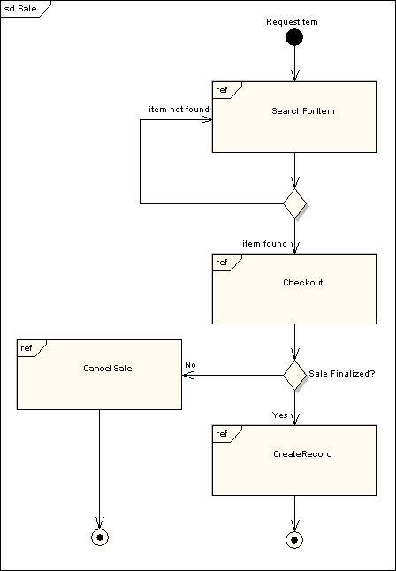
Unified Modeling Language (UML) Overview
2. Interaction Overview Diagram
Provides an overview in which the nodes represent communication diagrams. They are activity diagrams in which every node, instead of being an activity, is a rectangular frame containing an interaction diagram (i.e., a communication, interaction overview, sequence, or UML timing diagram).

Slide 11
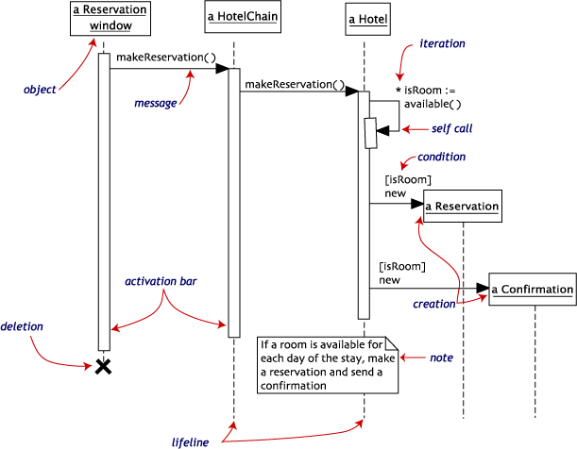
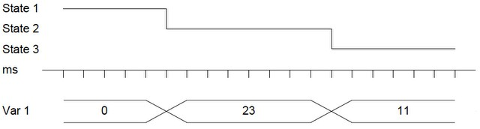
Unified Modeling Language (UML) Overview
3. Sequence Diagram
Shows how objects communicate with each other in terms of a sequence of messages. Also indicates the lifespans of objects relative to those messages.
4. Timing Diagram
A specific type of interaction diagram where the focus is on timing constraints. Timing diagrams model sequence of events and their effects on states and property values. Time flows along a horizontal axis from left to right. They can be used to show method execution profiling or concurrency scenarios.

Slide 12
Unified Modeling Language (UML) Overview
References
Unified Modeling Language http://en.wikipedia.org/wiki/Unified_Modeling_Language
UML basics: The component diagram http://www.ibm.com/developerworks/rational/library/dec04/bell/
Practical UML: A Hands-On Introduction for Developers http://wwwis.win.tue.nl/2R690/together/
OO – UML Behavior Diagrams http://giuliozambon.blogspot.com/2010/09/oo-uml-behavior-diagrams.html
UML 2 Tutorial http://www.sparxsystems.com/resources/uml2_tutorial/

