Slide 1
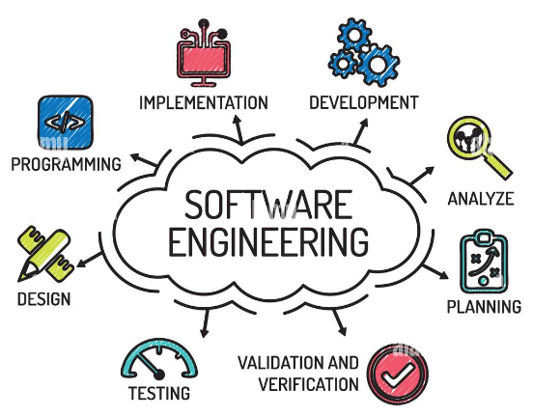
Software Engineering
Introduction

Slide 2
Why Do We Need Software Engineering? LINK: Biggest Software Failures in History
Pentium FDIV bug
A math professor discovered a flaw in the Pentium processor that caused errors in lookup tables. Intel offered replacement chips to those affected, but the bug became more expensive due to mass hysteria.
Patriot missile mistiming
A software bug in the U.S. Army's Patriot Missile System caused it to fail to intercept an Iraqi missile during the Gulf War, resulting in 28 fatalities. The error was related to how the system handled timestamps.
The Y2K bug
Many software developers assumed that writing "19" before the variable "year" was unnecessary and omitted the two digits. This led to problems when the millennium changed.
Nest thermostat freeze
A software update for the Nest thermostat caused the device's batteries to drain, which led to a temperature drop. This prevented customers from heating their homes.
Boeing 737 MAX Software Issues (2018-2019): Two Fatal Crashes
In 2018 and 2019, two Boeing 737 MAX airplanes crashed, killing 346 people.
A Maneuvering Characteristics Augmentation System (MCAS) failure contributed to two fatal crashes, leading to a global grounding of the aircraft.
This failure led to the grounding of the 737 MAX fleet worldwide and raised serious concerns about the safety of automated flight systems.

Slide 3
Likely Causes
Increasing Software Complexity
Systems have to be built and delivered more quickly; larger, even more complex systems are required; and systems have to have new capabilities that were previously thought to be impossible.
New software engineering techniques have to be developed to meet new the challenges of delivering more complex software.
Failure to use sound engineering processes and methods
Use of unskilled SW Engineeers
Failure to start with adequate requirements
Failure to develop robust software architectures and designs
Failure to follow software standards
Failure to perform adequate testing
Lack of configuration management
In summary, lack of software engineering!!

Slide 4
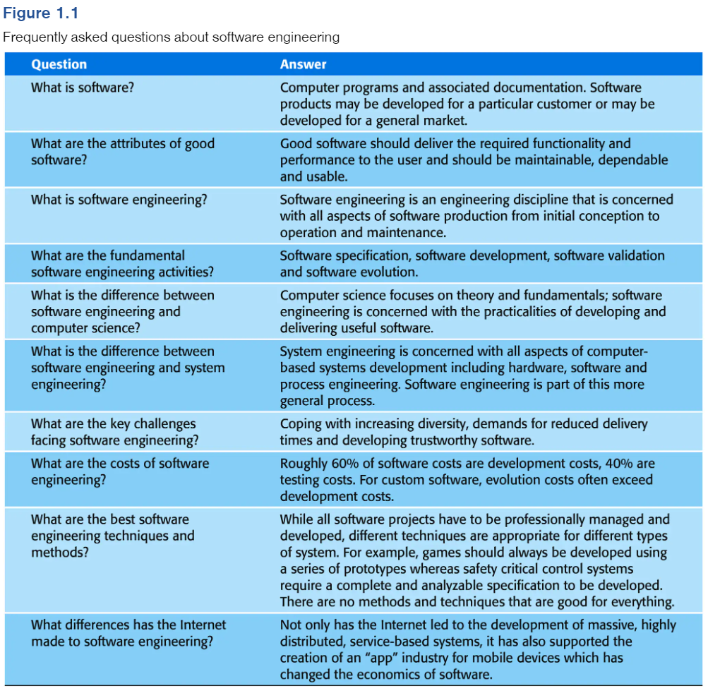
Lots of Questions

Slide 5
Can Generative AI Replace SW Engineers
“Generative AI cannot create large software projects on its own. If you ask ChatGPT to create a search engine, it can only make a basic search engine: Nothing close to a functional search engine like Google. Furthermore, generative AI often produces code that is incorrect or contains bugs, so a human needs to review it to ensure it is correct.”
“Companies may hire fewer engineers if all the software engineers in the United States become 25% more productive [because of Generative AI]. On the other hand, if software engineers are 25% more effective, companies may pursue more ambitious projects, which might not affect the number of software engineering jobs.”
“Existing AI tools do not fully understand abstract concepts, context and the nuances of human language and requirements. They also cannot make ethical decisions, consider the societal implications of a piece of software or innovate in the way humans can. Therefore, while generative AI can be a powerful tool in a software engineer's toolkit, helping to automate specific tasks and improving productivity, it is not likely to replace software engineers entirely. Instead, the role of software engineers might evolve, with a greater focus on tasks that require a high level of creativity, critical thinking and human judgment.”
https://www.comptia.org/blog/will-ai-replace-software-developers#:~:text=Generative%20AI%3A%20Not%20a%20Replacement%20for%20Humans%2C%20Yet&text=Despite%20these%20advancements%20in%20AI,to%20understand%2C%20innovate%20and%20adapt.

Slide 6
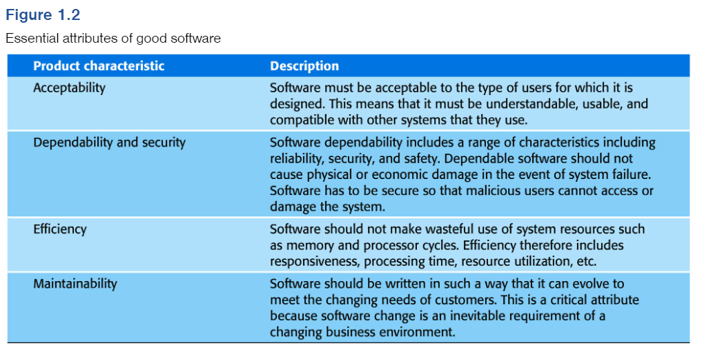
Good Characteristics
These characteristics contribute to the challenges Generative AI faces in trying to replace good Software Engineering

Slide 7
Our usual emphasis..
Programming with total disregard to software engineering

Slide 8
Common sense questions
(going backwards from programming)
What is the design on the basis of which programmers do their work?
What is the architecture of the system used to design it?
What should the software be doing, so that we know which architecture (& design & code) to use, and what is more important among many possible objectives?

Slide 9
Common sense questions
(going forwards from programming)
How do we evaluate the code?
Testing
Verification
Validation
Computational effort (time & space)
Deployment considerations
Usability
Security & privacy concerns
If you are paying attention, raise your hand
What happens after the code is written and deployed?

Slide 10
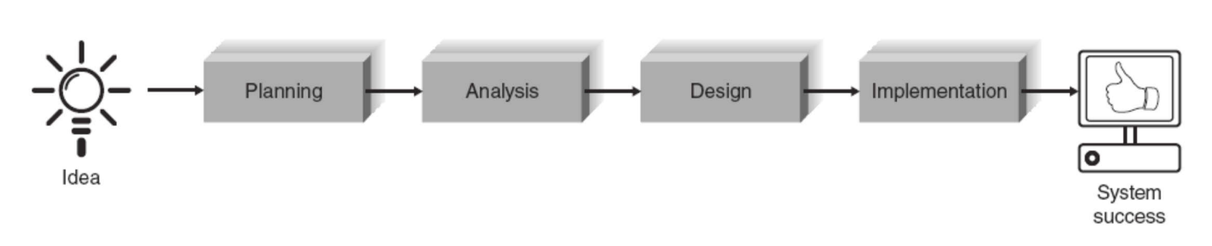
Systems (Software) Development Life Cycle – SDLC

Slide 11
SDLC
Planning – WHY are we doing this?
Analysis – WHO will use the system, WHAT the system will do, and WHERE and WHEN will it be used.
Design – HOW will we do all this stuff?
Implementation – Where the rubber meets the road.
Maintenance – Were does that fall. Isn’t it part of the life cycle of a software system? Yes it is, but the “D” in SDLC stands for Development. Maintenance is part of the overall Product life cycle.

Slide 12
What are the main components of the software product?
High level perspective: What is the software intended to accomplish? If it is the component of a larger system, what does the system do?
Requirements Specification: Details of what the software accomplishes.
Architecture: High level description of how the software is structured.
Design: Details of how various parts of the software and how they are connected.
Code (Implementation)
Test cases and results
Future plans (enhancements, needed changes, maintenance plan)

Slide 13
Processes for software engineering:
Sequential processes
“Waterfall” https://www.youtube.com/watch?v=Y_A0E1ToC_I
Cyclic (iterative) processes
“Spiral model” https://www.youtube.com/watch?v=mp22SDTnsQQ
Parallel processes
“Agile” https://www.youtube.com/watch?v=Z9QbYZh1YXY [We’ll be covering this in CIS454]

Slide 14
CMU-SEI’s Capabilities Maturity Model (CMM) [focus on process of software development]
Five levels along which software development organizations are evaluated:
Initial - chaotic, ad hoc.
Repeatable - the process is documented sufficiently to facilitate repeating the same steps.
Defined - the process is defined/confirmed as a standard business process
Capable - the process is quantitatively managed in accordance with agreed-upon metrics.
Efficient - process management includes deliberate process optimization/improvement.

Slide 15
Quick question for the class
What are the first things we must do when we build a new software product?
Notes:
What are the first things we must do when we build a new software product?
Learn what problem the software is intended to address.
Formulate what it means to be successful.
Limit the scope of the software.
Identify constraints (hardware, people, time, cost).
Identify the stakeholders, and their primary concerns.
Plan the software development process.

Slide 16
Project Initiation, Planning and Scheduling
Most projects begin with a short proposal summarizing:
what needs to be done,
why,
the scope of the project, as well as
an estimate of the resources needed.
Then more details are sketched out, including milestones and timeline (e.g., using Gantt charts).
Resource approval (people, time, hardware, software resources) must then be obtained from decision-makers (e.g., company executives).

Slide 17
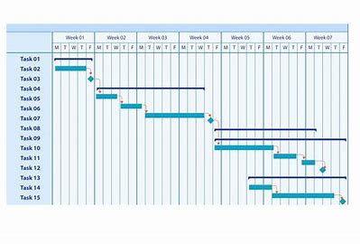
Gantt Charts
Describe the time duration of each task and subtask, accounting for dependencies between them.
Very useful for laying out the entire project timeline to see if it makes sense.

Slide 18
Analysis
Who, what when where?

Slide 19
Stakeholders: who is affected by what we do? (E.g., for developing a mobile app software)
Direct Stakeholders? • Indirect Stakeholders?

Slide 20
Specification: what needs to be done
Look at each stakeholder’s perspective:
The ultimate users of the software (possibly different kinds of users)
Designers
Coders
Managers of the software engineering team
Sales & Marketing people in your company
Executives concerned with costs & finances
Human Resource & Staffing Managers
“The general public” who may be impacted by the use of the software (e.g., patients affected by glitches in hospital accounting software)

Slide 21
How would we evaluate a software specification? (Discriminating Good vs. Bad Specification)
Understandable
Implementable
Testable

Slide 22
How do we express a specification (or design)?
English
Formal logic
Various diagrams that follow a well-understood format
“Structured Analysis & Structured Design”
“Unified Modeling Language” (UML)
https://www.youtube.com/watch?v=8CBnAmYnwk0 https://www.youtube.com/watch?v=vgYKW9O6fFE https://www.youtube.com/watch?v=FkRwbVUVFvE

Slide 23
Class Exercise 1
A mobile app has to be developed to be used by customers of a hardware store chain (e.g., Home Depot, Lowe’s, Truvalue).
You are the manager of a software engineering team, which has developed a software specification for this system.
What are the criteria you would use to decide whether it is acceptable, so that the Design can start?
[Work with someone sitting next to you; both of you must submit on Blackboard, clearly indicating with whom you worked.]

