Slide 1
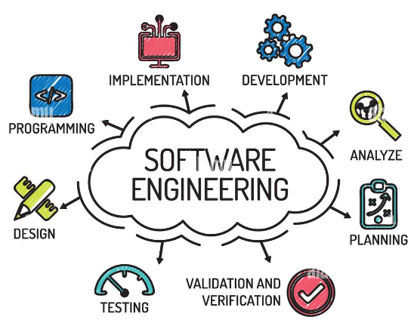
Software Engineering Introduction

