Slide 1
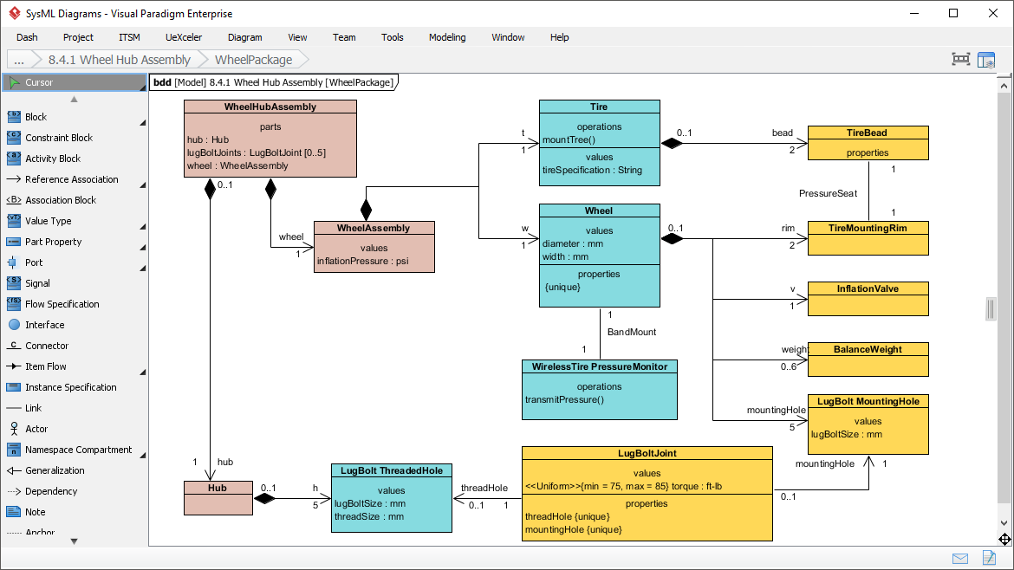
UML Modeling With Visual Paradigm
Introduction to Using a REAL Modeling Tool

Slide 2
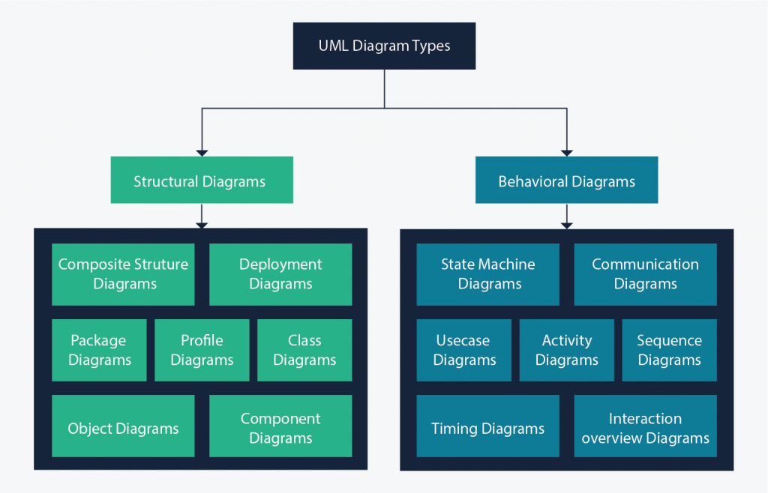
UML Diagrams

Slide 3
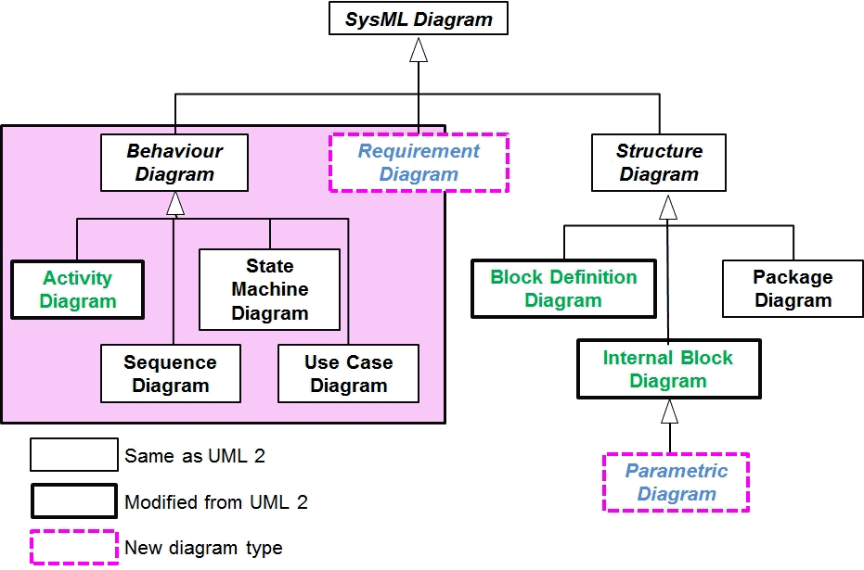
SysML Diagrams

Slide 4
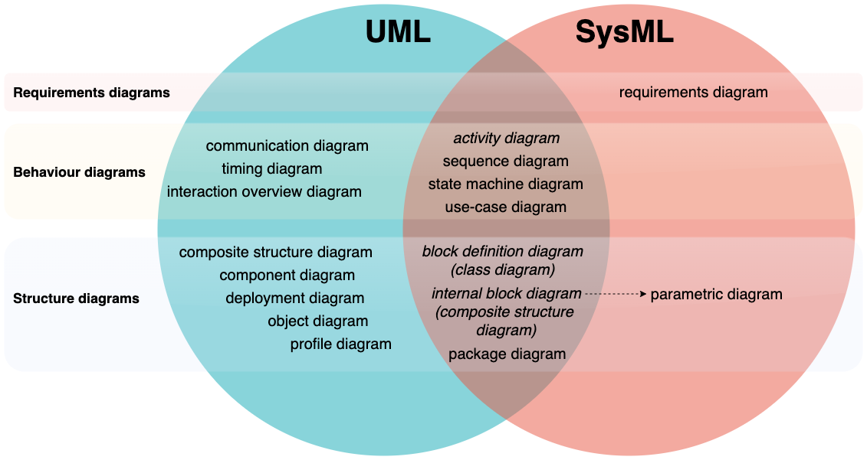
UML/SysML Diagram Relationships

Slide 5
Diagram Drawing Options
The following are all tools for making diagrams, NOT making models.
UMLet
Draw.io
Gleek.io
Lucidchart
Diagrams.net
MS Visio Professional
Many others….

Slide 6
UML Modeling Tool
The following are UML Modeling Tools
Enterprise Architect
Cameo
Rhapsody
Magic Draw
StarUML
Others…

Slide 7
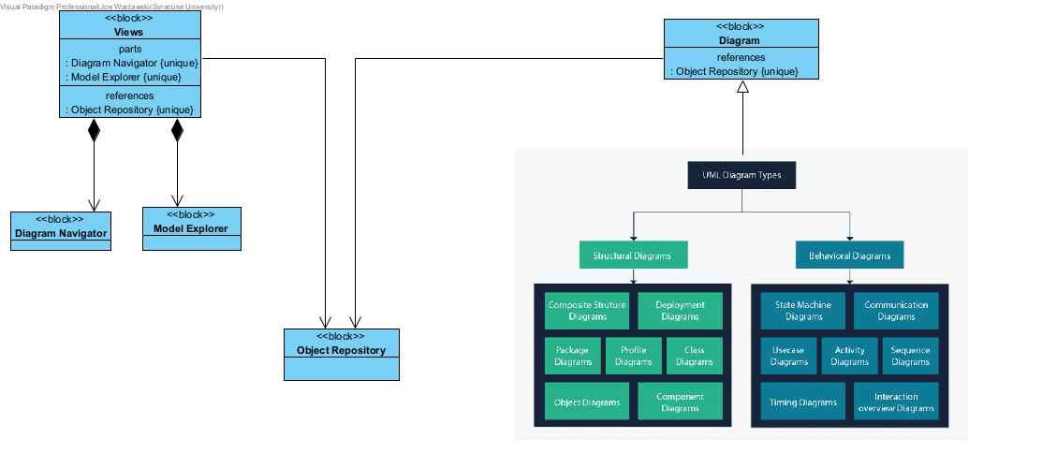
Why a UML Modeling Tool?
UML Modeling tools allow you to generate complete and cohesive Analysis, Design, Implementation and Deployment models.

Slide 8
Visual Paradigm Features
Unlimited Team Collaboration with Cloud Repository
Document Generation
SysML
UML
Export to XMI (OMG Standard), XML, Visual Paradigm Project
Visual Paradigm Online – Provides web browser access to your online models.
Available for Windows, MAC and Linux

