Slide 1
System Analysis and Design UML
Sixth Edition
Alan Dennis, Barbara Wixom, Roberta M. Roth
Chapter 1
The Systems Analyst and Information Systems Development

Slide 2
Objectives
Explain the role played in IS development by the systems analyst.
Describe the fundamental systems development life cycle and its four phases.
Explain how organizations identify IS development projects.
Explain the importance of linking the IS to business needs.
Be able to create a system request.
Describe technical, economic, and organizational feasibility assessment.
Be able to perform a feasibility analysis.

Slide 3
Introduction
The systems development life cycle (SDLC) is the process of determining how an information system (IS) can support business needs, designing the system, building it, and delivering it to users
The systems analyst plays a key role in the SDLC, analyzing the business situation, identifying opportunities for improvements, and designing an IS to implement the improvements
The primary goal of the system analyst is to create value for the organization, which for most companies means increasing profits
Systems analysts do things and challenge the current way that an organization works.

Slide 4
Introduction Continued
Large systems development projects are particularly susceptible to failure
An analysis of very large development projects conducted by the Standish Group found that for projects that exceed $100 million in labor costs, only 2% are successful
Several major factors were delays in decision making and a high workforce turnover during the project

Slide 5
The Systems Analyst
The systems analyst works closely with all project team members so that the team develops the right system in an effective way
Systems analysts must understand how to apply technology to solve business problems
Systems analysts serve as change agents who identify the organizational improvements needed, design systems to implement those changes, and train and motivate others to use the systems

Slide 6
Systems Analyst Skills
Analysts must have the technical skills to understand the organization’s existing technical environment, the new system’s technology foundation, and the way in which both can be fit into an integrated technical solution
Business skills are required to understand how IT can be applied to business processes and to ensure that IT delivers real business value
Analysts are continuous problem solvers at both the project and the organizational level, and they put their analytical skills to the test regularly

Slide 7
Systems Analyst Skills Continued
Analysts need strong interpersonal skills to communicate effectively, one-on-one with users and business managers, with programmers and other technical specialists, and with people from outsourcing firms and vendor organizations
Analysts need to manage people with whom they work, and they must manage the pressure and risks associated with unclear situations
Analysts must deal fairly, honestly, and ethically with other project team members, managers, and system users

Slide 8
Systems Analyst Roles
The systems analyst role focuses on the IS issues surrounding the system
The business analyst role focuses on the business issues surrounding the system
The requirements analyst role focuses on eliciting the requirements from the stakeholders associated with the new system
The infrastructure analyst role focuses on technical issues surrounding the ways the system will interact with the organization’s technical infrastructure

Slide 9
Career Paths for System Developers

Slide 10
Systems Analyst Roles Continued
The software architect takes a holistic view of the organization’s entire IT environment and guides application design decisions within that context
The change management analyst role focuses on the people and management issues surrounding the system installation
The project manager role ensures that the project is completed on time and within budget and that the system delivers the expected value to the organization

Slide 11
The Systems Development Life Cycle

Slide 12
Planning Phase
Project initiation
Prepare system request
Perform preliminary feasibility analysis
Set up the project
Project plan, including work plan and staffing plan

Slide 13
Analysis Phase
Determine analysis strategy
Study existing system and its problems
Collect and analyze requirements
Develop new system concept
Describe new system with analysis models
Prepare and present system proposal
Summarize results of the Analysis Phase
Go/No Go decision made by sponsor and steering committee

Slide 14
Design Phase
Determine design strategy
Build / buy / outsource
Design system components
Architecture, interface, database, programs
Assemble design elements into system specification
Present to steering committee
Go /no go decision before entering final phase

Slide 15
Implementation Phase
System construction
Programming and testing
System installation
Training
Conversion to new system
On-going system support

Slide 16
Project Identification and Initiation
Fulfill a business need
Enable a business initiative or strategy
Support a merger/acquisition
Fix a “point of pain”
Utilize a new technology
Outgrowth of business process management (BPM)

Slide 17
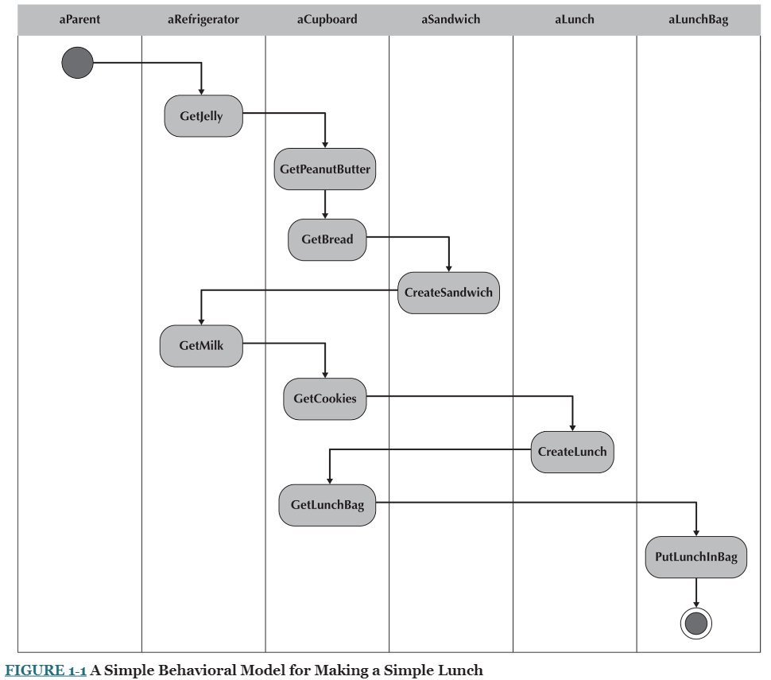
How many methods are there to develop a lunch making machine?

Slide 18
Structured Analysis
Structured design methodologies adopt a formal step‐by‐step approach to the SDLC that moves logically from one phase to the next.

Slide 19
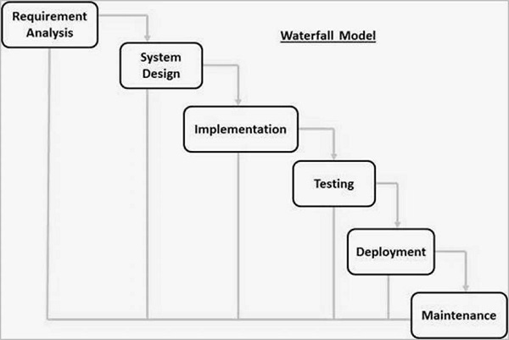
Structured Analysis Structured design methodologies adopt a formal step‐by‐step approach to the SDLC that moves logically from one phase to the next.
Waterfall
Development moves forward from phase to phase in the same manner as a waterfall.
Analysts and users proceed in sequence from one phase to the next.
Key deliverables for each phase are typically very long (often hundreds of pages in length) and are presented to the project sponsor for approval as the project moves from phase to phase.
Upon sponsor approval next phase begins, and not before
Although it is possible to go backward in the SDLC (e.g., from design back to analysis), it is extremely difficult (imagine yourself as a salmon trying to swim upstream against a waterfall).

Slide 20
Structured Analysis
Waterfall
Advantages
Requirements well defined before development
Minimizes changes to requirements during the SDLC.
Disadvantages
Design MUST be complete before programming
Long delays between Planning and actual development of any sort. Time To Market takes a hit

Slide 21
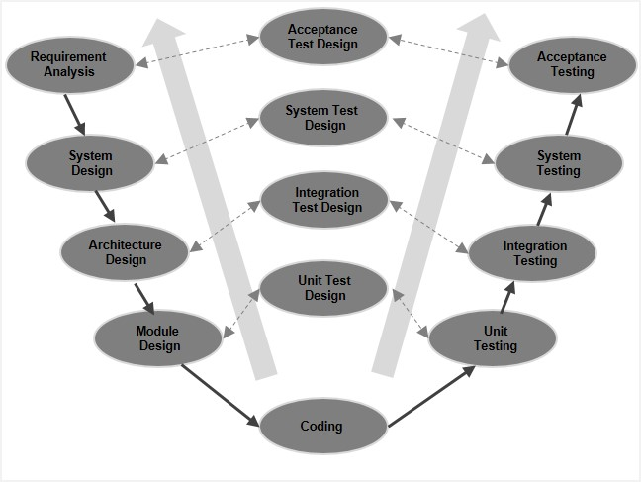
Structured Analysis
V-Model
Extension of the waterfall model
Based on the association of a testing phase for each corresponding development stage.
Every single phase in the development cycle, has a directly associated testing phase.
This is a highly-disciplined model and the next phase starts only after completion of the previous phase.

Slide 22
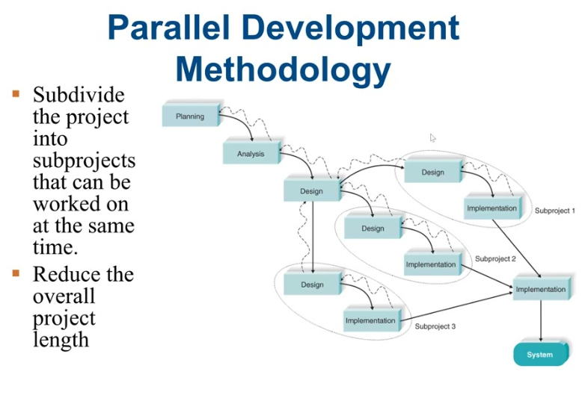
Structured Analysis
Parallel Development
Define high level system design
Divide into sub systems and develop in parallel.
Integrate once all sub systems complete
Advantage
Reduce time to market
Disadvantage
Independence and mutual exclusion of sub systems key. But dependencies necessarily exist. When one subsystem changes, the others need to as well. Lots of churn.

Slide 23
Rapid Application Develop
RAD‐based methodologies attempt to address both weaknesses of structured design methodologies by adjusting the SDLC phases to get some part of the system developed quickly and into the hands of the users.
In this way, the users can better understand the system and suggest revisions that bring the system closer to what is needed
Special techniques and computer tools to speed up the analysis, design, and implementation phases
Computer‐aided software engineering (CASE) tools,
Joint application design (JAD) sessions
Fourth‐generation or visual programming languages that simplify and speed up programming
Code generators that automatically produce programs from design specifications.

Slide 24
Rapid Application Develop
Adverse Affects
Use of the tools and techniques that can improve the speed and quality may result in user expectations of what is possible can change dramatically.
As a user better understands the information technology (IT), the systems requirements tend to expand.
This was less of a problem when using methodologies that spent a lot of time thoroughly documenting requirements.

Slide 25
Rapid Application Develop
Phased Development
Breaks an overall system into a series of versions that are developed sequentially.
The analysis phase identifies the overall system concept
Stakeholders categorize the requirements into a series of versions.
The most important and fundamental requirements are bundled into the first version of the system.
The analysis phase then leads into design and implementation—but only with the set of requirements identified for version 1.
Once version 1 is implemented, work begins on version 2.
Additional analysis is performed based on the previously identified requirements and combined with new ideas and issues that arose from the users' experience with version 1.
Repeat for version 3, etc.

Slide 26
Rapid Application Develop
Prototyping
Not really known what the end system is really supposed to be.
Analysis, design, and implementation phases are concurrently performed.
All three phases are performed repeatedly in a cycle until the system is completed.
The basics of analysis and design are performed, and work immediately begins on a system prototype, a quick‐and‐dirty program that provides a minimal amount of features.
The first prototype is usually the first part of the system that is used.
Stakeholder feedback is used to reanalyze, redesign, and reimplement a second prototype, which provides a few more features.
This process continues in a cycle until the analysts, users, and sponsor agree that the prototype provides enough functionality to be installed and used in the organization. After the prototype (now called the “system”) is installed, refinement occurs until it is accepted as the new system.

Slide 27
Rapid Application Develop
Prototyping
Advantages
Very quickly provides a system with which the users can interact, even if it is not ready for widespread organizational use at first
Reassures users that the project team is working on the system (there are no long delays in which the users see little progress)
Prototyping helps to more quickly refine real requirements.
Disadvantage
Its fast‐paced system releases challenge attempts to conduct careful, methodical analysis.
Often the prototype undergoes such significant changes that many initial design decisions become poor ones.
This can cause problems in the development of complex systems because fundamental issues and problems are not recognized until well into the development process.

Slide 28
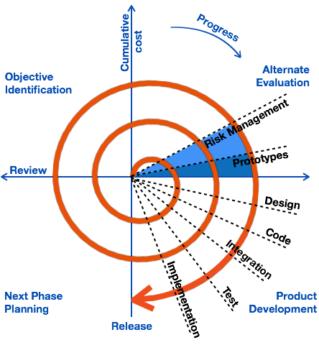
Rapid Application Develop
Spiral
Focused on Risk Management
Combines the idea of iterative development with the systematic, controlled aspects of the waterfall model.
It allows incremental releases of the product

Slide 29
Rapid Application Develop
Spiral
Advantages
Changing requirements can be accommodated.
Allows extensive use of prototypes.
Requirements can be captured more accurately.
Users see the system early.
Development can be divided into smaller parts and the risky parts can be developed earlier which helps in better risk management.
Disadvantages
Management is more complex.
End of the project may not be known early.
Not suitable for small or low risk projects and could be expensive for small projects.
Process is complex
Spiral may go on indefinitely.
Large number of intermediate stages requires excessive documentation.

Slide 30
More Reading
https://www.tutorialspoint.com/sdlc/index.htm

Slide 31
Object Oriented Analysis and Design
Use RAD‐based sequence of SDLC phases but attempt to balance the emphasis between process and data by focusing the analysis of problems on objects that contain both data and processes.

Slide 32
Object Oriented Analysis and Design
Use Case Driven – Focus on Uses of the system, versus desired functions of the system. Subtle, but different enough.
According to the creators of the Unified Modeling Language (UML), Grady Booch, Ivar Jacobson, and James Rumbaugh,5 any modern object‐oriented approach to developing information systems must be use‐case driven, architecture‐centric, and iterative and incremental.
Architecture Centric – The underlying software architecture of the evolving system specification drives the specification, construction, and documentation of the system
Functional
Structural (Static)
Behavioral (Dynamic)
Iterative and Incremental – specify, analyze, design, implement, repeat; in baby steps.

Slide 33
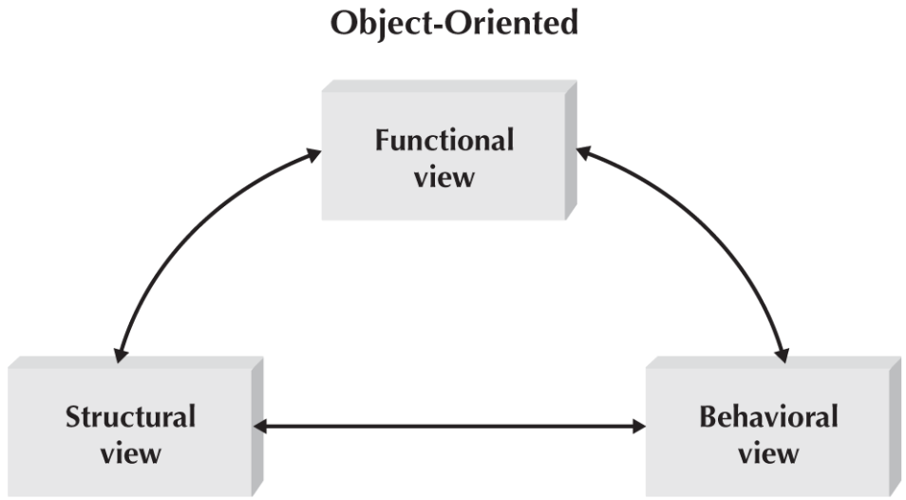
Object Oriented Analysis and Design
Functional View – Use Cases
Structural View – Architecture and Design Diagrams
Behavioral View - Activity and Sequence Diagrams

Slide 34
Agile Development
This is a process methodology, not a development methodology
Any of the above develop approaches can fit within the Agile paradigm.
OOAD just supports it best.
Agile is defined by the Agile Manifesto, and the 12 principles.
Individuals and interactions over processes and tools Working software over comprehensive documentation Customer collaboration over contract negotiation Responding to change over following a plan

Slide 35
Agile Development – 12 Principles
Software is delivered early and continuously through the development process, satisfying the customer.
Changing requirements are embraced regardless of when they occur in the development process.
Working software is delivered frequently to the customer.
Customers and developers work together to solve the business problem.
Motivated individuals create solutions; provide them the tools and environment they need, and trust them to deliver.
Face‐to‐face communication within the development team is the most efficient and effective method of gathering requirements.
The primary measure of progress is working, executing software.
Both customers and developers should work at a pace that is sustainable. That is, the level of work could be maintained indefinitely without any worker burnout.
Agility is heightened through attention to both technical excellence and good design.
Simplicity, the avoidance of unnecessary work, is essential.
Self‐organizing teams develop the best architectures, requirements, and designs.
Development teams regularly reflect on how to improve their development processes.

Slide 36
Agile Critics
Much of the actual information systems may be development offshore, outsourced, and/or subcontracted. Given agile development methodologies requiring co‐location of the team, this seems to be a very unrealistic assumption.
If agile development is not carefully managed, and by definition it is not, the development process can devolve into a prototyping approach that essentially becomes a “programmers gone wild” environment where programmers attempt to hack together solutions.
Based on the lack of actual documentation created during the development of the software, issues are raised regarding the auditability of the systems being created. Without sufficient documentation, neither the system nor the systems‐development process can be assured.
Can deliver large mission‐critical systems???

Slide 37
Extreme Programming
Based on communication, simplicity, feedback, and courage.
Whenever courage is a basis, you may be doomed to failure
Very small sets of functionality developed with little to no documentation, and no concrete vision of the final product.
May work for very small, non safety or mission critical pieces of software.

Slide 38
SCRUM
In rugby, a scrum is used to restart a game.
In a nutshell, the creators of the Scrum method believe that no matter how much you plan, as soon as the software begins to be developed, chaos breaks out and the plans go out the window.
The best you can do is to react to where the proverbial rugby ball squirts out. You then sprint with the ball until the next scrum.
In the case of the Scrum methodology, a sprint is defined as a time-boxed event, during which a small piece of the product is produced.
At the end of the sprint, a demonstratable product is delivered to the customer.
Much more later….

Slide 39
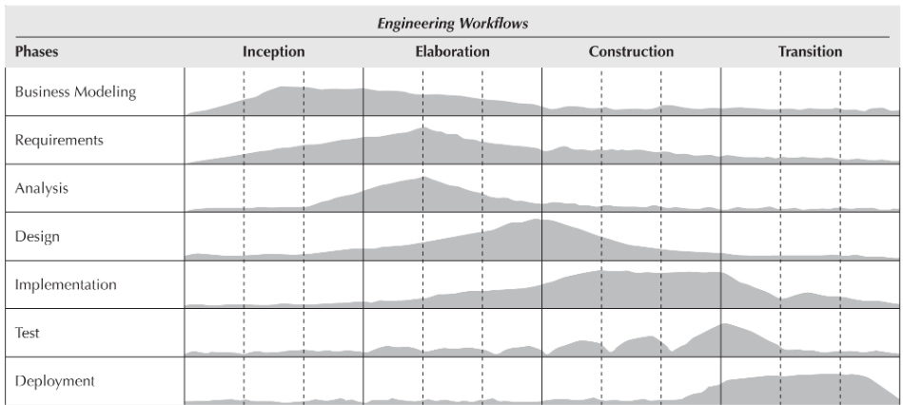
Unified Process

Slide 40
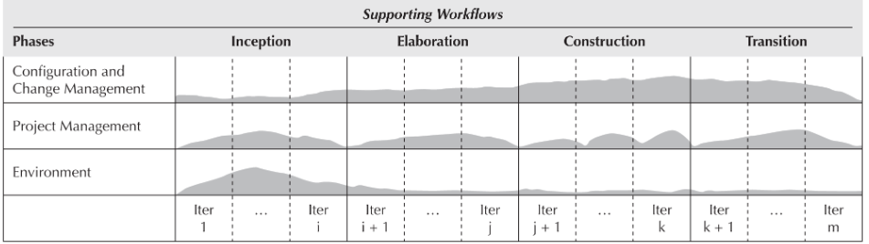
Unified Process

Slide 41
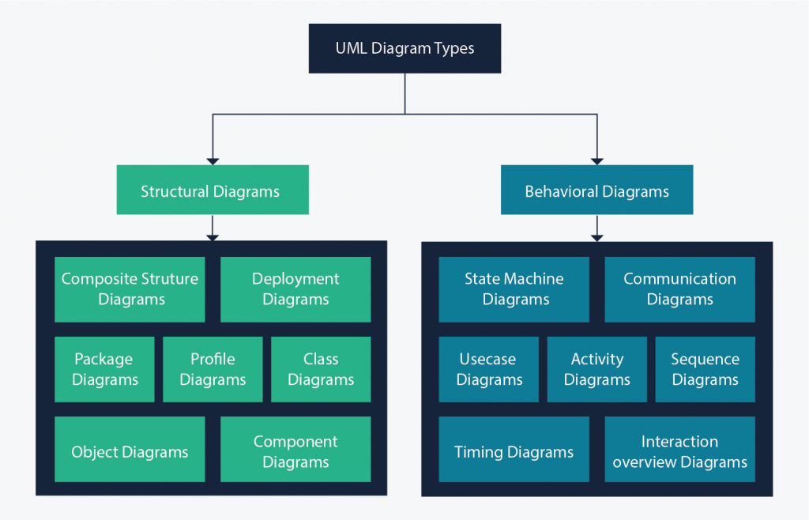
UML Diagrams

Slide 42
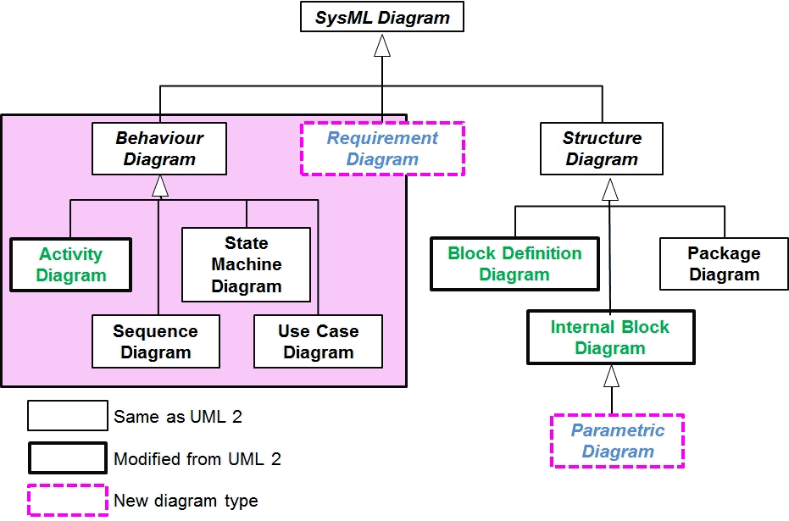
SysML Diagrams

Slide 43
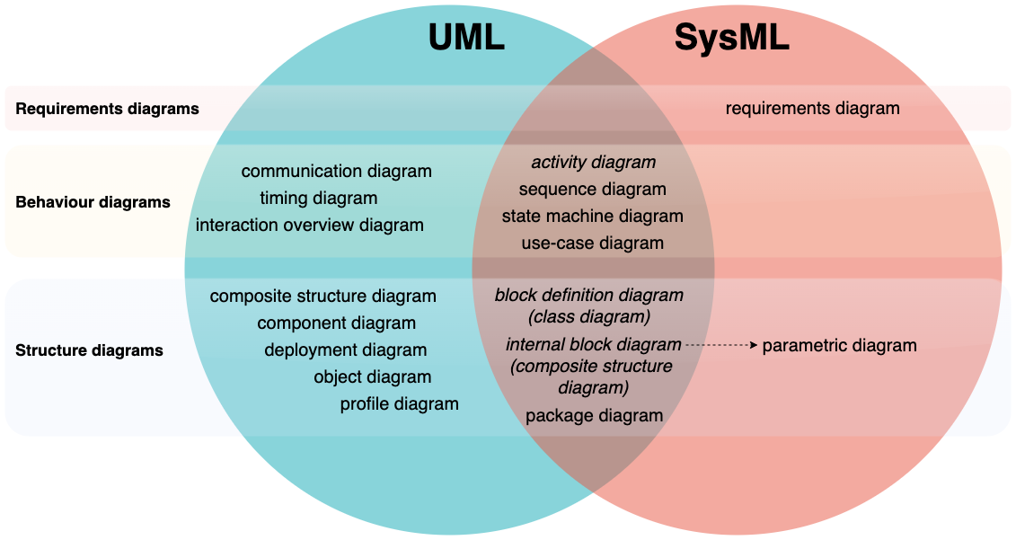
UML/SysML Diagram Relationships

