Slide 1
System Analysis and Design UML
Sixth Edition
Alan Dennis, Barbara Wixom, Roberta M. Roth
Chapter 2
Project Managment

Slide 2

Project Selection
https://www.youtube.com/watch?v=BKorP55Aqvg&pp=ygUOaSdtIGFuIGV4cG9lcnQ%3D

Slide 3
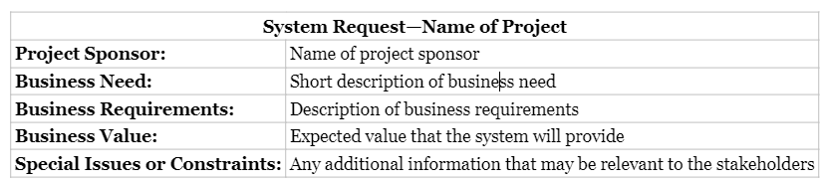
Project – System Request
Make this convincing.
First Impressions are Important
Convince the stakeholders that the world cannot make it without this project

Slide 4
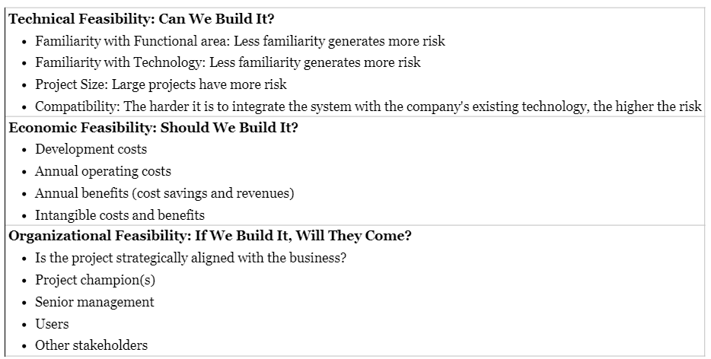
Feasibility

Slide 5
Economic Feasibility
Development Costs | Operational Costs
1. Identifing Costs and Benefits | List the tangible costs and benefits for the project. Include both one‐time and recurring costs.
2. Assigning Values to Costs and Benefits | Work with business users and IT professionals to create numbers for each of the costs and benefits. Even intangibles should be valued if at all possible.
3. Determining Cash Flow | Project what the costs and benefits will be over a period of time, usually three to five years. Apply a growth rate to the numbers, if necessary.
4. Determining Net Present Value (NPV) | Calculate what the value of future costs and benefits are if measured by today's standards. You will need to select a rate of growth to apply the NPV formula.
5. Determining Return on Investment (ROI) | Calculate how much money the organization will receive in return for the investment it will make using the ROI formula.
6. Determining the Break‐Even Point | Find the first year in which the system has greater benefits than costs. Apply the break‐even formula using figures from that year. This will help you understand how long it will take before the system creates real value for the organization.
7. Graphing the Break‐Even Point | Plot the yearly costs and benefits on a line graph. The point at which the lines cross is the break‐even point.

Slide 6
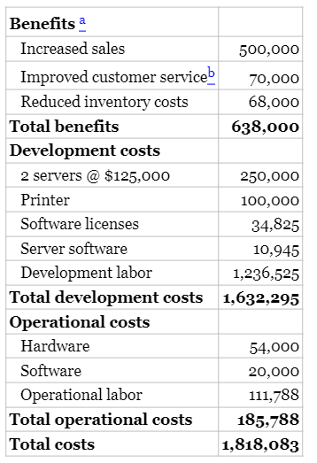
Economic Feasibility

Slide 7
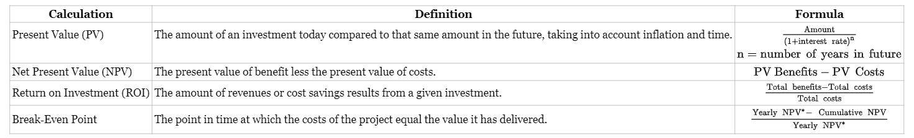
Economic Feasibility – Current and Future Calculations

Slide 8
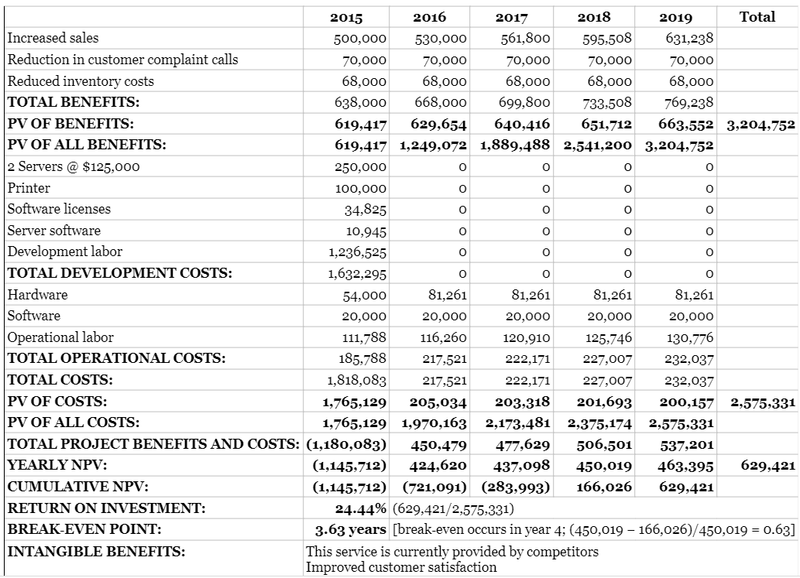
The Numbers

Slide 9
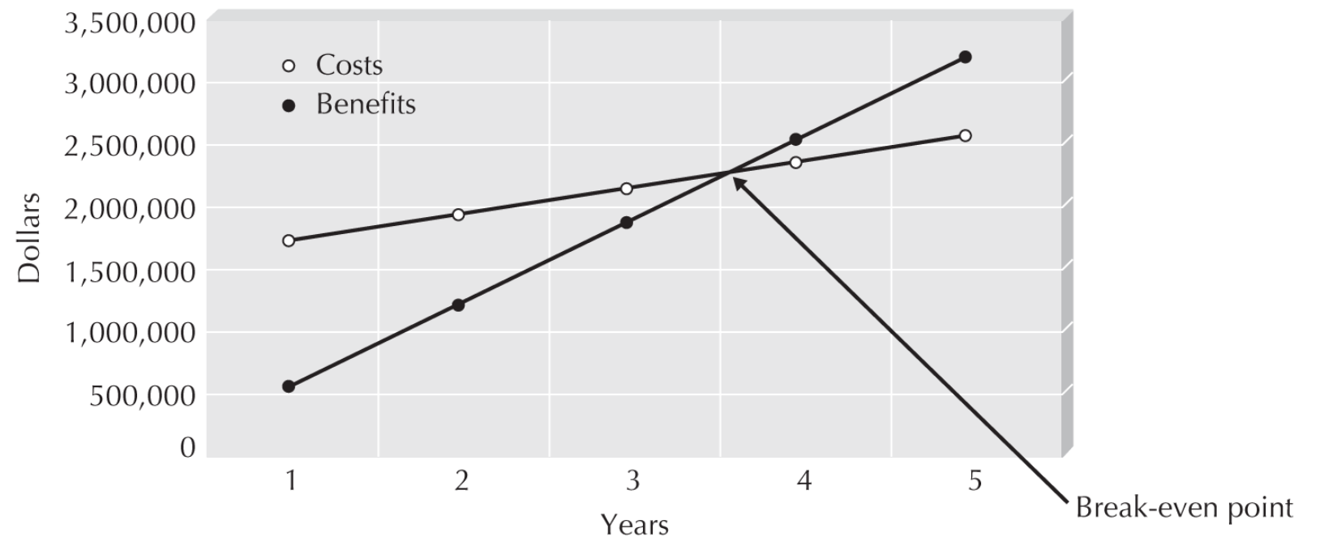
Break Even

Slide 10
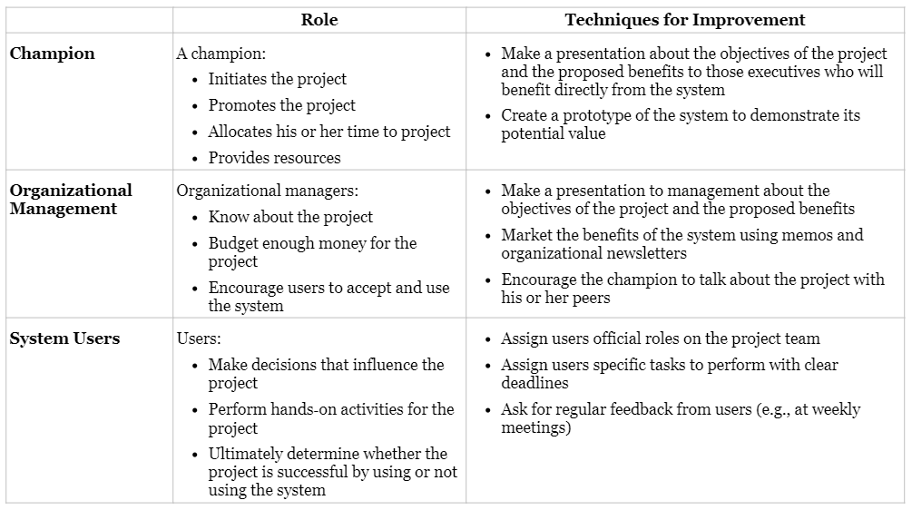
Making the Case
Initial concept approved
Data gathered
Time to pitch for final approval.

Slide 11
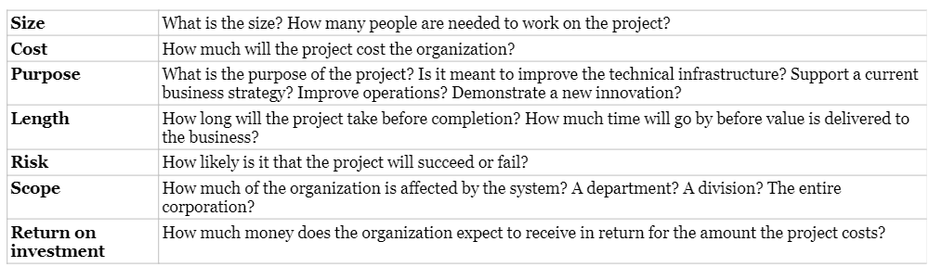
Project Selection Decision
Committee considers key metric to determine if project should finally be approved.
The following are the major things consider

Slide 12
Ethical Considerations
Many ways new IT systems can bring about ethics questions.
Workforce reduction during economic downturns
Deskilling with AI
Employee monitoring – just because we could, doesn’t mean we should.
Employee monitoring can result in many benefits, including catching employees not performing.
Excessive and unethical monitoring must be avoided. Can increase job stress, resulting in lower productivity
Technostress
Technology that provides for 24/7 access
Downtime is removed/reduced. Instead of stress 8 hours/day. It becomes 16-24 hours per day.
IT Health Affects
Increased eye strain, carpal tunnel, headaches, neck and back arthritis, etc

Slide 13
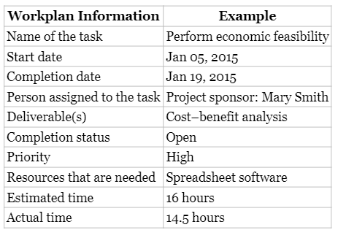
Work Breakdown Structure (WBS) Structured Development Approaches
Top down, hierarchical breakdown of work to be performed
In a structured development method, this would all be done and predicted soon after contract award.

Slide 14
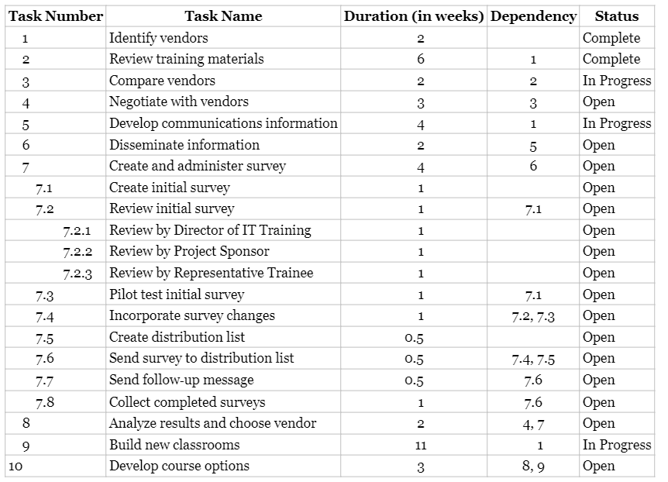
Task Tracking
Very detailed, specific, and rigid.

Slide 15
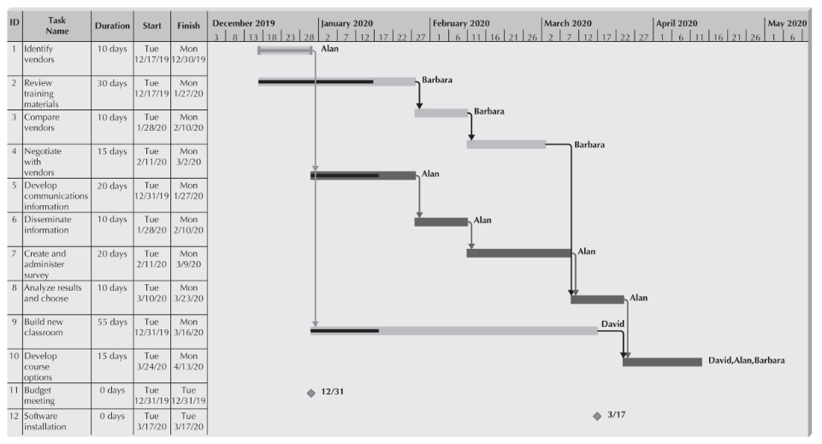
Gantt Chart
Tool used by program management, finance, and customers to keep track of progress in a structured development approach.
Very useful for determining critical path.

Slide 16
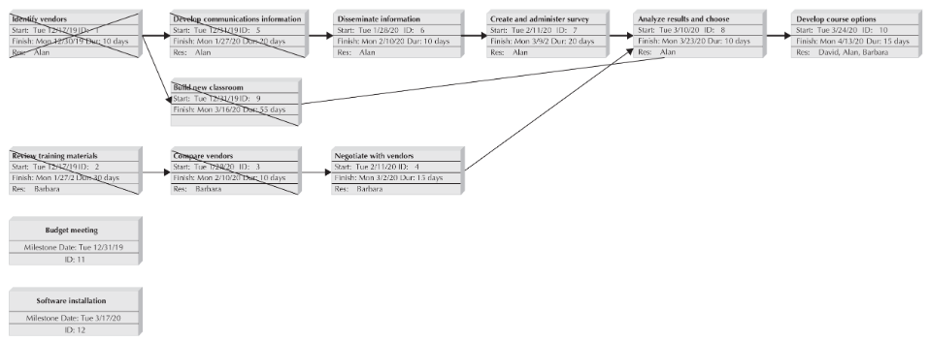
Network Diagram
Just another view Gantt information.

