Slide 1
System Analysis and Design UML
Sixth Edition
Alan Dennis, Barbara Wixom, Roberta M. Roth
Chapter 3
Requirements Determination

Slide 2
The Analysis Phase
Goal is to develop a clear understanding of the new system’s requirements
Understand the “As-Is” system
Identify Improvements
Develop the “To-Be” system concept
Use critical thinking skills to determine the true causes of problems
Apply knowledge of IS and business to outline ways to solve the problems in the new system
To move the users “from here to there,” an analyst needs strong critical thinking skills
Copyright ©2022 John Wiley & Sons, Inc.

Slide 3
The Analysis Phase Continued
It is unrealistic to expect the true requirements to be delivered during a few conversations with the business users
A number of techniques and tools can be used by the analyst to facilitate this process of discovering requirements
The final deliverable of the analysis phase is the system proposal
o This is a document compiling the detailed requirements definition statement, use cases, process models, and data model together with a revised feasibility analysis and work plan
At the conclusion of the analysis phase, the system proposal is presented to the approval committee, usually in the form of a system walk-through
Copyright ©2022 John Wiley & Sons, Inc.

Slide 4
The Analysis Phase Continued
Before moving into the design phase, the project’s business value should be reviewed to ensure it remains positive
The line between the analysis and design phases is very blurry
In many ways, determining requirements is the single-most critical aspect of the entire SDLC
During requirements determination, the to-be system concept is easy to change because little work has been done yet
As the system moves through the subsequent SDLC phases, it becomes harder and harder to return to requirements determination and make major changes because of all the rework that is involved
Copyright ©2022 John Wiley & Sons, Inc.

Slide 5
Requirements Determination
Requirements determination is performed to transform the system request’s high-level statement of business requirements into a more detailed, precise list of what the new system must do
This detailed list of requirements is supported, confirmed, and clarified by the other activities of the analysis phase
Copyright ©2022 John Wiley & Sons, Inc.

Slide 6
What is a Requirement?
A requirement is a statement of what the system must do or what characteristics it needs to have
Types of requirements:
What the business needs (business requirements)
What the users need to do (user requirements)
What the software should do (functional requirements)
Characteristics the system should have (nonfunctional requirements)
How the system should be built (system requirements)
Copyright ©2022 John Wiley & Sons, Inc.

Slide 7
Business Requirements
In the systems request, there are statements that describe the reasons for proposing the systems development project
These statements reflect the business requirements that this system will fulfill
When the systems development project is complete, success will be measured by evaluating whether the stated business requirements have been achieved
o Therefore, they provide the overall direction for the project
Copyright ©2022 John Wiley & Sons, Inc.

Slide 8
User Requirements
What the user needs to do to complete a needed job or task
Focus on user tasks that are integral to business operations
Understanding user tasks helps reveal ways that the new system can support those tasks
Copyright ©2022 John Wiley & Sons, Inc.

Slide 9
Functional Requirements
A process the system should perform as a part of supporting a user task, or
Information the system should provide as the user performs a task
Specify the support the system will provide to the user in fulfilling his/her work tasks
Copyright ©2022 John Wiley & Sons, Inc.

Slide 10
More on Functional Requirements
Functional Requirement | Description | Examples
Process-oriented | A process the system must perform; a process the system must do | The system must allow registered customers to review their own order history for the past 3 years. The system must check incoming customer orders for inventory availability. The system should allow students to view a course schedule while registering for classes.
Information-oriented | Information the system must contain | The system must retain customer order history for 3 years. The system must include real-time inventory levels at all warehouses. The system must include budgeted and actual sales and expense amounts for the current year and 3 previous years.
Copyright ©2021 John Wiley & Sons, Inc.
3-11

Slide 11
Nonfunctional Requirements
Nonfunctional requirements are “the quality attributes, design, and implementation constraints, and external interfaces which a product must have”
This requirement category includes important behavioral properties that the system must have
Behavioral properties the system must have
Operational – physical and technical operating environment
Performance – speed, capacity, and reliability needs
Security – access restrictions, needed safeguards
Cultural and political – issues that will affect the final system
Nonfunctional requirements are discussed in Chapter 7
Copyright ©2022 John Wiley & Sons, Inc.
3-12

Slide 12
More on Nonfunctional Requirements (1 of 2)
Nonfunctional Requirement | Description | Examples
Operational | The physical and technical environments in which the system will operate | The system will run on Andriod mobile devices. The system should be able to integrate with the existing inventory system. The system should be compatible with any Web browser.
Performance | The speed, capacity, and reliability of the system | Any interaction between the user and the system should not exceed 2 seconds. The system downloads new status parameters within 5 minutes of a change. The system should be available for use 24 hours per day, 365 days per year. The system supports 300 simultaneous users from 9–11 a.m.; 150 simultaneous users at all other times.
Copyright ©2021 John Wiley & Sons, Inc.

Slide 13
More on Nonfunctional Requirements (2 of 2)
Nonfunctional Requirement | Description | Examples
Security | Who has authorized access to the system under what circumstances | Only direct managers can see staff personnel records. Technicians can see only their own work assignments. The system includes all available safeguards from viruses, worms, Trojan horses, etc.
Cultural and Political | Cultural and political factors and legal requirements that affect the system | The system should be able to distinguish between US currency and currency from other nations. Company policy is to buy computers only from Dell. Country managers are permitted to authorize custom user interfaces within their units. Personal information is protected in compliance with the Data Protection Act.
Copyright ©2021 John Wiley & Sons, Inc.

Slide 14
The Process of Determining Requirements
Both business and IT perspectives are needed to determine requirements during the analysis phase
Systems analysts may not understand the true business needs of the users
The business users may not be aware of promising new technologies
The analyst must also consider how best to elicit the requirements from the stakeholders
There are a variety of elicitation techniques that can be used to acquire information
The evolution of the requirements definition must be carefully managed
Keeping the requirements list tight and focused is a key to project success
3-14

Slide 15
The Requirements Definition Statement
The requirements definition statement is a straightforward text report that simply lists the functional and nonfunctional requirements in an outline format
o Usually just called the requirements definition
Requirements are typically identified by numbering
Sometimes, requirements are prioritized on the requirements definition statement
The most obvious purpose of the requirements definition is to provide a clear statement of what the new system should do
A critically important purpose of the requirements definition is to define the scope of the system
3-15

Slide 16
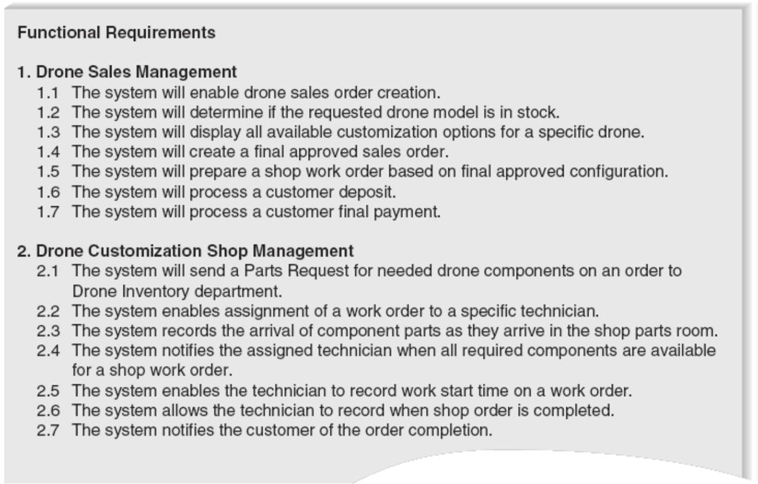
Sample Functional Requirements
3-16

Slide 17
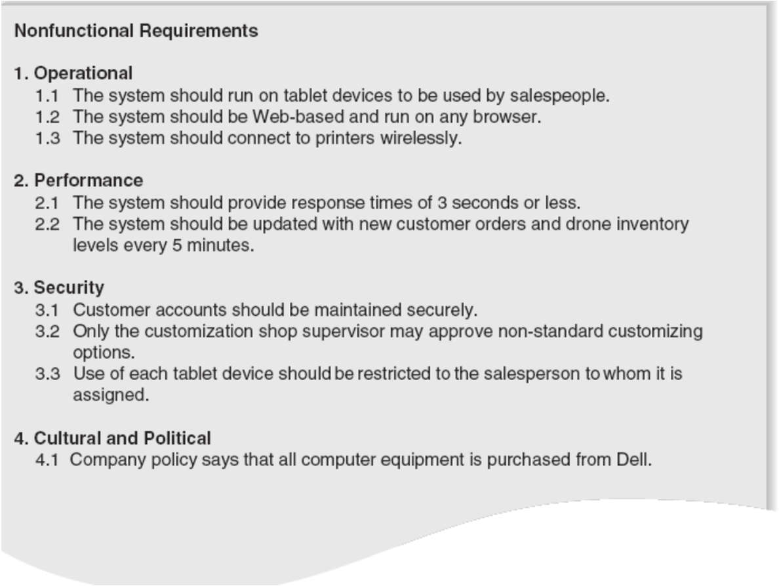
Sample Nonfunctional Requirements
3-17

Slide 18
Requirements Elicitation Techniques
An analyst knows that there is a problem to be solved and therefore must look for clues that uncover the solution
Unfortunately, the clues are not always obvious, so the analyst needs to notice details, talk with witnesses, and follow leads
The best analysts will thoroughly search for requirements using a variety of techniques and make sure that the current business processes and the needs for the new system are well understood before moving into design
3-18

Slide 19
Requirements Elicitation in Practice
Use every interaction with managers and users to garner interest, support, and enthusiasm for project
Choose participants carefully
o Stakeholders are the people who can affect the system or who will be affected by the system
Make respectful use of people’s time
3-19

Slide 20
Most Common Requirements Elicitation Techniques
Interviews
Joint Application Development (JAD) sessions
Questionnaires
Document analysis
Observation
3-20

Slide 21
Interviews
Most important and most used fact-finding technique
The systems analysts collects information from individuals face to face
Who should be interviewed?
Managers in early project stages to get broad understanding
Staff can provide details and specifics later.
Political issues are important – may be necessary to interview influential people, even if they are not too knowledgeable
Interview Structure
Top-down (broad to specific; most common)
Bottom-up (specific to broad; useful for collecting details)
3-21

Slide 22
Three Types of Questions
Type of Question | Explanation | Examples
Closed-Ended Questions | Require a specific answer | How many telephone orders are received per day? How do customers place orders? What information is missing from the monthly sales report?
Open-Ended Questions | Seek a more wide- ranging response from the interviewee | What do you think about the way invoices are currently processed? What are some of the problems you face on a daily basis? What are some of the improvements you would like to see in the way invoices are processed?
Probing Questions | Follow up on what has just been discussed so that the interviewer can learn more | Why? Can you give me an example? Can you explain that in a bit more detail?
3-22

Slide 23
More on Interviewing
You should not ask questions about information that is readily available from other sources
Your interview questions should anticipate the type of information the interviewee is likely to know
No type of question is better than another
o Usually a combination of questions is used during an interview.
3-23

Slide 24
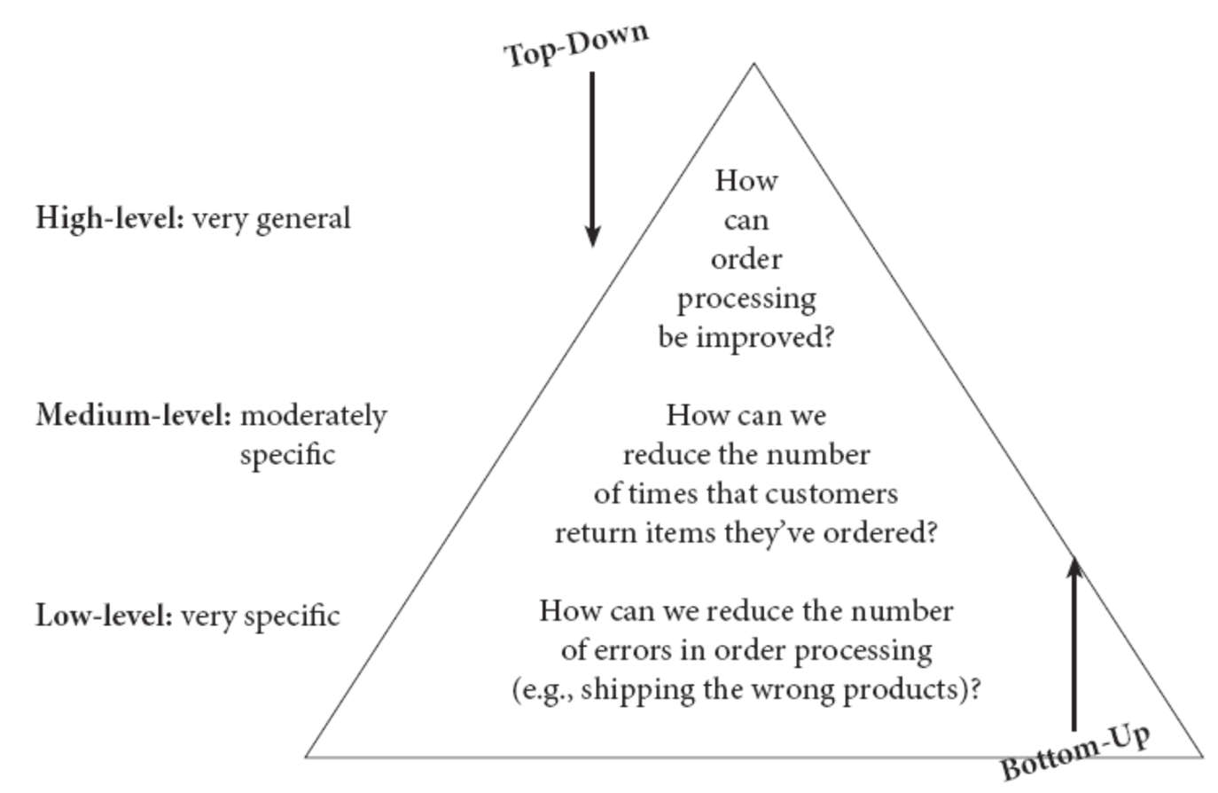
Top-Down and Bottom-Up Questioning Strategies
3-24

Slide 25
Interview as a Requirements Elicitation Technique
Strengths
Interviewee can respond freely and openly to questions
Interviewee can be asked for more feedback
Questions can be adapted or reworded for each individual
Interviewee’s nonverbal communication can be observed
Weaknesses
Very time-consuming, and therefore costly, fact-finding approach
Success is highly dependent on the systems analyst's human relations skills
May be impractical due to the location of interviewees
3-25

Slide 26
Preparing for the Interview
You should have an interview plan that lists the topics/issues that you will ask in the appropriate order
Confirm the areas in which the interviewee has knowledge so you do not ask questions that they cannot answer
Structured interviews with closed-ended questions take more time to prepare than unstructured interviews
When you schedule the interview, inform the interviewee of the reason for the interview and the areas you will be discussing
3-26

Slide 27
Conducting the Interview
The first goal is to build rapport with the interviewee
It is critical to carefully record all the information that the interviewee provides
Take lots of notes
If you do not understand something, be sure to ask
Do not be afraid to ask “dumb questions”
Separate facts from opinion
As the interview draws to a close, give the interviewee time to ask questions or provide information that they thinks is important
Briefly explain what will happen next
3-27

Slide 28
Post- interview Follow-Up
After the interview is over, the analyst needs to prepare an interview report
The interview report describes the information from the interview
It contains interview notes
Often, the interview report is sent to the interviewee with a request to read it and inform the analyst of clarifications or updates
3-28

Slide 29
Joint Application Development (JAD)
Joint Application Development (JAD) is an information gathering technique that allows the project team, users, and management to work together to identify requirements for the system
Its goal is to produce complete requirements definition document
Directly involves project sponsor, key managers, and key users with systems analysts
Requires a trained facilitator
Requires a comfortable facility for long-term, intensive group work; preferably off-site
Expensive but valuable
3-29

Slide 30
Electronic JAD or e-JAD
Any group activity may experience problems with group dynamics
e-JAD helps group overcome group dynamic issues – dominance, status differences, fear of reprisal
e-JAD provides ways for members to contribute, comment on, and rate ideas anonymously
Requires a trained e-JAD facilitator and groupware software
3-30

Slide 31
More on JAD
Participants are selected on the basis of information they can contribute, to provide a broad mix of organizational levels, and to build political support for the new system
Should be released from regular duties to attend
JAD sessions can run from as little as a half day to several weeks
JAD sessions usually are designed and structured along the same principles as interviews
Closed-ended questions are seldom used
It is important to prepare the analysts and participants for the JAD session
3-31

Slide 32
Conducting the JAD Session
Most JAD sessions try to follow a formal agenda
Most also have formal ground rules that define appropriate behavior
The JAD facilitator performs three key functions
They ensure that the group sticks to the agenda
They help the group understand the technical terms and jargon that surround the system development process
They record the group’s input on a public display area
The facilitator should try to help the group resolve issues
It is common for the JAD participants to make use of several tools during the JAD session to fully define the new system
3-32

Slide 33
Post-JAD Follow-Up
A JAD post-session report is prepared and circulated among session attendees
The post- session report is essentially the same as the interview report
Usually takes a week or two
3-33

Slide 34
Questionnaires
A questionnaire is a set of written questions for obtaining information from individuals
Mass produced and distributed
Respondents complete the questionnaire on their own time
Facts are collected from a large number of people while maintaining uniform responses
When dealing with a large audience, no other fact-finding technique can tabulate the same facts as efficiently
3-34

Slide 35
Questionnaires Continued
The first step is to select the individuals to whom the questionnaire will be sent
Developing good questions is critical for questionnaires because the information on a questionnaire cannot be clarified
You must have a clear understanding of how the information collected from the questionnaire will be analyzed and used
Questions should be relatively consistent in style so that the respondent does not have to read instructions for each question
The key issue in administering the questionnaire is getting participants to complete the questionnaire and send it back
3-35

Slide 36
Good Questionnaire Design
Begin with nonthreatening and interesting questions
Group items into logically coherent sections
Do not put important items at the very end of the questionnaire
Do not crowd a page with too many items
Avoid abbreviations
Avoid biased or suggestive items or terms
Number questions to avoid confusion
Pretest the questionnaire to identify confusing questions
Provide anonymity to respondents
3-36

Slide 37
Questionnaires as a Requirements Elicitation Technique
Strengths
Most can be answered quickly (if properly designed)
Relatively inexpensive
Allow individuals to maintain anonymity
Can be tabulated and analyzed quickly (if properly designed)
Weaknesses
Response is often low. How to motivate participation?
Incomplete questionnaires returned – are these worthless?
Tend to be inflexible
Body language cannot be observed
Cannot clarify a vague or incomplete answer to any question
Difficult to prepare a successful questionnaire
Copyright ©2021 John Wiley & Sons, Inc.

Slide 38
Questionnaires – Practical Tips
Determine what facts and opinions must be collected and from whom you should get them
Based on the needed facts and opinions, determine whether free- or fixed- format questions will produce the best answers. A mix of types may be ideal.
Write the questions
Pretest the questions on a small sample of “typical” respondents – not just other systems analysts
Use random sampling if necessary
Copyright ©2021 John Wiley & Sons, Inc.

Slide 39
Document Analysis
Collect facts from existing documentation
Organizational chart
History that led to the project
Documentation from previous system studies and designs performed by systems analysts and consultants
Analyze facts to determine currency
Even outdated documentation may be useful
Must recognize what is current and what is outdated
Analyze to understand the documentation
Take notes, draw pictures, and use systems analysis and design tools to model what you are learning or proposing for the system
Use appropriate sampling techniques
3-39

Slide 40
Document Analysis – Practical Tips
Good place to start
History
Vocabulary
Key personnel
Learn as much as you can from existing documentation
People get annoyed being asked about things you could have learned from existing documentation
3-40

Slide 41
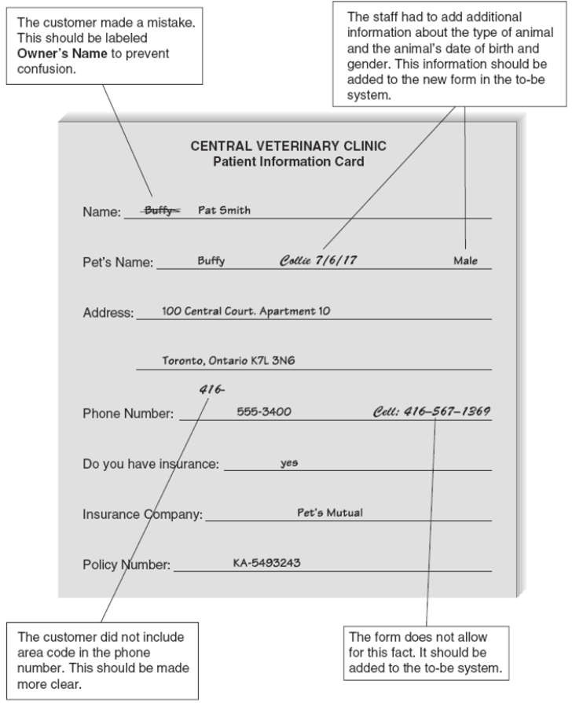
Sample Document Analysis
3-41

Slide 42
Observation
Observation , the act of watching processes being performed, is a powerful tool to gain insight into the as- is system
Use when the validity of data collected using other methods is in question
Use when the complexity of certain aspects of the system prevents end- users from providing a clear explanation
3-42

Slide 43
Observation as a Requirements Elicitation Technique
Strengths
Data gathered may be highly reliable
Can see exactly what is being done
Relatively inexpensive (compared with other fact-finding techniques)
Can do work measurements (if needed)
Weaknesses
People may perform differently when being observed
Work may vary in difficulty and volume
Some activities may take place at odd times
The tasks being observed are subject to various types of interruptions
Copyright ©2021 John Wiley & Sons, Inc.

Slide 44
Observation– Practical Tips
Properly plan for observation
Obtain approval and inform people of your purpose
Conduct observations first when the work load is normal, followed by observations during peak periods
Obtain samples of documents or forms that will be used by those being observed
Apply the sampling techniques discussed earlier for observation
Review observation notes with appropriate individuals
Copyright ©2021 John Wiley & Sons, Inc.

Slide 45
Comparison of Requirements Elicitation Techniques
 | Interviews | Joint Application Design | Questionnaires | Document Analysis | Observation
Type of information | As-is, improvements, to-be | As-is, improvements, to-be | As-is, improvements | As-is | As-is
Depth of information | High | High | Medium | Low | Low
Breadth of information | Low | Medium | High | High | Low
Integration of information | Low | High | Low | Low | Low
User involvement | Medium | High | Low | Low | Low
Cost | Medium | Low–Medium | Low | Low | Low–Medium
Copyright ©2021 John Wiley & Sons, Inc.

Slide 46
Requirements Analysis Strategies
Problem analysis
Root cause analysis
Duration analysis
Activity-based costing
Informal benchmarking
Outcome analysis
Technology analysis
Activity elimination
Copyright ©2022 John Wiley & Sons, Inc.

Slide 47
To Identify Small Improvements
Problem analysis
Ask users to identify problems and solutions
Improvements tend to be small and incremental
Rarely finds improvements with significant business value
Root cause analysis
Challenge assumptions about why problem exists
Trace symptoms to their causes to discover the “real” problem
Copyright ©2022 John Wiley & Sons, Inc.

Slide 48
To Identify Moderate Improvements
Goal is to improve efficiency and effectiveness
Expect moderate changes to existing systems
Expect moderate impact and value to organization
Types of activities:
Duration analysis: requires a detailed examination of the amount of time it takes to perform each process in the current as-is system
Activity-based costing: examines the cost of each major process or step in a business process rather than the time taken
Informal benchmarking: refers to studying how other organizations perform a business process to learn how your organization can do something better
Copyright ©2022 John Wiley & Sons, Inc.

Slide 49
To Identify Major Improvements
Goal is radical redesign of business processes
Expect significant impact and value to organization
Existing system is “obliterated:
Activities focus on envisioning the business in new ways:
Outcome analysis
Technology analysis
Activity elimination
Copyright ©2022 John Wiley & Sons, Inc.

Slide 50
Outcome Analysis
Consider desirable outcomes from customers’ perspective
Consider what the organization could enable the customer to do
Brainstorm on desirable customer outcomes enabled by information systems and new technologies
Copyright ©2022 John Wiley & Sons, Inc.

Slide 51
Technology Analysis
Analysts list important and interesting technologies
Managers list important and interesting technologies
The group reviews each list and identifies how each technology might apply to and benefit the business
Brainstorming with special emphasis on technology use
Copyright ©2022 John Wiley & Sons, Inc.

Slide 52
Activity Elimination
Identify what would happen if each organizational activity were eliminated
Use “force-fit” to test all possibilities
Insist that all activities are potentially eliminated, even if it seems preposterous.
Brainstorming technique that helps to overcome “but we’ve always done it that way” limitations on thinking
Copyright ©2022 John Wiley & Sons, Inc.

Slide 53
Chapter Review (1 or 3)
Explain the purpose of the analysis phase. Discuss how its purpose differs from the design phase
Discuss the contents and purpose of the system proposal
Explain the concept of a requirement in an IS development project
Discuss the difference between a functional requirement and a nonfunctional requirement. Explain how both contribute to our understanding of the new information system
Discuss how to use interviews when eliciting requirements
Discuss how to use JAD when eliciting requirements
Copyright ©2022 John Wiley & Sons, Inc.

Slide 54
Chapter Review (2 or 3)
Discuss how to use questionnaires when eliciting requirements
Discuss how to use document analysis when eliciting requirements
Discuss how to use observation when eliciting requirements
Describe the problem analysis strategy and how it contributes to the analysis phase
Describe the root cause analysis strategy and how it contributes to the analysis phase
Describe the duration analysis strategy and how it contributes to the analysis phase
Describe the activity-based costing strategy and how it contributes to the analysis phase
Copyright ©2022 John Wiley & Sons, Inc.

Slide 55
Chapter Review (3 or 3)
Describe the informal benchmarking strategy and how it contributes to the analysis phase
Describe the outcome analysis strategy and how it contributes to the analysis phase
Describe the technology analysis strategy and how it contributes to the analysis phase
Describe the activity elimination strategy and how it contributes to the analysis phase
Copyright ©2022 John Wiley & Sons, Inc.

Slide 56
Key Terms (1 of 2)
Activity-based costing
Activity elimination
Analysis
As-is system
Benchmarking
Bottom-up interview
Business requirements
Business value
Closed-ended questions
Critical thinking skills
Document analysis
Duration analysis
Electronic JAD, or
e-JAD
Facilitator
Formal system
Functional requirements
Ground rule
Informal benchmarking
Informal system
Interpersonal skills
Interview
Interview notes
Interview report
Interview schedule
Joint Application
Development (JAD)
Nonfunctional requirements
Observation
Open-ended questions
Outcome analysis
Copyright ©2022 John Wiley & Sons, Inc.

Slide 57
Key Terms (2 of 2)
Parallelization
Post-session report
Probing questions
Problem analysis
Process integration
Project cost
Questionnaire
Requirement
Requirements definition
Requirements determination
Root cause
Root cause analysis
Sample
Scribe
Stakeholder
Structured interview
Symptom
System proposal
System requirements
Technology analysis
To-be system
Top-down interview
Unstructured interview
User requirements
Walk-through
Copyright ©2022 John Wiley & Sons, Inc.

