Slide 1
System Analysis and Design
Eighth Edition
Alan Dennis, Barbara Wixom, Roberta M. Roth
Chapter 1
The Systems Analyst and Information Systems Development

Slide 2
Objectives
Explain the role played in IS development by the systems analyst.
Describe the fundamental systems development life cycle and its four phases.
Explain how organizations identify IS development projects.
Explain the importance of linking the IS to business needs.
Be able to create a system request.
Describe technical, economic, and organizational feasibility assessment.
Be able to perform a feasibility analysis.

Slide 3
Introduction
The systems development life cycle (SDLC) is the process of determining how an information system (IS) can support business needs, designing the system, building it, and delivering it to users
The systems analyst plays a key role in the SDLC, analyzing the business situation, identifying opportunities for improvements, and designing an IS to implement the improvements
The primary goal of the system analyst is to create value for the organization, which for most companies means increasing profits
Systems analysts do things and challenge the current way that an organization works.

Slide 4
Introduction Continued
Large systems development projects are particularly susceptible to failure
An analysis of very large development projects conducted by the Standish Group found that for projects that exceed $100 million in labor costs, only 2% are successful
Several major factors were delays in decision making and a high workforce turnover during the project

Slide 5
The Systems Analyst
The systems analyst works closely with all project team members so that the team develops the right system in an effective way
Systems analysts must understand how to apply technology to solve business problems
Systems analysts serve as change agents who identify the organizational improvements needed, design systems to implement those changes, and train and motivate others to use the systems

Slide 6
Systems Analyst Skills
Analysts must have the technical skills to understand the organization’s existing technical environment, the new system’s technology foundation, and the way in which both can be fit into an integrated technical solution
Business skills are required to understand how IT can be applied to business processes and to ensure that IT delivers real business value
Analysts are continuous problem solvers at both the project and the organizational level, and they put their analytical skills to the test regularly

Slide 7
Systems Analyst Skills Continued
Analysts need strong interpersonal skills to communicate effectively, one-on-one with users and business managers, with programmers and other technical specialists, and with people from outsourcing firms and vendor organizations
Analysts need to manage people with whom they work, and they must manage the pressure and risks associated with unclear situations
Analysts must deal fairly, honestly, and ethically with other project team members, managers, and system users

Slide 8
Systems Analyst Roles
The systems analyst role focuses on the IS issues surrounding the system
The business analyst role focuses on the business issues surrounding the system
The requirements analyst role focuses on eliciting the requirements from the stakeholders associated with the new system
The infrastructure analyst role focuses on technical issues surrounding the ways the system will interact with the organization’s technical infrastructure

Slide 9
Career Paths for System Developers

Slide 10
Systems Analyst Roles Continued
The software architect takes a holistic view of the organization’s entire IT environment and guides application design decisions within that context
The change management analyst role focuses on the people and management issues surrounding the system installation
The project manager role ensures that the project is completed on time and within budget and that the system delivers the expected value to the organization

Slide 11
The Systems Development Life Cycle

Slide 12
Planning Phase
Project initiation
Prepare system request
Perform preliminary feasibility analysis
Set up the project
Project plan, including work plan and staffing plan

Slide 13
Analysis Phase
Determine analysis strategy
Study existing system and its problems
Collect and analyze requirements
Develop new system concept
Describe new system with analysis models
Prepare and present system proposal
Summarize results of the Analysis Phase
Go/No Go decision made by sponsor and steering committee

Slide 14
Design Phase
Determine design strategy
Build / buy / outsource
Design system components
Architecture, interface, database, programs
Assemble design elements into system specification
Present to steering committee
Go /no go decision before entering final phase

Slide 15
Implementation Phase
System construction
Programming and testing
System installation
Training
Conversion to new system
On-going system support

Slide 16
Project Identification and Initiation
Fulfill a business need
Enable a business initiative or strategy
Support a merger/acquisition
Fix a “point of pain”
Utilize a new technology
Outgrowth of business process management (BPM)

Slide 17
What is B P M?
Business process management: A methodology used by organizations to continuously improve end-to-end business processes
Internal and cross-organizational processes
Benefits include:
Enhanced process agility
Process alignment with industry “best practices”
Increased process efficiencies
Four-step continuous cycle:
Define and map the steps in a business process
Create ways to improve on steps in the process that add value
Find ways to eliminate or consolidate steps in the process that do not add value
Create or adjust electronic workflows to match the improved process maps

Slide 18
BPM Identifies Business Needs
Business process automation
“Create or adjust electronic workflows to match the improved process maps”
Business process improvement
Study the business processes
Create new, redesigned processes to improve the process workflows, and/or
Utilize new technologies enabling new process structures
Business process reengineering
Total overhaul of work processes

Slide 19
Project Sponsor
Driving force behind project
Specifies overall business requirements
Determines business value
Formally requests a project via the system request

Slide 20
Business Value
The project sponsor has the insights needed to determine the business value that will be gained from the system, in both tangible and intangible ways
Tangible value can be quantified and measured easily
Intangible value results from an intuitive belief that the system provides important, but hard-to-measure, benefits to the organization

Slide 21
System Request
Describes business reasons for project
Defines system’s expected value
Force the sponsor to formalize his/her ideas
Provide a framework for collecting initial project information
Standardize information to be used by steering (approval) committee
Lists project’s key elements

Slide 22
Elements of the Systems Request
Element | Description | Examples
Project Sponsor | The person who initiates the project and who serves as the primary point of contact for the project on the business side | Several members of the finance department Vice president of marketing C I O C E O
Business Need | The business-related reason for initiating the system | Reach a new market segment Offer a capability to keep up with competitors Improve access to information Decrease product defects Streamline supply acquisition processes
Business Requirements | The new or enhanced business capabilities that the system will provide | Provide onIine access to information Capture customer demographic information Include product search capabilities Produce performance reports Enhance online user support

Slide 23
Elements of the Systems Request Continued
Element | Description | Examples
Business Value | The benefits that the system will create for the organization | 3% increase in sales 1% increase in market share Reduction in headcount by 5 FTEs $200,000 cost savings from decreased supply costs $150,000 savings from removal of outdated technology
Special Issues or Constraints | Issues that pertain to the approval committee’s decision | Government-mandated deadline for May 30 System needed in time for the Christmas holiday season Top-level security clearance needed by project team to work with data

Slide 24
Systems Request for DrōnTeq Client Services System (1 of 3)
System Request—Client Services Project
Project Sponsor: Carmella Herrera, General Manager, Client Services Business Unit
Business Need: This project has been initiated to create the capability of clients requesting drone flight service and data analysis through the company website. The capability is an essential element in the business model of the newly formed Client Services business unit.

Slide 25
Systems Request for DrōnTeq Client Services System (2 of 3)
Business Requirements: Using this system from our company website, clients will be able to request specific drone flight services and data analysis. A request will be offered to any contracted DrōnTeq drone pilots in the vicinity, who can submit bids during the bidding window. Once the bidding window closes, the pilot with the “winning“ bid will be assigned the request.
Business Value: The Client Services business unit has been formed to enable clients who do not have a need for actual drone ownership to receive drone flight service and data analysis promptly and cost effectively. As a new business unit, we must estimate additional revenue from two streams: additional drone pilots who contract with DrōnTeq and lease a drone; and clients who contract for specific drone flight service and data analysis.

Slide 26
Systems Request for DrōnTeq Client Services System (3 of 3)
Conservative estimates of tangible value to the business unit include
$357,500 in revenue from new pilot contracts and drone leases
$565,000 in revenue from drone flight service and data analysis
Special Issues or Constraints: The capabilities described in the Business Requirements are essential to the business model for the Client Services Business Unit. This project is necessary for the new business unit’s operations.

Slide 27
Estimating Business Value for DrōnTeq (1 of 2)
Identify sources such as:
Increased sales
Decreased costs
Reduced headcount
Lower turnover
Assign values as initial estimates

Slide 28
Estimating Business Value (2 of 2)
 | Revenue Projections of Pilot Contracts and Drone Leases | Revenue Projections of Client Requests for Drone Flight Service and Data Analysis
High-level estimate (prob. = 25%) | $500,000 | $700,000
Medium-level estimate (prob. = 60%) | $350,000 | $550,000
Low-level estimate (prob. = 15%) | $150,000 | $400,000
Weighted average expected revenue | $357,500 | $565,000

Slide 29
Feasibility Analysis
Feasibility analysis guides the organization in determining whether to proceed with the project
Also identifies the important risks associated with the project that must be managed if the project is approved
Each organization has its own process and format for the feasibility analysis
Most include techniques to assess three areas: technical feasibility, economic feasibility, and organizational feasibility

Slide 30
Technical Feasibility: Can We Build It?
Familiarity with application: Less familiarity generates more risk
Familiarity with technology: Less familiarity generates more risk
Project size: Large projects have more risk
Compatibility: The harder it is to integrate the system with the company’s existing technology, the higher the risk will be

Slide 31
Economic Feasibility: Should We Build It?
Development costs
Annual operating costs
Annual benefits (cost savings and/or increased revenues)
Intangible benefits and costs

Slide 32
Organizational Feasibility: If We Build It, Will They Come?
Is the project strategically aligned with the business?
Project champion
Senior management
Users
Other stakeholders

Slide 33
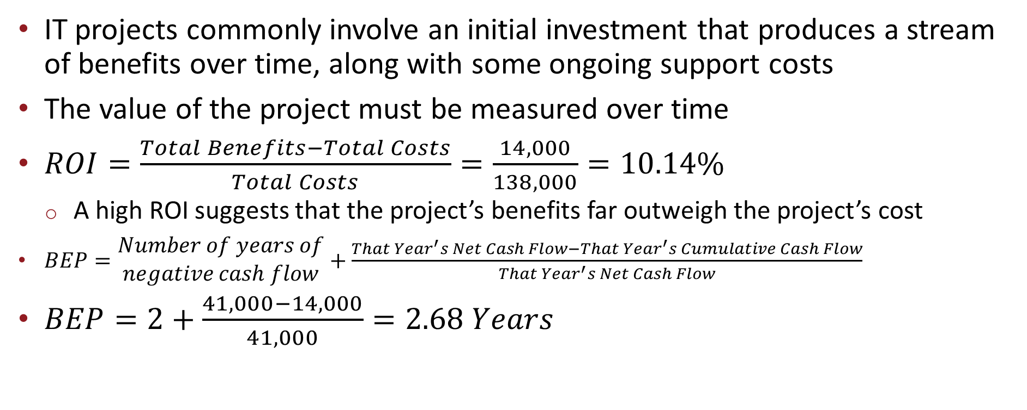
Cash Flow Analysis and Measures
IT projects commonly involve an initial investment that produces a stream of benefits over time, along with some ongoing support costs
The value of the project must be measured over time
$ROI=\frac{Total Benefits−Total Costs}{Total Costs}=\frac{14,000}{138,000}=10.14\%$
A high ROI suggests that the project’s benefits far outweigh the project’s cost
$BEP=\begin{matrix}Number of years of \\ negative cash flow\end{matrix}+\frac{That Year^{′}s Net Cash Flow−That Year^{′}s Cumulative Cash Flow}{That Year^{′}s Net Cash Flow}$
$BEP=2+\frac{41,000−14,000}{41,000}=2.68 Years$

Slide 34
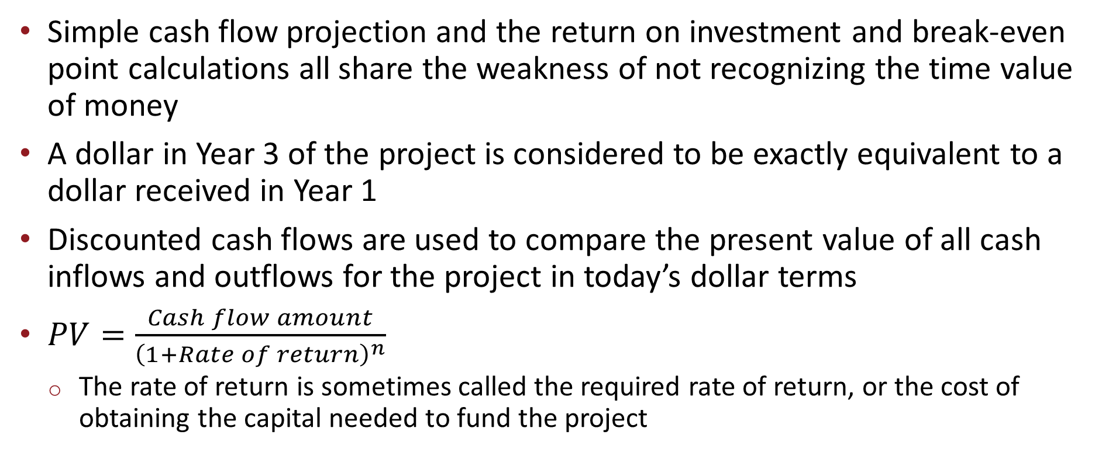
Discounted Cash Flow Technique
Simple cash flow projection and the return on investment and break-even point calculations all share the weakness of not recognizing the time value of money
A dollar in Year 3 of the project is considered to be exactly equivalent to a dollar received in Year 1
Discounted cash flows are used to compare the present value of all cash inflows and outflows for the project in today’s dollar terms
$PV=\frac{Cash flow amount}{{\left(1+Rate of return\right)}^{n}}$
The rate of return is sometimes called the required rate of return, or the cost of obtaining the capital needed to fund the project

Slide 35
Discounted Cash Flow Projection

Slide 36
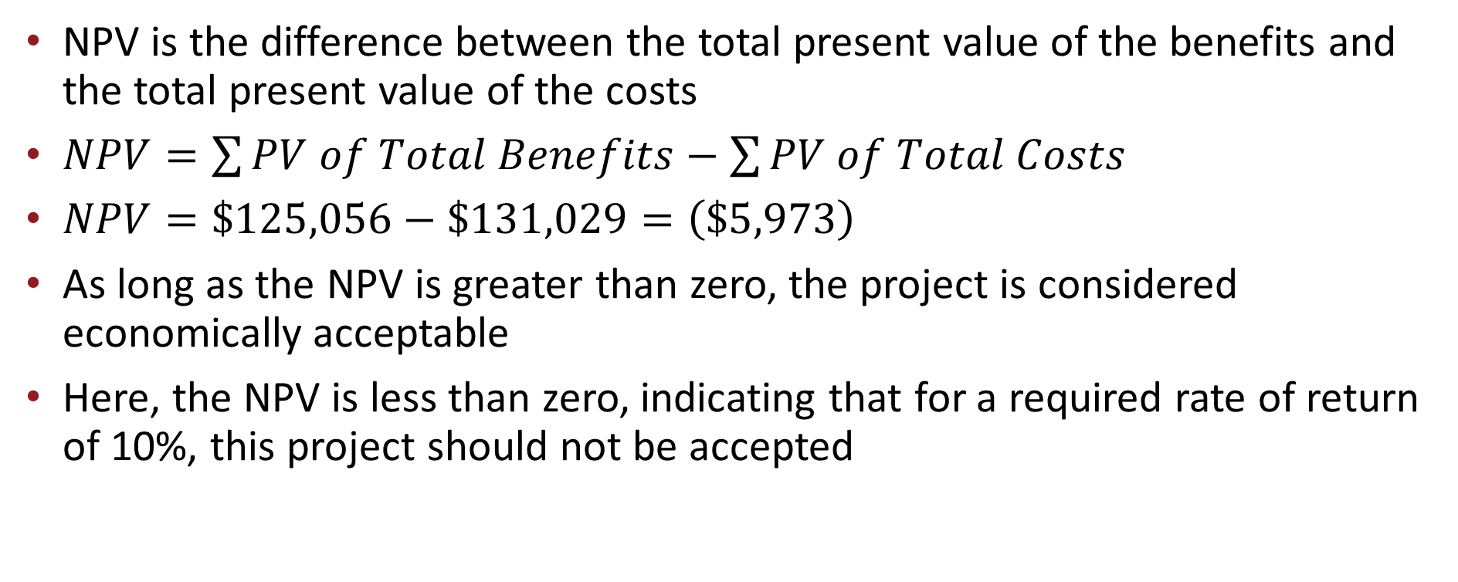
Net Present Value (NPV)
NPV is the difference between the total present value of the benefits and the total present value of the costs
$NPV=\sum{PV of Total Benefits−\sum{PV of Total Costs}}$
$NPV=\$125,056−\$131,029=\left(\$5,973\right)$
As long as the NPV is greater than zero, the project is considered economically acceptable
Here, the NPV is less than zero, indicating that for a required rate of return of 10%, this project should not be accepted

Slide 37
Steps Involved in Performing an Economic Feasibility Analysis
Identify costs and benefits
Assign values to costs and benefits
Determine cash flow
Assess projects economic value
Return on investment (ROI)
Break-even point (BEP)
Net present value (NPV)

Slide 38
Development and Operational Costs
Development Costs | Operational Costs
Development team salaries | Software upgrades
Consultant fees | Software licensing fees
Development training | Hardware repair and upgrades
Hardware and software | Cloud storage fees
Vendor installation | Operational team salaries
Office space and equipment | Communications charges
Data conversion costs | User training

Slide 39
Tangible and Intangible Benefits
Tangible Benefits | Intangible Benefits
Increased sales | Increased market share
Reductions in staff | Increased brand recognition
Reductions in inventory | Higher-quality products
Reductions in IT costs | Improved customer service
Better supplier prices | Better supplier relations

Slide 40
Cost-Benefit Analysis (1 of 2)
 | 2022 | 2023 | 2024 | 2022 | 2025 | Total
Benefits
Increased sales Reduction in customer complaint callsª Reduced inventory costs |  | 500,000 70,000 68,000 | 530,000 70,000 68,000 | 561,800 70,000 68,000 | 595,508 70,000 68,000
Total Benefits^{b} |  | 638,000 | 668,000 | 699,800 | 733,508
Present Value Total Benefits |  | 601,887 | 594,518 | 587,566 | 581,007 | 2,364,978
Development Costs
2 servers @ $125,000 Printer Software licenses Server software Development labor | 250,000 100,000 34,825 10,945 1,236,525 | 0 0 0 0 0 | 0 0 0 0 0 | 0 0 0 0 0 | 0 0 0 0 0
Total Development Costs | 1,632,295 | 0 | 0 | 0 | 0
Operational Costs
Hardware Software Operational labor |  | 50,000 20,000 115,000 | 50,000 20,000 119,600 | 50,000 20,000 124,384 | 50,000 20,000 129,359
Total Operational Costs |  | 185,000 | 189,600 | 194,384 | 199,359

Slide 41
Cost-Benefit Analysis (2 of 2)
 | 2022 | 2023 | 2024 | 2022 | 2025 | Total
Total Costs | 1,632,295 | 185,000 | 189,600 | 194,384 | 199,359
Present Value Total Costs | 1,632,295 | 174,528 | 168,743 | 163,209 | 157,911 | 2,296,686
NPV (PV Total Benefits − PV Total Costs ) |  |  |  |  |  | 68,292

Slide 42
Organizational Feasibility
The organizational feasibility of the system: concerns how well the system ultimately will be accepted by its users and incorporated into the ongoing operations of the organization
Strategic alignment is the fit between the project and business strategy—the greater the alignment, the less risky the project will be, from an organizational feasibility perspective
A second way to assess organizational feasibility is to conduct a stakeholder analysis
A stakeholder is a person, group, or organization that can affect (or can be affected by) a new system

Slide 43
Important Stakeholders for Organizational Feasibility
 | Role | To Enhance Feasibility
Champion | Initiates the project Promotes the project Allocates his or her time to the project Provides resources | Make a presentation about the objectives of the project Create a prototype of the system
Organizational management | Know about the project Budget enough money for the project Encourage users to accept and use the system | Make a presentation about the objectives and benefits of the project Market the benefits of the systems Encourage the champion to talk about the project
System users | Make decisions that influence the project Perform hands-on activities for the project Ultimately determine whether the project is successful using or not using the system | Assign users official roles on the project team Assign users specific tasks to perform Ask for feedback from users

Slide 44
Organizational Feasibility Continued
The champion is a high-level executive and is usually the project sponsor who created the system request
Supports the project by providing time and resources by giving political support to the project
Organizational management also needs to support the project
This support conveys to the rest of the organization the belief that the system will make a valuable contribution and that necessary resources will be made available
A third important set of stakeholders is the system users who ultimately will use the system once it has been installed in the organization

Slide 45
Chapter Review
Explain the role of the systems analyst in the process of developing IS
Discuss the skills needed to be a successful systems analyst
List and explain the four primary phases of the SDLC
Explain the ways that projects are identified and initiated
Explain why it is important to ensure that a proposed IS will add value to the organization
Describe the purpose of the systems request and explain the contents of its four main sections

Slide 46
Chapter Review Continued
Be able to create a systems request for a proposed project
Discuss the purpose of the feasibility study
Describe the issues that are considered when evaluating a project’s technical feasibility
Be able to develop an economic feasibility assessment for a project
Understand and evaluate the organizational feasibility of a project

Slide 47
Key Terms
Analysis models
Analysis phase
Analysis strategy
Approval committee
Architecture design
As-is system
Break-even point
Business analyst
Business need
Business process automation (BPA)
Business process improvement (BPI)
Business process management (BPM)
Business process reengineering (BPR)
Business requirements
Business value
Cash flow analysis
Champion
Change management analyst
Compatibility
Construction
Cost–benefit analysis

Slide 48
Key Terms Continued
Database and file specifications
Deliverable
Design phase
Design strategy
Development costs
Economic feasibility
Emerging technology
Familiarity with technology
Familiarity with the application
Feasibility analysis
Feasibility study
First mover
Gradual refinement
Implementation phase
Infrastructure analyst
Installation
Intangible benefits
Intangible costs
Intangible value
Interface design
Net present value (NPV)
Operational costs
Organizational feasibility
Organizational management
Payback method
Phase
Planning phase
Program design
Project initiation
Project management

Slide 49
Key Terms Continued
Project manager
Project plan
Project size
Project sponsor
Requirements analyst
Software architect
Special issues
Stakeholder
Stakeholder analysis
Steering committee
Step
Strategic alignment
Support plan
System proposal
System request
System specification
System users
Systems analyst
Systems development life cycle (SDLC)
Tangible benefits
Tangible value
Technical feasibility
Technique
To-be system
Training
Total cost of ownership (TCO)
Workplan

