Slide 1

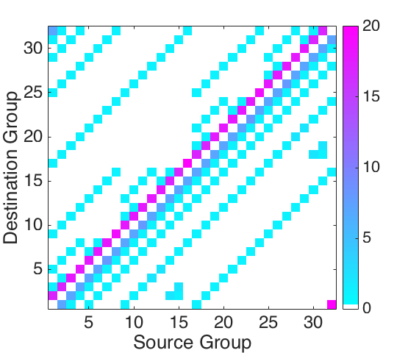
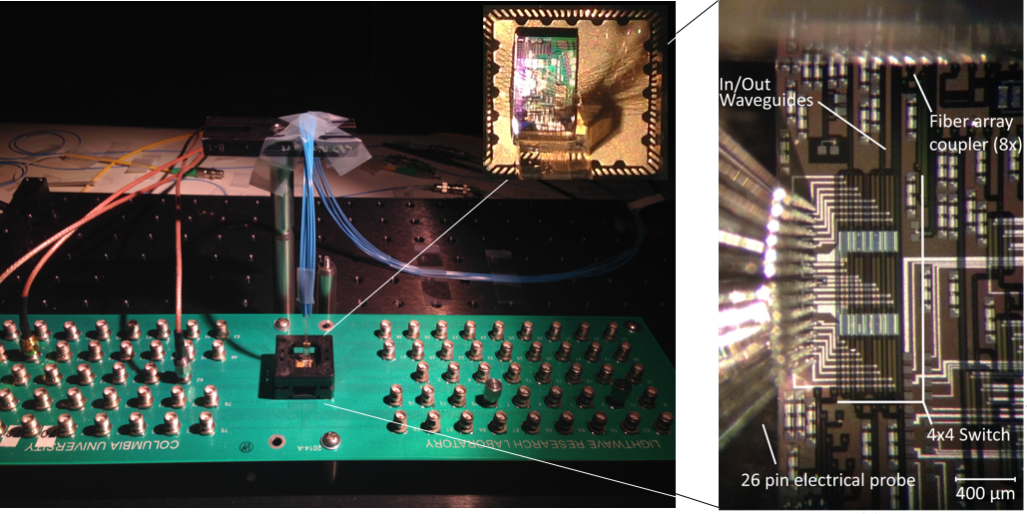
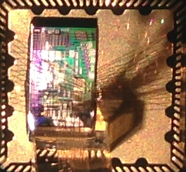

Flexfly: Enabling a Reconfigurable Dragonfly Through Silicon Photonics
Ke Wen, Payman Samadi, Sebastien Rumley, Christine P. Chen, Yiwen Shen, Meisam Bahadori, Keren Bergman, and Jeremiah Wilke
G0
G4
G1
Destination
Groups
Optical
Switches
G3
G2
Source
Groups

