Slide 1
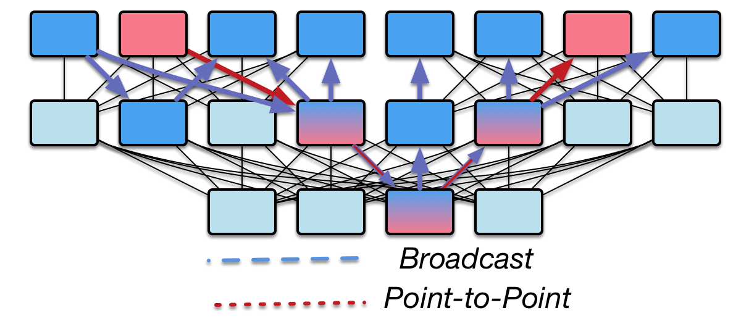

Opportunities and limitations of Quality-of-Service in Message Passing applications on adaptively routed Dragonfly and Fat Tree networks
Jeremiah Wilke and Joseph Kenny

