Slide 1
StreamGenie — Multi-User Platform Roadmap
From single-user prototype to multi-platform SaaS (20-month plan)

Slide 2
Executive Vision
API-first, multi-user SaaS with web, mobile, voice, and social
“Letterboxd for TV” — watchlist, reminders, discovery
Lean MVP ➜ scale features progressively

Slide 3
Current Snapshot — What Exists
Single-user Streamlit app with TMDB + SendGrid
SQLite storage, manual watchlist, provider logos

Slide 4
Current Snapshot — Gaps
No authentication/multi-tenancy, no API layer
SQLite limits, no mobile/social/voice, manual tracking

Slide 5
Phase Overview
Phase 1: Foundation & Multi-User Core (M1–M3)
Phase 2: Mobile Apps (M4–M7)
Phase 3: Recommendations (M8–M10)
Phase 4: Social Layer (M11–M13)
Phase 5: Voice Integration (M14–M16)
Phase 6: Auto-Sync & Smart Tracking (M17–M20)
Phase 7: Monetization (ongoing)

Slide 6
Phase 1 — Foundation & Multi-User Core (M1–M3)
Supabase PostgreSQL + Supabase Auth (RLS)
FastAPI backend; Streamlit UI connects to API
Redis caching; scheduled reminders via task queue
Milestone: Web MVP with login + scalable DB

Slide 7
Phase 2 — Mobile Apps (M4–M7)
React Native + Expo for iOS/Android
Auth flow, watchlist, search, push notifications
Milestone: Public app store launch

Slide 8
Phase 3 — Recommendations (M8–M10)
Hybrid: content-based (new users) + collaborative filtering
Trending boosts; personalized ‘Discover’
Milestone: 50% users engage with recs

Slide 9
Phase 4 — Social Layer (M11–M13)
Public profiles & share links; follows & feeds
Optional comments/likes; collections
Milestone: 20% public watchlists

Slide 10
Phase 5 — Voice Integration (M14–M16)
Google Assistant & Alexa Skills
Add/check watchlist; ‘What’s airing tonight?’
Milestone: 500 voice commands/day

Slide 11
Phase 6 — Auto-Sync & Smart Tracking (M17–M20)
Browser extension for watch history sync
Smart rules: auto-add/auto-remove
Milestone: 30% extension adoption

Slide 12
Monetization & Unit Economics
Free (10 shows), Pro ($4.99), Family ($9.99)
Break-even ≈ 15 Pro users; high gross margins
Upsell: AI summaries, referral rewards, annual plans

Slide 13
KPIs & Checkpoints
M3: 100 beta users; <$100/mo infra
M7: 1,000 installs; 10+ paying customers
M13: Retention + feature usage gating next investments

Slide 14
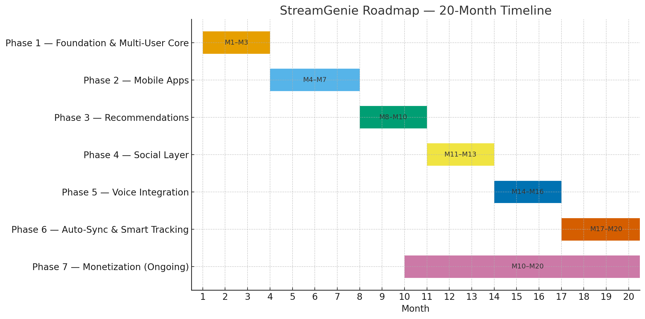
20-Month Roadmap Timeline

